Slide 1
VT Federated Data for HBP Technologies

Slide 2
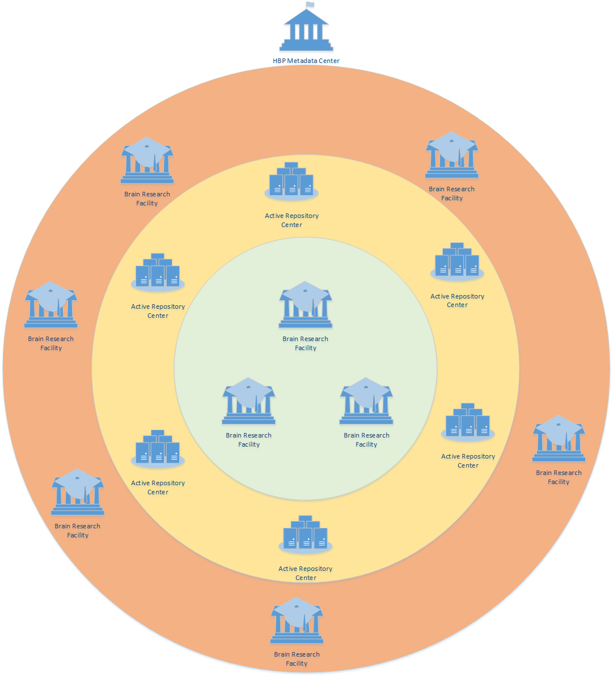
Distributed HBP Infrastructure

Slide 3
Use Cases Summary
UC1: Brain Scan Creation, Main issue to migrate data to Active Repository Centre
FTS – deployed at the Active Repository Centre -> together with GridFTP or HTTP..
Globus Connect Server as GridFTP could be deployed at both ends (ARC, BRF)
Globus Online for data transfer
Onedata locally deployed
UC2: Remote interactive multiresolution visualization of large volumetric datasets Main issue to provide efficient access to data interactively browsed by user at ARC.
dCache as a local storage providing pNFS – integration with OpenID as extension, currently ACL should be controlled by Brain Scan WebGL Interface
Onedata – as a federated virtual storage working on top of Parallel FS integrated with OpenID supporting ACLs aware access to the data
[For selection by Metadata centre site where data is located] DynaFed – as a HTTP redirector to data [ type here Fabrizio input]

Slide 4
Use Cases Summary
UC3: Feature extraction and analysis of large volumetric datasets Problem of registering data in the global registry Main issue to provide access to existing data and be able to easily register new data in the global repository.
Onedata – can keep control on the whole data registry, data stored locally are registered instantly
dCache – data stored needs to be registered in the global HBP registry via API
DynaFed – is there a way to work with metdata?
UC4: Publication and citation of data
Onedata – Currently data persistent share url are available. It could be fully supported by onedata extension developed for EGI Engage called Open Data Platform
UC5: Management of Access Control Rights
Onedata - Fully supported, keeping ACL aware at all access level, currently integrated with OpenID, multiple communities keeping control on their ACL by their own
dCache – extention for OpenID would make there possibility to
DynaFed – extension for OpenID is possilble?

Slide 5
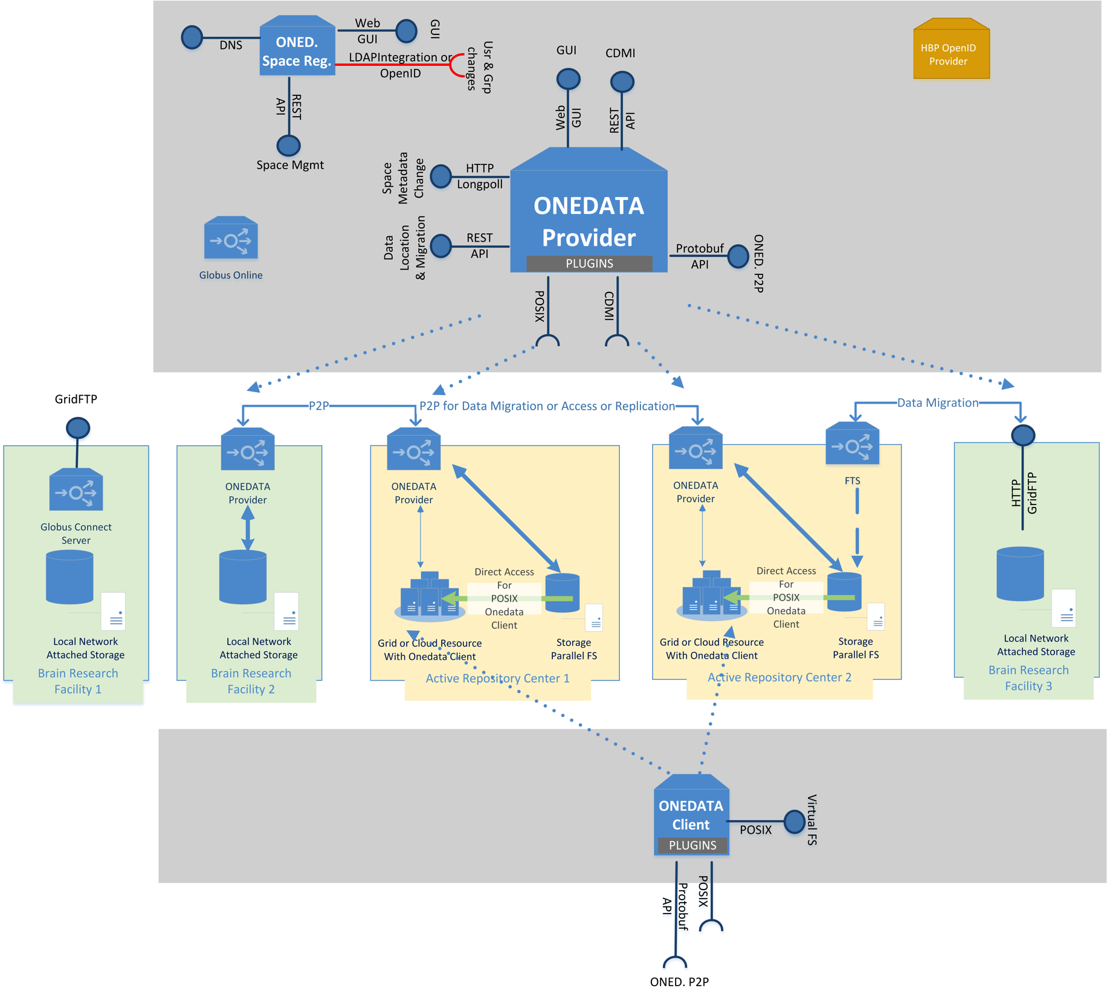
Integrated Deployed on HBP Infrastructure
OpenID at all levels
Provider is scalable
It can work as
a gateway to
NAS Storage
Can work as a data orchestrator in large data centres

