Slide 1
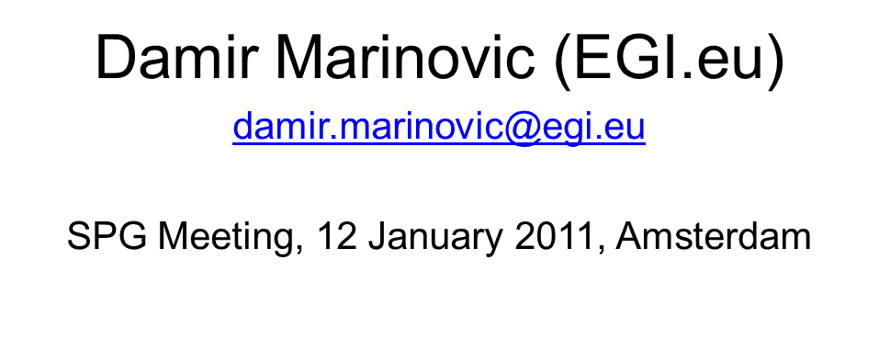
Policy Development Team (PDT)
Digital Agenda for Europe
Focus on Security and Data Protection

Slide 2
Europe 2020 Strategy
EU's growth strategy for the coming decade in order to transform the EU into a smart, sustainable and inclusive economy that will deliver high levels of employment, productivity and social cohesion.
Seven flagship initiatives of Europe 2020
Smart growth | Sustainable growth | Inclusive growth
Digital agenda for Europe | Resource efficient Europe | An agenda for new skills and jobs
Innovation Union | An industrial policy for the globalisation era | European platform against poverty

Slide 3
WHY?
Why Europe 2020?
The crisis is a wake-up call, the moment where we recognise that "business as usual" would consign us to a gradual decline, to the second rank of the new global order. This is Europe's moment of truth. It is the time to be bold and ambitious.
Jose Manuel Barroso, President of the European Commission

Slide 4
Digital Agenda for Europe
A Digital Agenda for Europe deals with:
ways to develop and gain the benefits from enhancing interoperability of IT solutions in Europe
promoting a better use of standards
establishing single digital market and high-speed broadband internet.
“Europe should also build its innovative advantage in key areas through reinforced e-Infrastructures”
in the document’s footnote for this sentence EGI was explicitly mentioned
Key terms: Digital Economy, Digital Revolution, Digital Single Market

Slide 5
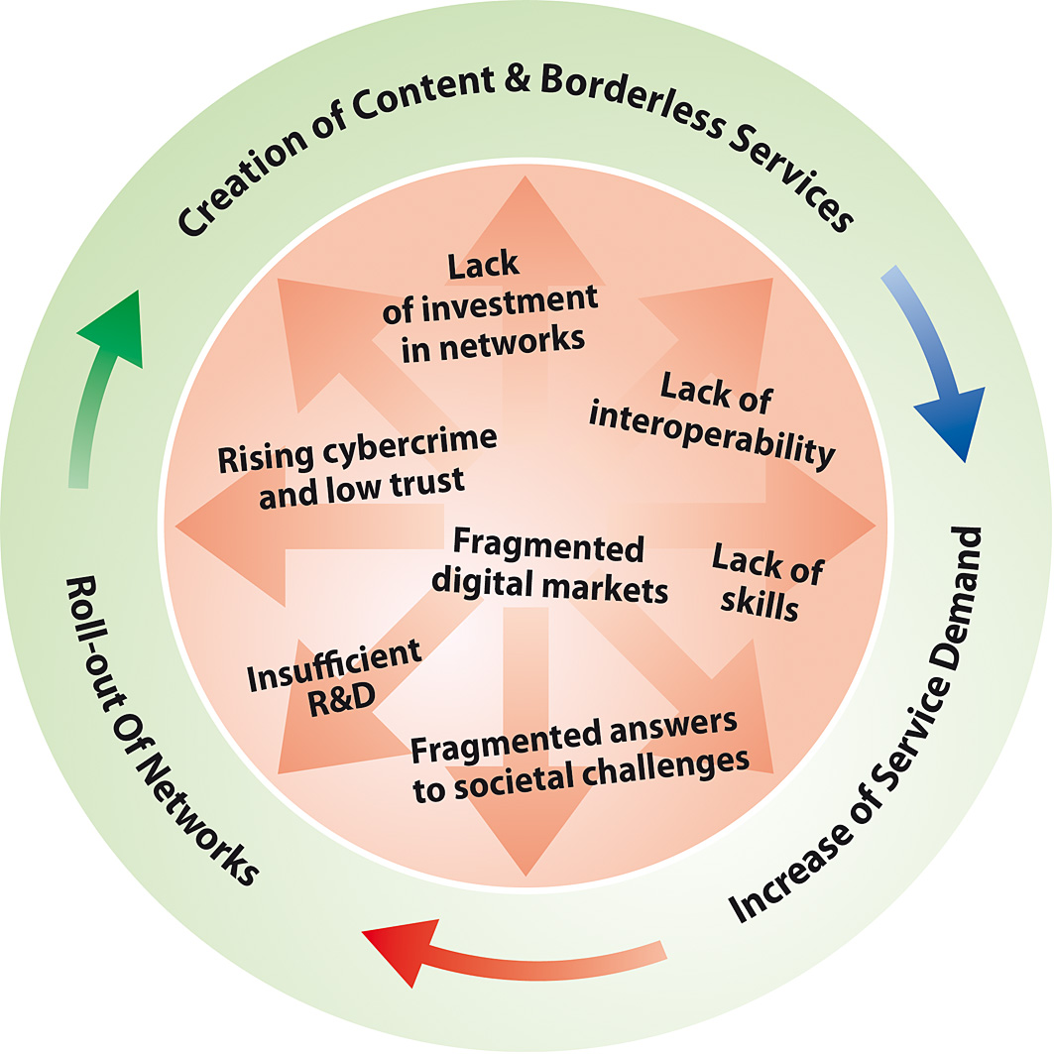
Virtuous cycle of the digital economy
Source: Digital Agenda website

Slide 6
Goals of Digital Agenda
The Agenda focuses on seven priority areas for action:
creating a new digital Single Market
greater interoperability and improved ICT standardisation
enhance internet trust and security
much faster internet access
more investment in cutting-edge research and innovation in ICT
enhancing digital skills and inclusion
applying ICT for the benefit of society ( e.g. reduce energy consumption, climate change, support ageing population etc.)

Slide 7
Key Actions – Trust and security
The Commission will:
Key Action : Measures aiming at a reinforced and high level Network and Information Security Policy, including legislative initiatives such as a modernised European Network and Information Security Agency (ENISA), and measures allowing faster reactions in the event of cyber attacks, including a CERT for the EU institutions
Key Action: Present measures, including legislative initiatives, to combat cyber attacks against information systems by 2010, and related rules on jurisdiction in cyberspace at European and international levels by 2013
Other actions:
Establish a European cybercrime platform by 2012
Examine the feasibility by 2011 to create a European cybercrime centre
Support EU-wide cyber-security preparedness exercises, from 2010
As part of the modernisation of the EU personal data protection regulatory framework to make it more coherent and legally certain, explore the extension of security breach notification provisions

Slide 8
Key Actions – Trust and security
EU Member States should:
• Establish by 2012 a well-functioning network of CERTs at national level covering all of Europe
• In cooperation with the Commission carry out large scale attack simulation and test mitigation strategies as of 2010
• Fully implement hotlines for
reporting offensive or harmful online content
organising awareness raising campaigns on online safety for children
offering teaching online safety in schools
encouraging providers of online services to implement self-regulatory measures regarding online safety for children by 2013
• Set up or adapt national alert platforms to the Europol cybercrime platform, by 2012, starting in 2010

Slide 9
EU Data Protection Directive
The EU Commission published official communication sets out aims and objectives to modernise the 1995 EU Data Protection Directive (4th November 2010)
Goal to address some of the key challenges facing current data privacy regulation, namely:
- the collection and use of personal data via new technologies
- the harmonisation and simplification of notification throughout
the EU
- globalisation and cross-border data flows
A key part of this harmonisation process will depend upon the establishment of precedents and template data processing agreements and fair processing notices. It will be required for organisations to adopt privacy impact assessments and privacy by design into new technologies from inception through to implementation and day-to-day operation, rather than prior to launch.

Slide 10
EU Data Protection Directive Key Objectives 1/2
Key objectives of the modernised data privacy strategy are to:
Strengthen individuals' rights (and clarify what types of information will fall into the definition of ‘personal data’ e.g. user profile information)
Increase transparency for data subjects, for example, by introducing mandatory personal data breach notification
Create new responsibilities for data controllers by making the appointment of an independent Data Protection Officer mandatory
Place a duty on data controllers to carry out a privacy impact assessment (PIA) where appropriate, and promote the use of Privacy Enhancing Technologies (PET) and the Privacy by Design model of system design
Enhance individuals’ control over their data including the so-called ‘right to be forgotten’ and empower users with a right to port their personal information (‘data portability’)
Source: http://www.lewissilkin.com

Slide 11
EU Data Protection Directive Key Objectives 2/2
Raise and finance public awareness and promote the application of approved ‘privacy seals’ for organisations which meet certain minimum privacy standards
Ensure informed and free consent (and, in so doing, provide pre-approved data privacy notices on EU standard forms)
Harmonise the conditions for processing sensitive data (and review the categories of information which may be classed as sensitive personal data)
Make remedies and sanctions more effective and promote an active infringement policy
Clarify and simplify the rules for international data transfers
Encourage self-regulatory initiatives
Source: http://www.lewissilkin.com

Slide 12
Proposal for a Directive on attacks against information systems
Proposal of Directive of the European Parliament and of the Council on attacks against information systems (30 Sep. 2010)
Reason for the new Directive is the number of attacks against information systems increased significantly in the last few years and a number of attacks of previously unknown large and dangerous scale have been observed.
For example, 'Conficker' (also known as Downup, Downadup and Kido), than new type of malicious computer warm Stuxnet that is infecting a high number of power plants, pipelines and factories and could be used to control plant operations remotely.
If confirmed, Stuxnet would be the first case of a highly sophisticated botnet aimed at industrial targets, a development experts don't hesitate to define ''the first directed cyber weapon''.
Source: http://europa.eu/rapid/

Slide 13
Proposal for a Directive on attacks against information systems – What is new?
The proposed Directive will retain its current provisions – namely the penalisation of illegal access, illegal system interference and illegal data interference - and include the following new elements:
Penalisation of the use of tools (such as malicious software – e.g. 'botnets' – or unrightfully obtained computer passwords) for committing the offences
Introduction of 'illegal interception' of information systems as a criminal offence
Improvement of European criminal justice/police cooperation by strengthening the existing structure of 24/7 contact points, including an obligation to answer within 8 hours to urgent request
The obligation to collect basic statistical data on cybercrimes
Raising the level of criminal penalties to a maximum term of imprisonment of at least two years. Instigation, aiding, abetting and attempt of those offences will become penalised as well
Source: http://europa.eu/rapid/

Slide 14
Discussion point suggestions
The newest set of security and data privacy proposals and recommendations are still under development. The key EU actions and any national laws which may follow from them will have an impact on EGI’s computing infrastructure, sites and services
Potential implication of new objectives and aims in order to modernise the EU Data Protection Directive on EGI community and policies?
Potential implication of new Proposal for the Directive on attacks against information systems on EGI community and policies?
Legal and regulatory framework governing data protection and security flexibility?
EGI.eu to ensure that any new EGI policy is consistent with the current EU security and trust set of the policies
Intensify communication with ENISA (should we engage them via MoU?)
Coming event - Important 4th International Conference on Computers, Privacy and Data Protection – “European Data Protection: In Good Health?” (25-27 Jan. 2011, Brussels)

Slide 15
Useful links
Europe 2020
http://ec.europa.eu/europe2020/index_en.htm
Digital Agenda for Europe
http://ec.europa.eu/information_society/digital-agenda/index_en.htm
The European Network and Information Security Agency (ENISA)
http://www.enisa.europa.eu/
EC Communication A comprehensive approach on personal data protection in the European Union
http://ec.europa.eu/justice/news/consulting_public/0006/com_2010_609_en.pdf
Proposal for a Directive of the European Parliament and of the Council on attacks against information systems
http://eur-lex.europa.eu/LexUriServ/LexUriServ.do?uri=COM:2010:0517:FIN:EN:PDF
4th International Conference on Computers, Privacy and Data Protection – “European Data Protection: In Good Health?”
http://www.cpdpconferences.org/Resources/CPDP2011.pdf
4th European Privacy Day
http://www.europeanprivacyday.org/

Slide 16
Contacts
THANK YOU!
Policy Development Team
policy@egi.eu
Sergio Andreozzi:
sergio.andreozzi@egi.eu
Damir Marinovic
damir.marinovic@egi.eu
Sy Holsinger New Colleague in PDT
sy.holsinger@egi.eu

