Slide 1
Collaborative scientific platforms for accessing, processing and validation of biodiversity observation and biosensor data.
Francisco Hernandez, Joram Declerck, Klaas Deneudt, Cis Hernandez
Lifewatch - EGI engage May 2015

Slide 2
Outline
Lifewatch
EGI - ENGAGE
  Collaborative scientific platform
    Biosensors
    Challenges
    Status
  Virtual labs and research environments
Progress

Slide 3
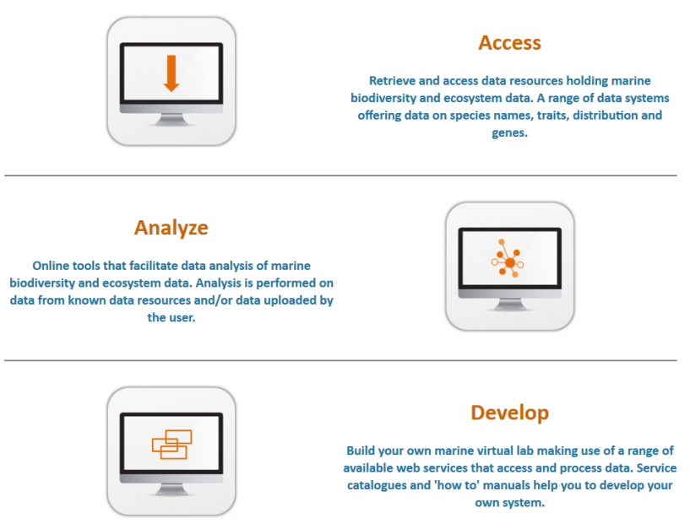
Lifewatch infrastructure
European research infrastructure, ESFRI roadmap
Study of biodiversity and ecosystems
Access to realtime data
Biosensor networks
BIG data, inline data processing
More info : http://www.lifewatch.eu
Example VRE : http://marine.lifewatch.eu/
Belgian contribution: http://www.lifewatch.be

Slide 4
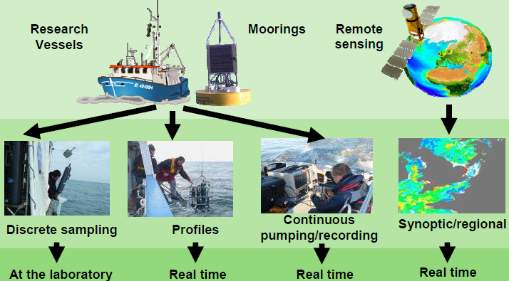
Biosensors
Biological sensors that enable observations at space and time scales relevant to organisms behavior, physiology and life history
  Optics, Acoustics, Genetics, GPS
Discrete => continuous
Delayed mode => real-time

Slide 5
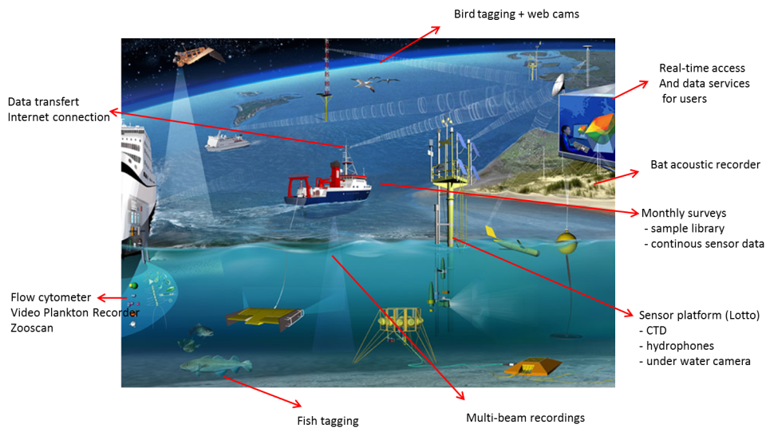
http://www.lifewatch.be/en/sensors

Slide 6
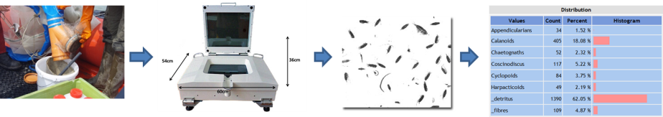
Zooscan
High resolution flatbed scanner for water samples
Digital storage and processing of zooplankton samples -> taxonomic composition and abundance
Image acquisition: 2400-4800 dpi
Data generation: +/- 4 GB/sample; 432 Gb/year
Analysis: pattern recognition software (Plankton Identifier [Tanagra], ZooImage [R], …)

Slide 7
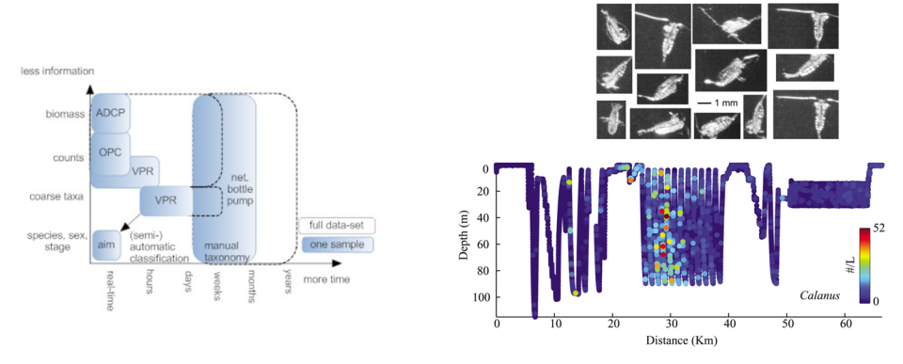
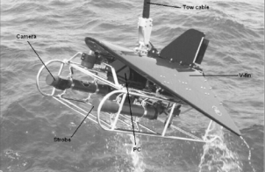
Video Plankton Recorder (VPR)
Real-time underwater digital camera system + strobe
Rapid quantification of plankton taxonomic composition and abundance
Image acquisition: 30 frames/second of 7.2 ml image volume
Data generation: +/- 10GB/h (at 150kb/image) , 1.5M files / h
Analysis: pattern recognition software (Visual Plankton software [Matlab])

Slide 8
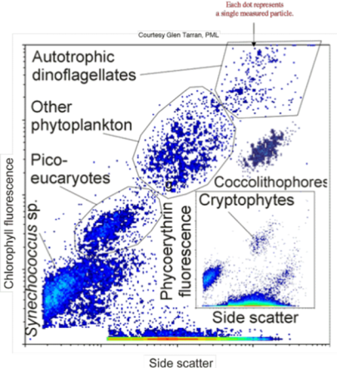
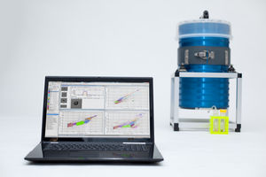
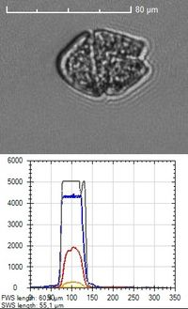
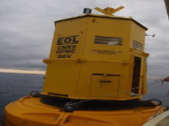
Flow cytometer
Laser based instrument for particle detection and characterisation in fluids
Counting and characterisation of phytoplankton particles -> taxonomic composition and abundance
Image acquisition: particle scattering + fluorescence
Data generation: +/- 200 MB/sample; 1Tb/year
Analysis: clustering software (Easyclus [Matlab], FCM [R], …)

Slide 9
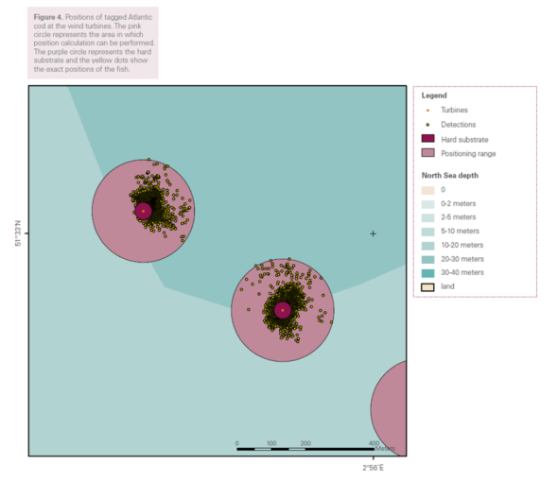
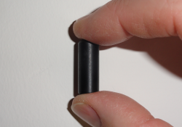
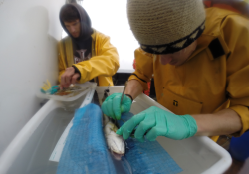
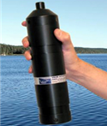
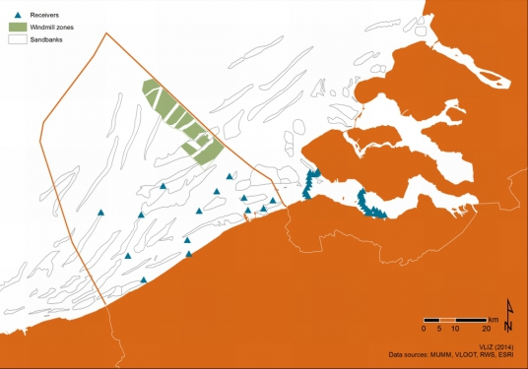
Acoustic fish telemetry
Acoustic fish tag tracking
Studying distribution, migration and habitat use
Data generation: 25 MB/month
Analysis: GIS mapping & visualization (CartoDB), behaviour analysis (Matlab, Python)

Slide 10
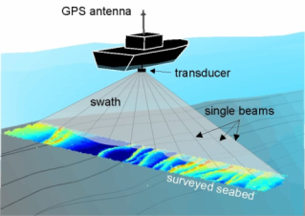
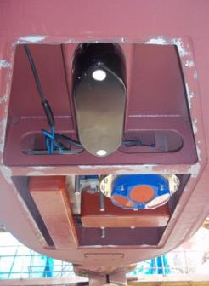
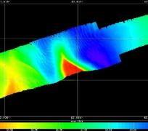
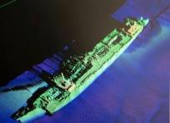
Multibeam echosounder
Acoustic high resolution depth sounding sonar
Bathymetry and sediment typology
Data generation: sediment 10Gb; water column 100Gb/day
Analysis: data cleaning and validation, chart creation, deriving sediment typology (CARIS, Fledermaus)

Slide 11
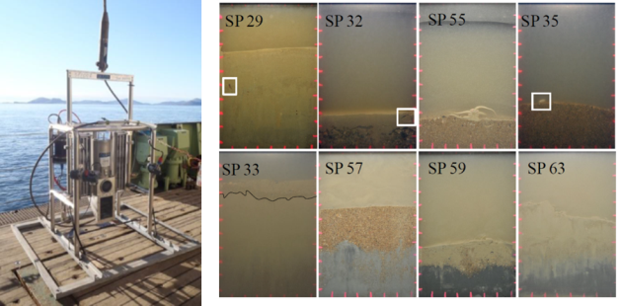
Sediment profiler imaging
Digital Sediment Profiling Camera
Vertical cross section of the sediment/water interface
Image acquisition: 24.1 Mpixel images of 320 cm2 of sediment
Data generation: 1Gb/image; 130 Gb/year
Analysis: Image pattern recogition software, relating to benthic communities

Slide 12
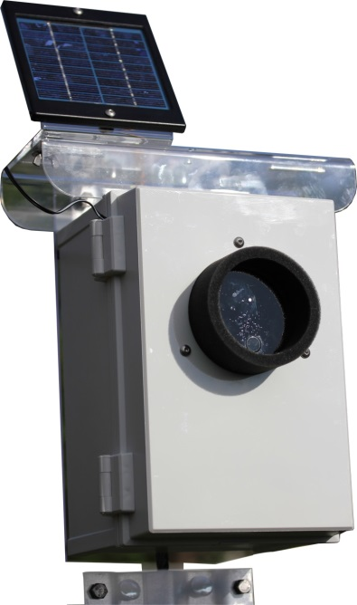
Acoustic bat recorder
Ultrasound detection and recording
Sound acquisition: 500 kHz with 16 Bit amplitude resolution
Data generation: 1 MB/per second of sound recording; 0.5 Gb/night
Analysis: Call detection and recogition software

Slide 13
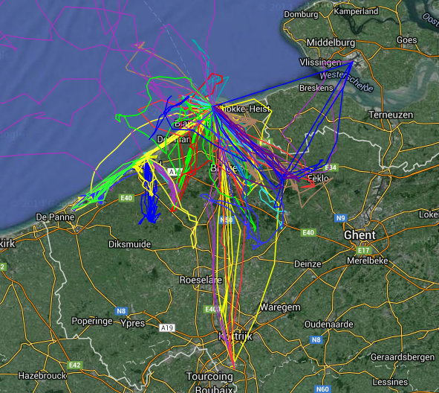
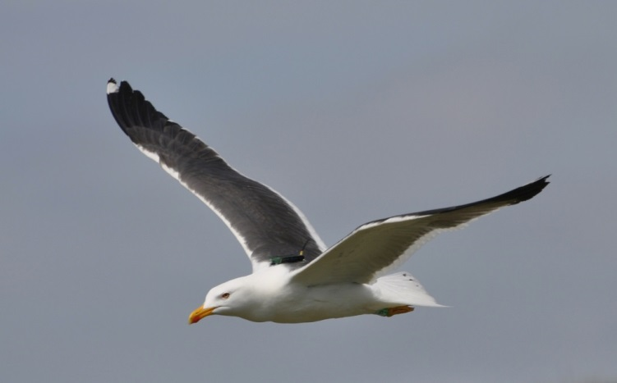
Bird tracking with GPS
Tracking of large birds with GPS tags developed by UvA-BiTS
Studying migration and habitat use
GPS position every 10min, 70 birds, soon > 100
Data generation: 3G/year (Flemish LifeWatch), multiple GB/year (UvA-BiTS)
Analysis: GIS mapping & visualization, behaviour analysis (Matlab,Python,R)

Slide 14
Challenges
Biosensor
  buy and install equipment: sensors, winches, antennas
  technical calibration, raw signal processing, vendor softw.
IT
  real-time data transfer, storage, processing
Biology
  sensor output -> biodiversity parameters
  aggregating, combine data, models & predictions, visualization, sharing, validation,…

Slide 15
  Doctoral studies on sensor use and application
  4 PhD’s at Ghent University
  Started October 2014
  Work on :
    Standard operation procedures
    Algorithms for translation of sensor output to biodiversity parameters on abundance and distribution of taxa
    Recommendations on optimization and upgrade of the infrastructure
    Applications of the infrastructure in biodiversity and ecosystem studies

Slide 16
Collaborative platform for sensor data processing and analysis
Sensor network
Processing network
Science community
Flowcytometer
eDNA
Sensor data
Calibration data
Scripts, workflows, algorithms
Bird Radar
VPR
Fish sonar
Benthic img
?
Remote sensing
Rsync
LW ICT core
FedCloud
Species identifications, field observations, crowd sourcing
Postgis, Geoserver
R, Java, Python, Rstudio, Rshiny
Bird video
Hydrophones
Bird tracks
Fish tags
In situ habitat obs.
?
Scientific data
Archive

Slide 17
Infrastructure | Status
Bird GPS tracking network + web cams | 3 base stations installed and operational 70 birds with GPS
Flow Cytometer | Installed on RV Simon Stevin and operational
Multi beam | Installed on RV Simon Stevin and operational
Acoustic bat detectors | Test installation installed. Offshore installation in preparation
ZooScan | Installed in MSO lab and operational
Video Plankton Recorder | To be installed July 2014
Sediment Profile Imaging | Installed on RV Simon Stevin and operational
Acoustic fish telemetry | 40 fishes tagged, 51 receivers installed, data for >2 years
Environmental DNA | Several species of fish and jellyfish under investigation

Slide 18

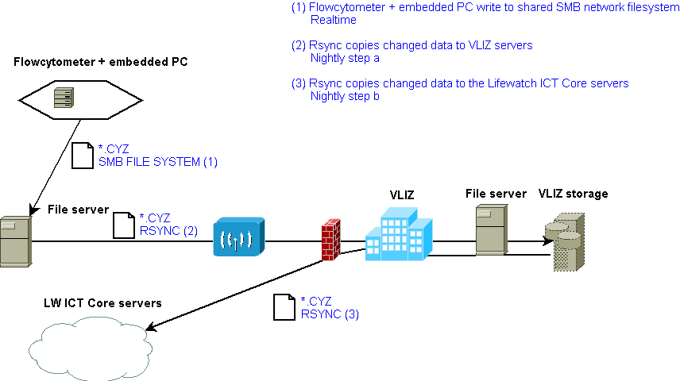

Slide 19
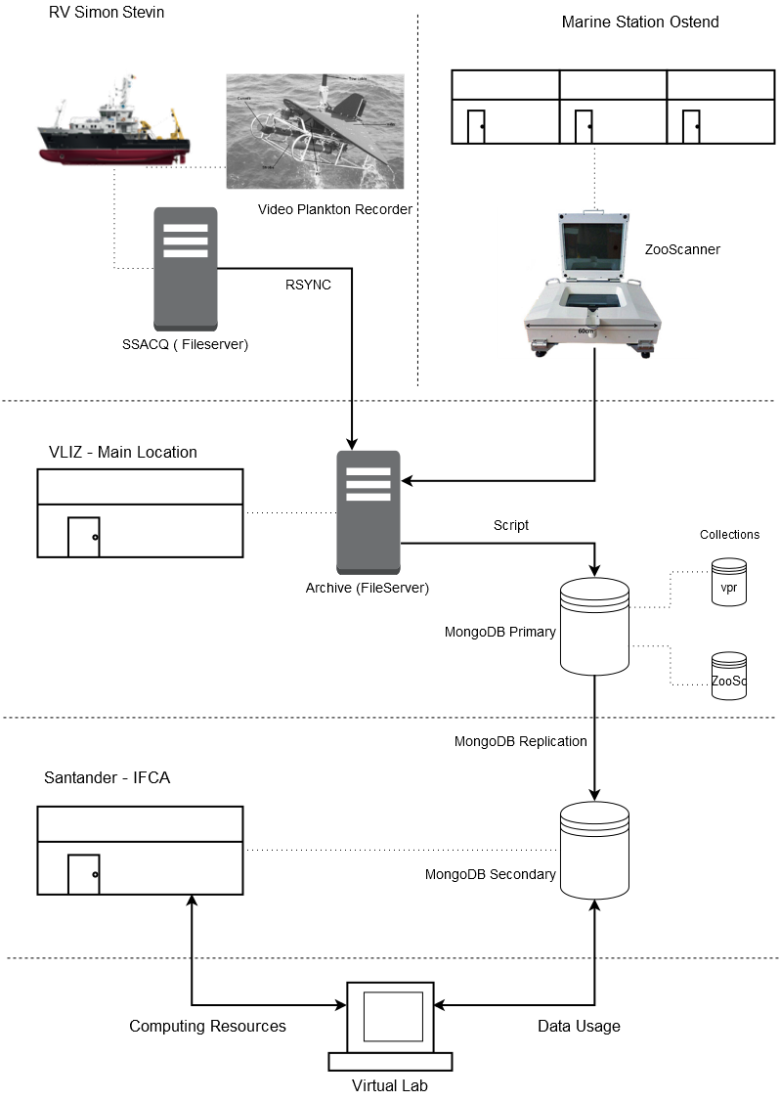
mongoDB network

Slide 20
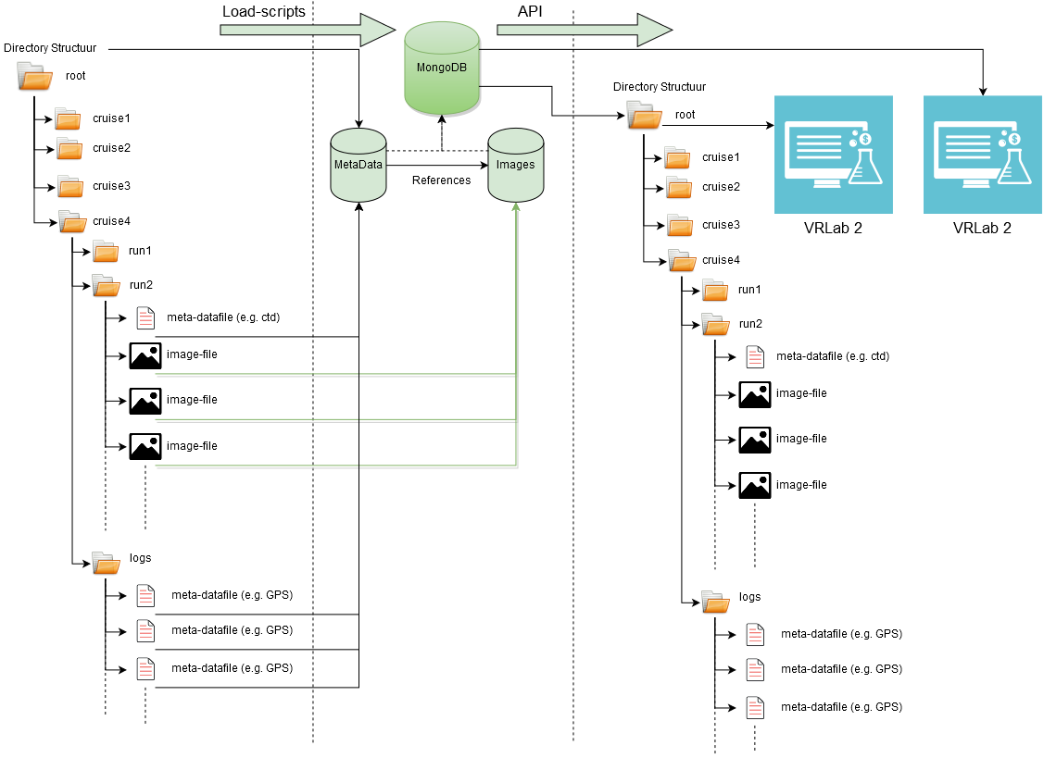
File management

Slide 21
Progress
Ongoing testing with ICT Core facilities: IFCA, EGI ENGAGE
Create virtual servers
  on fedcloud : problem with OCCI
  on IFCA / LW servers : on going / tickets
  R, R studio server, Rshiny : at VLIZ
  PostGIS, geoserver : at VLIZ
Set up data transfer
  from ship & stations to IFCA : daily Rsync operational
  from VLIZ geoserver to IFCA
  manage storage capacity
Set up user interfaces for scientists
  VLIZ users : started
  external users
  manage resources: user data, algorithms, scripts, models, …

Slide 22
Lifewatch virtual labs to ICT core
Meeting in Amsterdam
Collect and present existing virtual labs
  Lifewatch Marine Virtual Research Environment (VRE) : done
  VRE for terrestrial & other thems: started
Upscale virtual lab components using LW ICT core
  Environmental layers, Species occurence data
  BIOVEL portal , Biodiversity catalogue
  Taxonomic, Biostatical & Modelling webservices
http://marine.lifewatch.eu/

Slide 23
More info
Lifewatch website http://www.lifewatch.eu
Marine VRE : http://marine.lifewatch.eu/
Belgian contribution: http://www.lifewatch.be
Flanders Marine Institute : http://www.vliz.be

