Slide 1
Summary of VRE needs and initial analysis for support on FedCloud
VLIZ - Flanders Marine Institute

Slide 2
Lifewatch Marine VRE developments
2nd LifeWatch e-Infrastructure Construction Operational Meeting (Granada, Feb 2014)
LifeWatch Marine technical Meeting (Crete, June 2014)
Plans reported to LifeWatch stakeholders board (June 2014)
BioVeL Portal integration meeting (September 2014)
Technical developers workshop BioVeL (October 2014)
First version marine VRE portal online (November 2014)
Feedback phase (December 2014)
Official launch marine VRE (February 2015)
LifeWatch Virtual Labs working meeting (Amsterdam, March 2015)
Non-marine VRE meeting (Louvain-la-Neuve, July 2015)

Slide 3
Concept
LifeWatch bottom-up development demonstrating possibilities
Construction of light version that can grow towards a full grown infrastructure conform reference model envisaged under LW
VRE is a collection of Virtual Laboratories
Building marine virtual research environment based on existing & operational components :
data resources, web services, analysis services and tools.
Inventorizing components that could and should be supported by Lifewatch ICT

Slide 4
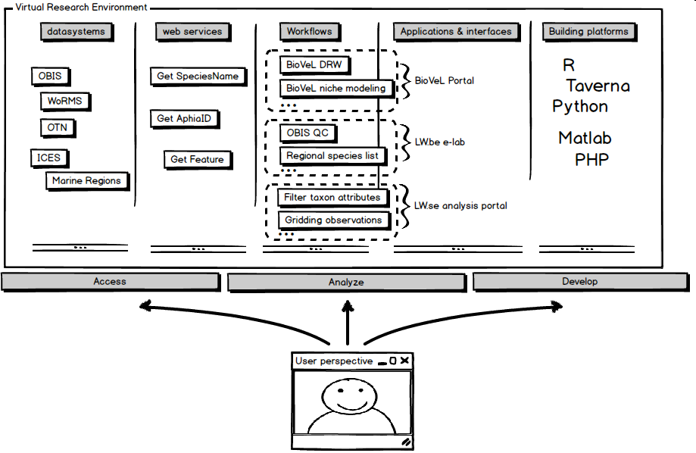

Slide 5
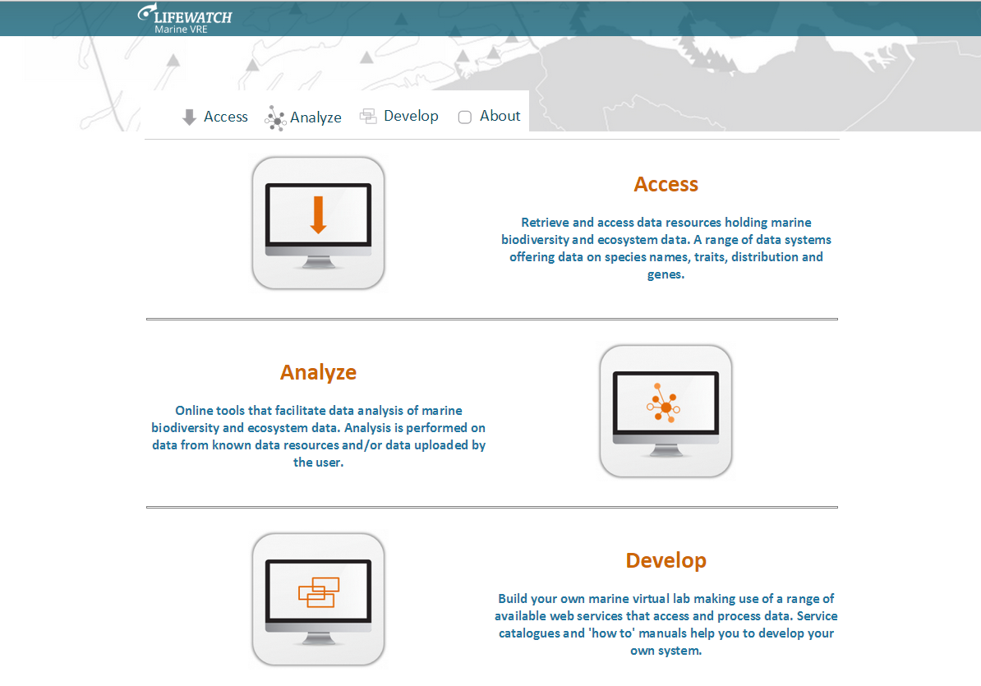
LifeWatch Marine VRE
http://marine.lifewatch.eu

Slide 6
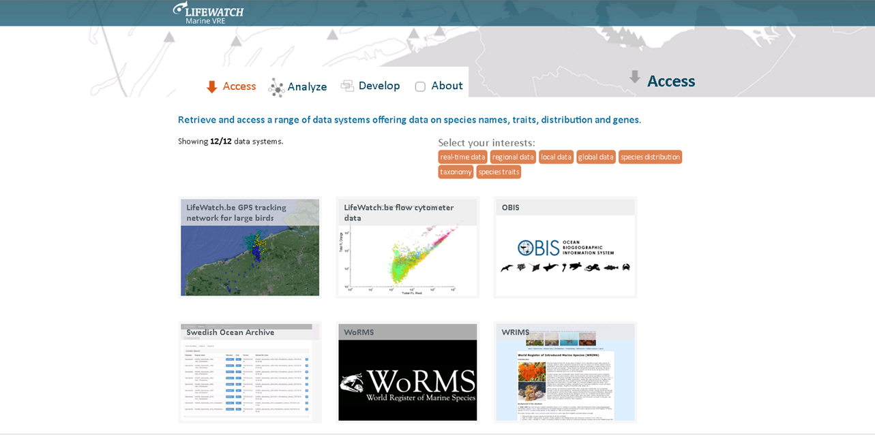
LifeWatch Marine VRE

Slide 7
Needs for support on FedCloud
Access -> Upscale virtual lab components
Upgrading performance geospatial web services
Load balanced farm of Geoservers
(room for detailed technical discussion?)
Biodiversity catalogue listing and monitoring web services

Slide 8
Needs for support on FedCloud
Analyse -> Requirements for upscaling virtual labs
Performant server running Biovel/Blue portal workflows with multiple simultaneous users
Performant server running Vlabs created using R Shiny

Slide 9
Needs for support on FedCloud
Develop
Sandbox environment for development of Vlabs
R Studio Server, Gitthub, … (see R Tools session)
Taverna Server workflow platform
Possibility to publish created Vlabs in Access or Analyse section

