Slide 1
Alien Species Virtual Research Environment & Services and OutReach
Nicola Fiore
LW Service Centre

Slide 2
WEB PORTAL
COMM-3
VIRTUAL LABS
DATAGEN-8, DATAGEN-3, DATAGEN-11, DATAGEN-12
SECURITY
E-Learning
Platform
SERV-23
Help-Desk
SERV-4
User
Platform
SERV-28
Multimedia Education
SERV-14
External Data Facilities
WORMS, GBIF, etc …
WORKFLOW
ICTSERV-21, ICTSERV-22, ICTSERV-8
Link to External Data Facilities
DATAGEN-14
Modelling
Services
ICTSERV-26
GSDs
DATAGEN-7
GNA
DATAGEN-6
Global Species Databases (GSDs)
WORMS, Algabase, etc…
INTEROPERABILITY
DATAGEN-13
DATAGEN-2
Search & Discovery
Nodi BIO4IU
Data
Metadata
European Natural
History Collections
Sensor Networks
DATAGEN-12

Slide 3
DATASETS
LIFEWATCH DATA PORTAL
VIRTUAL LAB
Darwin Core
Basic Metadata Search
Advanced Data Search
Geospatial Search
Tools
R Studio
Taverna Workbench
ARCGIS Suite
…
ABCD
ABCDna
Thesauri
O&M
Dataset Mapping
Inference Search (SPARQL)
REST API
CSV
Services
RDBMS
ESB (Search)
SERVICE LAYER
API REST
Cleaning ETL
Ontology ETL
Inference Engine
Legacy Scientific Data
Persistence Layer
….
PESI
WoRMS
GBIF
LW NO-SQL
Staging Area
LW RDBMS
LW NO-SQL
Cleaned Data
LW
Triple Store

Slide 4
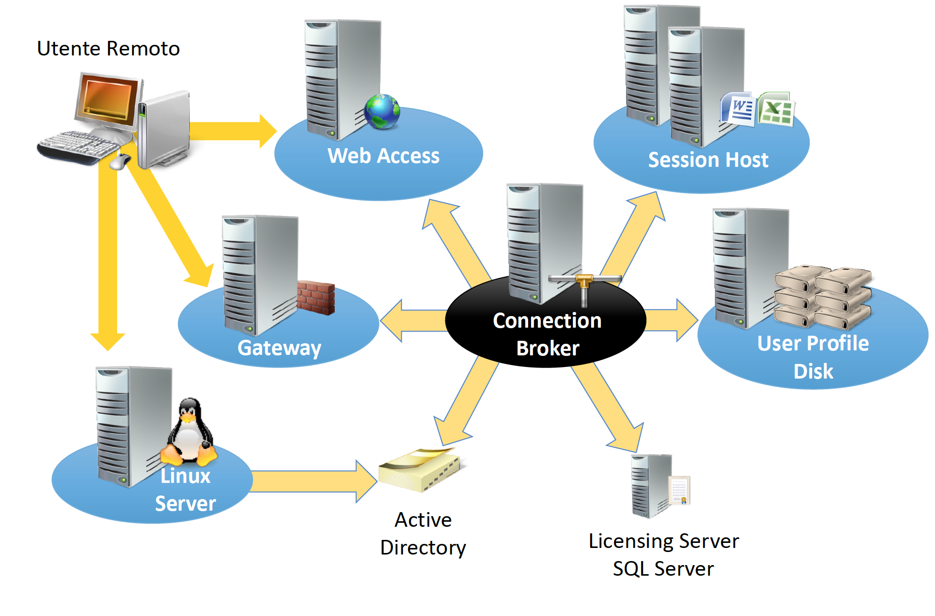
REMOTE USER

Slide 5
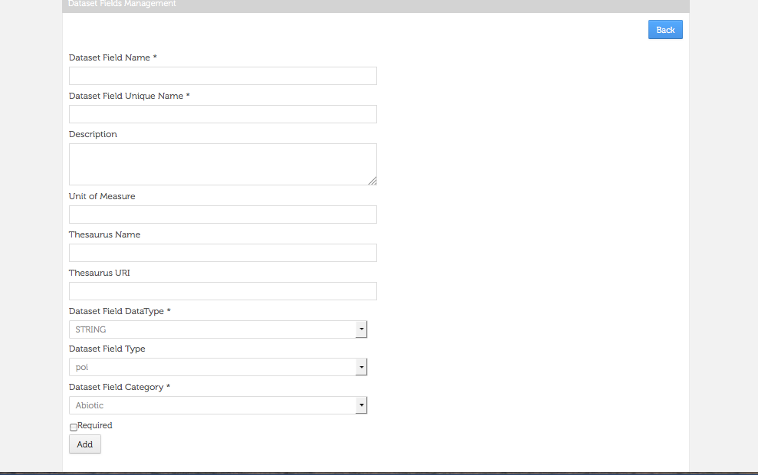
Data Standardization
DarwinCore
LW Thesauri :
PhytoTraits
FishTraits
ZooplanktonTraits
MacrozoobenthosTraits
AlienSpecies
EnvThese3
LUSTRE
Cast
SeaDataNet Parameter Discovery Vocabulary
Climate & Forecast Standard Name Table

Slide 6
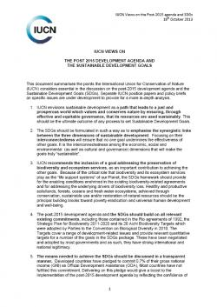
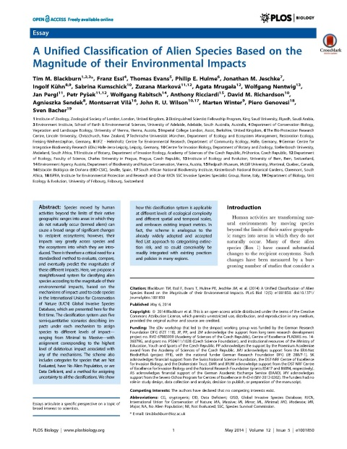
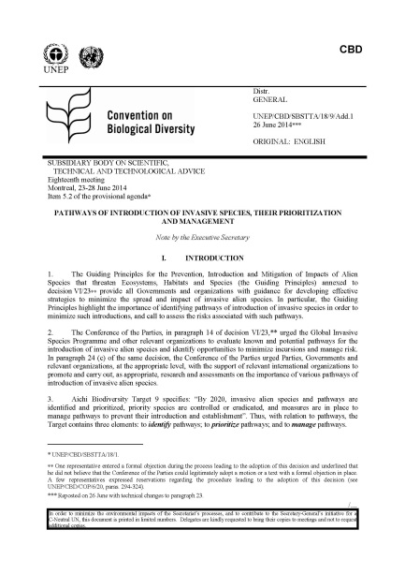
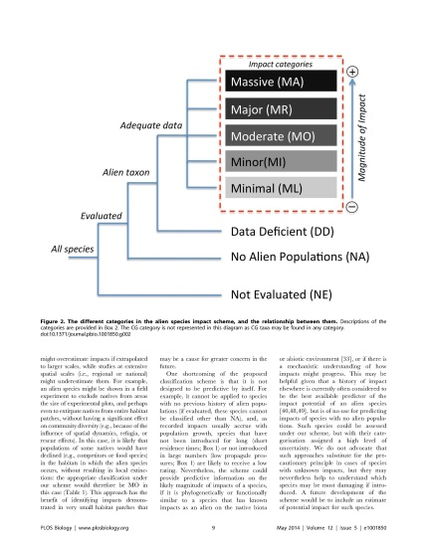
Alien Species: Thesaurus
http://openskos.lifewatchitaly.eu/AlienSpecies/
380 Terms
221 Definitions
195 Bibliographic references

Slide 7
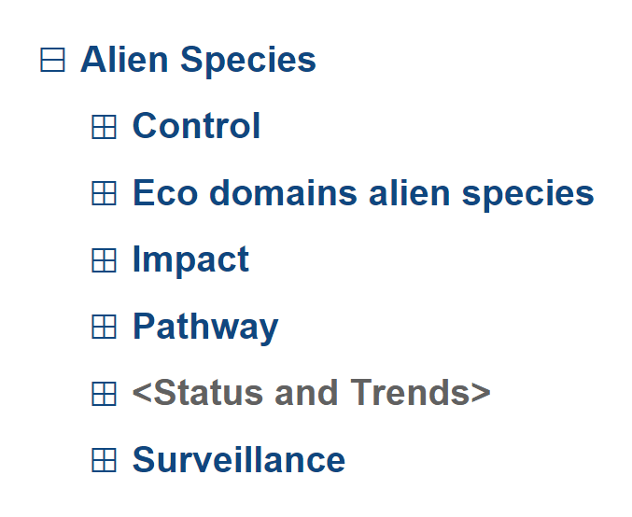
Alien Species: Thesaurus
Main categorization
It includes the definitions of alien species
according to the papers published by
the LifeWatch-Italy community
Meta-term including information on Establishment, Invasiveness, Propagule pressure, Residence Time, etc.

Slide 8
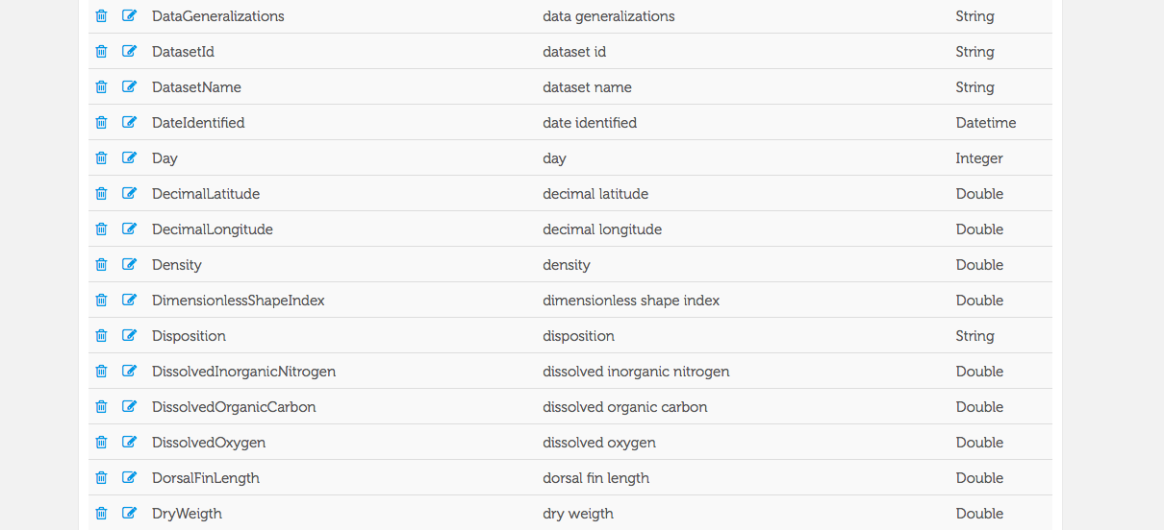
Data Standardization

Slide 9
Data Standardization
LifeWatch – ONTOLOGY
Domain
Context
hasObservation (0:n)
hasContext (0:n)
hasEntity (0:n)
Observation
any
hasValue (1:1)
hasObservation (0:n)
hasMeasurement (0:n)
Entity
Measurement
hasPrecision (0:1)
real
hasCaracteristic (0:n)
ofCaracteristic (1:1)
usesStandard (1:1)
usesProtocol(1:1)
Characteristic
Measurement
Standard
Protocol

Slide 10
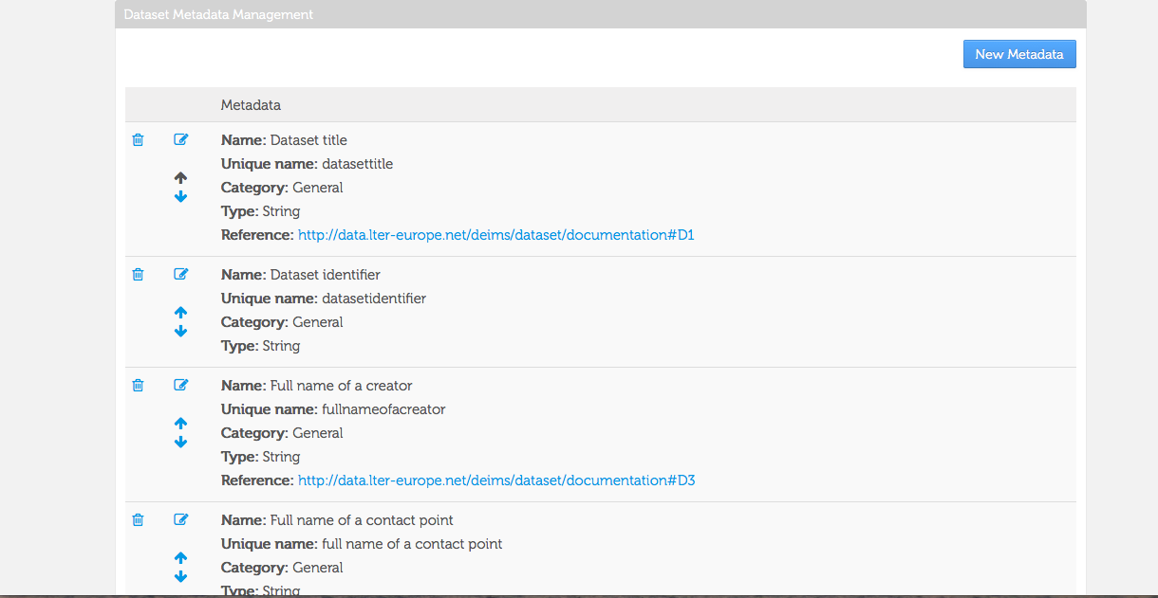
Metadata Management

Slide 11
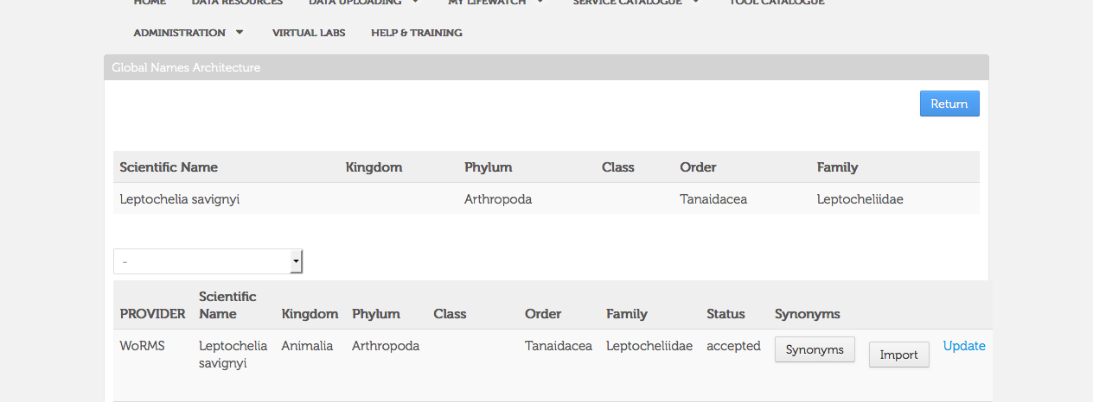
Data Quality – Taxonomic Cleaning

Slide 12
Data Quality – Semantic Cleaning
Work in Progress

Slide 13
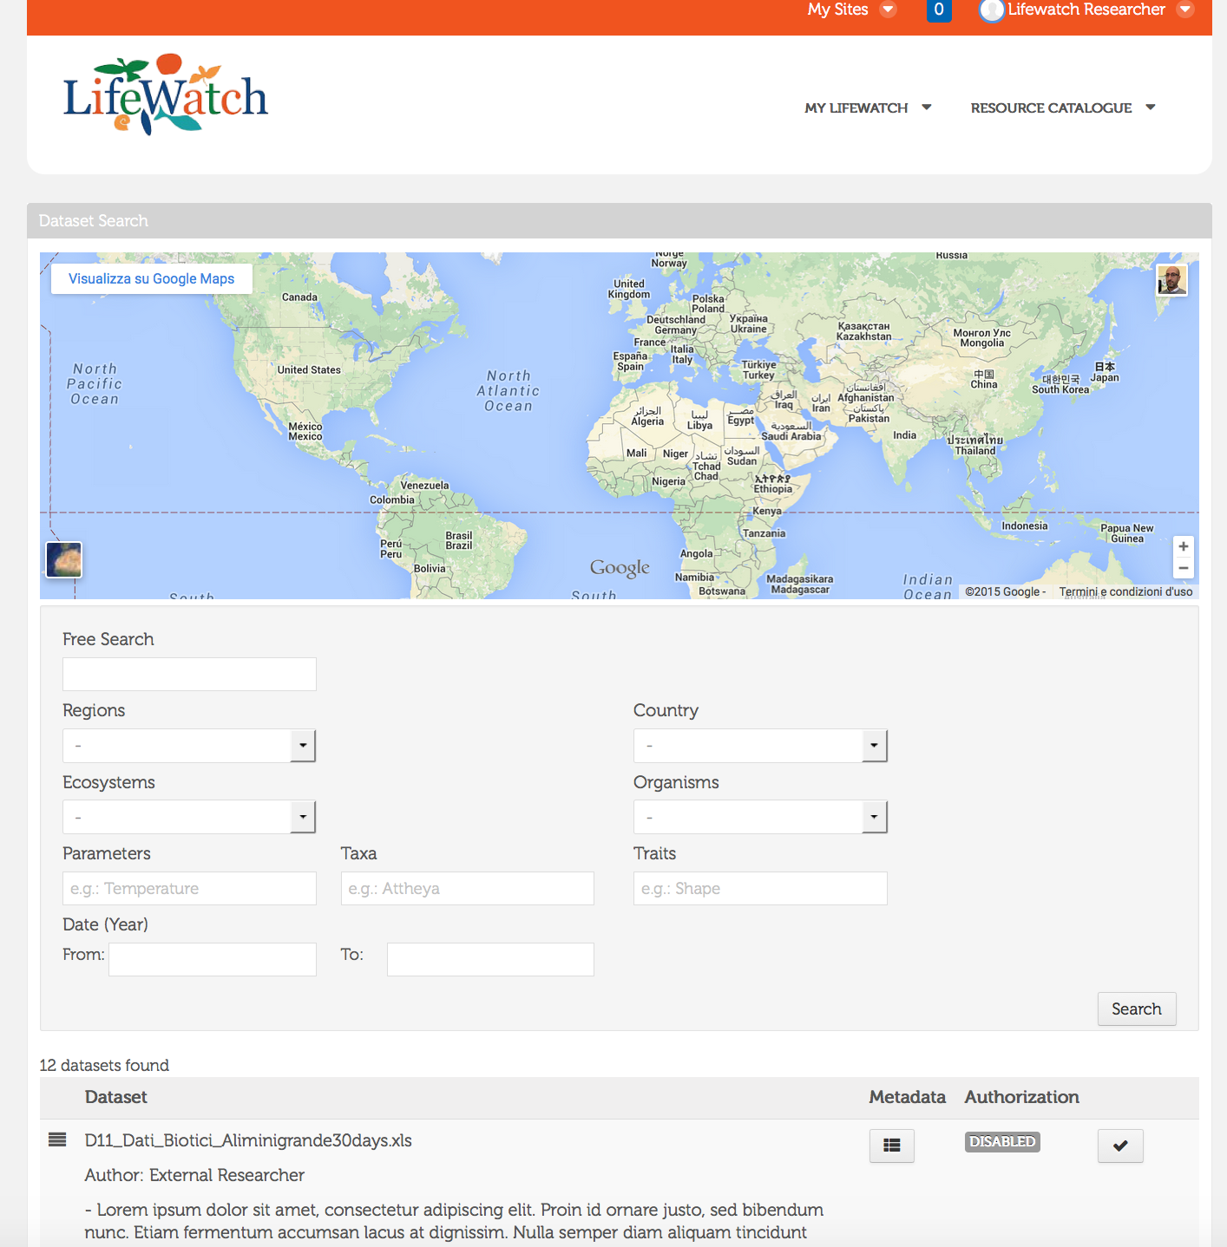
DATA PORTAL - Search

Slide 14
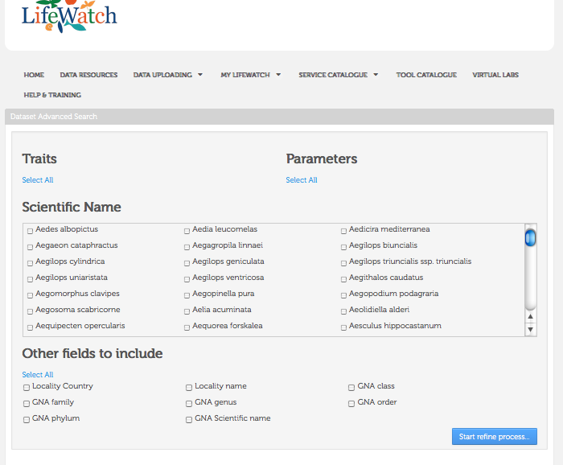
DATA PORTAL – Advanced Search

Slide 15
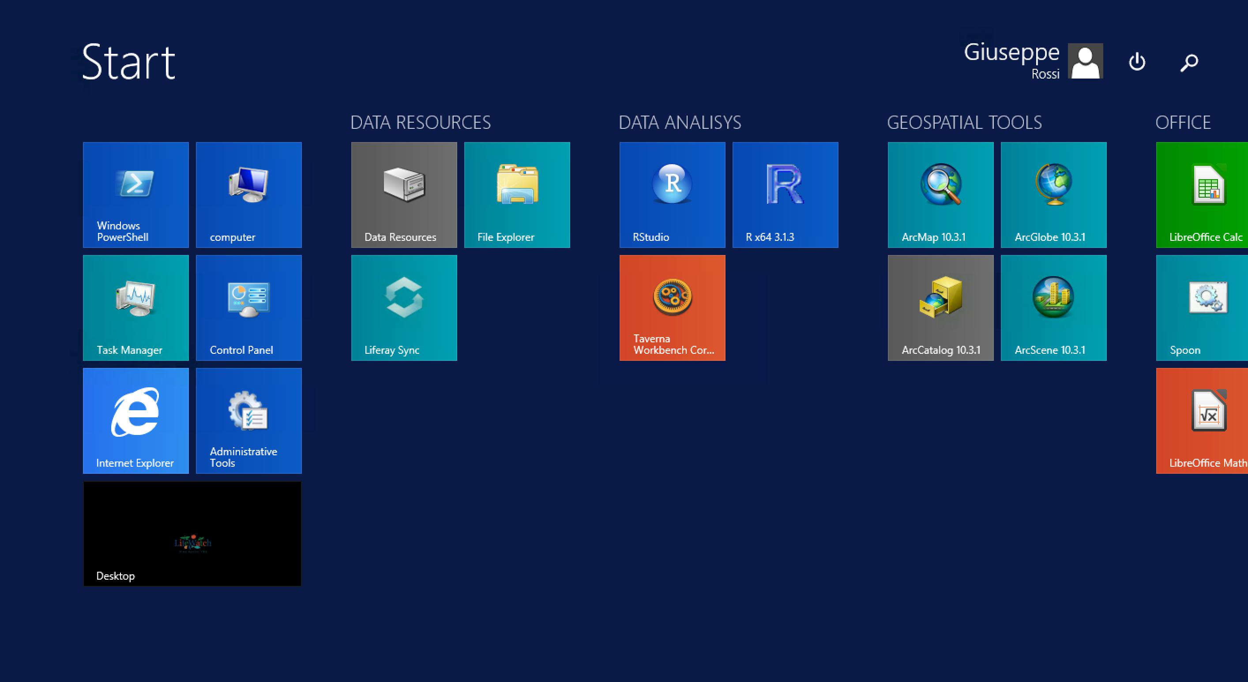
Alien Species: VRE

Slide 16
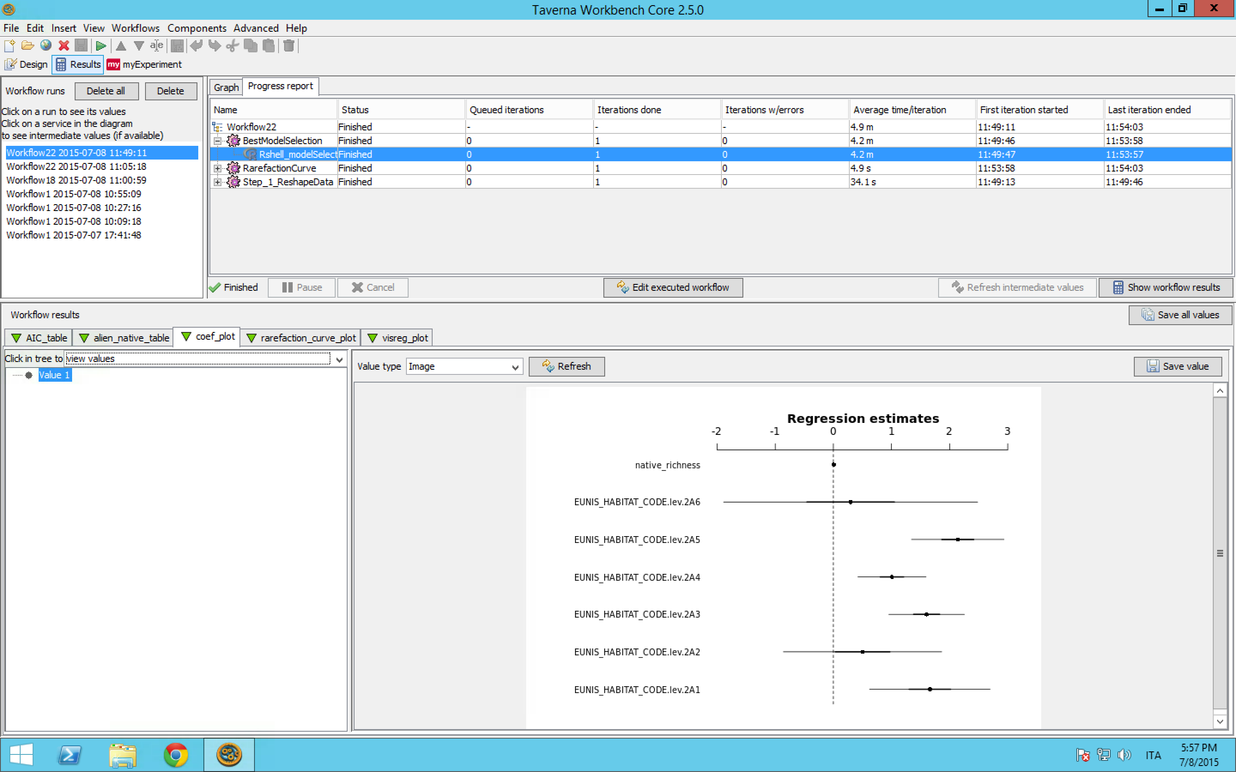
Alien Species: VRE

Slide 17
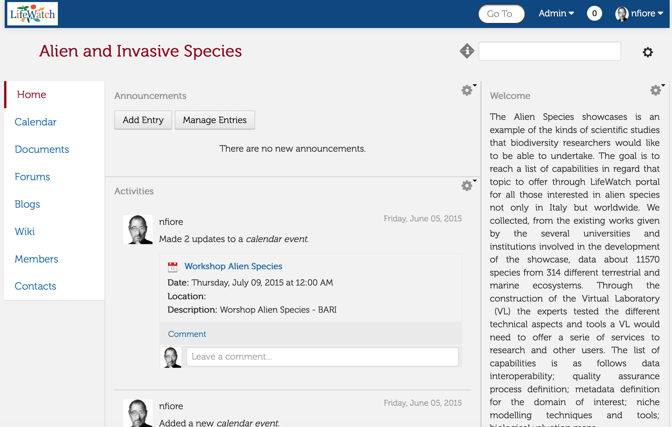
Alien Species: USER PLATFORM

Slide 18
EEF 2015 Conference 21-25 September 2015 http://www.ecologyatinterface.eu/

Slide 19
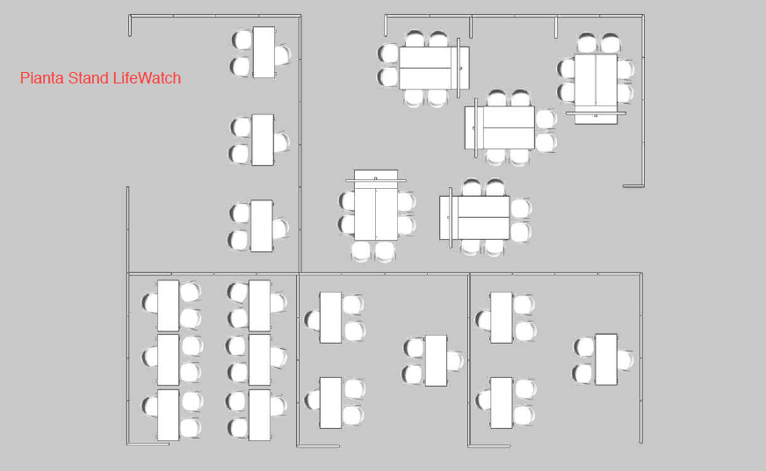
COMMON FACILITIES
WORKSHOP & DEMO AREA
5 tv screens
Posters on the walls
Rollups
DISTRIBUTED CENTRES

Slide 20
24 September 2015 – LW Workshop & Demos
Each country participating will have a slot of 40’ to present its demos.
The setting of the common space will then allow to have “parallel demos” if you wish. However, should you wish to have more sessions, it would be possible to book other slots in the common space during the other days of the conference. In case please get back to Sara and Nicola and we will take care of arranging it coherently with other requests.

Slide 21
24 September 2015 – LW Workshop & Demos – Schedule
Number of demo | Country | Subject | Duration | Schedule
5 | Service Centre | Portal | 40' | 09:000-9:40
2 | Spain | access to LifeWatch cloud-based infrastructure supporting the deployment of VRE, Demonstration of applications: water resources management (SWIRL), water quality including the example of algae bloom in water reservoir (hydrodynamics and cyano grow), as well as other LW-ES related applications (pipeline for transcriptomes, monitoring air quality in Pyrinees zone, RESPIRA, etc.), Demonstration of LW VRE : marine, non-marine, invasive species. | 40' | 10:30 11:10
6 | Belgium | Demo about GPS bird tracking network, Demo about fish acoustic receiver network, Demo about ZooScan and Video Plankton Recorder, Demo about phytoplankton flow cytometer, Demo about Microbial Antarctic Resource System (mARS), Demo about modelling tool of the Biogeographic Atlas of the Southern Ocean | 40' | 15:00-15:40
2 | Italy | Alien Species, CollMap, Thesaurus, Mobilab | 40' | 16:00-16:40
2 | Sweden | One demo will explain how to use the SLW infrastructure for marine invasive research, while the other will explain how to use the Swedish Analysis Portal to mine biodiversity data. | 40' | 17:30-18:10
 | Greece????

Slide 22
We kindly ask you to please:
- confirm your availability for the slot allocated to your team, titles of your demo(s) and presenter details
- details of the stand holder(s)
- send a list of the printed materials you intend to distribute or show
- send a Wetransfer file with all digital materials you intend to show.

Slide 23
Biodiversity is life
Biodiversity is our life

