Slide 1
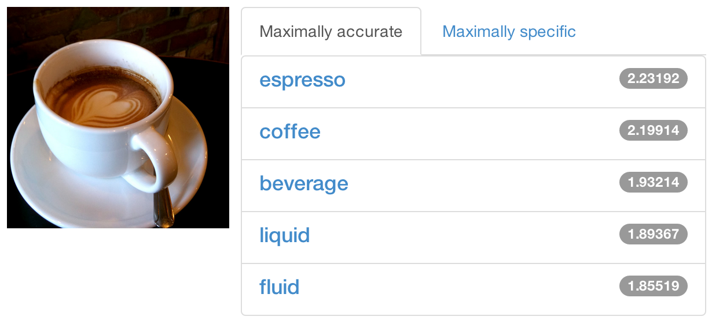
Brewing Deep Networks
With Caffe
Look for
additional notes
for the slides
Yangqing Jia
Notes:
Greetings! If you are reading the notes - the footnote contains some additional pointers to things mentioned in the slides, which I may not cover due to time constraints of the talk.
First - the cover image is an actual caffe prediction, from http://demo.caffe.berkeleyvision.org/
The Caffe homepage is at http://caffe.berkeleyvision.org/
The github repository for Caffe is at http://github.com/BVLC/caffe/
Learn more about the Berkeley learning and vision center at http://bvlc.eecs.berkeley.edu/
Yangqing's personal homepage is at http://daggerfs.com/

Slide 2
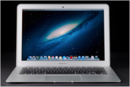
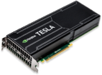
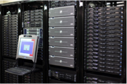
What is, and Why Caffe?
Pure C++/CUDA Implementation
Fast, well-tested code
Tools, demos, and recipes
Seamless switch between CPU and GPU
  Caffe::set_mode(Caffe::GPU);
Prototype
Training
Deployment
All with essentially the same code!
Notes:
The core Caffe is written purely in C++, with GPU code written using either explicit kernels or Cublas.
Caffe uses the Google testing framework to carry out unit testing.
The caffe layers (as we will touch shortly) contain both GPU and CPU code that gets carried out depending on the current caffe mode. However, if you are writing a custom layer, you don't HAVE to write GPU code: the default GPU implementation of a layer falls back to CPU implementation, and the Caffe framework deals with data copying under the hood for you. This means you can mix CPU and GPU layers without difficulty - of course, this leads to larger computation overheads
The Caffe mode and other global settings are defined at caffe/include/caffe/common.hpp.

Slide 3
Statistics...
Speed with Krizhevsky's 2012 model:
  K40 / Titan: 2 ms/image, K20: 2.6ms
  (40 million images / day)
  8-core CPU: ~20 ms/image
~ 8K lines of C/C++ code
  with unit test: ~14k
* Not counting image I/O time. Details at http://caffe.berkeleyvision.org/performance_hardware.html
Notes:
If you are wondering - training imagenet took about 4-5 days.
Just in case you are curious about what GPU to buy: in our lab we have tested K20, K40, Titan, GTX780, and they all work reasonably well.
- K40 and Titan seems the fastest, since they are also the newest.
- K20 and K40 are supposed to be more stable, but are more expensive.
- Titan and 780 run reasonably fine for us, although we do observe high temperature (~80 degrees Celsius, while the K20/K40s are around 60).
- K20 and K40 support nvidia-smi (e.g. device usage details), which may come quite handy.
On recent Laptops with good Nvidia GPUs, Caffe runs smoothly as well, but you may encounter memory issues when training large models (and honestly, you probably don't want to use the laptop too harshly due to other reasons like heat issues).
On Macbook Pros with dual GPUs, you may want to use software such as gfxCardStatus to switch between low-end and high-end GPUs (usually the high-end one will run Caffe better).

Slide 4
Do I want Caffe If I...
Have small or medium scale applications?
  Scripting languages may save engineering time indeed.
Prefer simpler scripting languages?
  We now provide Python and Matlab wrappers.
Hate tricky compilation issues?
  Recipes on Caffe webpage, and github.
  Virtualbox / EC2 images to be provided soon.
Notes:
For questions you encounter, you are more than welcome to check out the github issue list, and to create a new issue if no similar questions exist yet - the community may be able to give you a quick answer.

Slide 5
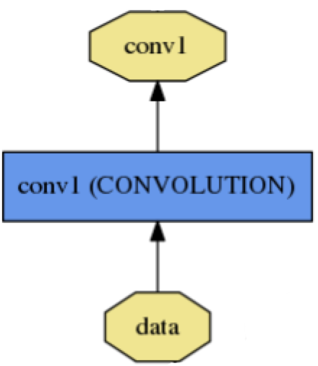
A Caffe Layer
name: "conv1"
type: CONVOLUTION
bottom: "data"
top: "conv1"
convolution_param {
num_output: 20
kernel_size: 5
stride: 1
weight_filler {
type: "xavier"
}
}
name, type, and the connection structure
(input blobs and output blobs)
layer-specific parameters
*Link to the Google Protobuffer Documentation
Notes:
Note: The caffe layer and network definitions are at src/caffe/proto/caffe.proto.
caffe/python/draw_net.py can be used to draw the network picture as shown in this slide and the next ones.

Slide 6
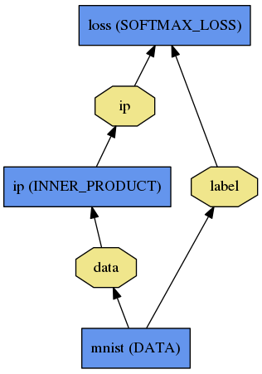
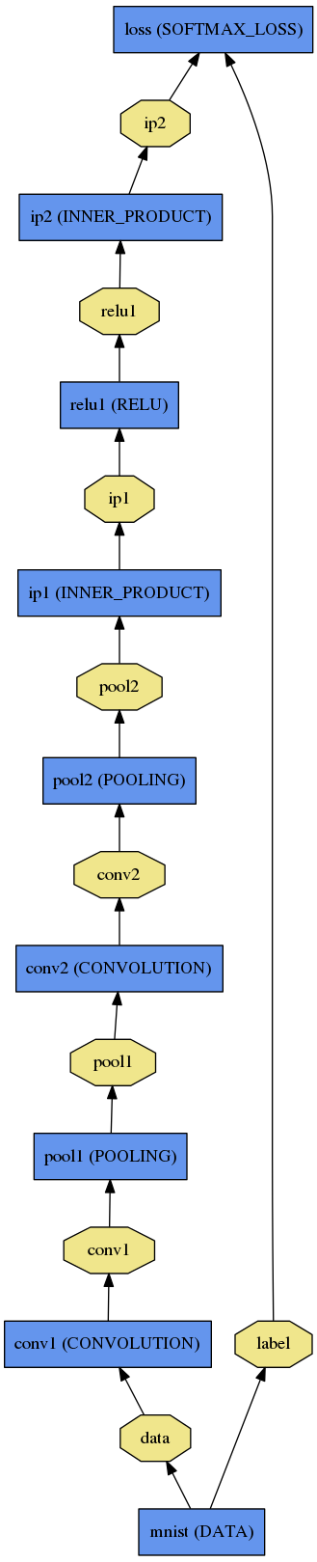
A Caffe Network
A network is a set of layers connected as a DAG:
name: "dummy-net"
layers { name: "data" …}
layers { name: "conv" …}
layers { name: "pool" …}
… more layers …
layers { name: "loss" …}
LogReg ↑
LeNet →
ImageNet, Krizhevsky 2012 →
Notes:
The networks being visualized here can all be accessed under caffe/examples/.

Slide 7
Training a Caffe Net
Write a solver protobuffer:
train_net: "lenet_train.prototxt"
base_lr: 0.01
momentum: 0.9
weight_decay: 0.0005
max_iter: 10000
snapshot_prefix: "lenet_snapshot"
solver_mode: GPU
All you need to run things on the GPU.
Notes:
This slide does not show all the options: for example, you can also specify the learning rate decreasing policy (like exponentially, or inversely proportional to time). Check out src/caffe/proto/caffe.proto for details - the code itself gives good inline explanations on what individual fields mean.
Currently, Caffe supports training with stochastic gradient descent with minibatches and momentum - probably the most widely used training method for deep networks. You can also write your own solver - check out caffe/src/caffe/solver.cpp for details.
Take special notice at the last line - you can simply switch the solver mode between GPU and CPU by this. Viola! Simple as that.

Slide 8
End to End Recipe...
Convert the data to Caffe-format
  leveldb, hdf5/.mat, list of images, LMDB, etc.
Write a Network Definition
Write a Solver Protobuffer text
Train with the provided train_net tool
  build/tools/train_net.bin solver.prototxt
Examples are your friends
  caffe/examples/mnist,cifar10,imagenet
  caffe/tools/*.bin
Notes:
To convert the data, caffe/tools/extra/ may contain multiple scripts that are useful.
Make sure you also check out the mnist, cifar and imagenet tutorials on the caffe webpage - they provide step-by-step guides on how to run such examples.

Slide 9
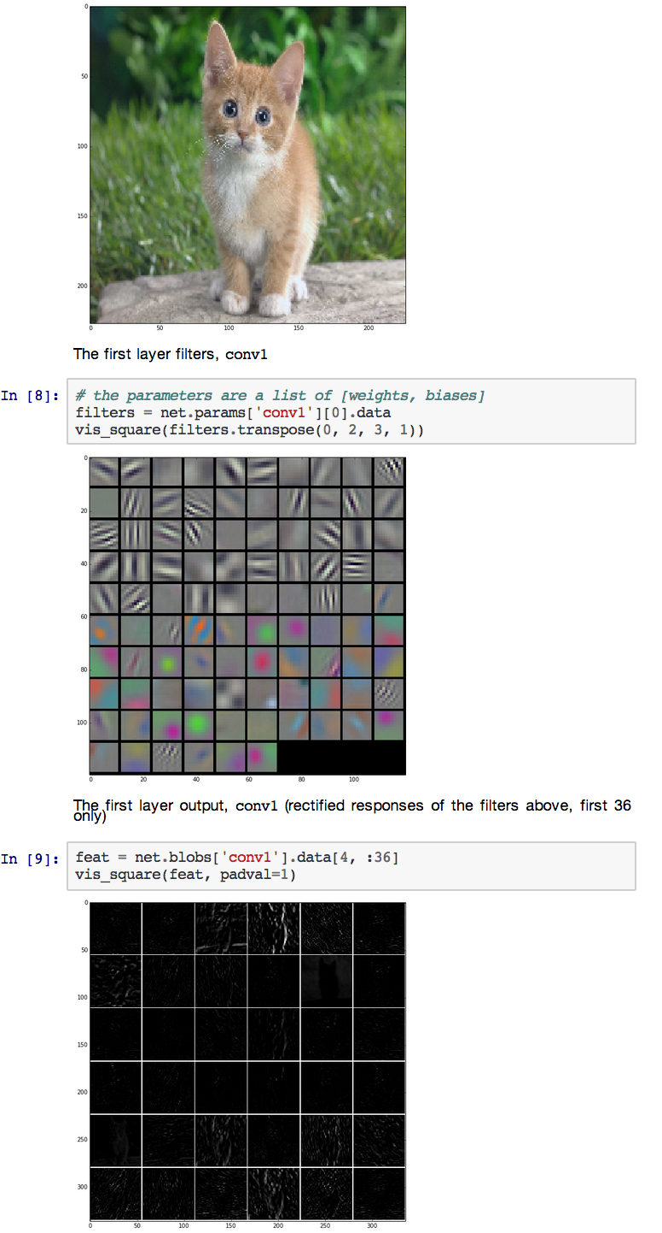
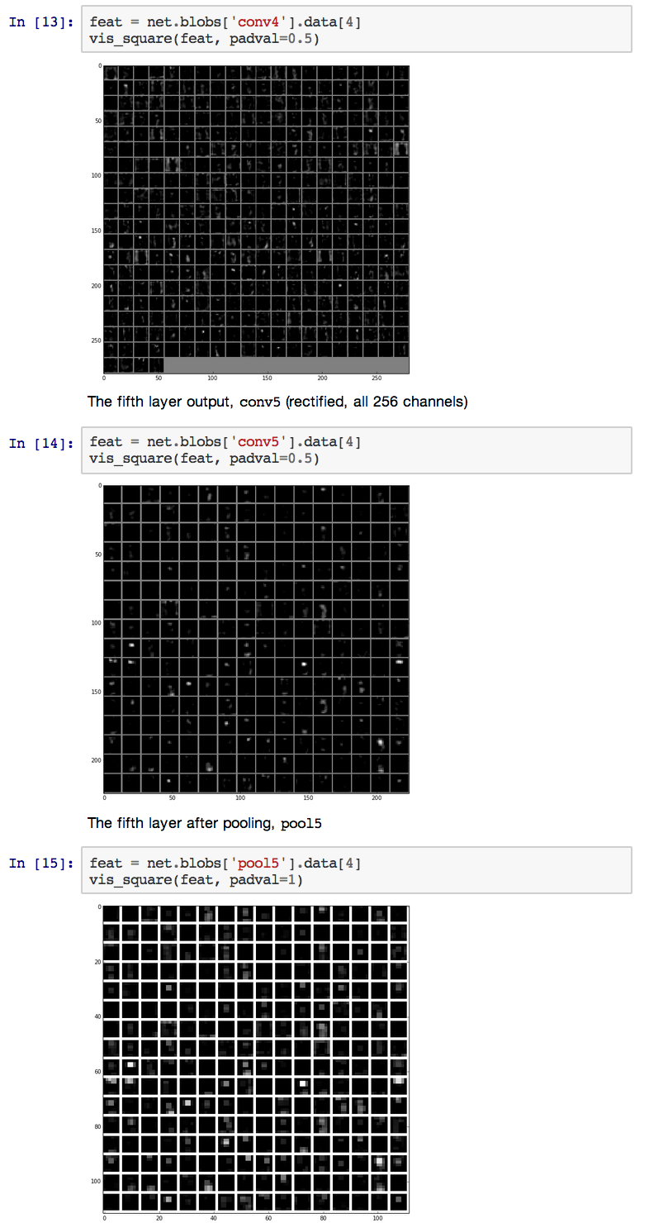
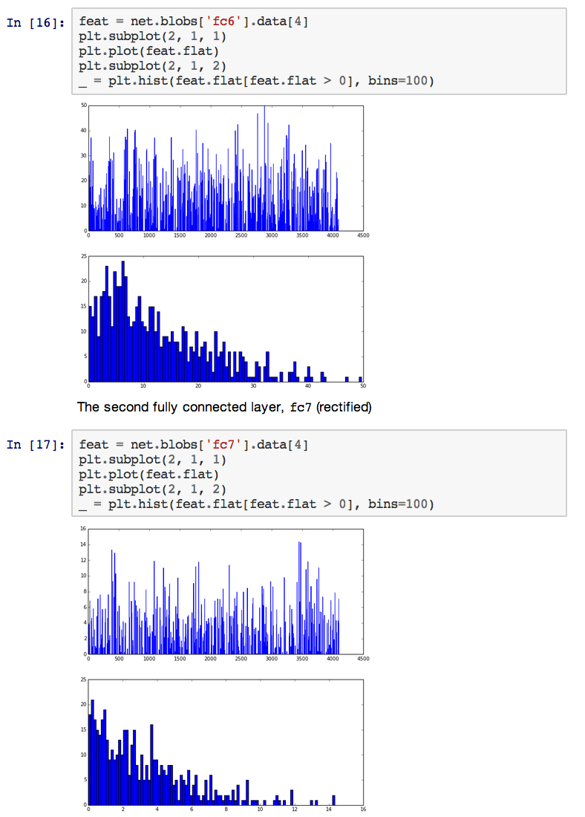
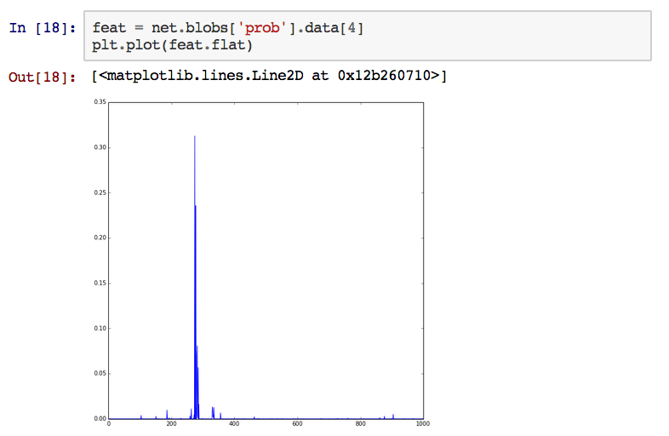
Peeking into Networks
Notes:
The sample ipython notebook is at caffe/examples/filter_visualization.ipynb
While you are at it, also checkout the imagenet classification tutorial at caffe/examples/imagenet_classification.ipynb
Both could be easily viewed online using the nbviewer tool:
http://nbviewer.ipython.org/github/BVLC/caffe/blob/master/examples/filter_visualization.ipynb
http://nbviewer.ipython.org/github/BVLC/caffe/blob/master/examples/imagenet_classification.ipynb

Slide 10
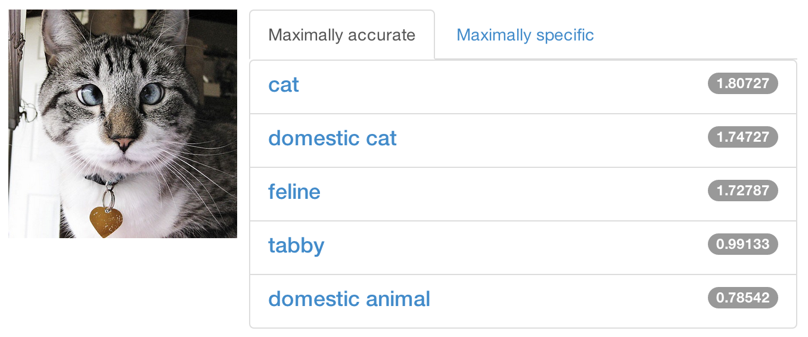
A Quick Sip of Brewed Models
http://demo.caffe.berkeleyvision.org/
(demo code to be open-sourced soon)
Notes:
Note: the demo is running at one of our lab's development machines, so depending on how much experiment we need to run, it might appear slow from time to time (because the demo is giving way to actual research). Please bear with us if it appears slow or is down.
If you want to try out the same classification, the imagenet ipython notebook is always available to run locally, and once the demo code is released, you can consider running your own demo too.
It is worth mentioning that there are several other demos online that use deep models for various tasks, some from startups:
http://horatio.cs.nyu.edu/
http://clarifai.com
http://rekognition.com/demo/concept
(feel free to let me know if you find more demo links)
Of course, you can always find your personal photos with Google+ Photo's search functionality, which uses deep models (among other techniques) to understand image contents and provides a nice user experience.

Slide 11
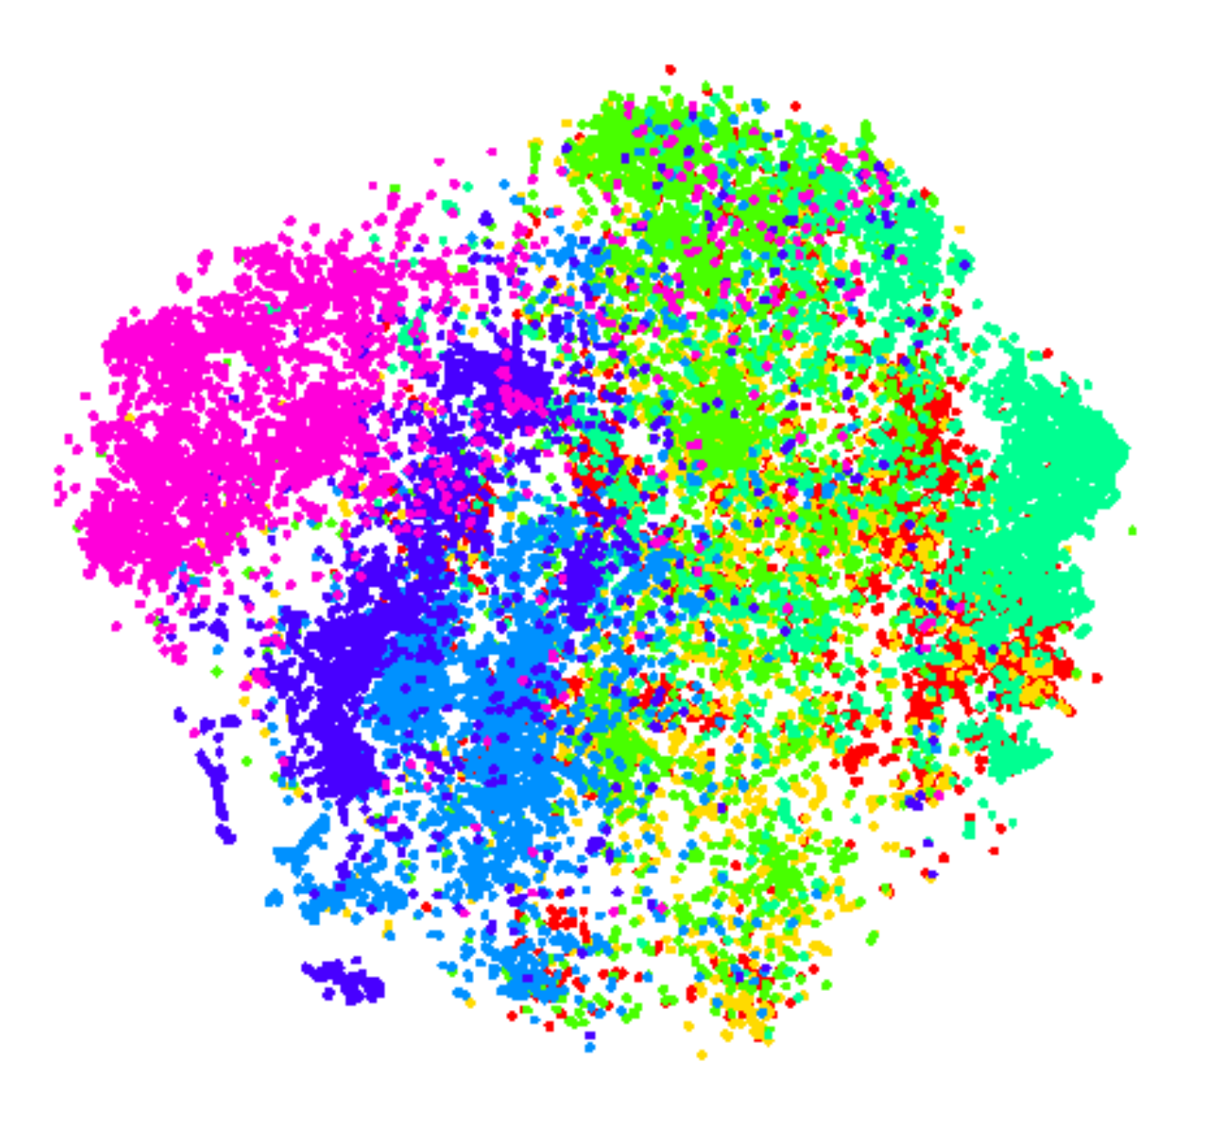
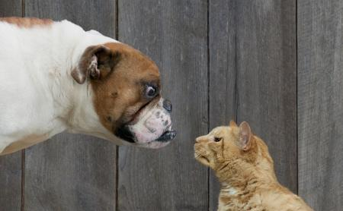
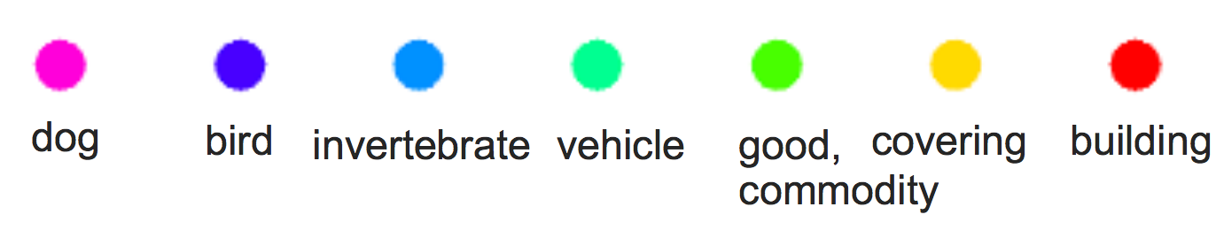
Transfer Learned Knowledge
Taking a pre-trained model and finetune it for related tasks [Zeiler-Fergus] [DeCAF] [OverFeat]
*Dog and cat image Copyright kaggle.com
Notes:
Multiple papers have discussed and demonstrated the power of such an approach - in Zeiler and Fergus's arXiv paper describing the ILSVRC 2013 winning result, our earlier paper on DeCAF, and Pierre Sermanet's OverFeat work, respectively:
[Zeiler-Fergus] http://arxiv.org/abs/1311.2901
[DeCAF] http://arxiv.org/abs/1310.1531
[OverFeat] http://arxiv.org/abs/1312.6229
DeCAF is deprecated and is officially replaced by our new caffe implementation, but if you would like to check out the old good decaf, here it is:
https://github.com/UCB-ICSI-Vision-Group/decaf-release
A friendly note that the pretrained OverFeat is also available as a feature extractor at:
http://cilvr.nyu.edu/doku.php?id=software:overfeat:start
If you would like to use deep features in a detail-agnostic way, think like this: consider the convolutional network as a "better SIFT": it gives you a feature vector, similar to what SIFT does, but is much more powerful and has richer semantics.

Slide 12
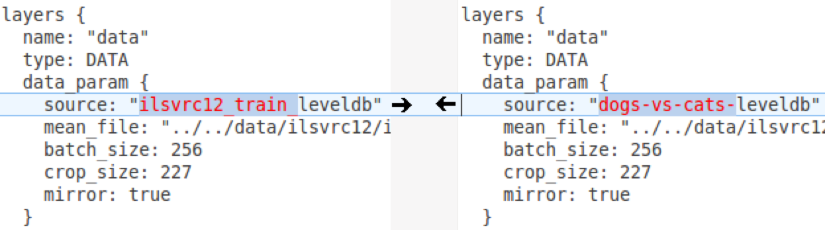
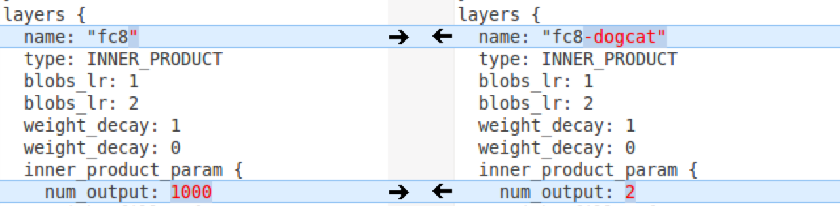
Dogs vs Cats: top 10% in 10 minutes
Simply change a few lines in the layer definition
Input:
A different source
Last Layer:
A different classifier
Notes:
The reason we change the last layer's name is that, Caffe's network copy (in the next page) relies on the layer name to figure out which layers it needs to copy. As a result, naming it "fc8-dogcat" tells the trainer that this is a different layer.
In addition, you may want to set all lower layers' learning rates to zero using:
blobs_lr: 0
in the corresponding layers. This would fix the lower layers and basically only train a logistic regressor based on the penultimate layer's output.
You may have noticed that the top layer could have only 1 output, since we are doing a binary classification. Indeed, we are being a little lazy here by still using a softmax loss, but it is perfectly reasonable that you may want to use logistic loss instead.

Slide 13
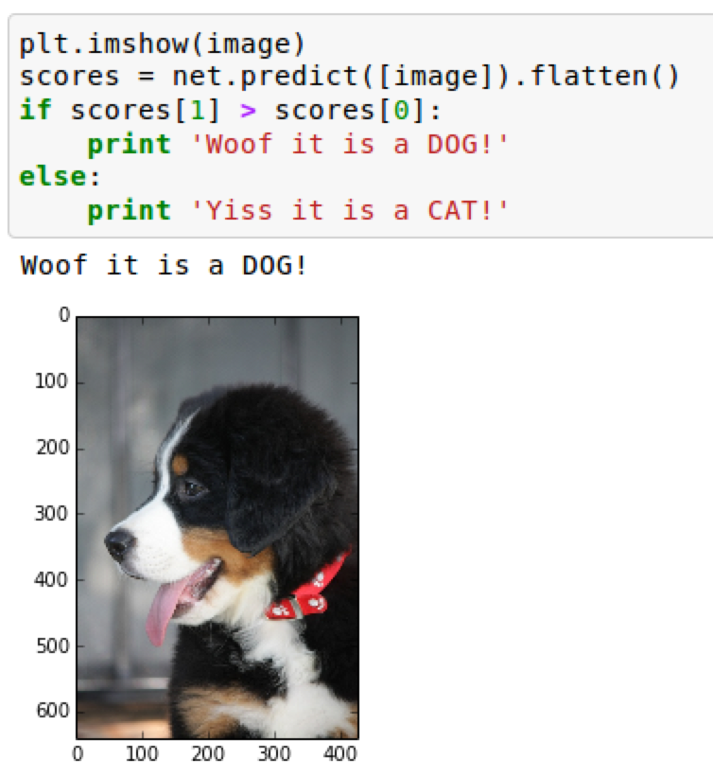
Dogs vs Cats: top 10% in 10 minutes
build/tools/finetune_net.bin dogcat_solver.prototxt pretrained_imagenet_model
Under the hood (loosely speaking):
net = new Caffe::Net(
"dogcat_solver.prototxt");
net.CopyTrainedNetFrom(
pretrained_model);
solver.Solve(net);
Example code to be made available at
caffe/examples/dogs-vs-cats/
Notes:
(I'll upload the example as well as the ipython notebook soon.)
It is noteworthy that Pierre Sermanet, who won the challenge, also used a similar fine-tuning strategy, showing the (surprisingly) consistent good performance of deep models. Pierre's Google+ post about it is at:
https://plus.sandbox.google.com/+PierreSermanet/posts/GxZHEH9ynoj

Slide 14
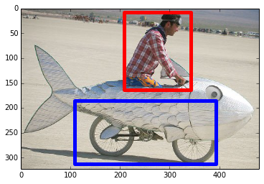
Object Detection
R-CNN: Regions with Convolutional Neural Networks
http://nbviewer.ipython.org/github/BVLC/caffe/blob/dev/examples/detection.ipynb
Full R-CNN scripts available at
https://github.com/rbgirshick/rcnn
Ross Girshick et al.
Rich feature hierarchies for accurate object detection and semantic segmentation
Oral Session 2A, Tue 1:30 pm
Notes:
Ross has shared all his R-CNN code (from training data generation to training to running detection on test data), so you probably want to try it out, especially if you would like to participate in this year's challenge - it is a strong baseline!
We have to use Matlab a little bit for this task since selective search, the algorithm we use to generate bounding box proposals, is available in a closed-source Matlab package as of now.

Slide 15
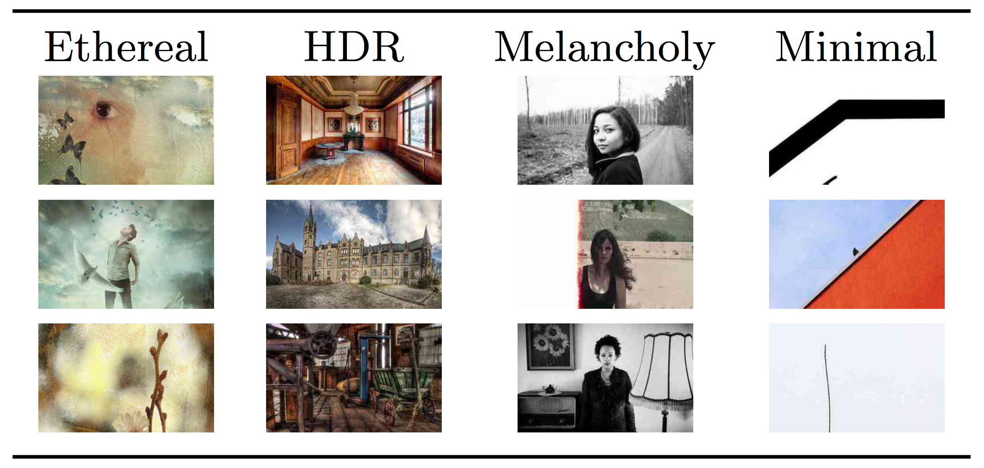
Visual Style Recognition
Sergey Karayev, http://vislab.berkeleyvision.org/, demo available online
Other Styles:
Vintage
Long Exposure
Noir
Pastel
Macro
… and so on.
Notes:
Sergey developed this with colleagues from Adobe. Click on the links to see how well they perform!

Slide 16
In One Sip
Caffe...
is C++/CUDA friendly
is fast
is state-of-the-art
has tips, recipes, demos
all available under an open-source initiative
Notes:
This is just to provide a refreshing summary.

Slide 17
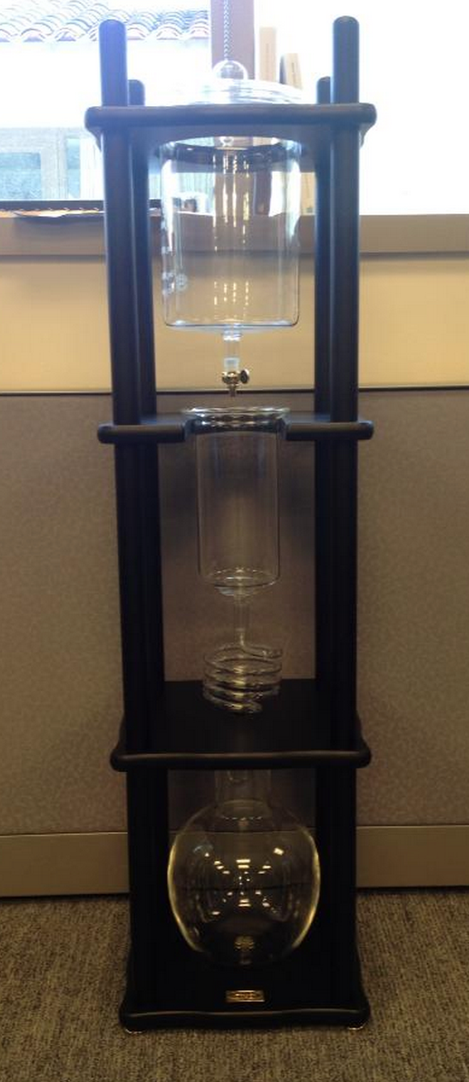
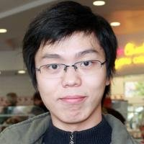
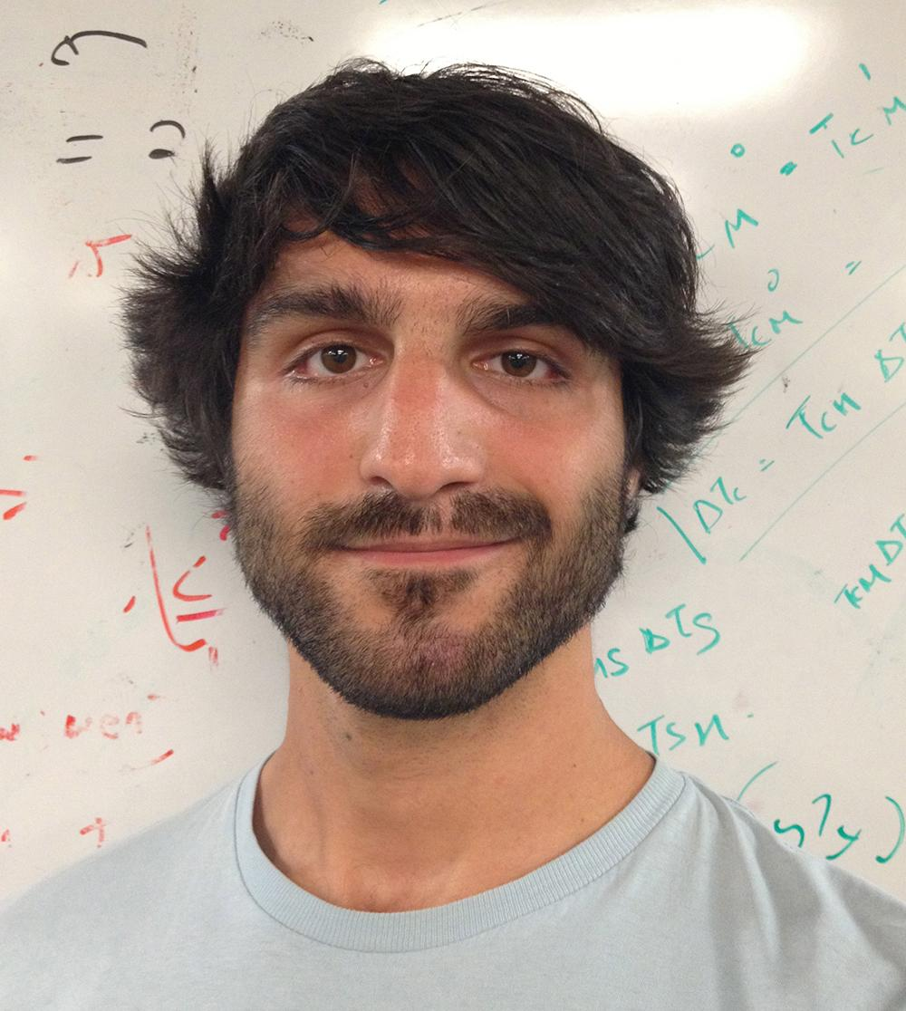
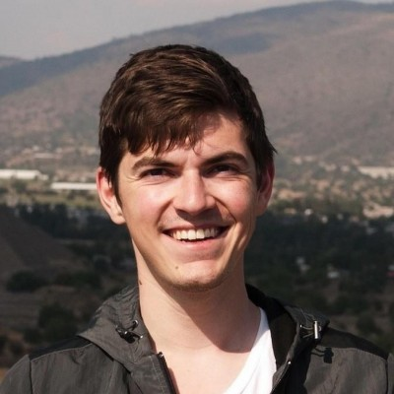
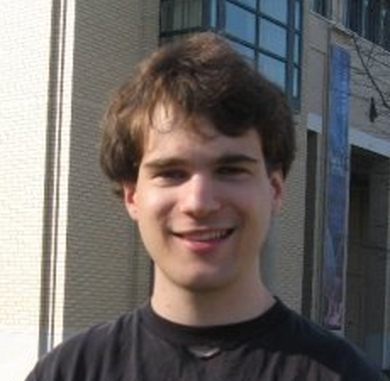
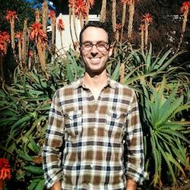
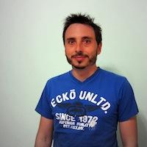
Yangqing Jia, Evan Shelhamer, Jeff Donahue, Sergey Karayev
Jonathan Long, Ross Girshick, Sergio Guadarrama
https://github.com/UCB-ICSI-Vision-Group/caffe-paper/raw/arxiv/caffe.pdf
Notes:
The coldbrew tower on the right provides us coffee to keep writing code fast - it produces extraordinary aroma and taste. The only downside is that, it's not as fast as the GPUs we have! Evan is our chief brewmaster. He's also a git master that merges, branches, and rebases like a piece of cake.
Special thanks to Oriol Vinyals, who has been a great colleague and co-started our recent deep learning efforts at Berkeley. He's now happily at Google, doing research no one has done before.
Thanks, and happy brewing!

