Slide 1
e-Infrastructure commons Updates
Diego Scardaci
Technical Outreach Expert

Slide 2
Outline
WP3 Milestones & Deliverables
KPI and Metrics
First roadmap revision
Software and services - instructions and rules
Tool information

Slide 3
Milestones and Deliverables Review Process (1/2)
R: Document, report
Input: full report
DEM: Demonstrators, pilots, prototypes, plan design
Input: Delivery of the product, short 1-4 page report
DEC: Website, press & media actions, events
Input: Delivery of the product, short 1-4 page report
Events: in addition feedback on satisfaction is provided

Slide 4
Milestones and Deliverables Review Process (2/2)
OTHER: software, technical diagram etc.
Non-user facing software
Input: delivery, UMD software provisioning process , short 1-4 report based on the staged rollout process outcome
User facing software
Input: delivery, feedback on satisfaction is provided, short 1-4 page report
Other
Input: short 1-4 page report

Slide 5
WP3 Milestones and Deliverables
M3.1: Operational tools development roadmap agreed (M04 – June ‘15)
Done
D3.1: Technical design of the new Accounting Portal and implementation plan (R)
Done

Slide 6
Next WP3 Deliverables and Milestones
M3.2 - User requirements on data accounting collected (R) (PM12)
Contact relevent stakeholders. Interviews and Survey
D3.2 - Design of the EGI Service Registry and Marketplace (R) (PM12)
Definition of the new EGI Tools ecosystem
D3.3 - Accounting Repository release (OTHER) (PM12)
D3.4 - First release of the Operational tools (OTHER)

Slide 7
Next WP3 Deliverables and Milestones
D3.5 - First release of the new Accounting Portal deployed in production (OTHER) (PM14)
Demos (Nov, Jan, Mar)
D3.6 - Analysis on techniques to manage big data on the EGI accounting system (R) (PM15)
Technology assessment
M3.3 - Operational tools development roadmap revised
D3.7 - First release of the EGI Service Registry and Marketplace prototype (DEM) (PM18)
D3.8 - First data accounting prototype DEM-PM20

Slide 8
KPI and Metrics
Metrics | Description | Type | How measured | Target PM12 | Target PM24 | Target PM30
KPI.6.JRA1.AAI | Number of users adopting federated IdP | Cumulative | Number of users accessing EGI services through the IdP Proxy/broker | TBD | TBD | TBD

Slide 9
KPI and Metrics
Metrics | Description | 15 | 16 | 17 | Task
M.JRA1.AAI.1 | Number of communities whose IdP framework integrates with EGI AAI | 0 | 4 | 8 | 3.1
M.JRA1.Marketplace.1 | Number of entries in the EGI Marketplace (i.e. services, applications etc.) | 0 | 50 | 200 | 3.2
M.JRA1.Accounting.1 | Number of kinds of data repository systems integrated with the EGI accounting software | 0 | 0 | 5 | 3.3
M.JRA1.Accounting.2 | Number of kinds of storage systems integrated with the EGI accounting software | 2 | 2 | 5 | 3.3
M.JRA1.OpsTools.1 | Number of new requirements introduced in the roadmap | 40 | 80 | 120 | 3.4
M.JRA1.OpsTools.2 | Number of probes developed to monitor cloud resources | 3 | 8 | 15 | 3.4
M.JRA1.eGrant.1 | Number of user requests handled in e-GRANT | 10 | 20 | 30 | 3.5

Slide 10
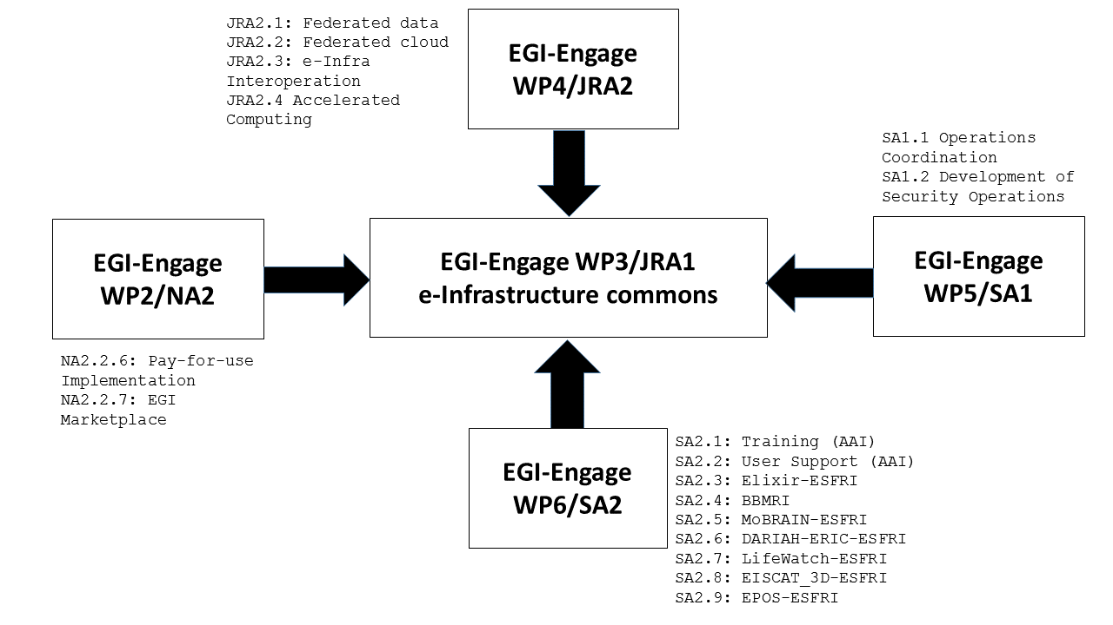
Roadmap & Requirements

Slide 11
First Roadmap Revision
Roadmap revision each 3 months:
each PT collects the requirements (should be in RT)
each PT proposes a roadmap revision
proposed revisions are discussed during the monthly meeting and approved by relevant OTAG (when exist)
PTs should update the roadmap in the wiki after the revision
First revision: September 2015

Slide 12
First Roadmap Revision - Actions
Each PT should send to the relevant OTAG (when exist) a proposal for the roadmap revision for approval
Deadline: 25 Sept CoB
Include the list of new requirements registered in RT
Send me the roadmap if an OTAG for your tool doesn’t exist yet
After approval, each PT should update the roadmap in the WP3 wiki page (by end of Sept)

Slide 13
Software and services instructions and rules
See https://wiki.egi.eu/wiki/EGI-Engage:Software_and_services

Slide 14
Tool Information
Release Notes
Documentation
Users
Sys-admin (setup a tool instance)
License
Public source code repository

Slide 15
F2F at the EGI CF (Bari, Italy)
Monday 9th of Nov 16-18
Each PT should attend the meeting
https://indico.egi.eu/indico/contributionDisplay.py?contribId=21&confId=2544

