Slide 1
Cryo-EM in the cloud:
bringing clouds to the data
L del Caño, J Cuenca-Alba, JM Carazo
Instruct Image Processing Center (I2PC)

Slide 2
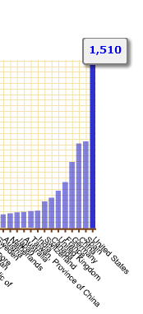
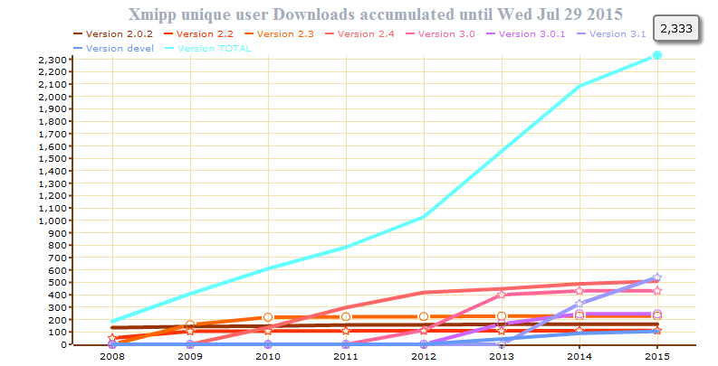
Xmipp is a comprehensive suite of image processing algorithms with a strong emphasis in the analysis of single particles,
It is extending towards electron and X-ray tomography.

Slide 3
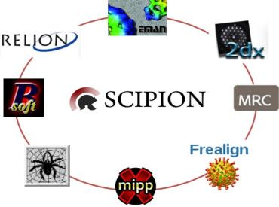
Scipion is an image processing framework to obtain 3D models of macromolecular complexes using Electron Microscopy (3DEM).
It integrates several software packages with an unified interface, useful for both biologists and developers.
Scipion workflows combine different software tools (with transparent conversion of formats) and track all steps (so they can be reproduced later)
http://scipion.cnb.csic.es/
Cluster Edition
Cloud Edition
Desktop Edition
Web Tools

Slide 4
Scipion requirements
The basics
Big data
transfers (>2TB)
Linux
(Debian,
Ubuntu)
MPI, shared storage
Packages & libraries
Network
infrastructure
Storage
Tools / Platform

Slide 5
MoBrain T2.1:
deployment at Federated Cloud
February 17: BioMed Bridges (ELIXIR)
February 22: spanish EGI-Engage meeting at Madrid
June 11: meeting with IFCA & INFN. VOs: Fedcloud, ENMR.eu. First deployments at IFCA
July 7: meeting with Engage@UPV
July 15: first deployments at CESNET
September 2: discussion with Ales Krenek (CESNET / MU)
September 7: joined ENMR.eu. First deployments at INFN.
Today, we are actively working with our FC partners (IFCA, INFN, CESNET) towards M2.1 & D2.1

Slide 6
SWT
on FC
SWT: automated deployment
“Real” testing @ FC
Deploy
(1 node)
Mini
cluster
Cluster +
SWT
(“production”)
Scipion
VM
Tools:
IM & EC3 for Scipion Cloud
Federated cloud (FC)
✔
✔
Elastic computing @ FC
Fault-
tolerant
Filesystem
Reliability
(fault tolerance)
Scipion benchmark on FC
GlusterFS:
€ or weeks...
Check-
pointing
Analyze benchmark results
Big data
AAI
SWT
Legacy GUIs:
X11
“Cloud X11”
(web client)
Scipion GUI benchmark
User experience: Scipion GUI
Tools:
CNB, FC, AWS
Scipion
user
Network benchmark
Network bandwidth
Data life cycle
Grid credentials
“Web service” credentials

Slide 7
MoBrain T2.3:
deployment at “Instruct EM Access” sites
Deploy Scipion at NeCEN, with the collaboration of SURFSara
September 30:
Meeting with Jan Pet (SURFSara). Presentation and first discussions

