Slide 1
Top-BDII Topology and High Availability
Tiziana Ferrari, OMB
14 April 2011

Slide 2
Top-BDII Availability
Core service needed by all VOs to discover services and get status information → critical for all VOs
High availability and response time
WLCG: 99%, max 10 s
WLCG guidelines: https://twiki.cern.ch/twiki/pub/LCG/WLCGISArea/BDII_Deployment_Plan.pdf
Performance depends on load and network latency
How to improve availability?
How to distribute load?

Slide 3
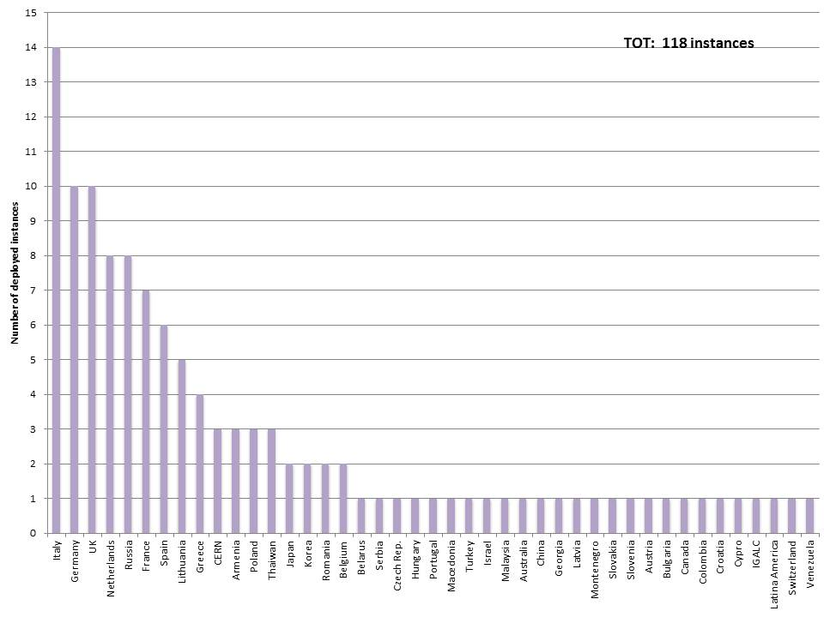
Top-BDII Deployment
26 Infrastructures with 1 instance
4 infrastructures with 2 instances
4 infrastructures with 3 instances
9 infrastructures with >3 instances

Slide 4
High Availability
Proposal
Development of a best-practice on how to run top-BDII in cluster with DNS-based load balancing, and Nagios monitoring for removal of defective instances
Deployment of top-BDII in HA (or improvement of its configuration) in a subset of medium-large infrastructures where still not available (Group A)
Implementation of failover from a client perspective (see next slide)
Extension of the availability framework to include BDII in NGI availability monthly statistics
Discussion with WLCG

Slide 5
Failover from client perspective
gLite clients use the LCG_GFAL_INFOSYS variable to determine the default top-bdii at each node (UI, WN, WMS)
Optional yaim variable (BDII_LIST) to define a list of top-BDIIs to support failover in the GFAL clients
Supported: gfal and lcg_utils (storage), lcg-infosites, lcg_info and glite-sd-query (service discovery)
FTS?
Topology: usage of a list of top-bdii (e.g. 3)
the first in the list is the default top-bdii of the NGI
the second and the third in list depend on network latency
Constraints:
At least one HA top-BDII (group A) in the list
Load is distributed
Network latency needs to be minimized
Issue: top-bdii instances in the list need to include the same set of information

Slide 6
Current deployment?
Which of the following NGIs are deploying top-BDII in cluster mode?
Any top-BDII instance dedicated to WLCG?
Italy, Germany, Uk, Netherlands, Russia
France, Spain, Lithuania, Greece, CERN
Armenia, Poland, Taiwan
Shall we set-up a task force to discuss this?

