Slide 1
Impact of increasing suspension thresholds
Christos Kanellopoulos, Dimitris Zilaskos (AUTH/GRNET)

Slide 2
Current status
Site suspension threshold from EGEE: <50% availability for 3 consecutive months
Inherited to EGI
Proposal from the OLA Task Force, based on feedback from the NGIs, to OMB on November 2010, to increase threshold to <70% for 3 consecutive months, on the second year of the project.
DECISION. The new suspension procedure is accepted and will come into force on May 01 2011.
https://www.egi.eu/indico/getFile.py/access?resId=0&materialId=3&confId=151

Slide 3
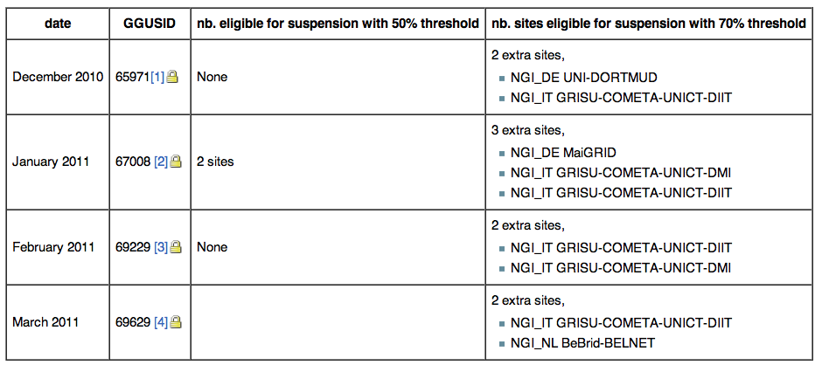
Evaluation status
Evaluation is recorded at: https://wiki.egi.eu/wiki/Availability_and_reliability_threshold_change_impact

Slide 4
Evaluation status
Max 3 extra sites would be suspended with the new threshold per month
but actually the majority of the extra suspensions involves the same 2 sites
if these sites were suspended from start as if the new threshold was in place, suspention cases would be even less
No noticable impact from the new threshold
If OMB agrees, enforcement can begin from May 2011(start of Y2) reports.

