Slide 1
EGI Operations Requirement Gathering Process
Tiziana Ferrari

Slide 2
Process
We need a clear process and tools to periodically collect requirements from NGIs and sites
Middleware → OMB
Operational tools → OTAG

Slide 3
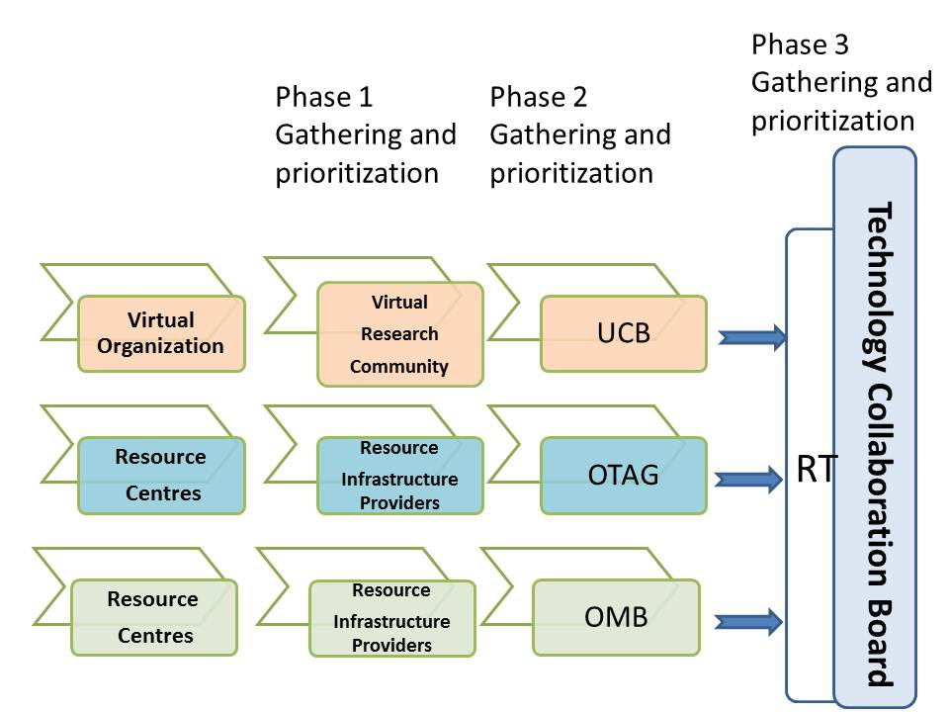
EGI overall process

Slide 4
Process 1/2 (proposal)
Top-down
the COO opens a call for requirements or other survey every 3 months:
Beginning of January, April, July, October
The NGI is responsible of contacting the respective site managers
Requirements are discussed and prioritized in OMB (1 month time)
input is provided to the Technical Coordination Board – TCB – by the beginning of the following month (Feb, May, Aug, Nov)

Slide 5
Process 1/2 (proposal)
Bottom-up (asynchronous process)
Site managers can provide requirements to the respective NGI at any time
The NGI collects requirements and passes them to the OMB for evaluation at any time
The OMB discusses the requirements collected every quarter (according to the timing presented in previous slide)

Slide 6
Testing of required features
The partners providing the EGI requirements are encouraged to participate in pre-release testing activities either with direct participation to testing, or with their own resources to make sure that the software developed meets their requirements, and to verify its usability and scalability in a production environment, as applicable.
This activity is voluntary relationship between EMI, JRA1 and other technology providers, and the group involved and does not form any part of the software verification or validation activities undertaken by EGI in formally accepting the software from external technology providers.

