Slide 1
BBMRI Competence Centre Status Report
Jim Dowling, KTH – Royal Institute of Technology
Notes:
genome-wide association study

Slide 2
BiobankCloud
EU General Data Protection Regulation
IT-Admins
Biobankers
Scalable and Secure
Genomic Data
Ethics/Auditors
Bioinformaticians
Notes:
Biobankers/Bioinformaticians
Store your big genomic data securely and reliably
Fast data intensive analyses and pipelines
Support for open-source and commercial tools
Secure sharing of data sets
IT organizations
Reduced barrier of entry
Reduced total cost of ownership
Minimal Administration, Commodity hardware,
Compliance with regulatory and ethical standards

Slide 3
Bringing together Biobankers & Bioinformaticians
Biobankers
NGS data producers
Collections, samples
Non-programmers
Bioinformaticians
NGS data analysts
Programmers
Python, R, Matlab, scripts
Web Application
Cuneiform/HiWAY
IT
Admins
Karamel
Hops-YARN
CharonFS
Hops-HDFS

Slide 4
Goal: Multi-Tenancy and Data Sharing
Study NSA
Member of
authorize access
No Unauthorized Copying/Cross-Linking of Data
Member of
Study Lifegene
DataSet
owns
Notes:
Dynamic Roles is what I am talking about for the white-hat and black-hats out there.

Slide 5
Users, DataSets, and Projects
DataSet₁
DataSet₂
DataSet₃
Project 1
Project 2
Project 3
In-Place Data Sharing - not Copying!

Slide 6
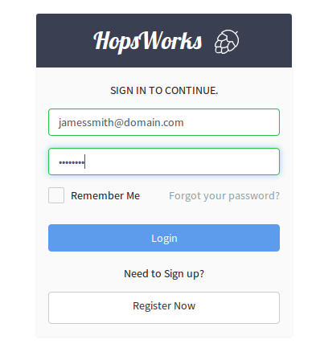
User
Authentication Provider
JDBC Realm
2-Factor Authentication
LDAP

Slide 7
Project
Members
Roles: Owner, Data Scientist
DataSets
Home project
Can be shared
Notes:
Privileges – upload/download data, run analysis jobs
Like RBAC solution.
All access via HopsWorks.

Slide 8
Project Roles
Owner Privileges
Import/Export data
Manage Membership
Share DataSets
Data Scientist Privileges
Write code
Run code
Request access to DataSets
We delegate administration of privileges to users
Notes:
Fixed set of privileges for the roles
No need for administrator to manage roles -> Users mapping

Slide 9
DataSet
Primary DataSets
Read/Write access for Data Owner
Read-Only access for Data Scientists
Sticky-Bit DataSets
Logs
Resources
Derived Data / Results

Slide 10
Sharing DataSets between Projects
The same as Sharing Folders in Dropbox

Slide 11
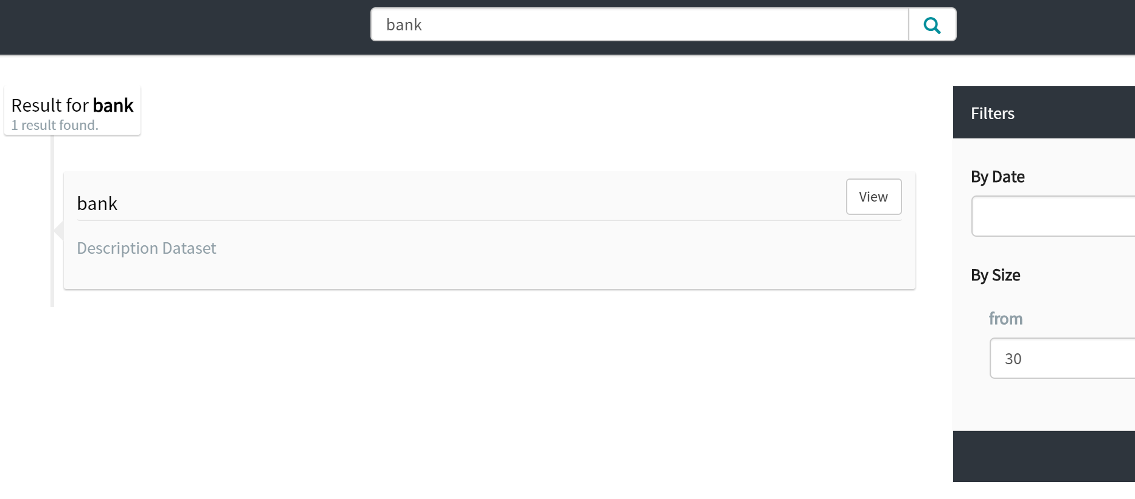
Global Search: Projects and DataSets

Slide 12
Project Search: Files, Directories

Slide 13
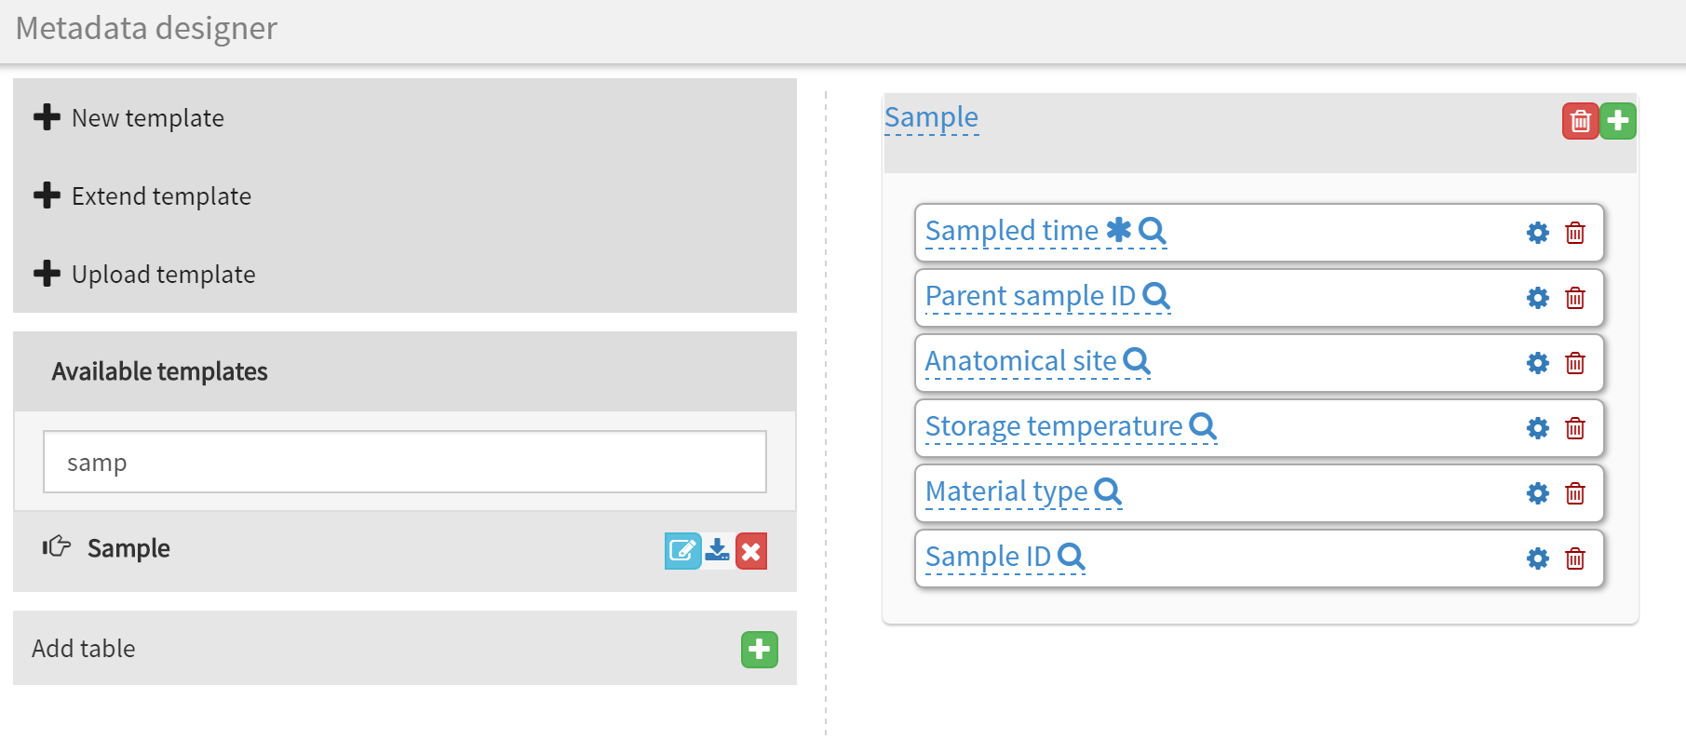
Design your own Extended Metadata

Slide 14
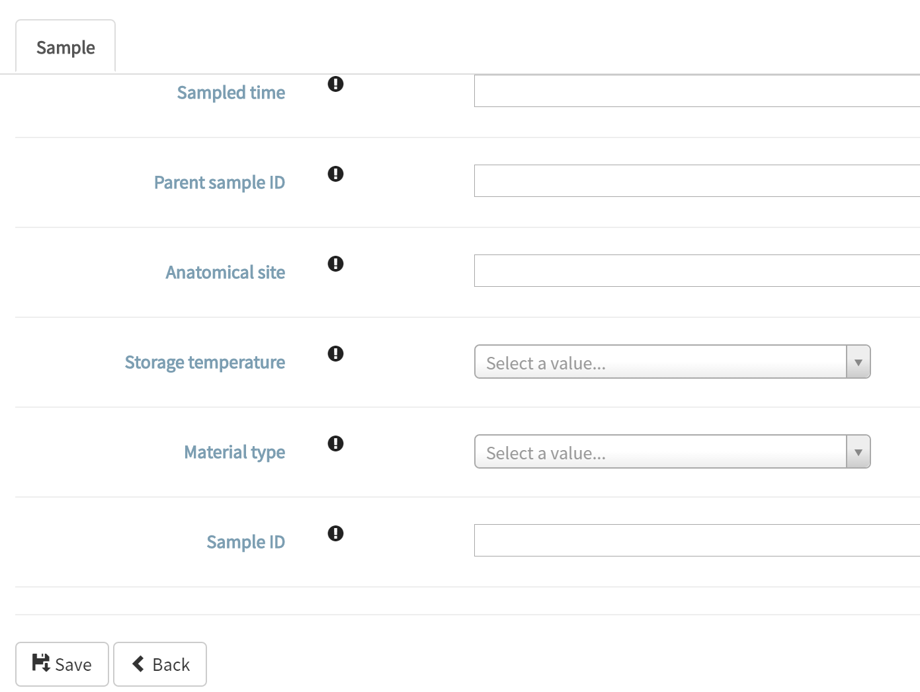
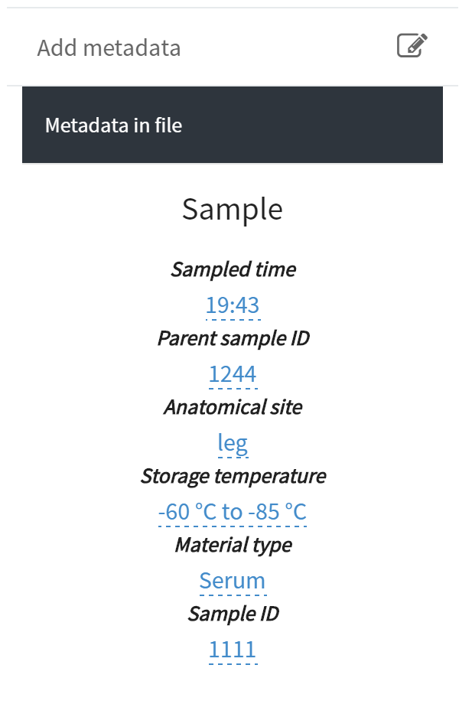
MetaData Entry

Slide 15
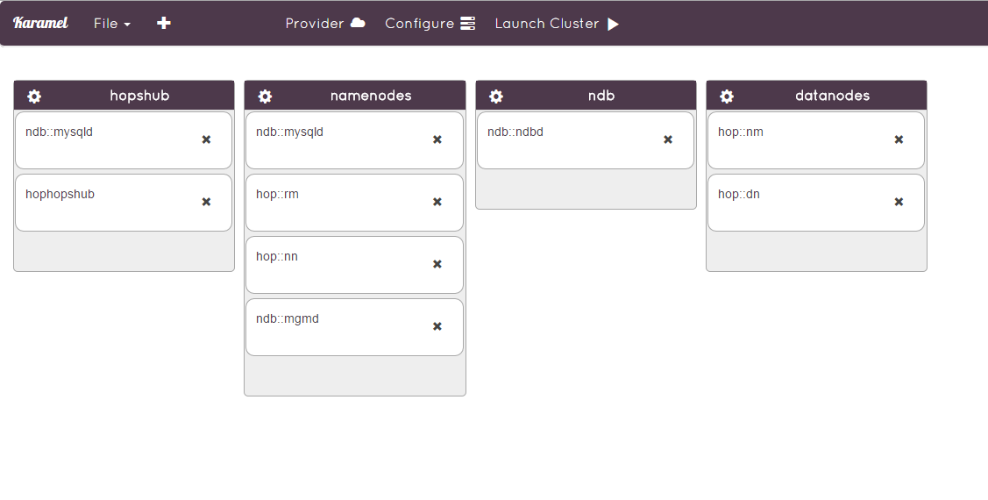
PaaS support with Chef/Karamel
Support for EC2 and Bare Metal.

Slide 16
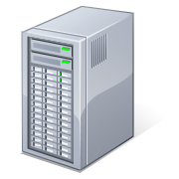
Perimeter Security
Network Isolation
J2EE Web Application Server
Glassfish 4.1.1
Authentication
JDBC Realm
2-Factor Authentication
LDAP
EGI Federated Cloud?
WebApp
Hops
Notes:
Hadoop can run in secure-mode or non-secure mode.
Hadoop contradicted the maxim that security must be designed into a system in its inception.
Perimeter = Network isolation + authentication
Access = permissions + authorization
Visibility = audit log + lineage + provenance
Data = encryption, tokenization, data masking
Multi-tenancy = resource management and access control
4 pillars: Authentication, Authorization, Accounting, Data Protection.
Authentication for REST APIs to Hadoop Services (Apache Shiro)
Multi-cluster support
REST API auditing
Also data governance – compliance adherence.
Cross-site Request Forgery built-in to J2EE
Vulnerability Plugin Filters in Knox

Slide 17
Roadmap for BiobankCloud
In 2015:
Release Documented Workflows
Documentation for User Interface
Documentation for Hadoop Platform
Documentation for Installation
In 2016
Integration with EGI Federated Cloud
Distributed Search among BiobankCloud sites

