Slide 1
The EGI Federated Cloud e-Infrastructure and BBMRI
Enol Fernández
EGI.eu User Community Support Team

Slide 2
EGI Federated Cloud
EGI Federated Cloud is a collaboration of communities developing, innovating, operating and using cloud federations for research and education.
Design (2011-2014)
  Establishment of the FedCloud Task Force
  Collect requirements, architecture design, deploy testbed services to expand EGI compute capabilities
Production (Since May 2014)
  Start of production activity of the Federated Cloud as a a standards-based, open cloud IaaS system
New federation model (2015)
  Expansion of the federation to become a collaboration to enable cloud federations

Slide 3

EGI Federated Cloud Architecture
IaaS
Capabilities
Uniform interfaces and behaviour
Share & endorse
VM images
EGI Cloud Service Providers
Cloud Management Framework
Replicate
VM images
Federation Integration
EGI AppDB
EGI Core Platform
VM Image Catalogue
Operation-Level Federator Services

Slide 4
EGI Cloud Federations
Public Cloud (1)
Community Clouds (n)
Open to any research community, maintained by EGI FC Task Force
Open Standards: use of open standards to implement federation: OCCI, OVF, GLUE2, APEL, (CDMI), … Standards required.
Stronger integration profile: Cloud Computing integrated into the existing production infrastructure.
Available for specific communities, maintained by them
Community choices: Services and APIs to implement federation is community choice.
Standards encouraged.
Looser Federation profile: Based on a subset of EGI components (accounting, monitoring, …)
Notes:
The EGI Cloud is a open hybrid cloud federation
Different levels of federation are possible offering various degrees of interoperability
All cloud providers pooling resources and data in a multi tenant model
Need to adhere to a set of common policies, procedures and processes for federated service management
Can join in by adopting the federation model that provides the interoperability needs of the target groups
Can choose among federated services offered by EGI in a modular way, while still relying on local tools and exposing own service interfaces to the federation, as applicable
Low barriers to join the federation

Slide 5
Public Cloud Architecture
IaaS
Capabilities
OCCI
CDMI
Share & reuse
VM images
EGI Cloud Service Providers
OpenStack
OpenNebula
Synnefo
Replicate
VM images
Federation Integration
EGI AppDB
EGI Core Platform
VM Image Catalogue
AAI
Information discovery
Monitoring
Accounting
Service
Registry

Slide 6
Build a federation of Biobank clouds
EGI and Biobankcloud to create an integrated software package that allows biobanks to deploy in-house clouds
  Biobanks can become data and compute providers in the BBMRI network
EGI to offer IaaS and Federation capabilities
  Using FedCloud and EGI technologies
Biobankcloud to offer PaaS capabilities:
  data discovery, hadoop and other capabilities that are relevant for biobank users

Slide 7
BioBank Cloud
BioBankCloud PaaS
BioBank User
jclouds
IaaS interfaces
BioBank SW providers
Cloud Service Providers
Cloud Management Framework
Federation Integration
EGI AppDB
EGI Core Platform
VM Image Catalogue
Operation-Level Federator Services
Notes:
EGI: Biobanks can deploy VM images from EGI AppDB. These images can be maintained by BBMRI SW providers and can include analysis SW relevant for biobanks. This results harmonised and high quality functions at biobanks. (Need to create a Biobank VO in EGI)
EGI: IaaS cloud operation tools can help biobanks maintain high quality operation of their clouds, and can enable users to obtain an integrated view on resource usage.

Slide 8
IaaS Capabilities
  VMs & Block Storage
  Object Storage
  On demand compute to run any kind of workloads on virtual machines
  Persistent Block Level Storage to attach to VMs
  User control of the computing infrastructure
  OGF OCCI API
  OpenStack Nova API now supported
  Data storage infrastructure for storing and retrieving data from anywhere at any time
  Sharing and serving of data in a scalable infrastructure
  SNIA CDMI API (development in progress)
Notes:
* Biobankcloud: the PaaS can offer data discovery, hadoop and other capabilities that are relvant for biobank users.
- Details on technologies that are relevant for IaaS-PaaS integration (each of these can be also topics of discussion)
* AAI (X509+VOMS)
* AppDB
* Contextualisation and SAs
* OCCI (Compute+Block storage)
* Nova
* CDMI (only in Greece? If so, then better not to count on it)
* BDII (Explosing site-specific capabilities from Biobankcloud?)
* Hadoop on EGI cloud?
... anything else...?

Slide 9
VM Image Catalogue and Management
  VM Image Catalogue
  VM Image Management
  Open Library of Virtual Appliances
  Use on clouds or for personal download
  Re-use, share, associate contextualization
  Software Appliances for describing association of VA and context
  Community curated sets of images
  Automatic and secure distribution of sets to cloud providers
  EGI endorsed set of VM images prepared to run in a cloud in a secure manner

Slide 10
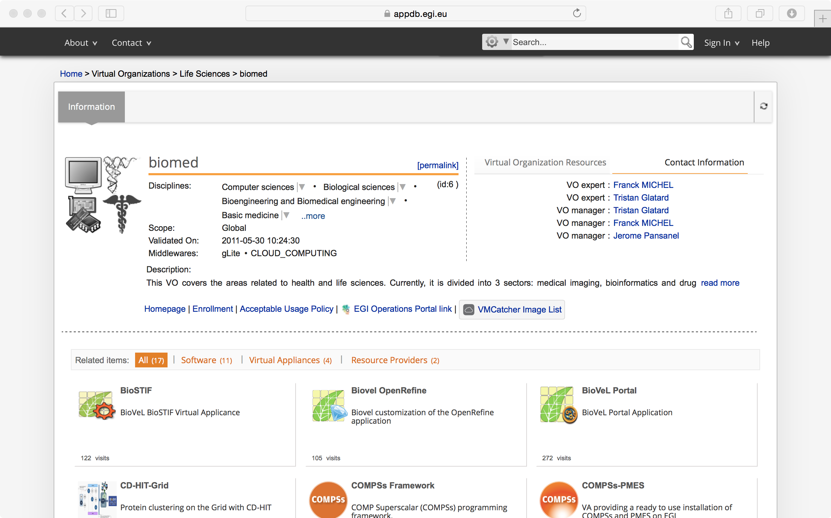
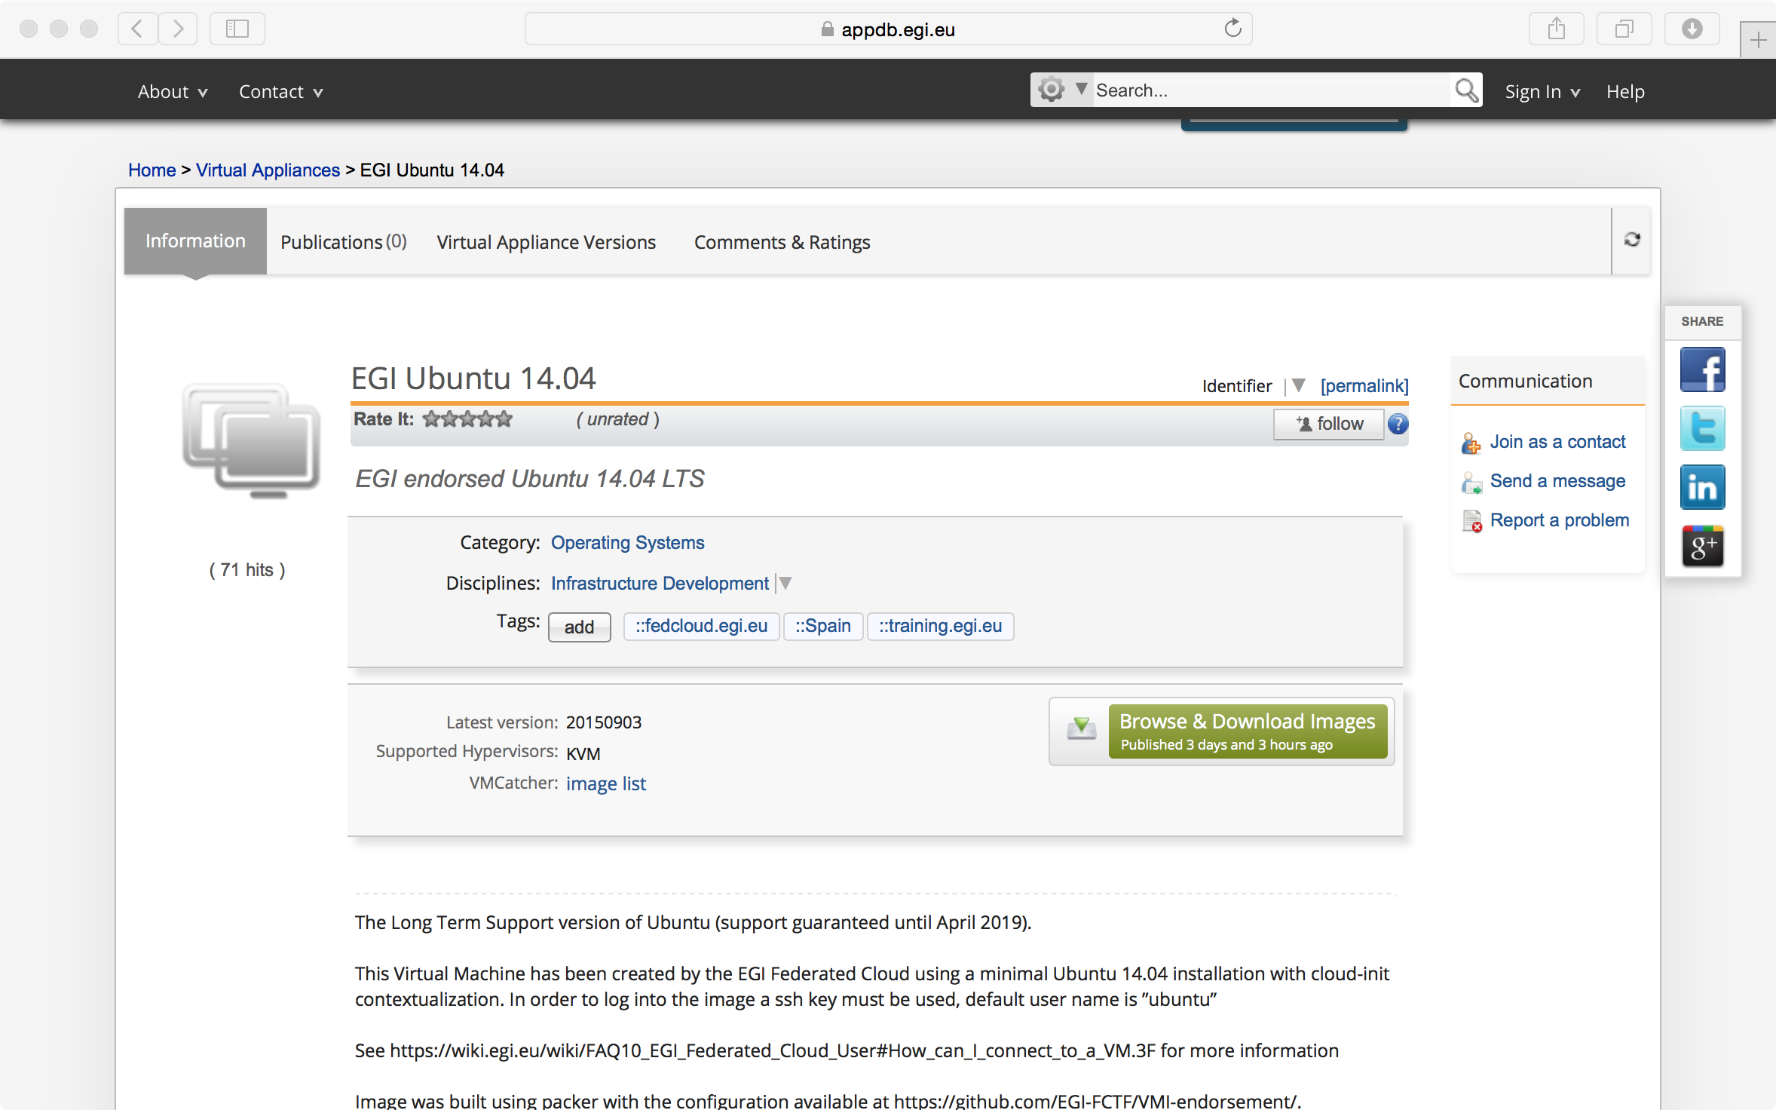
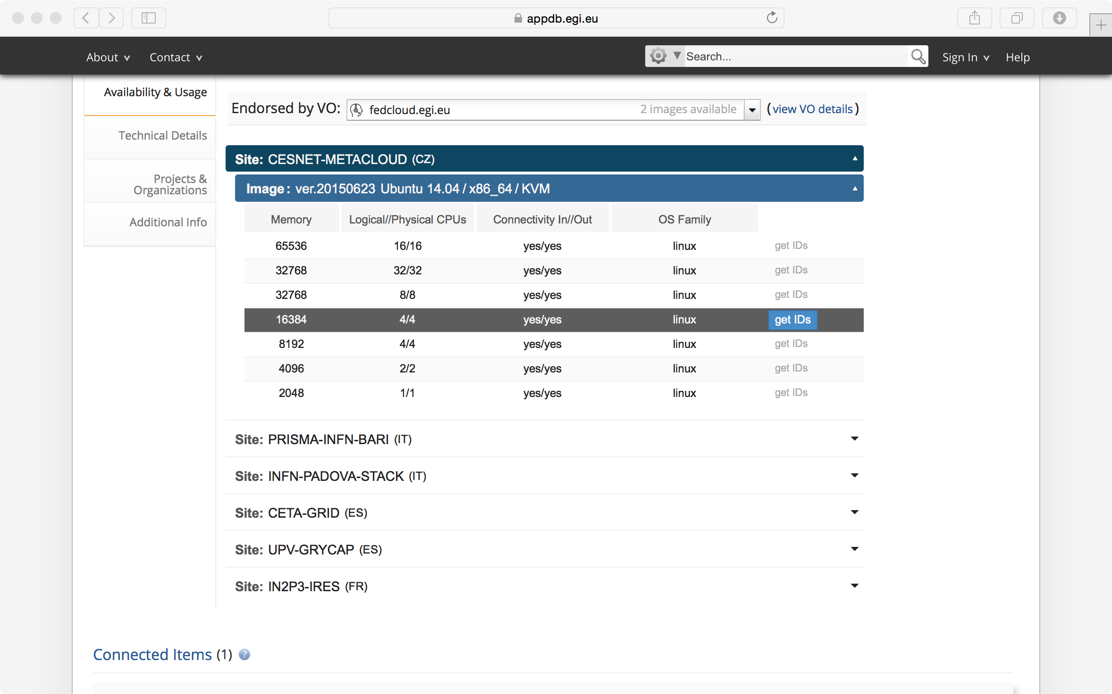
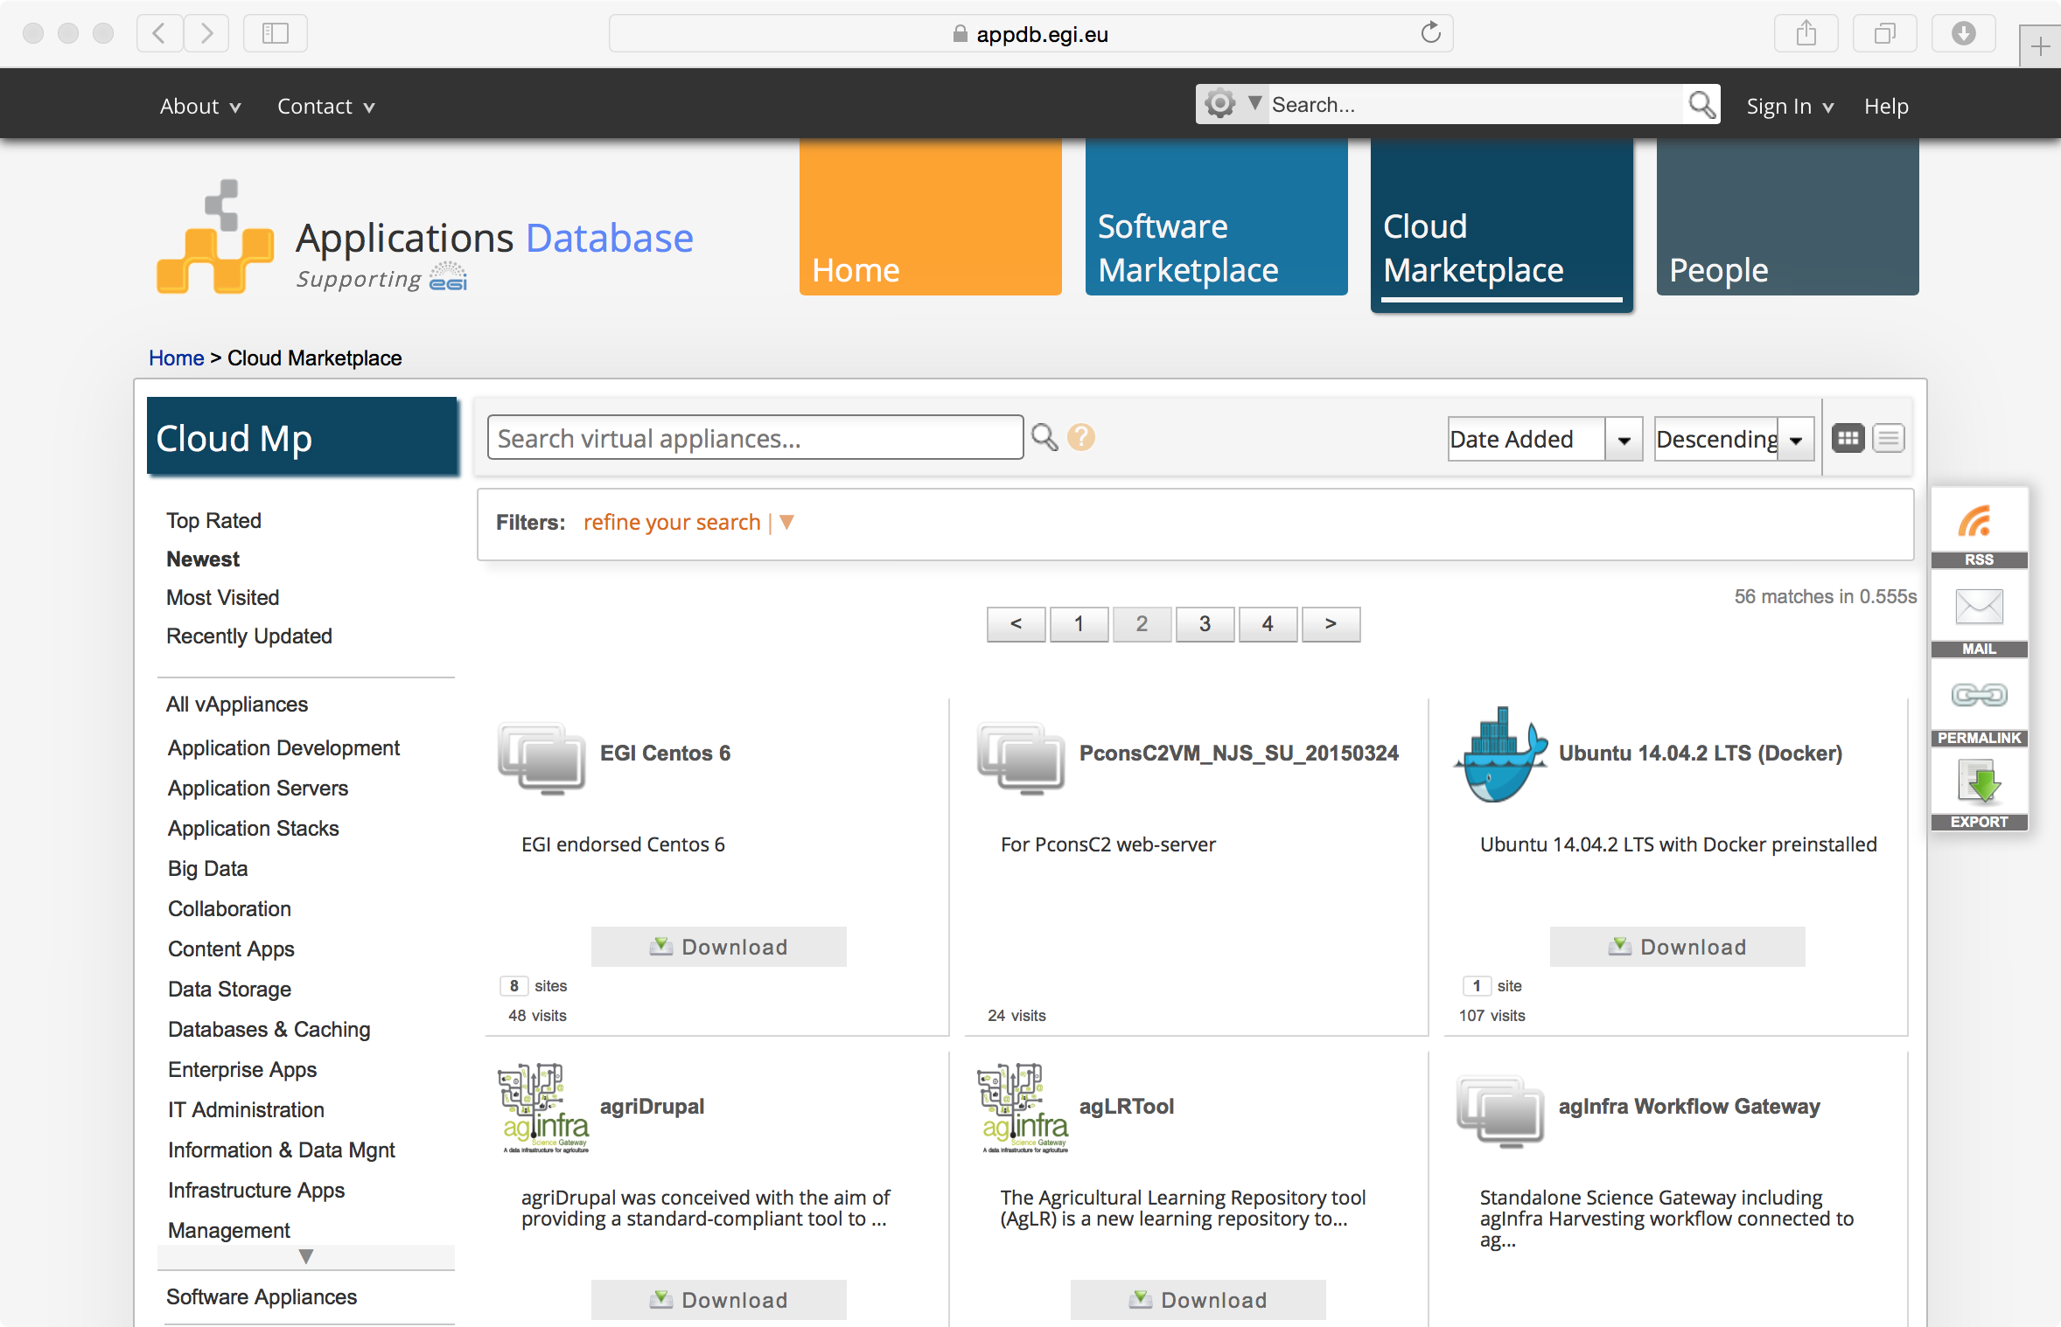
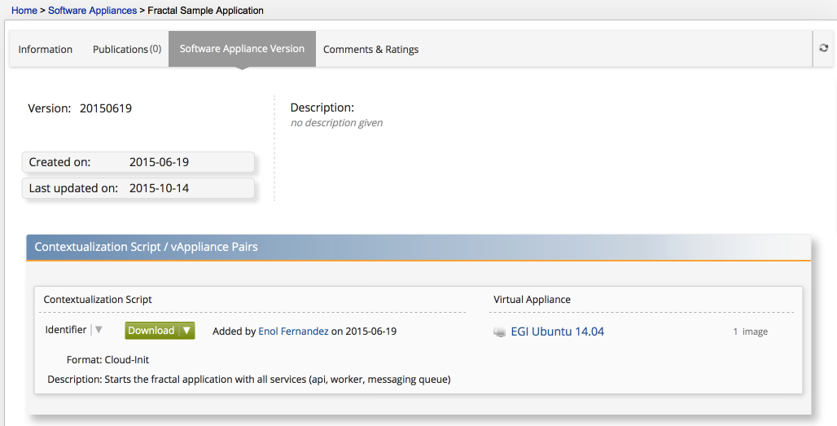
VM Image Catalogue
  Library of Virtual Appliances (bundle of VM images) for use on a cloud or personal download
Community Managed Views
VMI Description
Sofware Appliances
Easily get all the information to instantiate a VM

Slide 11
Federation Services
  AAI
  IGTF Federation with X509 certificates + VOMS extensions
  Credential translation for other IdP federations
  Accounting
  Collect, aggregate and display usage information across the whole federation.
  OGF Usage Record extended for Cloud
  Service Registry
  Central service catalogue with static information
  Web interface + API
  Information Discovery
  Real-time view of the actual capabilities of the federation
  OGF GlueSchema 2
  Availability Monitoring
  Health monitoring of services
  A/R metrics for SLA/OLAs

Slide 12

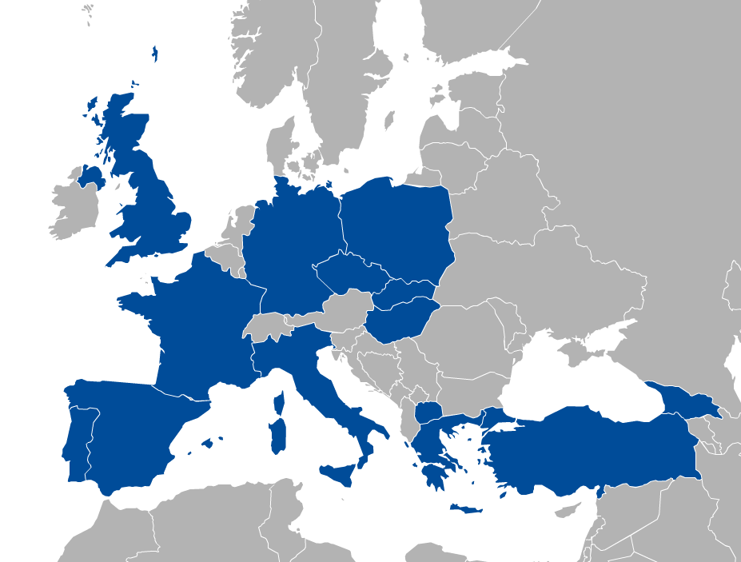
















FedCloud: the infrastructure
Production operations since May 2014
Currently:
21 providers from 14 NGIs
6.000 cores in total
700k VMs, 9M CPUh in last 12 months

Slide 13
Beyond IaaS
EGI FedCloud capabilities focus on IaaS
But open to external developments to provide PaaS/SaaS
  Hide IaaS complexity, provide higher level programming models
  FedCloud task force evaluates tools and offers them to support new use cases when they fit
Hadoop deployments tested by several FedCloud members

Slide 14
EGI Federated Cloud Evolution
EGI Federated Cloud keeps evolving:
  Docker Support (2015 Q4)
  Enable certificate-less access for users and system administrators (2015 Q4)
  Management of VMs from AppDB (2016-17)
  Create VM snapshots, resize VMs, migrate VMs with OCCI (2016)
Community specific service developments (PaaS/SaaS):
  for Competence Centers (ELIXIR, BBMRI, MoBRAIN, …)
  for HumanBranProject, Marine and Fisheries, CANFAR, …

Slide 15
References
FedCloud entry point: http://go.egi.eu/fedcloud
User support: https://wiki.egi.eu/wiki/Federated_Cloud_user_support
Federated Cloud Communities: https://wiki.egi.eu/wiki/Federated_Cloud_Communities
User support e-mail: support@egi.eu

Slide 16
