Slide 1
Deploying BiobankCloud with Karamel/Chef and Federated Authentication in BiobankCloud
Jim Dowling, KTH – Royal Institute of Technology
Notes:
genome-wide association study

Slide 2
Bringing together Biobankers & Bioinformaticians
Biobankers
NGS data producers
Collections, samples
Non-programmers
Bioinformaticians
NGS data analysts
Programmers
Python, R, Matlab, scripts
Web Application
Cuneiform/HiWAY
IT
Admins
Karamel
Hops-YARN
CharonFS
Hops-HDFS

Slide 3
BBC platforms have lots of different stacks*
ResourceMgr
NodeMgr
MYSQLD
NN
DN
NDBD
MGMD
ssh, agent, chef, collectd
ssh, agent, chef, collectd
ssh, agent, chef, collectd
ssh, agent, chef, collectd
*Configured stacks include apps, dependencies, and firewalls.
Notes:
U could add HBASE, Pig, HIVE

Slide 4
Plus the Frontend Stack
AngularJS Frontend
REST APIs
Web Application
Glassfish
collectd-server

Slide 5
How do we deploy our PaaS?
Data Center
NDBD
NDBD
MGMD
Works
NN
NN
DN
DN
DN

Slide 6
Deployment on AWS from Karamel using Ssh/Chef
Public Cloud (AWS)
NDBD
NDBD
MGMD
DashB
NN
NN
DN
DN
DN

Slide 7
Deployment when few public IPs available
Private Cloud (OpenStack)
NDBD
NDBD
MGMD
Karamel
NN
NN
DN
DN
DN

Slide 8
How do we install the software on the VMs?

Slide 9
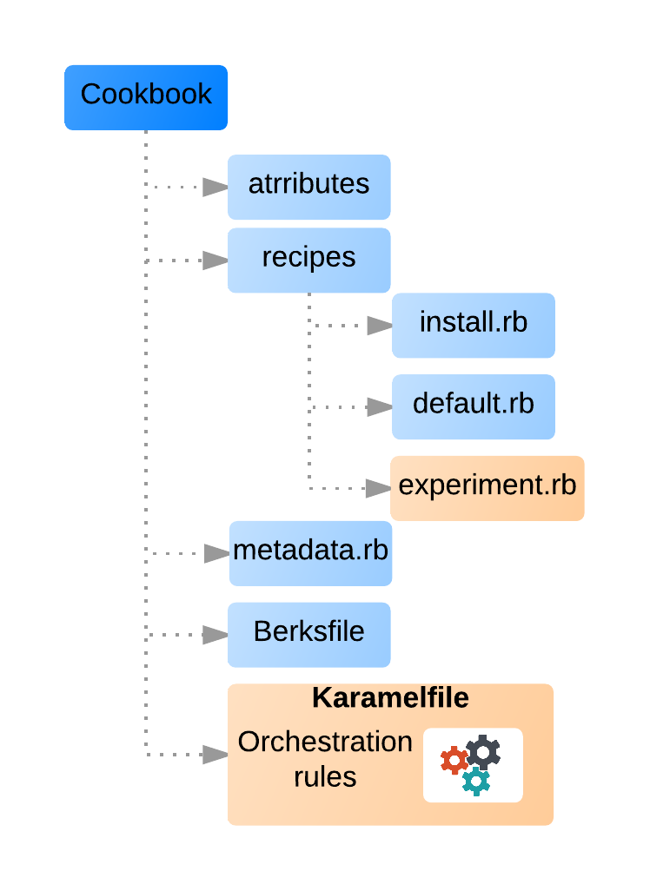
Karamel Layers
Virtual Machines
Google Compute Engine
Software is defined in Chef
Chef Cookbooks are publicly available in Github

Slide 10
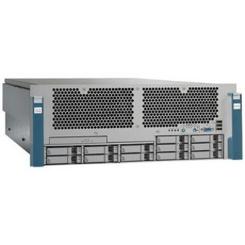
Ssh and Chef Solo to Install software
Karamel
Dependency Injection of Attributes (No Server or agents)
Recipes
Chef Recipes are infrastructure
as code: idempotent & composable
Recipes
Recipes
ResourceMgr
ssh
ssh
ssh
NodeMgr
MYSQLD
NN
DN
MGMD
ssh, agent, chef, collectd
ssh, agent, chef, collectd
ssh, agent, chef, collectd

Slide 11
Karamel Stack
Karamel API (YAML)
Chef
VMIs
JClouds
BitTorrent
ssh
Create VMs
Reduce Install Times
AWS
GCE
EGI
OpenStack
Bare Metal

Slide 12
Cluster Definition in Karamel
name: ApacheHadoopV2
ec2:
type: m3.medium
region: eu-west-1
cookbooks:
hadoop:
github: "hopshadoop/apache-hadoop-chef" version: "v0.1"
attrs: hadoop: version: 2.7.1
groups:
metadata:
size: 1
recipes:
- hadoop::nn
- hadoop::rm
- hadoop::jhs
datanodes:
size: 2
recipes:
- hadoop::dn
- hadoop::nm
egi:
XX: ??
YY: ??

Slide 13
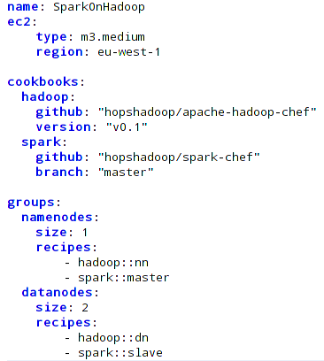
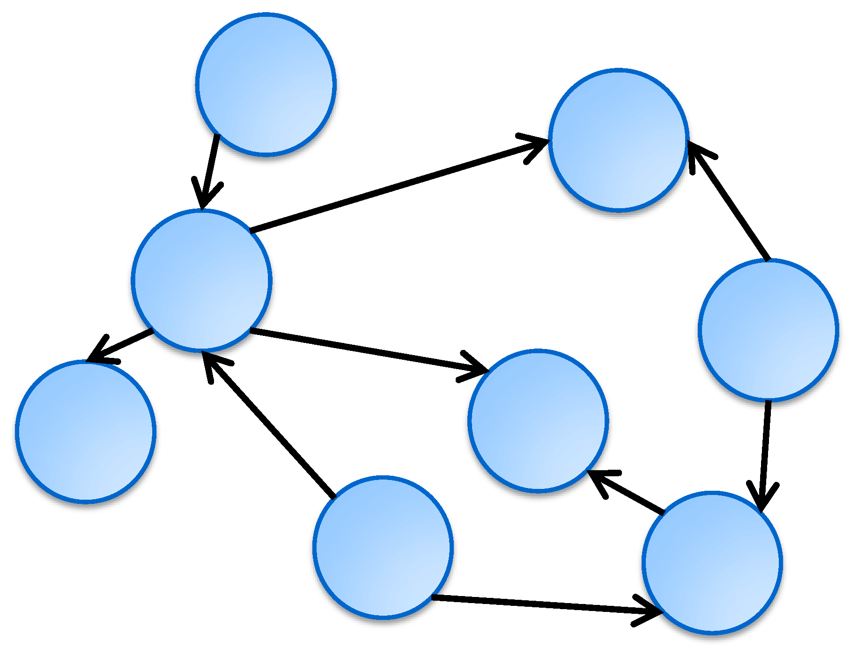
Orchestration of Deployments
DSL Service
Physical Mapping
Cloud Clients
Karamel Engine
Orchestrator

Slide 14
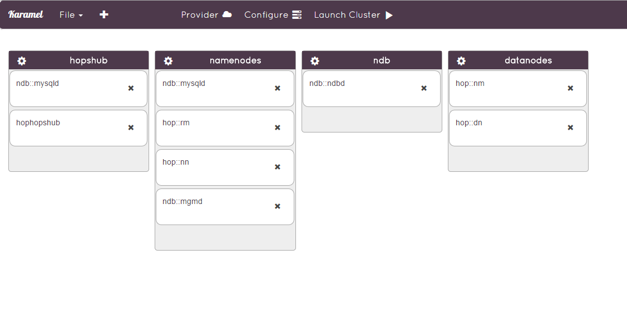
Karamel FrontEnd

Slide 15
Jclouds/Chef in the Wild
Node provisioning can fail for a variety of reasons.
Stragglers will appear as clusters grow in size.
Rate Limiting on (with low defaults) the number of concurrent operations that can be issued to AWS, OpenStack, etc.
Notes:
Basically, the same problems MapReduce in scheduling tasks.

Slide 16
Karamel Scheduler
Builds a Directed Acyclic Graph of Chef Recipes
Scheduler executes Chef recipes as a series of phases
Chef recipes are decomposed into the following phases: install, <service>
Respawn & provision failed and slow VMs.
Strategies for handling rate-limiting clouds.
Automatic retry for failed Chef Recipes
Notes:
Create security groups
Create nodes
BitTorrent
Install
Configure

Slide 17
Related Work
Virtualization and Hadoop
Project Serengeti (VMWare)
Project Savanna (Hortonworks & OpenStack)
Elastic MapReduce (Amazon Web Services)
Administration of Hadoop Clusters
Cloudera Manager with Puppet
Hortonworks Ambari with Puppet
AWS OpsWorks
OpenStack Heat
Docker Swarm

Slide 18
BiobankCloud Federation

Slide 19
Connecting Biobanks
Biobank
Meta-Data
Sample Availability Data
Omics Data (Big Data)
Biobank
Biobank
Biobank

Slide 20
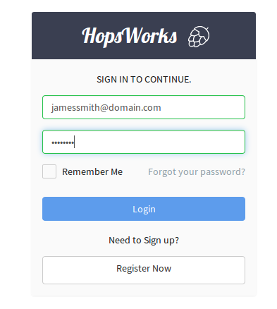
Authentication
Authentication Provider
JDBC Realm
2-Factor Authentication
LDAP
EGI as Federated Authentication Provider

