Slide 1
Introduction to EGI
Diego Scardaci
diego.scardaci@egi.eu
Technical Outreach Expert
(EGI User Community Support Team)

Slide 2
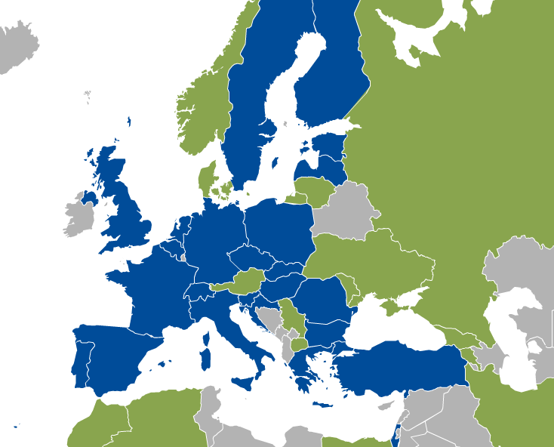
EGI.eu and its participants - 2015
26 participants: 24 NGIs and 2 EIROs (CERN, EMBL-EBI)
  Opening membership to research communities
  Opening membership to non-European countries
Affiliation programme
  Lower barriers of entry to widening countries
EGI.eu in Amsterdam
Participants
CERN, EMBL-EBI, Belgium, Bulgaria, Croatia, Czech Republic,
Estonia, Finland, France, Germany, Greece, Hungary, Israel, Italy,
FYR of Macedonia, Netherlands, Poland, Portugal, Romania,
Slovakia, Slovenia, Spain, Switzerland, Sweden, Turkey, UK
Under discussion
Armenia, Austria, Belarus,
Denmark, Moldova,
Norway, Russia, Ukraine
Notes:
E-Infrastructures are geographically distributed computing resources and data storage facilities linked by high-performance networks. They allow scientists to share information securely, analyse data efficiently and collaborate with colleagues worldwide. They are an essential part of modern scientific research and a driver for economic growth.
The European Grid Infrastructure (EGI) was established in 2010 building on over a decade of investment by national governments and the European Commission. EGI is a European-wide federation of national computing and data storage resources. Its aim is to support cutting-edge research, innovation and knowledge transfer in Europe. EGI federates resources from various resource centres, mainly from research insitututes and universities. These centres provide computer clusters, storage servers, applications and human support services for secure access and sharing. EGI provides these services to European researchers and their international collaborators.
EGI is coordinated by EGI.eu, a not-for-profit foundation based in Amsterdam and owned by EGI’s participants, the National Grid Infrastructures (NGIs).

Slide 3
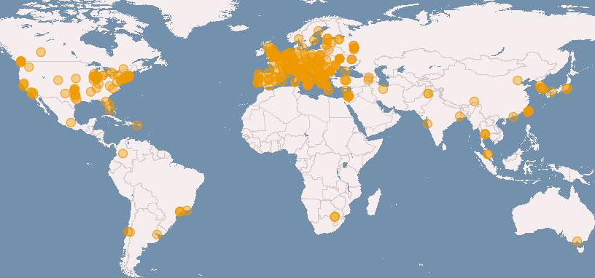








Enabling Global Infrastructures
Community SLAs
Provider OLAs
Distributed, federated storage and compute facilities
Compute platforms (Grid, Cloud)
Virtual Research Environments
> 200 user research projects
Total capacity (grid + cloud):
340 resource centres in 54 countries
550,000 logical CPU cores
290 PB disk, 180 PB tape
.
.
.
Notes:
SLA – Service Level Agreement
OLA – Operation Level Agreement
Grid vs cloud → highlight differences

Slide 4
EGI Technology
(focused on cloud)

Slide 5
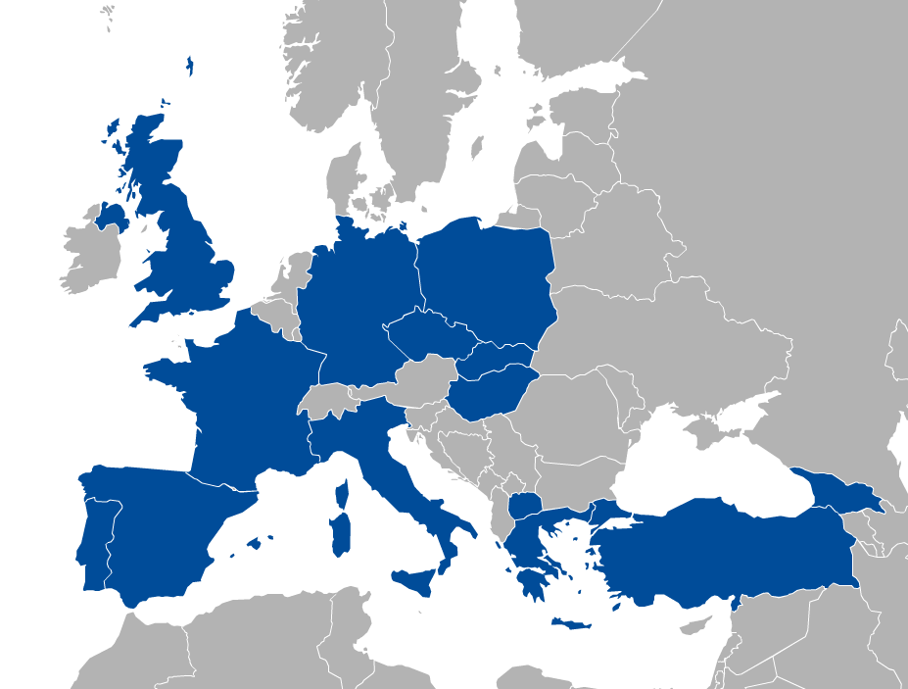

















EGI Federated cloud
Notes:
Development started in 2011
Production operations since May 2014
21 providers from 14 NGIs

Slide 6



Architecture of the EGI Federated Cloud
Manage
instances
Uniform interfaces and behaviour
Share & endorse
VM images (OVF)
Cloud Site
(OpenStack)
Cloud Site
(OpenNebula)
Cloud Site
(Synnefo)
Image
replication
Cloud Providers
VM
image
VM
image
VM
image
Endorsed VM images
Operation-level Federator Services
Appliances Marketplace (AppDB)
EGI Core Platform

Slide 7
Typical Usage Models
Service Hosting
  Long-running services (e.g. web, database or application servers)
Compute and data intensive workloads
  Batch and interactive computing with scalable and customized environments
Datasets repository
  Store and manage large datasets for your applications
Disposable and testing environments
  Hosting for demos, trainings, tests with minimal overhead

Slide 8
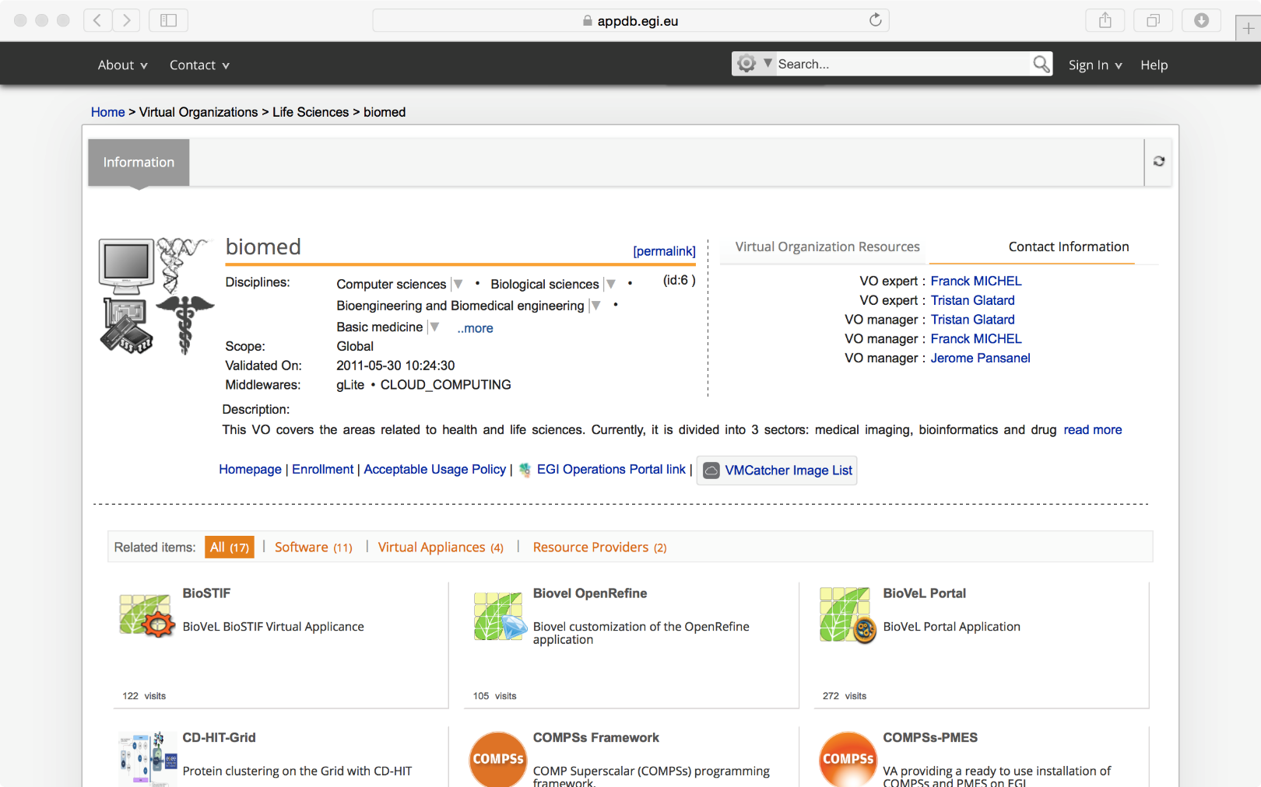
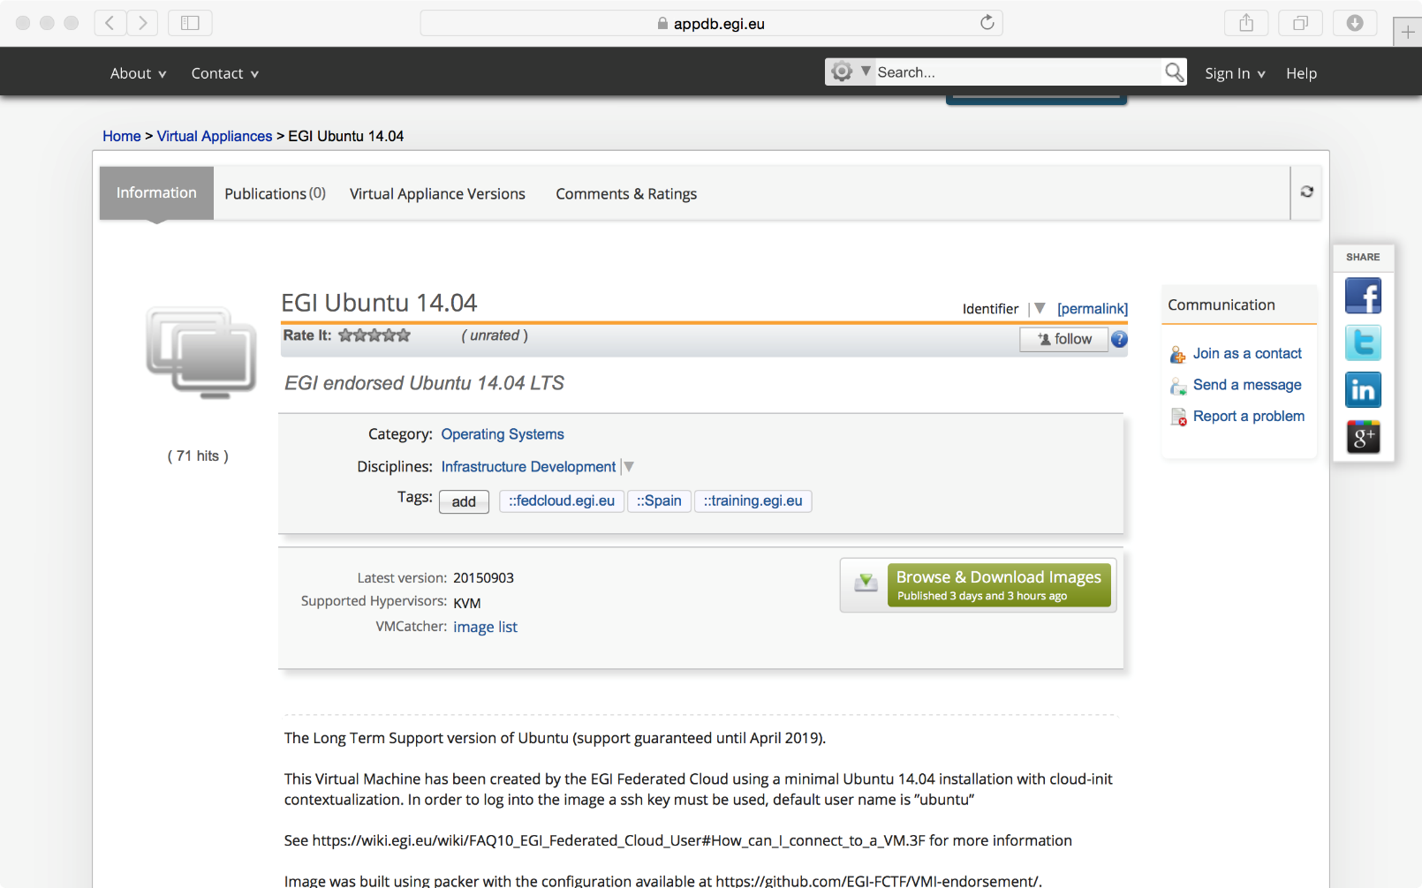
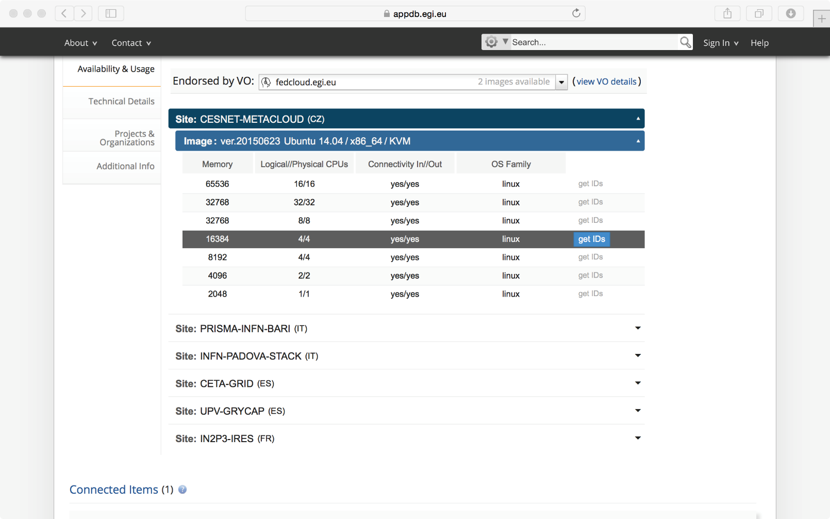
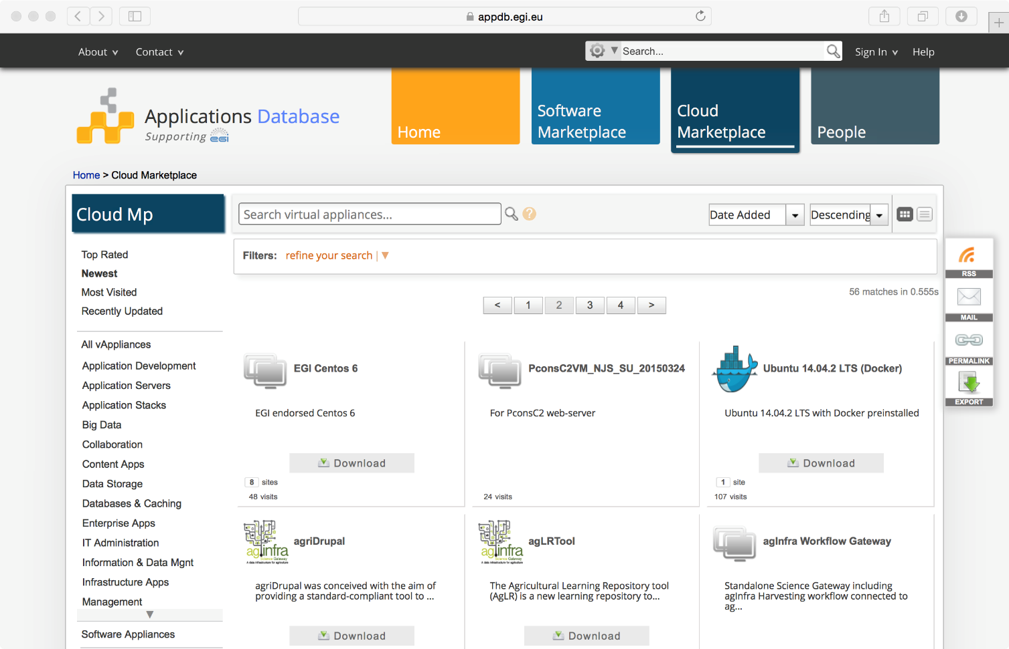
VM Image Catalogue
  Library of Virtual Appliances (bundle of VM images) for use on a cloud or personal download
Community Managed Views
VMI Description
Easily get all the information to instantiate a VM

Slide 9
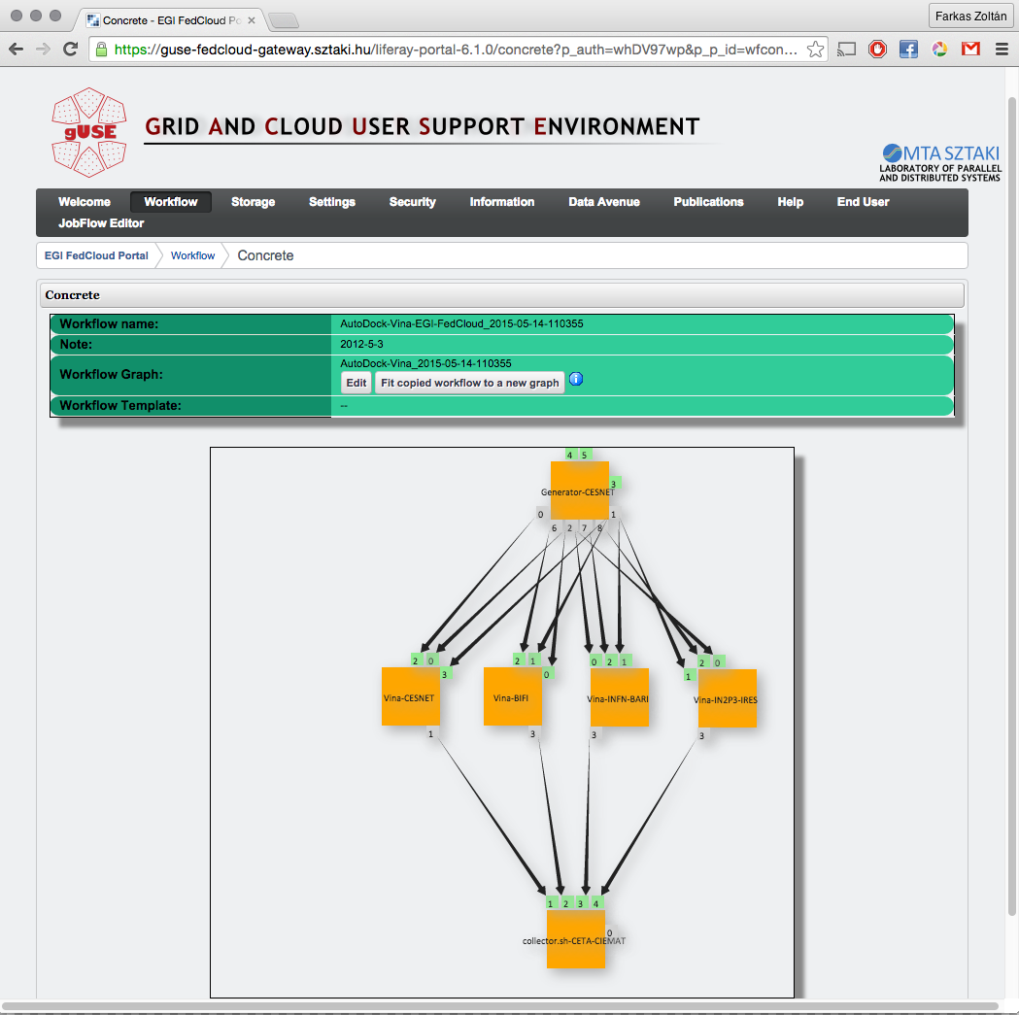
Frameworks for building VRCs
IaaS support with OCCI
  CLI, Ruby, Java SDK
AppDB
  Web GUI + RESTFUL APIs
Several tools extend the Iaas capabilities of the EGI cloud (PaaS/SaaS):
  External contributions (→ support for other clouds too
  Manage workflows of VMs and full VM lifecycle support
  E.g.: CSGF, VMDirac, WS-PGRADE, COMSs, SlipStream
A compute-intensive workflow in WS-PGRADE on the EGI cloud
http://sourceforge.net/projects/guse/

Slide 10
EGI Federated Cloud Evolution
EGI Federated Cloud keeps evolving:
  Docker Support (2015 Q4)
  Enable certificate-less access for users and system administrators (2015 Q4)
  Create VM snapshots, resize VMs, migrate VMs with OCCI (2016)
  Management of VMs from AppDB (2016-17)
Community specific service developments (PaaS/SaaS):
  for Competence Centers (ELIXIR, BBMRI, MoBRAIN, …)
  for HumanBranProject, Marine and Fisheries, CANFAR, …
  for ESA Thematic Exploitation Platforms (TEPs)

Slide 11
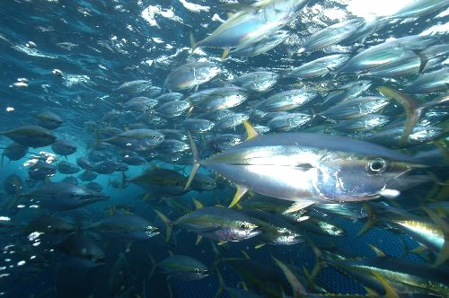
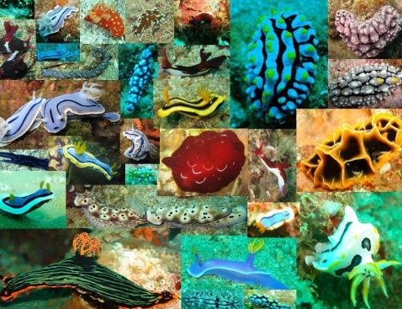
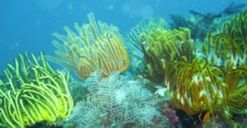
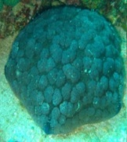
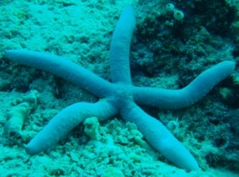
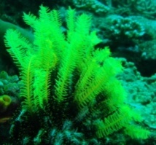
iMarine
Nov 2011
Sept 2014
Apr 2016
Launch an Initiative aimed at establishing and operating a data Infrastructure supporting the principles of the
Ecosystem Approach
to Fisheries Management and Conservation of Marine Living Resources
Notes:
“The Ecosystem Approach is a strategy for the integrated management of land, water and living resources that promotes conservation and sustainable use in an equitable way”

Slide 12


Address system harmonization
Open Source software
Open SDMX - CLM
Niche modelling algorithms
GBIF
Geo-Processing services
EoL
MyOcean
Taxonomy
WORMS
VLIZ
Ocean environment
T2
SeaDatanet
Emodnet Biology
OBIS
IOC
DwC
OGC
Other sources
RDF
SDMX
Policy fmk
FLUX std
Aquamaps
NEAFC
FIN
FishBase
DG-MARE
National DOF
CRIA
ESTAT
RDB
IRD
ICES
FAO
Ecoscope
FIGIS
Courtesy by Marc Taconet (FAO)
Biodiversity
Fisheries
Notes:
Agreeing on “iMarine” standards
OGC, Darwin Core, SDMX, RDF
Includes promotion of new standard (e.g. FLUX)
Identifying:
common requirements, generic solutions
roles in distributed infrastructure
Mainstreaming requirements and specifications
In the Biodiversity realm, everything is transformed through DC
iMarine is able to make available all these resources together and through a unique data set representation

Slide 13
Practical Examples
Geospatial Analysis
Ecology
Biodiversity
Life History Traits

Slide 14
Conclusions
EGI is a federation of national entities that operates an e-Infrastructure for e-Science
  340 resource centres in 54 countries
  550,000 logical CPU cores
  290 PB disk, 180 PB tape
iMarine use case:
  Integration in the EGI Federated Cloud
The EGI Federated Cloud is offering new to exploit the EGI infrastructure
  Service Hosting, Interactive computing, etc.

Slide 15
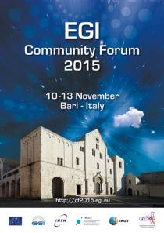
http://cf2015.egi.eu

