Slide 1
EGI FedCloud User Support coordination meeting
Diego Scardaci - EGI.eu/INFN
Technical Outreach Expert

Slide 2
Outline
Tutorial @ EGI CF 2015
OpenStack native interface
BILS SLA
LToS platform
AOB

Slide 3
Tutorials @ EGI CF 2015
Good participation to all tutorials
Training infrastructure

Slide 4
OpenStack Native Interface
First tests to support Horizon
Probe for SWIFT almost ready

Slide 5
BILS SLA
172 CPU Cores, 400 GB of RAM, 8 TB of storage
PRISMA-INFN-BARI (pledged resources)
TR-FC1-ULAKBIM (pledged resources)
IN2P3-IRES (opportunistic)
A/R: 95%/95%
SLA valid for 2 years

Slide 6
Accessing services by individual users – an example: EGI Platform for the long-tail of science. Pilot access: http://access.egi.eu
International resource pool with easy-to-use science gateway environments
Zero-barrier access for users (Facebook, Google, EGI SSO)
Extendible platform:
Join with an environment!
Join with a cloud or HTC cluster!
Science gateway
Science gateway
…
Resource pool with clouds and HTC clusters
User Registration Portal
Users
Science gateway
Science gateway
…
BEST DEMO
Support team
EGI Community Forum 2015, Bari

Slide 7
Front page: http://access.egi.eu

Slide 8
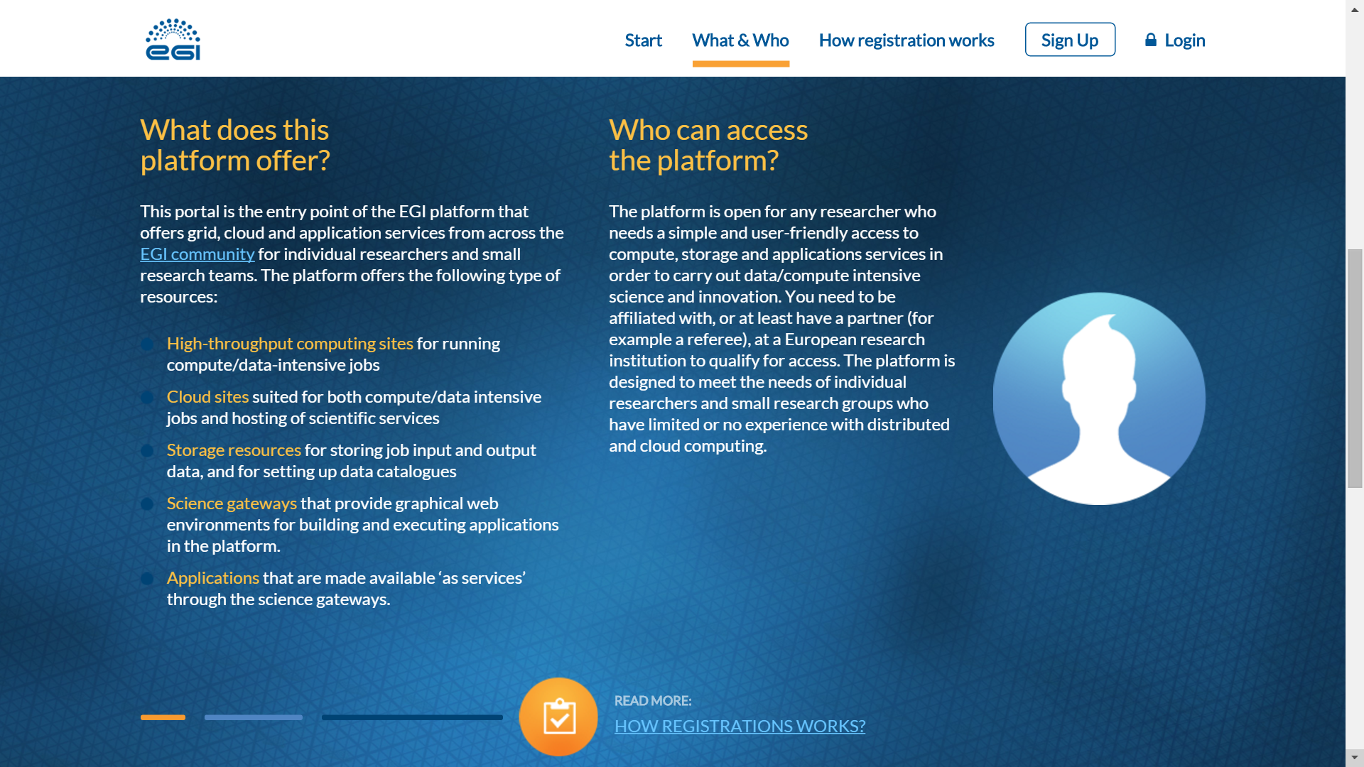
Front page

Slide 9
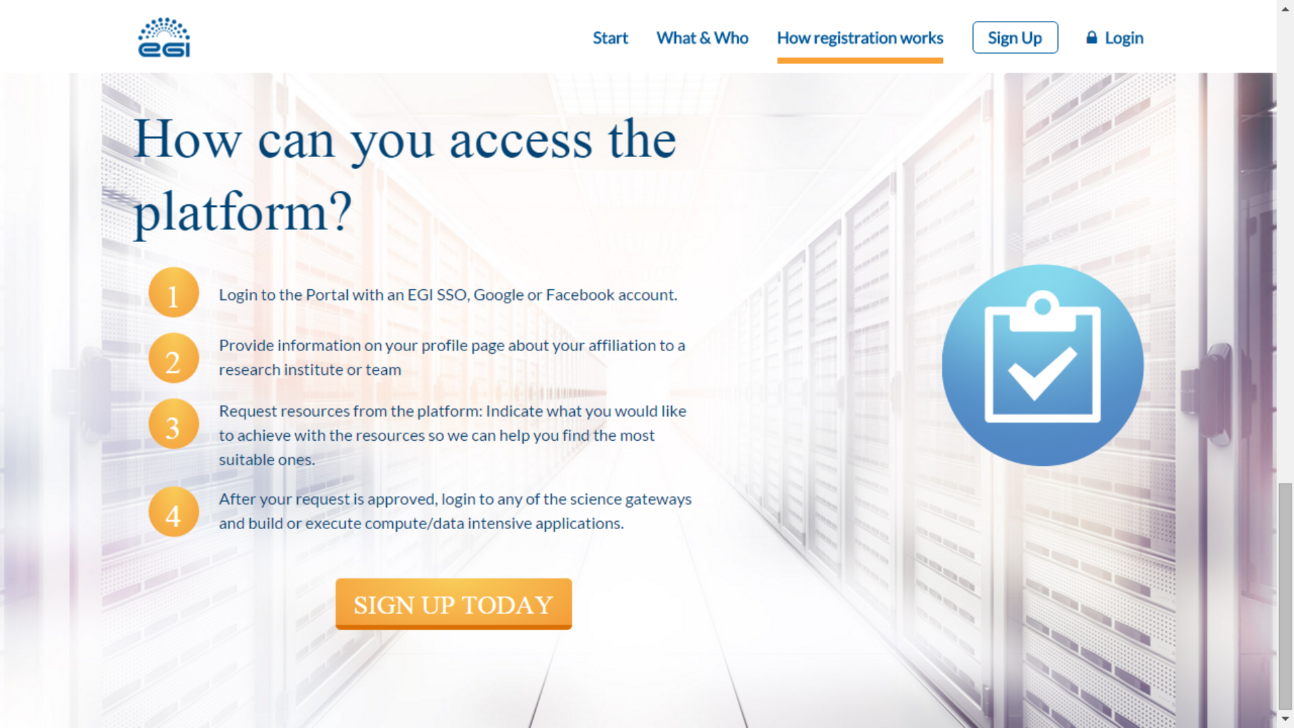
Front page

Slide 10
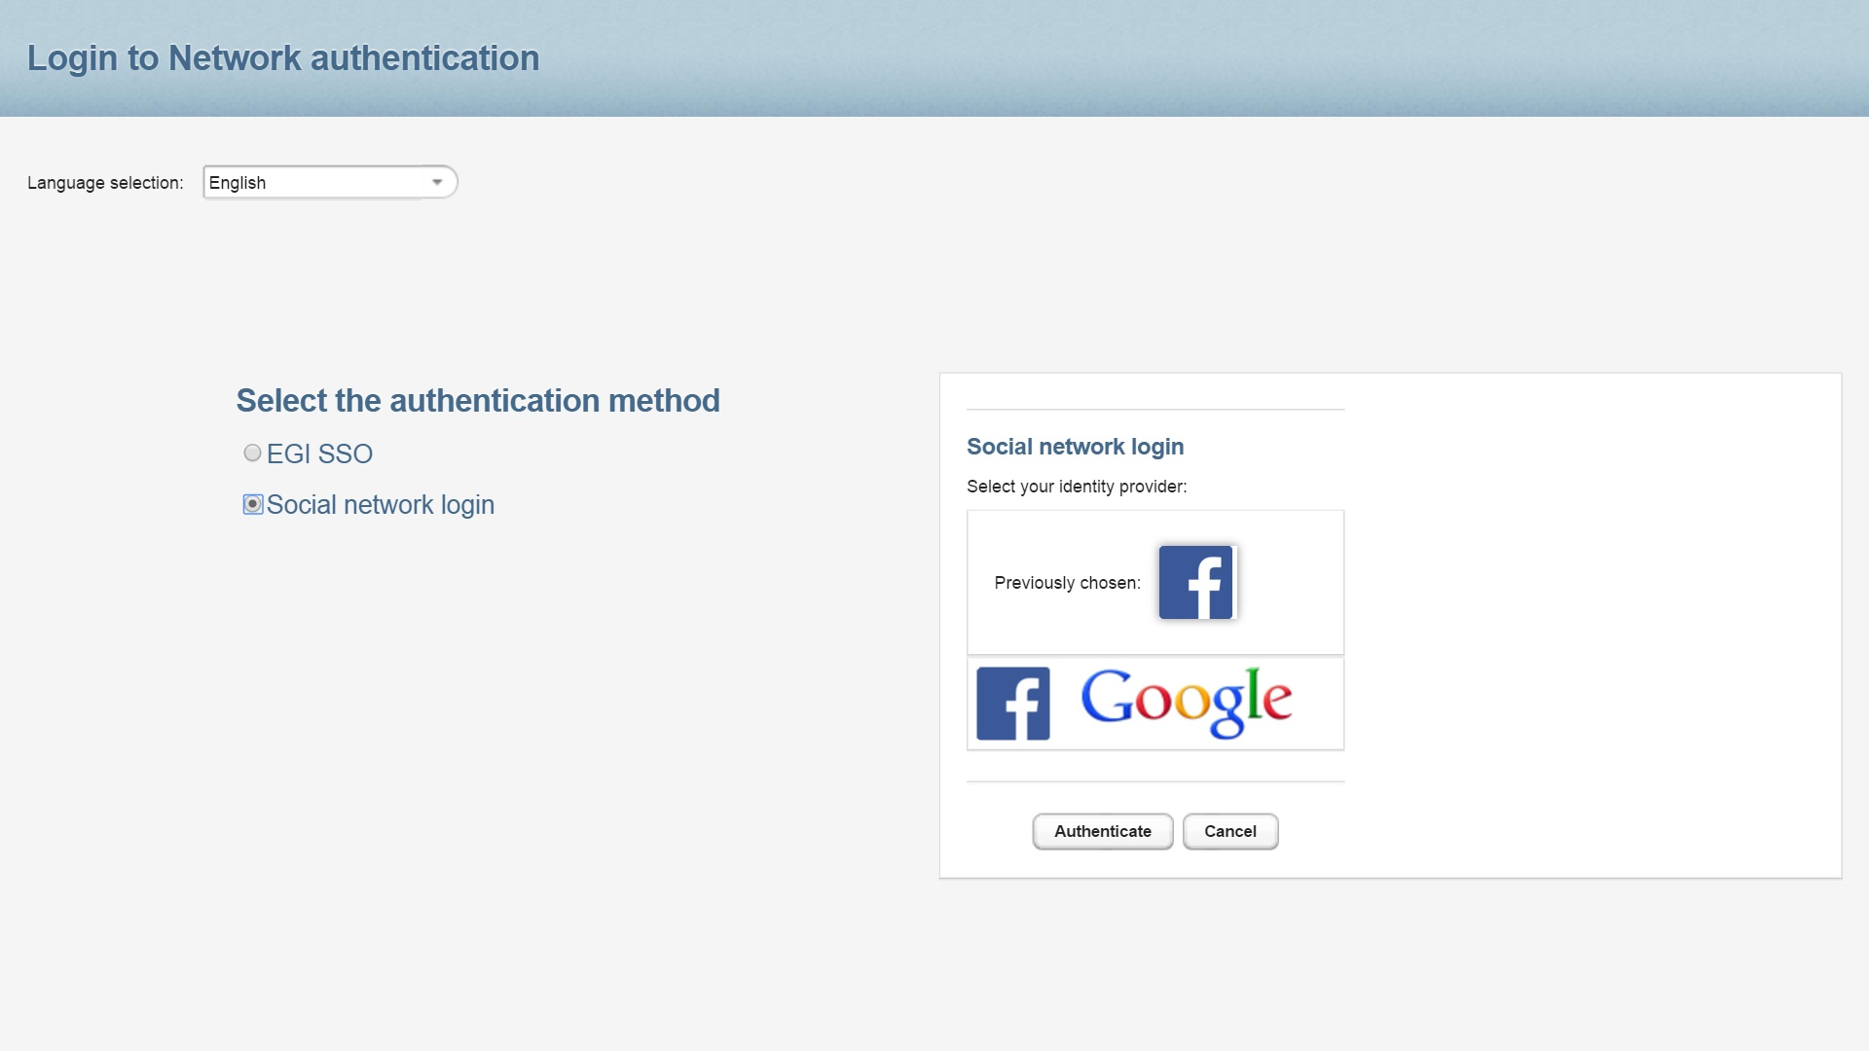
Login page

Slide 11
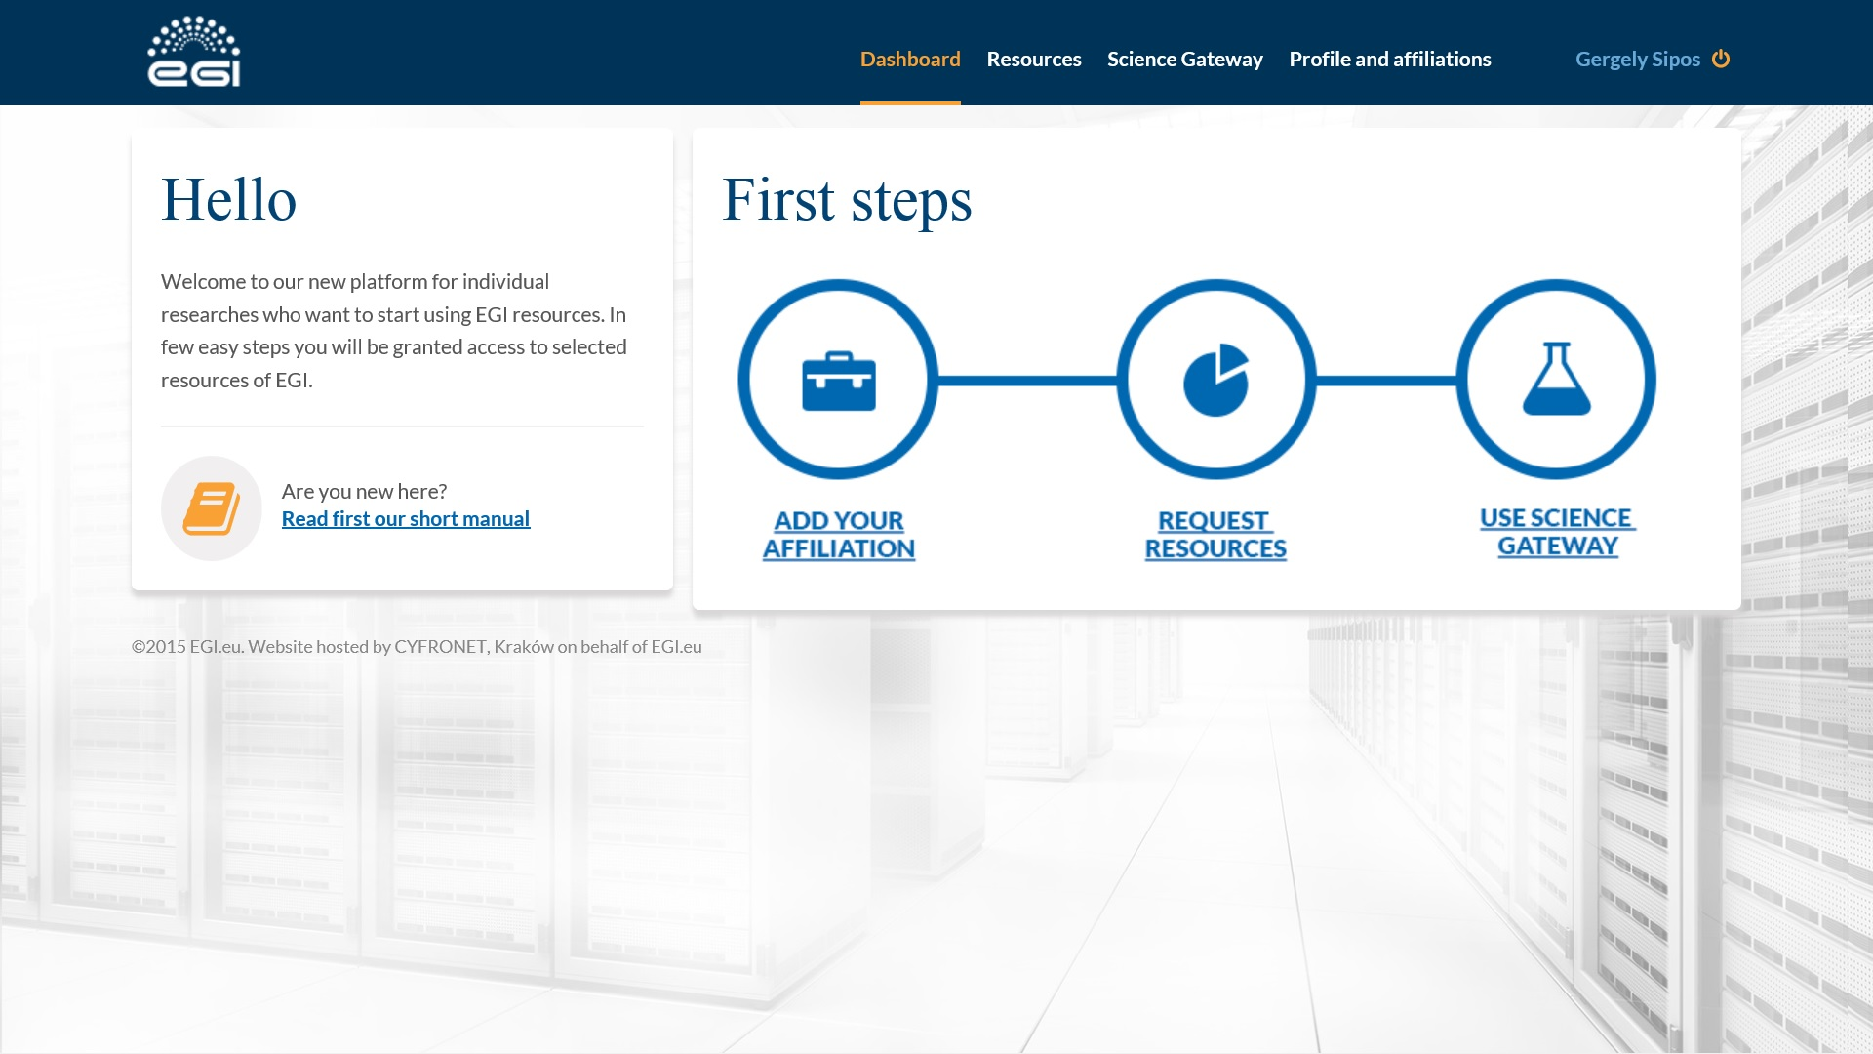
User ‘dashboard’ with 3-step process

Slide 12
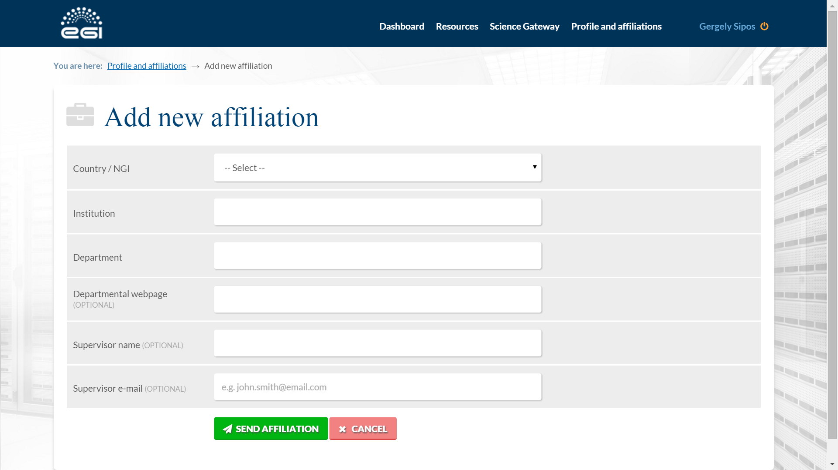
Step 1: Add affiliation

Slide 13
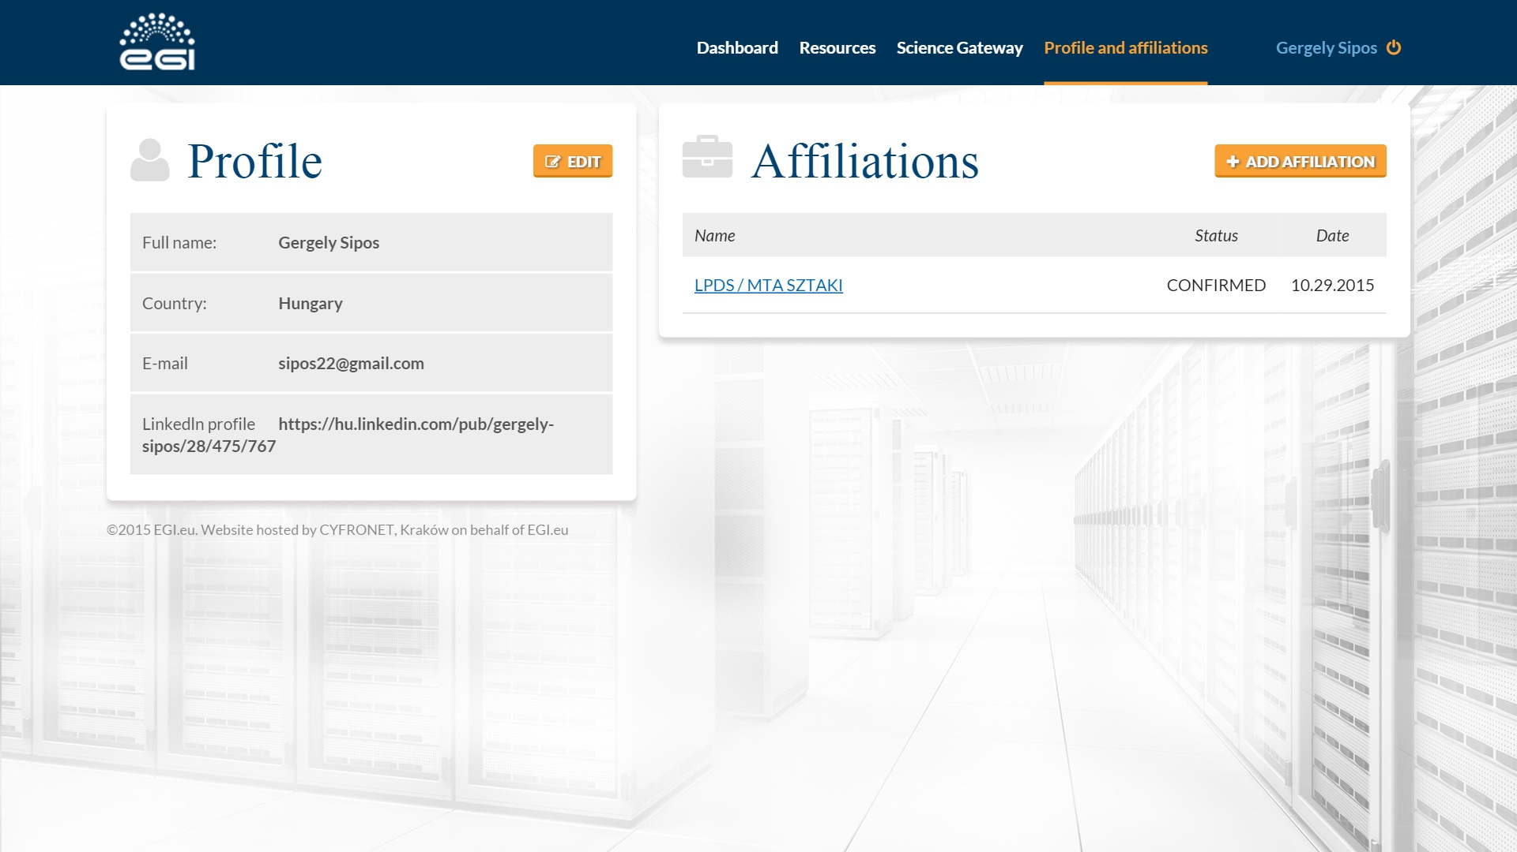
Step 1: Add affiliation

Slide 14
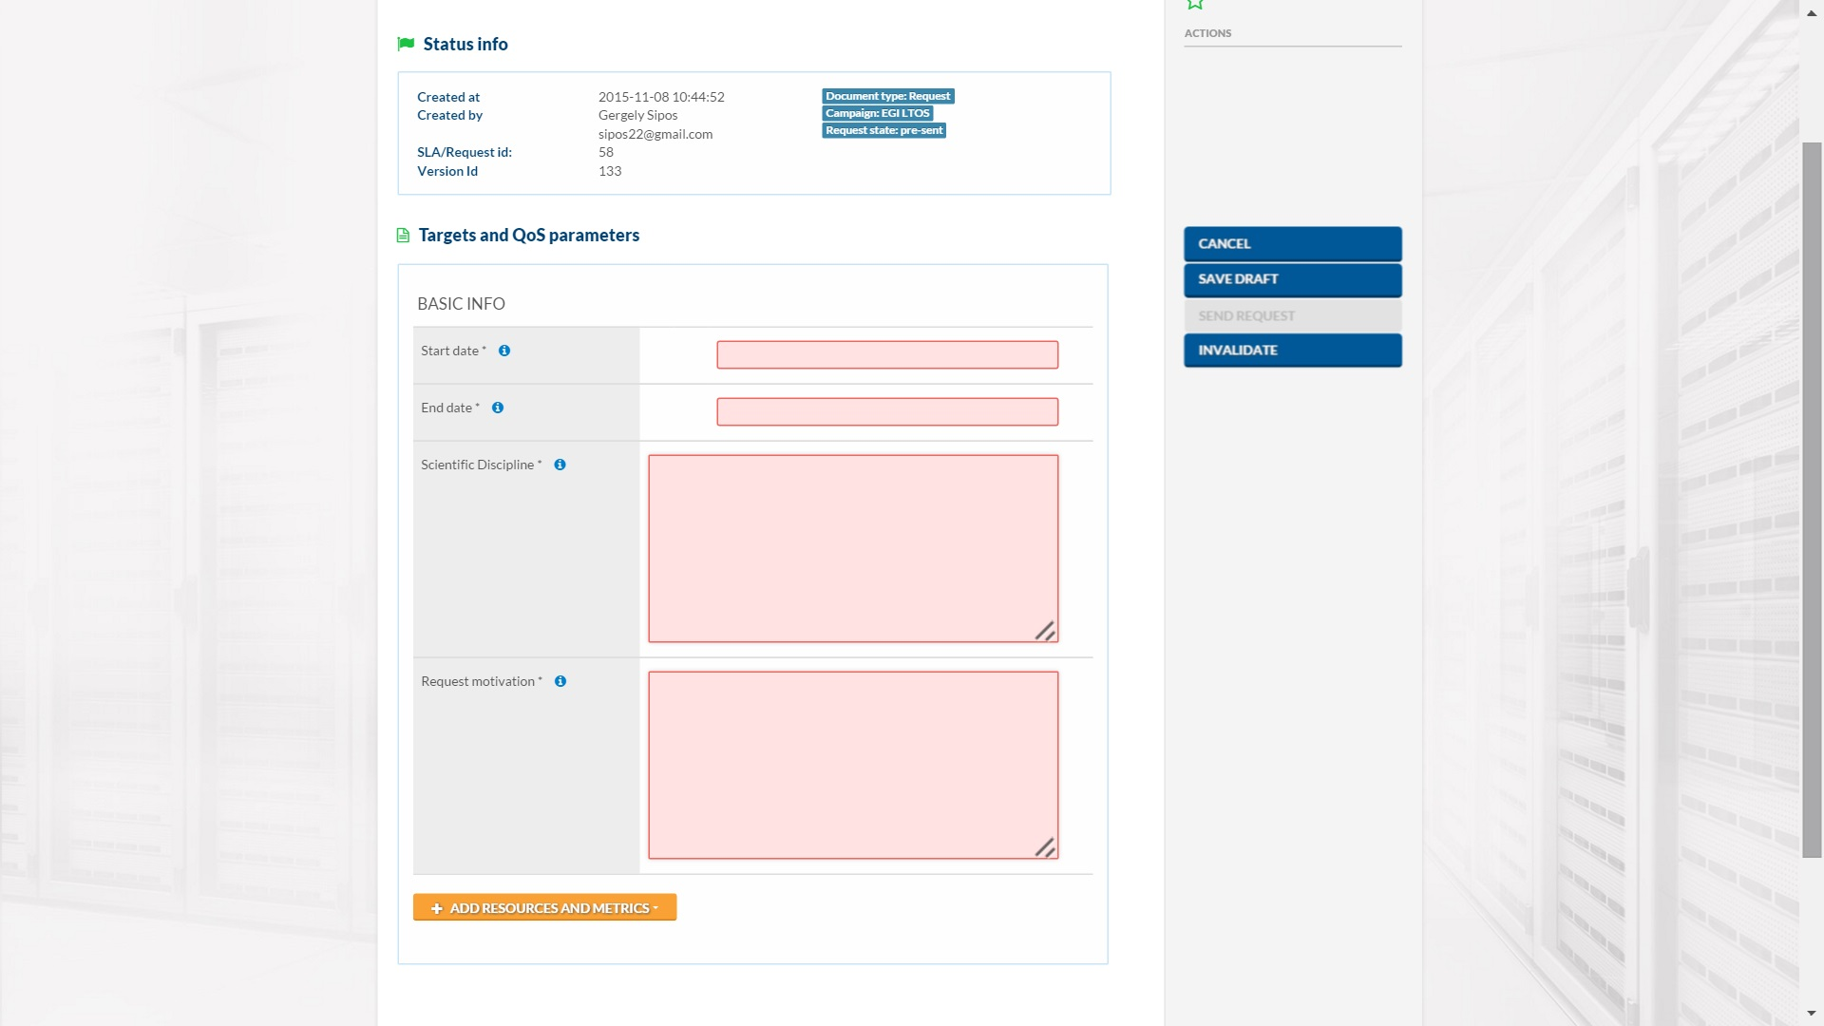
Step 2: Request resources

Slide 15
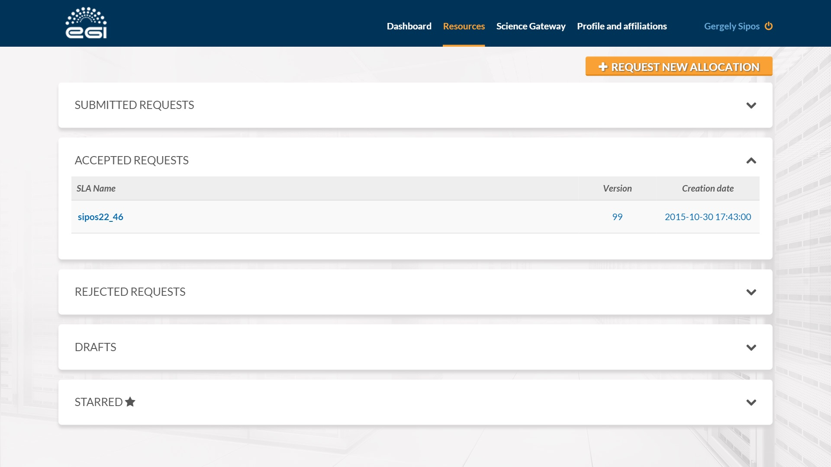
Step 2: Request accepted

Slide 16
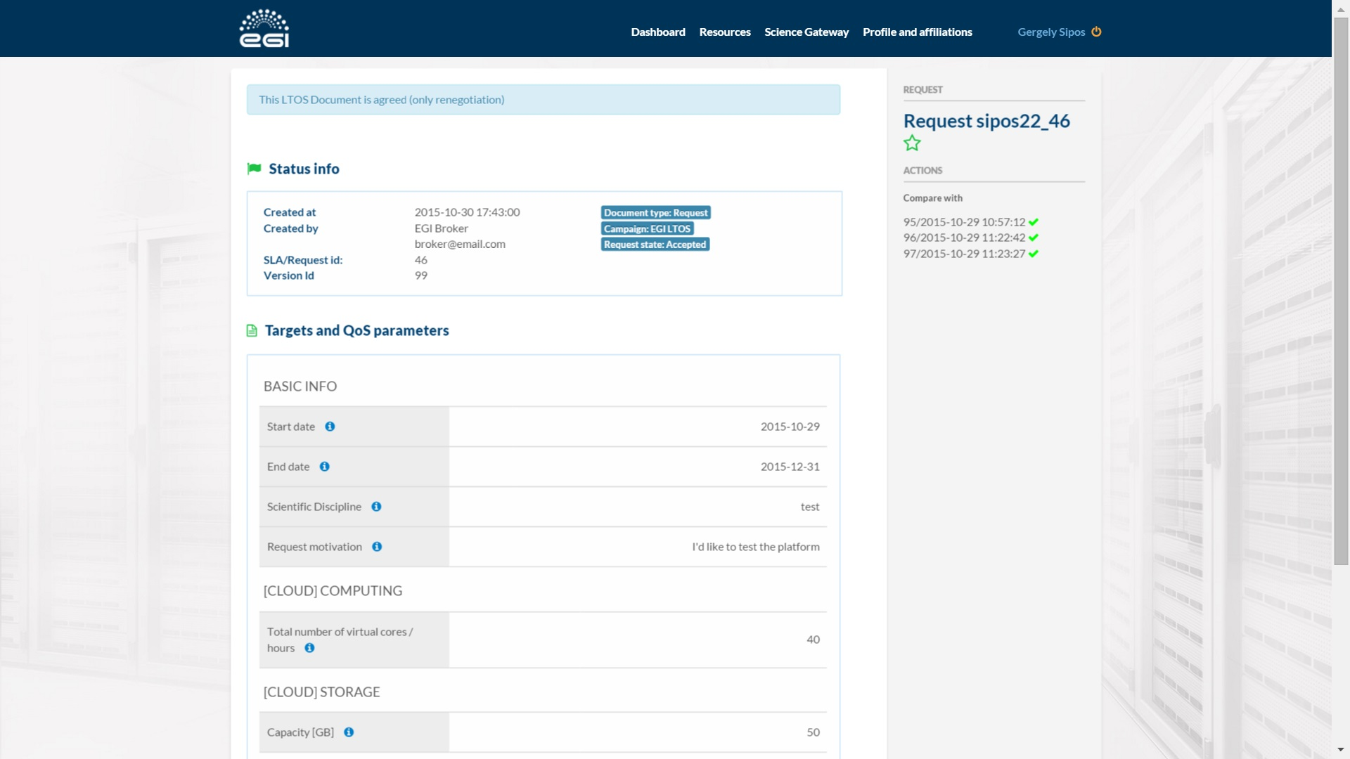
Step 2: Details of accepted request

Slide 17
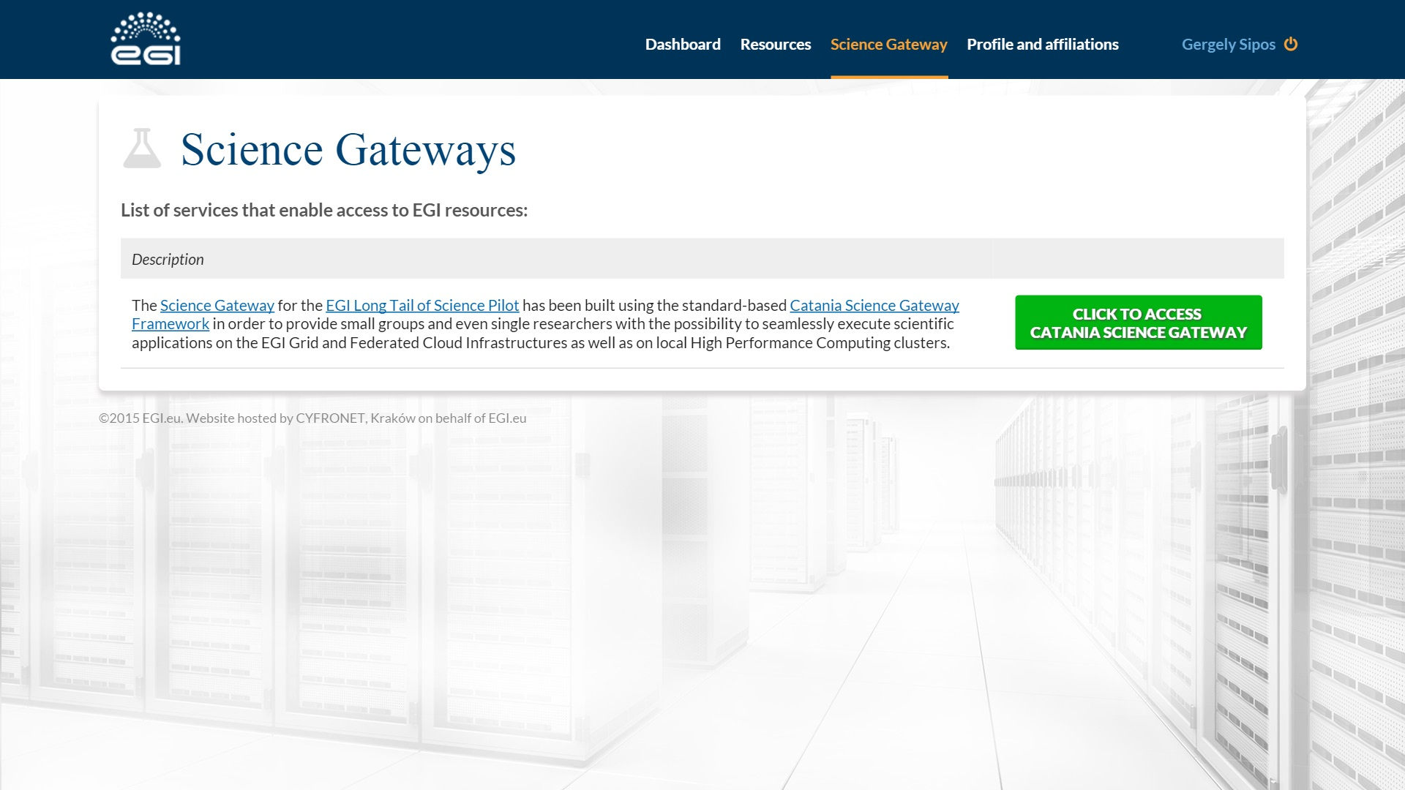
Step 3: Access resources

Slide 18
Step 3: Access resources

Slide 19
Services integrated so far…
Type | Name
Cloud and storage site | INFN Catania Openstack site
High-Throughput Computing site | INFN Catania EMI-gLite site
Science gateway | Catania Science Gateway
Application | The Statistical R
Application | The Semantic Search Engine (SSE)
Ongoing integration:
CYFRONET (HTC site), WS-PGRADE (gateway)
Expressed interest to integrate:
NGI-BE (HTC site), INFN Bari (cloud site), NGI-PT (site)
Disaster Mitigation CC (gateways), DIRAC (gateway), CosQosGrid (gateway)

Slide 20
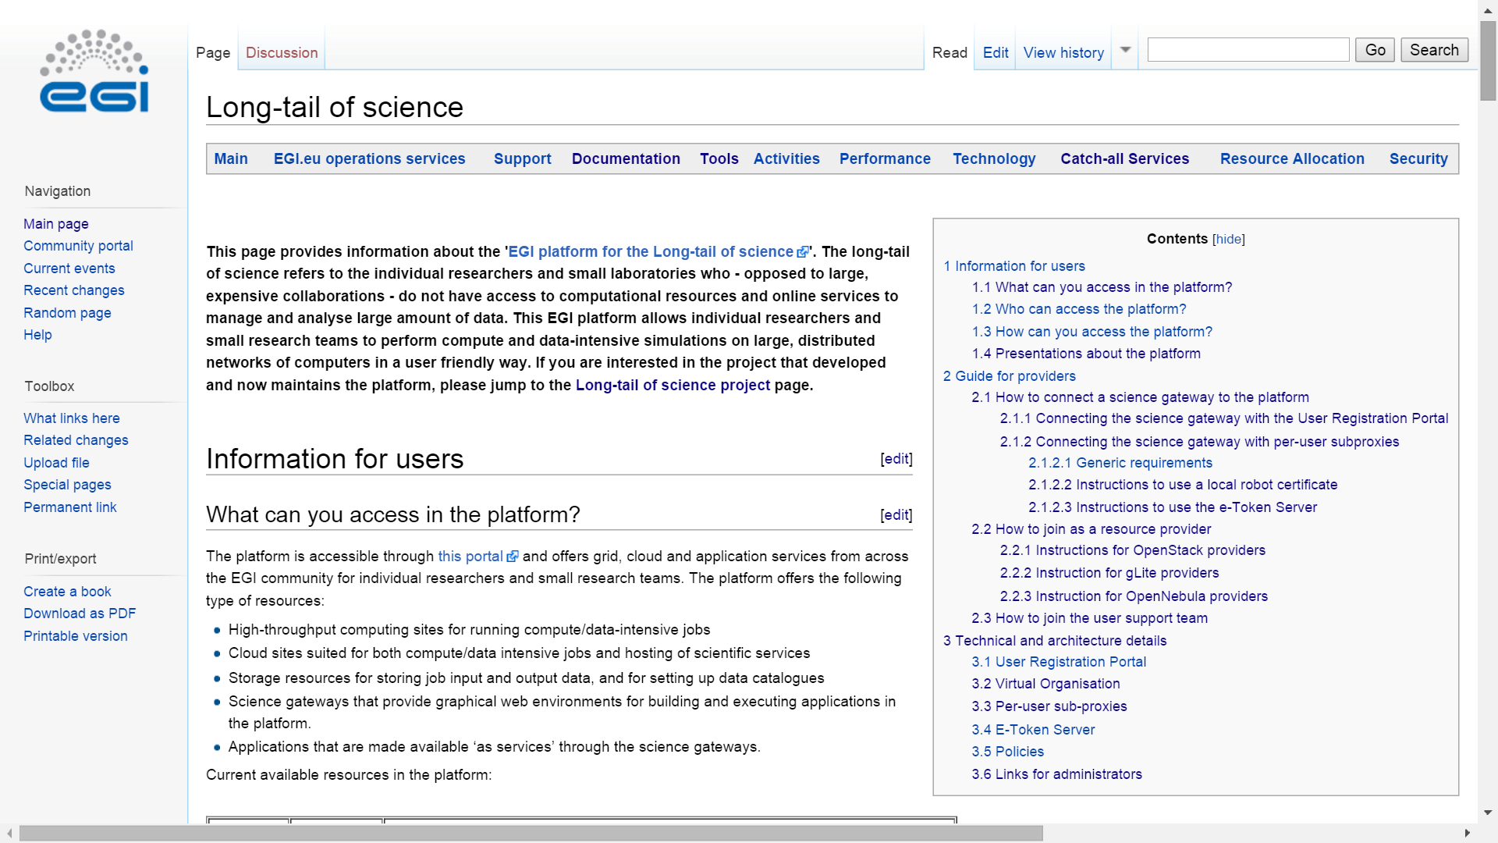
Guide for users and providers: https://wiki.egi.eu/wiki/Long-tail_of_science

Slide 21
Security considerations
Platform AUP
User
www
User Management Portal
User DB
Support team
Local robot OR hosted by INFN eToken server
UserID (String)
Science gateway
PUSP
Robot certificate (with ID)
Able to track back usage to the person
Gateway AUP
PUSP = Per-user subproxy
RobotID
UserID
VO Security Policy
EGI Accounting DB
VO

