Slide 1
Introduction to IISAS-GPUCloud

Slide 2
IISAS-GPUCloud site
Hardware:
IBM dx360 M4 server with two NVIDIA Tesla K20 accelerators
16 CPU cores, 64GB RAM, 1 TB storage on each WN
2x Tesla K20 on each WN, each with 2496 CUDA cores, 5GB GDDR5 RAM, peak performance 3.52 Tflops for SP
Software
Based OS: Ubuntu 14.04 LTS
KVM hypervisor with passthrough
Openstack Kilo middleware
Newest FedCloud tools
Status: integrated to FedCloud, certified

Slide 3
Flavors and images
Flavors:
gpu1cpu6 (1GPU K20 + 6 CPU cores)
gpu2cpu12 (2GPU K20 +12 CPU cores) (difficult to get resource, email me if you need it)
Images:
Vanilla images (Ubuntu, CentOS)
ubuntu-14-04-UEFI-cuda-runtime-70-75 (with preinstalled NVIDIA driver and runtime CUDA)
Requested VO images from AppDB
Supported VO: fedcloud.egi.eu, ops, dteam, moldyngrid, enmr.eu, vo.lifewatch.eu
Send me email if you need support for new VO

Slide 4
How to use IISAS-GPUCloud
Many useful info is provided in wiki:
https://wiki.egi.eu/wiki/GPGPU-FedCloud
Quick start:
Start a VM (“occi --action create …”)
Assign a public IP (“occi --action link …”)
Log in and use (“ssh … “)

Slide 5
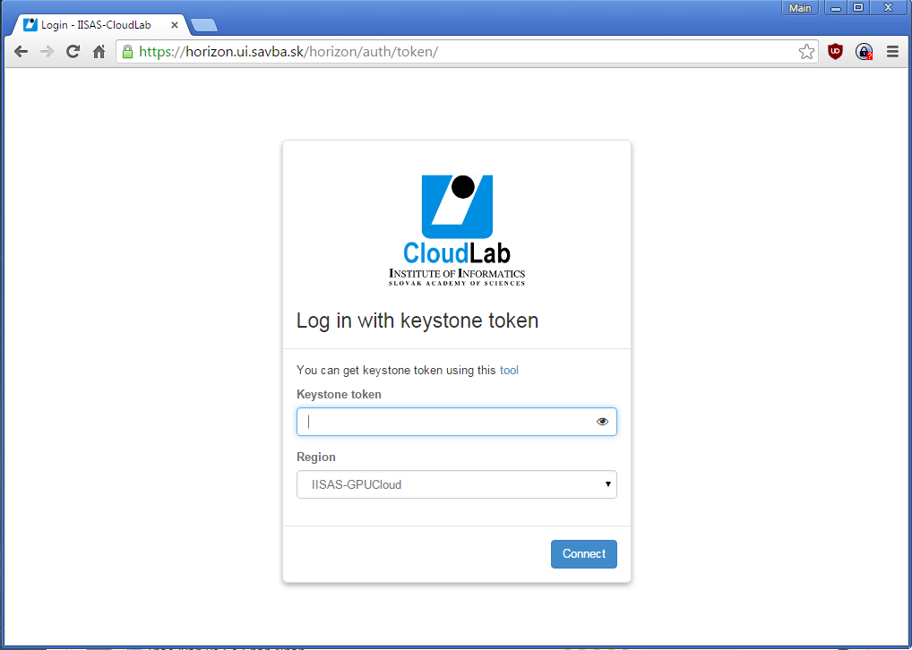
How to use IISAS-GPUCloud
Use Horizon portal at https://horizon.ui.savba.sk/horizon/

Slide 6
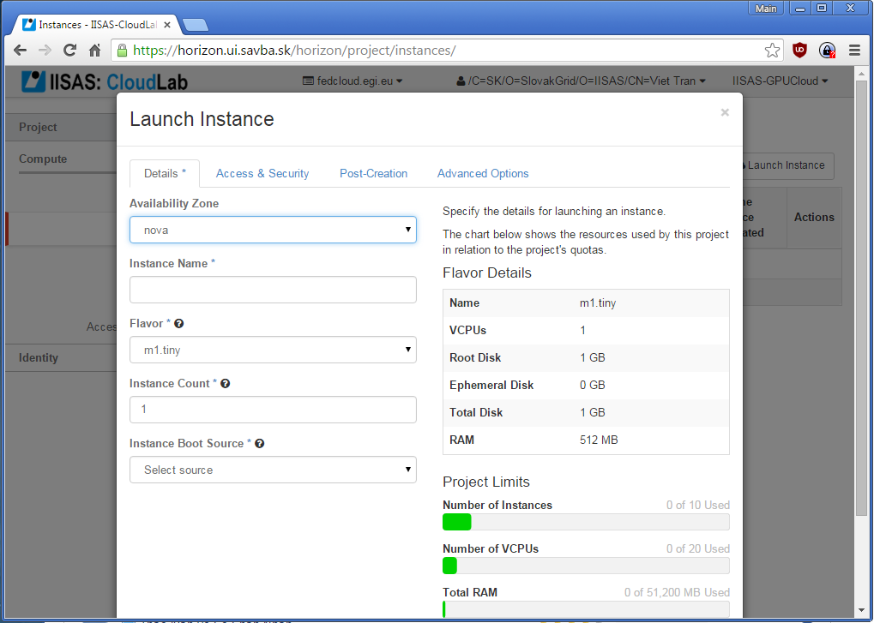
How to use IISAS-GPUCloud
Use Horizon portal at https://horizon.ui.savba.sk/horizon/

Slide 7
How to use IISAS-GPUCloud
Many useful info is provided in wiki:
https://wiki.egi.eu/wiki/GPGPU-FedCloud
How to use
How to install NVIDIA + CUDA
Contact information: Viet Tran, viet.ui@savba.sk

