Slide 1

EDISON Professional Training and Certification Scheme
WP4
18 Dec 2016
EDISON – Education for Data Intensive Science to Open New science frontiers
Grant 675419 (INFRASUPP-4-2015: CSA)

Slide 2




Outline
Training and Certification Scheme Options
  PMI-like (more closely linked to curriculum modules)
    This scheme would need to be fully defined as information not yet available
    More comprehensive; but more work
  FitSM-like (more closely linked to CF-DS)
    This scheme is more mature; however more lightweight (potentially achievable)
      Levels and Days
      Topics of each
      Prerequisites and Exam Format
Sustainability Model (Example)
Becoming a trainer / training organisation

Slide 3
EDISON Training and Certification Overview:
PMI Option – Curriculum Module Based
Find the Certification that Fits You Best
  Pick a module from the various descriptions to decide which certification best meets your experience and needs
  No certification is a pre-requisite for another
Module 1
Description
Price
Module 2
Description
Perquisites for individual module
Perquisites for individual module
Exam
Exam
Module 3
Description
Price
Perquisites for individual module
Exam
Module …
…
…
…
Price
…
Education
Experience
Degree
Education
Experience
Degree
Education
Experience
Degree

Slide 4
EDISON Training and Certification Overview:
PMI Option – Curriculum Module Based
Certification types:
Base
  CAPM – (Foundation) understanding of the fundamental knowledge, terminology and processes of effective project management.
  PMP – (Professional/Expert) competence to perform in the role of a project manager, leading and directing projects and teams
Specialized
  Eg. PMI-RMP (risk management) - certification recognizes demonstrated knowledge and expertise in the specialized area.

Slide 5
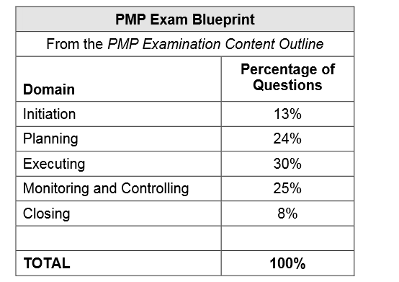
EDISON Training and Certification Overview:
PMI Option – Curriculum Module Based
PMP example
The PMP examination is developed based on the PMP examination blueprint contained in the PMP Examination Content Outline.
The proportion of questions from each domain that will appear on the examination is defined.
PMP Example:

Slide 6
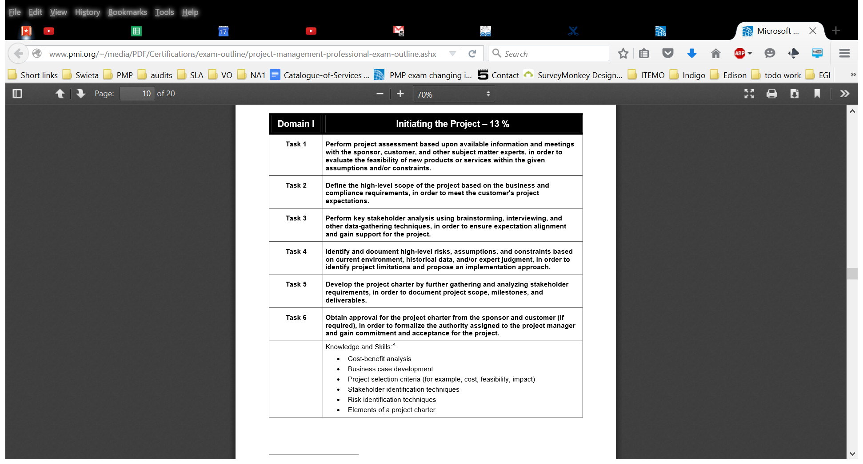
EDISON Training and Certification Overview:
PMI Option – Curriculum Module Based
Each domain contains tasks that are measured through the PMP certification progress. In addition, the domain contains knowledge and skills, which are required to competently perform these tasks. There are also cross-cutting knowledge and skills, which are used in multiple domains and tasks

Slide 7
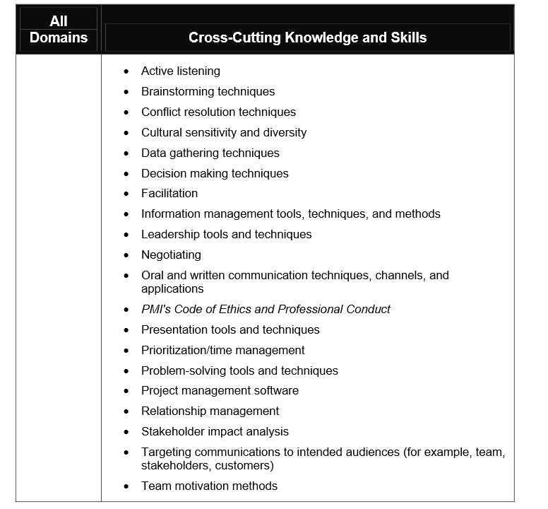
EDISON Training and Certification Overview:
PMI Option – Curriculum Module Based

Slide 8
EDISON Training and Certification Overview:
PMI Option – Curriculum Module Based
PMI is providing A Guide to the Project Management Body of Knowledge PMBoK and other materials which are base for the examination but is not limited to.
PMP exam
  200 multiple-choice questions
  Four answer choices per question
  25 are experimental – not included in the score for the exam (validation future questions)
  Weight of each question is different depending on difficulty

Slide 9
EDISON Training and Certification Overview:
PMI Option – Curriculum Module Based
Questions:
  Exam tests knowledge, application and analysis
  The multiple-choice format examination.
  Usually based on use cases, story
  Some questions are formula-related calculations
  Types of questions:
    Situational questions – require to integrate real-world experience and knowledge. Example: What is the best to do?
    Question with two or more right answers – What is the first thing to do?
    Questions with extraneous information – check understanding of the situation - Not all information is relevant
    Questions using made-up terms as answers – check knowledge about terminology

Slide 10
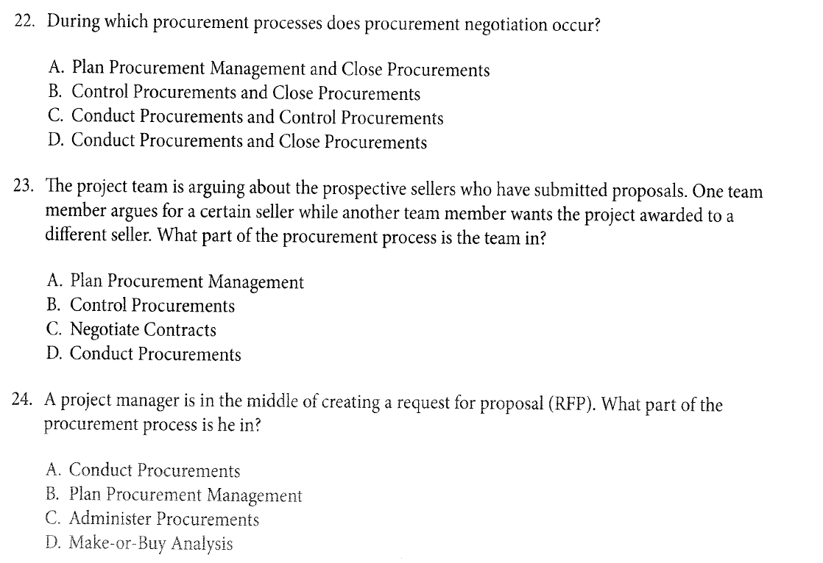
EDISON Training and Certification Overview:
PMI Option – Curriculum Module Based
Example:

Slide 11
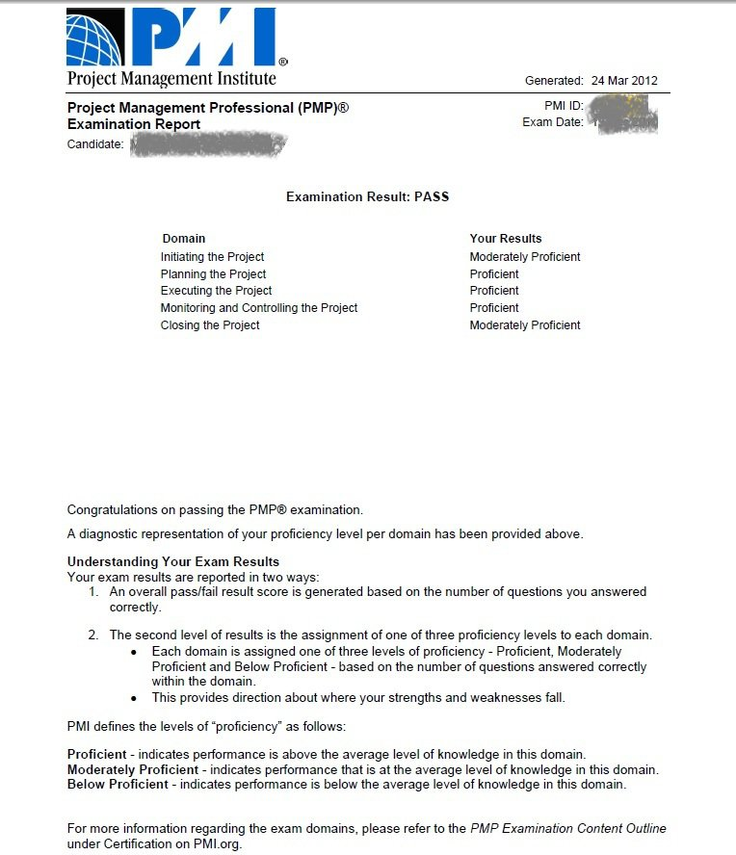
EDISON Training and Certification Overview:
PMI Option – Curriculum Module Based
Result:
  Provide your proficiency result per domain
  You can get result below proficiency score for a domain and still pass

Slide 12
EDISON Training and Certification Overview:
FitSM Option 1 – Role/Profile Based
Expert Level
Data Scientist Expert Training
2 days
Advanced Level
2 days
2 days
Advanced training in
data analytics and engineering
Advanced training in
data management and research
Foundation Level
Foundation training in data science
1 day
12

Slide 13
EDISON Training and Certification Overview:
FitSM Option 2 – Competence Based
Expert Level
Data Scientist Expert Training
2 days
Advanced Level
2 days
2 days
Advanced training in
data planning and delivery
Advanced training in
data operation and support
Foundation Level
Foundation training in data science
1 day
13

Slide 14
Overview
Expert Level
Data Scientist Expert Training
2 days
Advanced Level
2 days
2 days
Advanced training in
data analytics and engineering
Advanced training in
data management and research
Foundation Level
Foundation training in data science
1 day

Slide 15
Recommended agenda of the EDISON Foundation training (both options)
What is Data Science; Background
EDISON Data Science Competence Framework
Intro into Data Science
  Competencies and Skills
  Scientific Methods
  Business Process Operations
  Roles and Profiles
Career paths and job market
Related standards, frameworks and initiatives

Slide 16
Overview
Expert Level
Data Scientist Expert Training
2 days
Advanced Level
2 days
2 days
Advanced training in
data analytics and engineering
Advanced training in
data management and research
Foundation Level
Foundation training in data science
1 day

Slide 17
Recommended agenda of the EDISON Advanced trainings (Option 1)
Data analytics and engineering (DAE):
  DS Foundation wrap-up & DS basics
  Data Mining
  Machine Learning
  Data Analytics applications development
  Scientific programmer
  Data Science/Big Data Infrastructure engineer/developer/operator
Data management and research (DMR):
  DS Foundation wrap-up & DS basics
  Digital Librarian, Data Archivist, Data Curator
  Data Science creative
  Data Science consultant/Analyst
  Domain specifics

Slide 18
Overview
Expert Level
Data Scientist Expert Training
2 days
Advanced Level
2 days
2 days
Advanced training in
data planning and delivery
Advanced training in
data operation and support
Foundation Level
Foundation training in data science
1 day

Slide 19
Recommended agenda of the EDISON Advanced trainings (Option 2)
Data planning and delivery (DPD):
  DS Foundation wrap-up & DS basics
  Organisational workflow/processes model definition/formalisation
  Data models and data structures
  Apply data analytics methods (to organizational processes/data)
  Data analytics application development
  Data management applications and tools
  Data Science infrastructure deployment
Data operation and support (DOC):
  DS Foundation wrap-up & DS basics
  User/Usage data/statistics analysis
  Service delivery/quality data monitoring
  Information and Knowledge Management (powered by DS) – refactored
  Data presentation/visualisation, actionable data extraction
  Support business processes/roles with data and insight
  Data management/preservation/curation with data and insight

Slide 20
Overview
Expert Level
Data Scientist Expert Training
2 days
Advanced Level
2 days
2 days
Advanced training in
data analytics and engineering
Advanced training in
data management and research
Foundation Level
Foundation training in data science
1 day

Slide 21
Recommended agenda of the EDISON
Expert training
EDISON Foundation & Advanced wrap-up
Business Process Management
Business Analyst
Big Data Platforms and Tools
e-Infrastructures
Relations between Data Scientist and Subject Domain specialist
Employing new skills into job market

Slide 22
Perquisites and Exam Format

Slide 23
Prerequisites for Foundation training and exam participation
Prerequisites to attend a EDISON Foundation training | Recommended | Mandatory
None
Prerequisites to take a EDISON Foundation exam | Recommended | Mandatory
None

Slide 24
EDISON Foundation exam format
General:
  The exam is closed book, i.e. no aids are allowed.
  The exam consists of 20 multiple-choice questions.
  Each question comes with four possible answers (A, B, C and D).
  One of these answers is correct.
Instructions:
  Please mark the correct answer for every question.
The time allowed for completing this exam is 30 minutes.
Evaluation:
  For each correct mark, you receive 1 point.
  The maximum number of total points that can be achieved for this exam is 20. If you obtain 13 points (65 per cent of the maximum score) or more, the exam is passed.

Slide 25
Prerequisites for Advanced training and exam participation (relevant for both modules)
Prerequisites to attend a EDISON Advanced training | Recommended | Mandatory
Familiarity with the contents of the EDISON Foundation training | X
Completion of the self-study workbook “Preparing for the EDISON Advanced Level training” provided on www.edison.eu (or comparable preparation / e-learning) | X
Prerequisites to take a EDISON Advanced exam | Recommended | Mandatory
EDISON Foundation certificate |  | X
Participation in a EDISON Advanced training (same module as the exam) |  | X

Slide 26
EDISON Advanced exam format
(relevant for both modules)
General:
  The exam is closed book, i.e. no aids are allowed.
  The exam consists of 30 multiple-choice questions.
  Each question comes with four possible answers (A, B, C and D).
  One of these answers is correct.
Instructions:
  Please mark the correct answer for every question.
The time allowed for completing this exam is 60 minutes.
Evaluation:
  For each correct mark, you receive 1 point.
  The maximum number of total points that can be achieved for this exam is 30. If you obtain 21 points (70 per cent of the maximum score) or more, the exam is passed.

Slide 27
Prerequisites for Expert training and exam participation
Prerequisites to attend a EDISON Expert training | Recommended | Mandatory
Familiarity with the contents of the EDISON Foundation and Advanced level trainings | X
Completion of the self-study workbook “Preparing for the EDISON Expert training” provided on www.edison.eu (or comparable preparation / e-learning) | X
Practical experience in data science | X
Prerequisites to take a EDISON Expert exam | Recommended | Mandatory
EDISON Foundation certificate |  | X
EDISON Advanced certificate in data planning and delivery or data analytics and engineering |  | X (*)
EDISON Advanced certificate in data operation and control or data management and research |  | X (*)
Participation in the EDISON Expert training |  | X

Slide 28
EDISON Expert exam format
General:
  The exam is closed book, i.e. no aids are allowed.
  The exam consists of 30 multiple-choice questions.
  Each question comes with six possible answers.
  Each of these answers may either be true or false.
Instructions:
  Please mark every correct answer with a cross in the column labelled "True" and each incorrect answer with a cross in the column labelled "False".
  You may decide not to mark any of the two options for a given question.
The time allowed for completing this exam is 75 minutes.

Slide 29
EDISON Expert exam format
Evaluation:
  For each correct mark, you receive 1 point which is added to the total score for the respective question.
  For each incorrect mark, 1 point is deducted from the question's total score.
  For each answer which is left unmarked, 0 points are added or deducted.
  The maximum score per question is 6 points.
  The minimum score per question is 0 points, even if the number of incorrect marks is higher than the number of correct marks for this question (no negative question total scores).
  The maximum number of total points that can be achieved for this exam is 180. If you obtain 135 points (75 per cent of the maximum score) or more, the exam is passed.

Slide 30
EDISON Expert exam format: Example 1
Sample Question
True | False | Which of these cities are located in Europe?
X |  | Paris
X |  | Barcelona
 | X | New York
 | X | Rio de Janeiro
X |  | Munich
X |  | Helsinki
All marks correct
→ Resulting total score for this question: 6 points

Slide 31
EDISON Expert exam format: Example 2
Sample Question
True | False | Which of these cities are located in Europe?
 | X | Paris
X |  | Barcelona
X |  | New York
 | X | Rio de Janeiro
 | X | Munich
 | X | Helsinki
2 correct marks (+2 points) and 4 incorrect marks (-4 points)
Resulting total score for this question: 0 points

Slide 32
Exam Specifications
(future work)

Slide 33
Exam specification:
FitSM example (future work once agreed on focus areas)
No. | Topic Level 1 Requirements: | No. | Topic Level 2 Requirements: | No. | Topic Level 3 - The candidate can: | Weight
1 | Service and service management basics | 1.1 | Understanding service | 1.1.1 | explain what an (IT) service is | 30%
 |  |  |  | 1.1.2 | describe the components of an (IT) service
 |  | 1.2 | Understanding (IT) service management | 1.2.1 | explain the concept of (IT) service management
 |  |  |  | 1.2.2 | explain the benefits and risks of (IT) service management
 |  |  |  | 1.2.3 | describe the role of tools used within (IT) service management
 |  | 1.3 | Understanding processes | 1.3.1 | describe the benefits and characteristics of a process-based approach
 |  |  |  | 1.3.2 | describe how to measure and control a process
 |  |  |  | 1.3.3 | explain why and which roles are needed
 |  | 1.4 | Understanding continual improvement | 1.4.1 | identify the principles of the plan-do-check-act cycle
 |  |  |  | 1.4.2 | describe what maturity is and how maturity models work
 |  |  |  | 1.4.3 | explain the nature of assessments, reviews and corrective and preventive actions
 |  | 1.5 | Understanding the landscape of standards and frameworks | 1.5.1 | identify the purpose and stakeholder of CMMI, COBIT, ISO 9000, ISO/IEC 20000, ISO/IEC 27000, ITIL
 |  | 1.6 | Understanding the specific challenges of Service Management in federated IT infrastrutures | 1.6.1 | describe the differences between linear chains of responsibility and collaborative approaches to service provisioning.
 |  |  |  | 1.6.2 | describe different kinds of federation and which approaches to service management are suitable in different cases.
2 | Service management processes: Objectives, concepts and requirements | 2.1 | Understanding the processes for Service planning and delivery | 2.1.1 | describe the objective, key concepts and requirements of the Service Portfolio Management process; | 70%
 |  |  |  | 2.1.2 | describe the objective, key concepts and requirements of the Service Level Management process;
 |  |  |  | 2.1.3 | describe the objective, key concepts and requirements of the Service Reporting Management process;
 |  |  |  | 2.1.4 | describe the objective, key concepts and requirements of the Service Continuity & Availability Management process;
 |  |  |  | 2.1.5 | describe the objective, key concepts and requirements of the Capacity Management process;
 |  |  |  | 2.1.6 | describe the objective, key concepts and requirements of the Information Security Management process;
 |  |  |  | 2.1.7 | describe the objective, key concepts and requirements of the Customer Relationship Management process;
 |  |  |  | 2.1.8 | describe the objective, key concepts and requirements of the Supplier Relationship Management process;
 |  | 2.2 | Understanding the processes for Service operation and support | 2.2.1 | describe the objective, key concepts and requirements of the Incident & Service Request Management process;
 |  |  |  | 2.2.2 | describe the objective, key concepts and requirements of the Problem Management process;
 |  |  |  | 2.2.3 | describe the objective, key concepts and requirements of the Configuration Management process;
 |  |  |  | 2.2.4 | describe the objective, key concepts and requirements of the Change Management process;
 |  |  |  | 2.2.5 | describe the objective, key concepts and requirements of the Release & Deployment Management process;
 |  |  |  | 2.2.6 | describe the objective, key concepts and requirements of the Continual Service Improvement process;

Slide 34
Example Sustainability Model

Slide 35



Example Sustainability Model
ITEMO e.V. (non-profit)
Maintenance of the EDISON training/certification scheme
Maintenance and continual improvement of the training material
Certification body / examination institute
Processing and invigilation of EDISON exams
Issuing of certificates for persons after they passed the exams
Trainers and training organisations
Provision of EDISON trainings
Continual development and improvement of the pools of exam questions
Registration of trainers and training organisations
Overall quality control, training and exam feedback evaluation, …
Optional: Contribution to the development of EDISON trainings (e.g. material)
….

Slide 36
How to become an EDISON trainer

Slide 37
EDISON trainer policy
To give any training from the EDISON qualification scheme, the trainer must comply with the following:
  The trainer must have taken part in a previous training for the training module his or her training will be about, and passed the respective exam. He or she must hold the certificate of the module he or she is going to give a training for, issued by a certification body / examination institute registered with [e.g. ITEMO e.V.]
  If the trainer offers EDISON training(s) under the mandate of a registered EDISON training organisation, he or she must be registered as a trainer by the named representative of that organisation.
  If the trainer offers EDISON training(s) individually, the trainer must, prior to ordering the exam from an EDISON certification body [e.g. TUV SUD], register with the certification body him-/herself which will require the trainer to provide at least the following information:
    Personal and contact data
    Record or evidence of relevant training, education and experience
The certification body and the ITEMO e.V. EDISON qualification working group may monitor exam results and training / exam feedback, supervise trainings and exams and reserve the right to revoke trainer privileges. Trainings and exams may be subject to quality control mechanisms, and every trainer must commit to support and contribute to this process.
Notes:
Additional information:
Trainer registration according to the above policy is a prerequisite for ordering a EDISON exam from the certification body.
Trainer registration would be free of any charges with any certification body contracted under ITEMO e.V.

Slide 38
How to become a registered EDISON training organisation

Slide 39
Registration as a EDISON training organisation
When should you register your organisation as an EDISON training organisation?
  If you are going to organise internal EDISON trainings and exams for the members / employees of your organisation, which will be given by one or more trainers associated with your organisation
  If you are going to offer public EDISON trainings and exams or internal EDISON trainings and exams for other organisations, which will be given by one or more trainers associated with your organisation
How to register:
  Select an EDISON certification body / examination institute
  Fulfil the registration according to the procedures of the certification body.
  (This usually includes the provision of some information on the organisation and the foreseen trainers as well as an image file of the organisation’s logo for inclusion in the public website of the certification body, if desired)
Notes:
Additional information:
Registration as an EDISON training organisation is a prerequisite for registering individual EDISON trainers and ordering EDISON exams from the certification body.
Registration as an EDISON training organisation would free of any charges with any certification body contracted under ITEMO e.V.

