Slide 1
e-Infrastructure commons Updates
Diego Scardaci
Technical Outreach Expert

Slide 2
Outline
Milestones & Deliverables
Effort Report
Roadmap & Requirements

Slide 3
WP3 Milestones & Deliverables

Slide 4
Next WP3 Deliverables and Milestones
M3.2 - User requirements on data accounting collected (R) (PM12)
Contact relevent stakeholders. Interviews and Survey
D3.2 - Design of the EGI Service Registry and Marketplace (R) (PM12)
Definition of the new EGI Tools ecosystem
D3.3 - Accounting Repository release (OTHER) (PM12)
D3.4 - First release of the Operational tools (OTHER) (PM12)

Slide 5
Next WP3 Deliverables and Milestones
D3.5 (D3.6) - Analysis on techniques to manage big data on the EGI accounting system (R) (PM12)
Technology assessment
D3.6 (D3.5) - First release of the new Accounting Portal deployed in production (OTHER) (PM14)
Demos (Nov, Jan, Mar)

Slide 6
Important dates for PM12 deliverable
Toc and assigned reviewers: 11.01
Draft Complete, Start Internal WP review: 25.01
Start Review: 1.02
At AMB and PMB: 15.02
At QM: 22.02
At EC: 29.02

Slide 7
SW Deliverables
D3.3 - Accounting Repository release (OTHER) (PM12)
Non-user facing software → you should adopt a semi-automatic testing procedure → create Automatic Internal Testing procedure description
D3.4 - First release of the Operational tools (OTHER) (PM12)
Operations portal (Manual), GOCDB (Manual), ARGO (Automatic), messaging infrastructure(Automatic) and security monitoring tools (Manual?).
https://wiki.egi.eu/wiki/EGI-Engage:Software_Copyrights_and_Licenses#Procedure_for_quality_assessment

Slide 8
SW Deliverables - Actions
Software deliverable template
https://documents.egi.eu/document/2501
EGI-Engage Deliverable Milestone review form - Software
https://documents.egi.eu/document/2492
Documentation is part of the deliverable
We need to identify testers for Ops Portal, GOCDB, Security Monitoring (?)

Slide 9
Effort Report

Slide 10
Effort Report - Issues
GRNET 11%: 0.57 PM declared – 5.20 PM PY1
AUTH 25%: 0.98 PM declared – 4.00 PM PY1
CYFRONET 7%: 0.56 PM declared – 8.00 PM PY1

Slide 11
Roadmap & Requirements

Slide 12
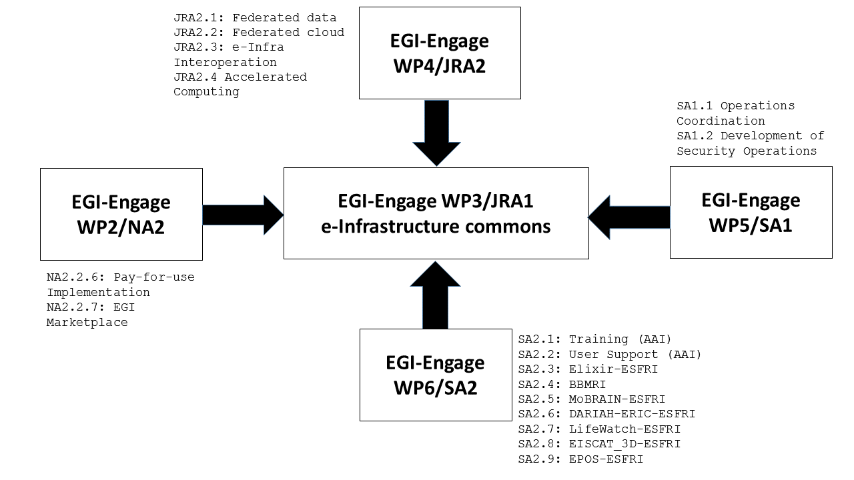
Roadmap & Requirements

Slide 13
Roadmap in the wiki
Many PTs are not updating the roadmap in the wiki
Keep your roadmap updated requires few second and give more visibility to your activity!
I will contact one by one PTs to keep the roadmap updated

