Slide 1
EGI Marketplace / Service Registry Update
WP3 Meeting, December 17 2015
Dean Flanders
Swiss National Grid Association

Slide 2
Topics
Issues with the MP:
Sustainable business model
Long list of requirements
Diverse items (services, applications, VMs, data, instruments, etc.)
Ability to integrate with other marketplaces
Diverse opinions on what should be covered
Requirement from the next round of H2020 to have a “Service Registry”
Limited budget for development
Recent work:
Discussions with Thermo Fisher to join in the project.
Discussions with various organizations (Curie in Paris, IST Austria, etc.)
Deliver a pre-summary of possible solutions: “High Level Evaluation of tools for EGI Engage Marketplace and Service Registry activity”
Next deliverable: “Design of the EGI Service Registry and Marketplace”

Slide 3
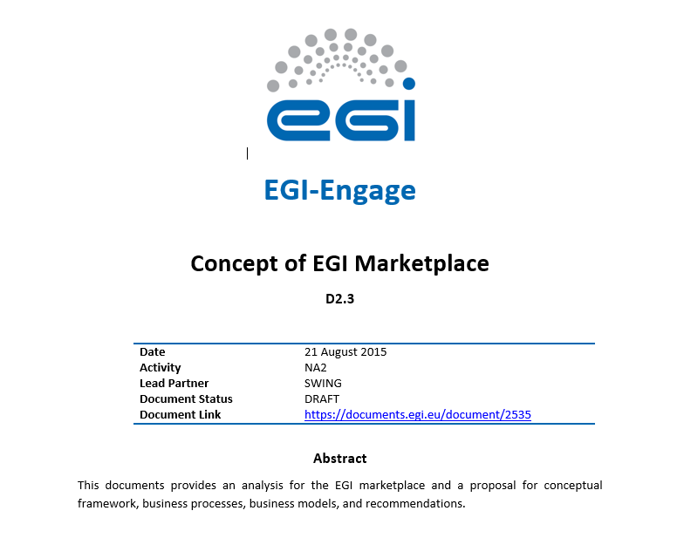
Concept Defined with Requirements

Slide 4
Marketplace as a Service…
Research
Group
Resources
Organization
Resources
Consortiums
EGI Marketplace
Commercial
Vendor
Resources
NGI
Resources

Slide 5
Requirements list based on original use cases
ID | Topic | Requirement
01 | Service Management
01.01 | Service Provider |  | Provisioning of services and service management
01.01.01.01 | Service Registration |  | Provider registration: Users can register a resource provider.
01.01.01.02 | Service Registration |  | Service registration: The service provider is able to register a service in the service catalogue and can specify detailed information and display options for his service including:
01.01.01.03 | Service Registration |  | Service name
01.01.01.04 | Service Registration |  | Service description
01.01.01.05 | Service Registration |  | Service instructions
01.01.01.06 | Service Registration |  | Service visibility
01.01.01.07 | Service Registration |  | Assign pricing
01.01.01.08 | Service Registration |  | Usage policy
01.01.01.09 | Service Registration |  | Picture
01.01.01.10 | Service Registration |  | Highlight service
01.01.01.11 | Service Registration |  | Hide a service
01.01.01.12 | Service Registration |  | Check order status
01.01.02.01 | Usage policies and SLAs |  | The service provider is able to manage service level agreements and usage policies for his services:
01.01.02.02 | Usage policies and SLAs |  | Usage policies and SLAs: The service provider is able to manage service level agreements and usage policies for his services:
Etc.

Slide 6
Examined Tools
AppDB
eGrant
GOCDB
Open IRIS
WooCommerce (WordPress based)
FIWARE Marketplace Generic Enabler
Stratuslab

Slide 7
Comparable Services
Services | Description
GEANT Cloud Catalogue | Catalog of cloud services being developed by GEANT
UberCloud Marketplace | HPC cloud marketpalce
Science Exchange | Various research services
Internet2 Net+ | Internet2 list of cloud service providers
Helix Nebula Marketplace | EU research cloud marketplace
UK Gov | UK government list of cloud services
Microsoft Azure Marketplace | Microsoft cloud solution
Fortissimo marketplace | Is a list of "Experiments" that give examples of services can be used with links to these services.
Strategic Service Store | The main goal of the STRATEGIC project is to facilitate organizations and notably public bodies to leverage the benefits of public cloud services.

Slide 8
Test case with Open IRIS solution
Users (currently 1900 users, will approach 3000 when fully deployed to organizations below, currenly~300 resources with ~200 requests per day)
Institut Curie (France) *
ETHZ (Switzerland) *
University of Basel (Switzerland) *
Friedrich Miescher Institute (Switzerland) *
Thermo Fisher Scientific (Europe) *
Collège de France (France)
VIB (Belgium)
Discussions
IST (Austria)
CRG (Spain)
University of Leiden (Netherlands)
University of Zurich (Switzerland)
* Organizations that have already agreed to contribute financially.

Slide 9
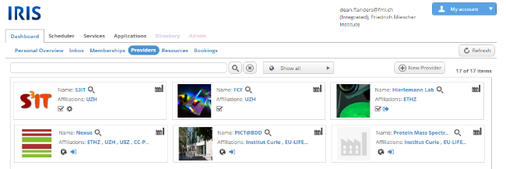
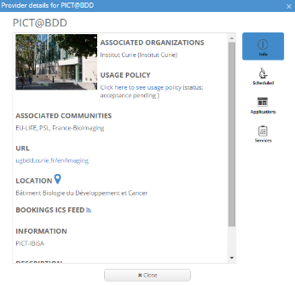
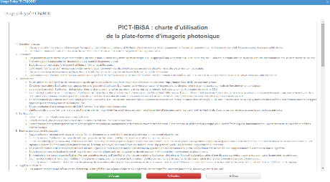
Concept: Resource Provider Discovery

Slide 10
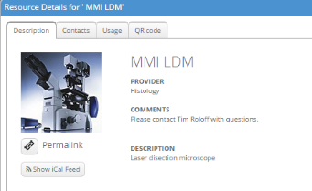
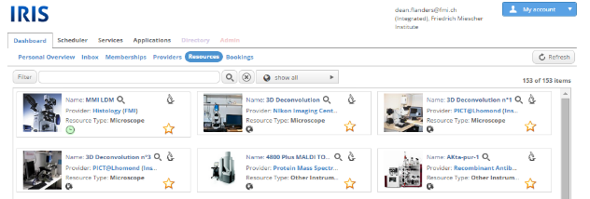
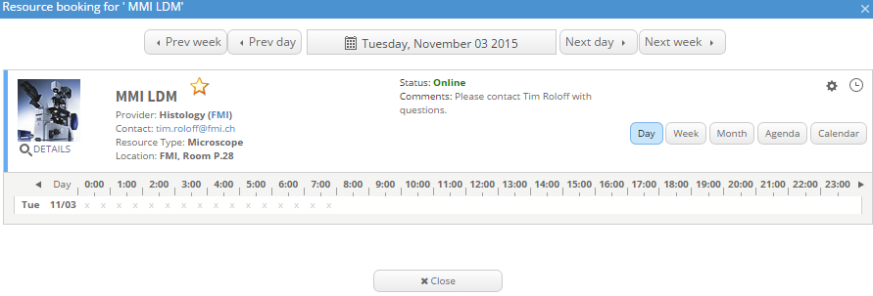
Concept: Resource Discovery

Slide 11
Concept: Resource Provider Discovery

Slide 12
Concept: Resource Discovery

