Slide 1
GOCDB v5.6
david.meredith@stfc.ac.uk
28/01/2016

Slide 2
GOCDB v5.6
v5.6 ready for test announcement soon, includes:
Reserved (protected) scope tags
Introduces restrictions/rules when tagging resources
Prevents random sites from using tags reserved for a particular grouping/project
Requested by WLCG InfoSys TF to categorise resources by WLCG-affiliation/VO/Tier and filter downtimes by VO
Also intended for use by Elixir resources
Downtime Calendar
UI to upload/manage multiple custom properties

Slide 3
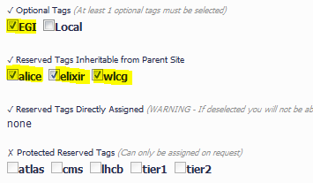
Reserved Scope Tags
Are *initially* assigned to resources by GocDB admins
Once assigned, reserved tags can be inherited from the parent object when creating/editing child objects
Tags cascade from: NGI->Site->Service-Downtime
Site Admins can manage the reserved tags their Sites/Services declare
Reserved tags inherited from parent Site
E.g. On edit service
Disabled

Slide 4
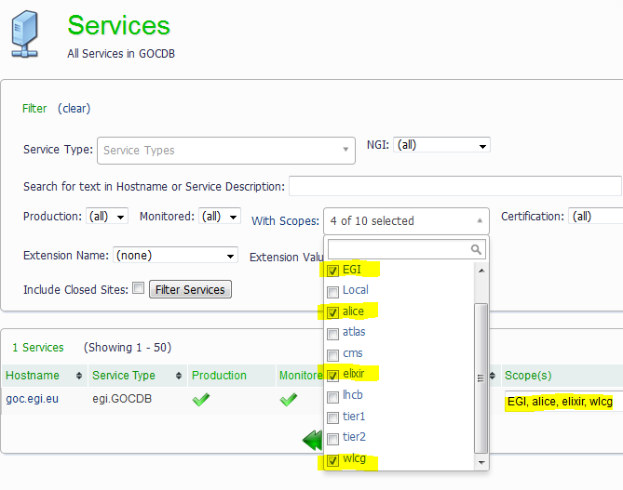
Filtering by Scope Tags in UI/API (no distinction between tags when filtering)
get_service&scope=EGI,alice,wlcg,elixir&scope_match=all
get_downtime&scope=EGI,alice,wlcg,elixir&scope_match=all
get_site&scope=EGI,alice,wlcg,elixir&scope_match=all

Slide 5
Downtime Calendar
*Produces URLs that can be bookmarked (includes filters options)

Slide 6
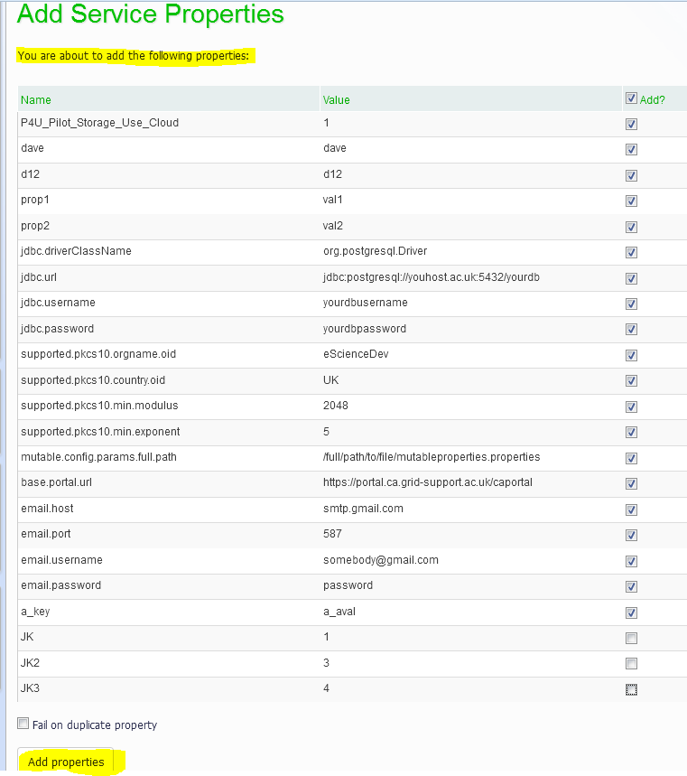
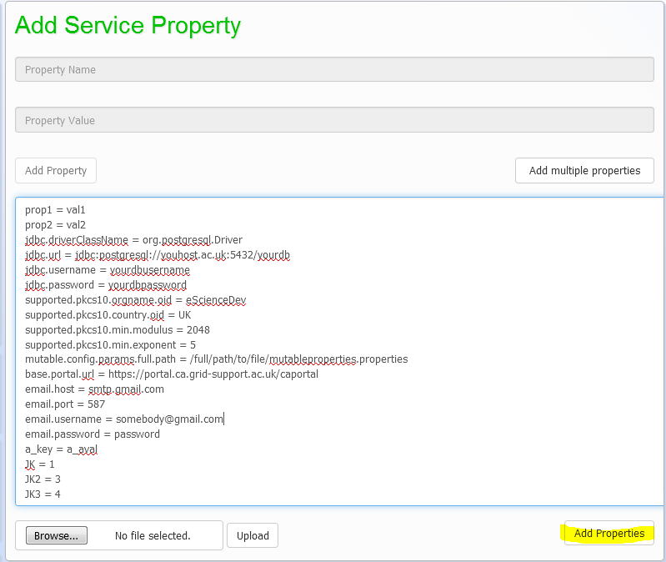
Upload/paste multiple custom properties to Sites, Services, SGs
Easily extend/customise data model of Services + Endpoints
2)
1)

Slide 7
WLCG Info System TF
TF provided a list of sites that should be tagged with WLCG/VO tags
Tags also assigned to every service belonging to these sites
Using the gocdb-test instance, site admins should now edit their service scopes as required
Not every service under a Site needs to declare same tags as Site !
Some discussion what should be the primary information source for declaring/managing these Site/Service VO tags
My 2p: VO tags Should be declared alongside the Site/Service declaration at source, i.e. in GOCDB / OIM
May need to query another VO tag source to seed/assign tags automatically to Sites/Services
Until decided, the WLCG VO tags may not be deployed into production in the v5.6 release (wlcg tags can always be added later)

Slide 8
Conclusion
v5.6 testing to be announced soon
https://gocdb-test.esc.rl.ac.uk
(Note, data in test instance quickly becomes stale compared to production)
Feedback welcome
Please edit Site/Service Reserved tags as required
New procedure for requesting new Reserved tags to be developed
~Request via email, lightweight peer review by EGI

