Slide 1
EGI-Engage Open Data Platform Prototype
Bartosz Kryza, Lukasz Dutka
Academic Computing Centre CYFRONET AGH
Krakow, Poland

Slide 2
Overview
Open Data vs Open Science
Open Data challenges
Open Data Platform vision and architecture
Deployment and integration issues
Conclusions
EGI OMB, 28 Thursday 2016

Slide 3
Open Data vs Open Access
Open Science covers a broad range of resources and services - including data
Most solutions and standards focus on:
open access to publications, documents
small data sets
EGI Open Data requires different approach
data is stored in federations
distributed geographically and administratively
varies in size, formats and metadata standards
EGI OMB, 28 Thursday 2016

Slide 4
Open Data challenges
Availability
Distributed, reliable storage, standard and easy protocols for accessing data, replicas
Interoperability
Data should be available in standard, interoperable, open formats
Discovery
Data should be enriched with metadata, which discovery services and users can understand and which can be indexed
Identification
Preservation
Data sets and items must have global unique identifiers which allow for their unambigous referencing
Provenance
Information on how the data was obtained or generated, in case of simulation data it should be possible to reproduce it
Data stored in long term retention archive should be usable after tens of years after creation
EGI OMB, 28 Thursday 2016

Slide 5
EGI-Engage Open Data Platform vision
Manage entire data life cycle from raw data to preservation
Combine efficient computation services with open data managed by federated infrastructures
Foster collaboration with SME’s (European Big Data Value)
EGI OMB, 28 Thursday 2016

Slide 6
Community requirements collection
REQ1. Publication of open research data based on policies
REQ2. Make large data sets available without transferring them completely
REQ3. Enabling complex metadata queries
REQ4. Integration of the open data access data management with community portals
REQ5. Data identification, linking and citation
REQ6. Enabling sharing of data between researchers under certain conditions
REQ7. Sharing and accessing data across federations
REQ8. Long term data preservation
REQ9. Data provenance
EGI OMB, 28 Thursday 2016

Slide 7
Open Data Platform issues
Existing EGI data management infrastructure does not support open data publishing
Public users don’t necessarily have certificates or VO membership
Metadata stored in EGI infrastructure is not compatible with „open” metadata standards
Data sets are often too large to be completely transferred to users infrastructure
EGI OMB, 28 Thursday 2016

Slide 8
Open Data Platform from users perspective
ODP
Non-Grid users friendly security – no VO certificate necessary for open data
Single user interface for personal, research and open data management
Open data specific functionality including DOI registration, publication policies and long term preservation
Users and community data is organized into spaces (virtual folders)
Web interface for data management, including ACL and sharing.
Data can be accessed from local filesystem or Grid and Cloud protocols
EGI OMB, 28 Thursday 2016

Slide 9
Open Data Platform interfaces
GUI/CLI
REST
CDMI
POSIX
OAI-PMH
HTTP
Web based.
Easy data management and sharing, access control
Publication of data items and collections
Advanced data and collection managemet
API for integration with community tools and portals
Standard data management operations
Advanced metadata queries
Integration with future data management applications
Enable direct mounting of spaces in the local filesystem without full data transfer
OAI Data Provider interface
Dublin Core metadata by default
More complex metadata can be registered in ODP directly
Direct download of open data from URL’s
Open Data Platform
EGI OMB, 28 Thursday 2016

Slide 10
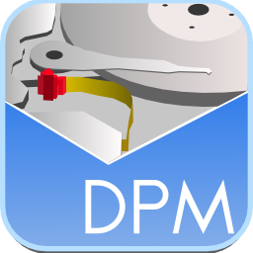
Open Data Platform interactions
DOI Registrar (e.g. DataCite)
Community Portal
EGI User 1 (VO x)
Anonymous
User 1
EGI User 2
(Onedata space)
Anonymous
User 2
REST
Web GUI
POSIX
HTTP
OAI-PMH
CDMI
REST
Space Manager
Space Manager
Open Data Manager
Metadata Registry
OAI-PMH Data
Provider
Authentication and Authorization
Long Term Retention
Open Data Platform
Generatore AIP package for abc
EGI Site 1
EGI Site 2
EGI Site 3
Cloud storage
EUDAT
EGI OMB, 28 Thursday 2016

Slide 11
Open Data Platform Interactions
Public Services
For Data Discovery
2: opendata publish
collection Data-set-1.1
-> DOI.1
3: discover data
-> DOI.1
Snapshot
Data-set-1.1
4: Visit Collection
Web Page (HTTP)
5: opendata mount remote
DOI.1 /localdir/
Data-set-1.1
Mounted to
/localdir/
1: opendata create
snapshot Data-set-1
6: opendata clone DOI.1
Data–set-1
Cloned
Data-set-1.1
Private Resources
Private Resources
EGI OMB, 28 Thursday 2016

Slide 12
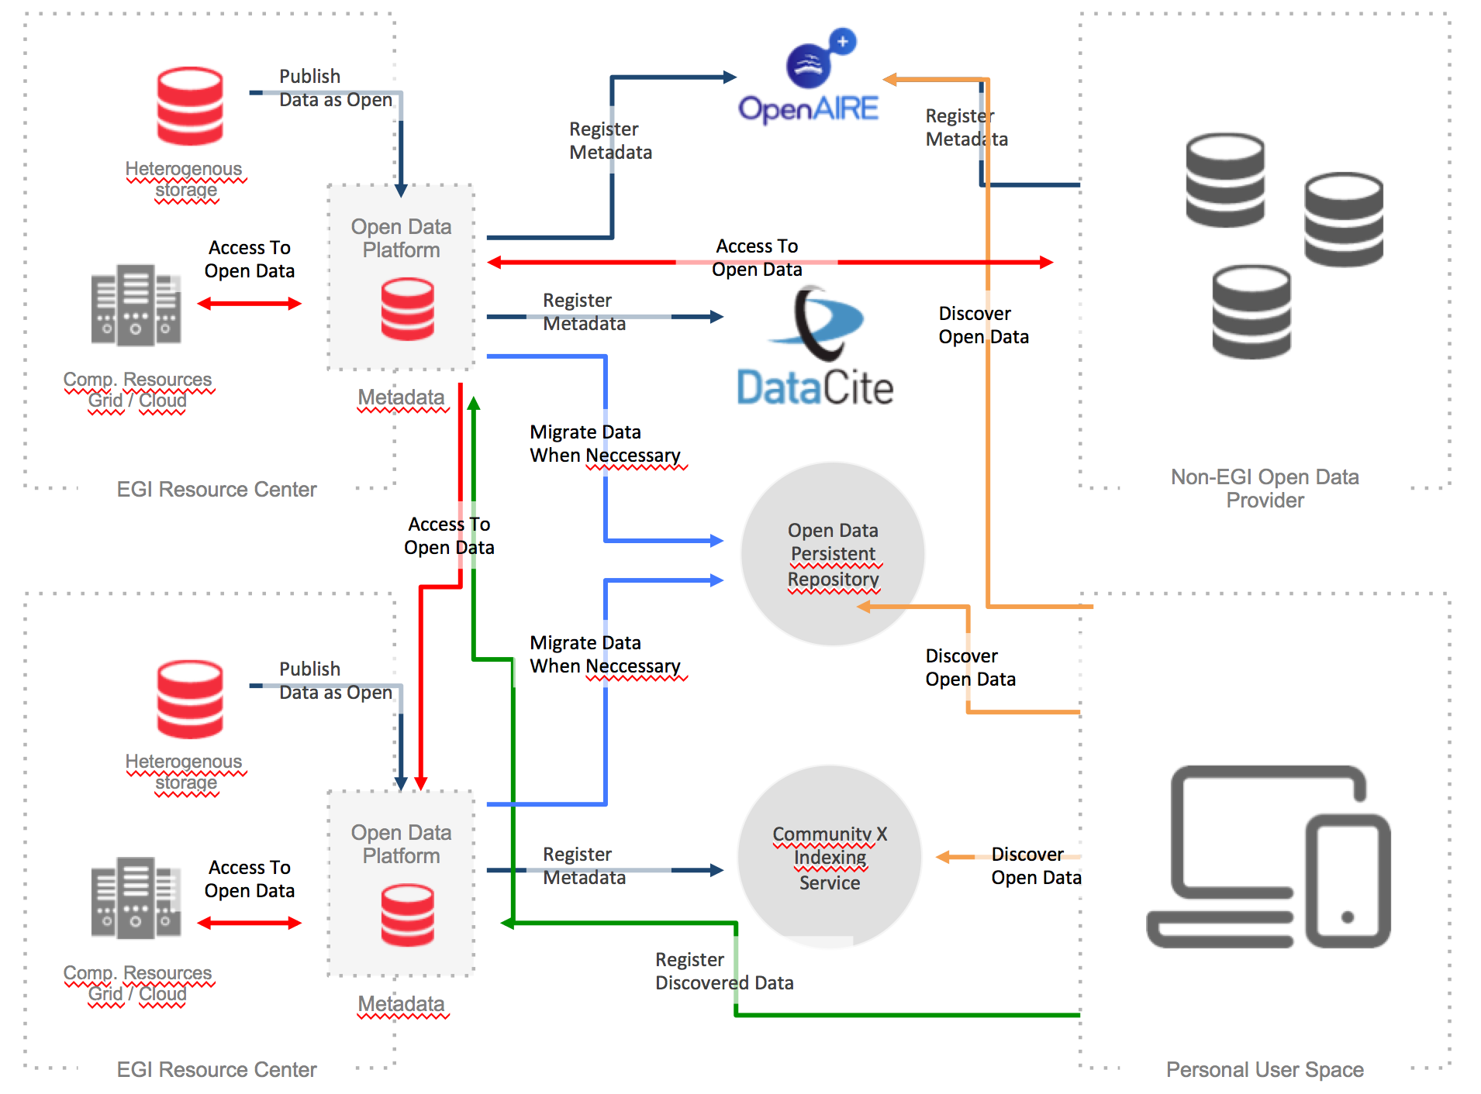
Open Data Platform
EGI OMB, 28 Thursday 2016

Slide 13
Open Data Platform integration
DOI (Digital Object Identifier)
Integration with a DOI assignment service (e.g. DataCite)
Enable users to automatically generate DOI for data which is made open
Each file or collection can be accessed directly using DOI identifier (DOI resolves to ODP recognizable URL)
Allow storage of additional custom identifiers (e.g. PURL, Life Science Identifier)
EGI OMB, 28 Thursday 2016

Slide 14
Open Data Platform integration
Long Term Preservation
Generation of selected standard archival packages
AIP (Archival Information Package)
SIRF (Self-contained Information Retention Format)
Migration of packages to long term storage sites
EUDAT’s B2SAFE
How can users negotiate long term storage SLA?
EGI OMB, 28 Thursday 2016

Slide 15
Open Data Platform integration
EGI data management components
Integration with LFC
Registration of „open” lfn’s in the Open Data Platform registry
ODP can migrate data to storage resources not requiring VO certificate or use robot certificates
Read-only access to LFC managed data for the prototype
Integration with VOMS
Present to the users VO structure consistent with their VO setup (groups, memberships, roles)
EGI OMB, 28 Thursday 2016

Slide 16
Conclusions
Communities have different requirements with respect to open data access and management
Open data, in particular data managed in EGI infrastructure, has different character than typical open resources (e.g. publications)
ODP will provide unifying approach to management of personal, research and open data
EGI OMB, 28 Thursday 2016

