Slide 1
OMB February 2016
Peter Solagna – EGI.eu

Slide 2
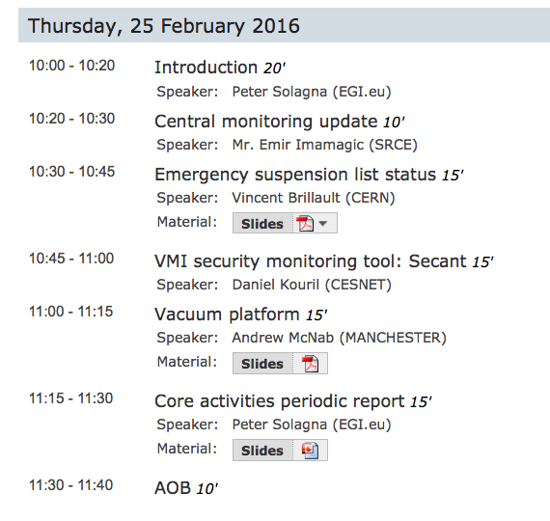

Slide 3
Preview repository 1.0.0 Released
Feb 23rd 2016: https://wiki.egi.eu/wiki/Preview_Repository
The aim of Preview is to make available in a single repository the updates of the middleware products as soon as they are released by the product teams.
Same function of the EMI-3 repos, which will not be updated anymore
The same updates will also undergo to the usual UMD verification and staged rollout processes, to be released – later – in UMD
The first release of Preview is a mirror of the EMI3 repository, containing the Update 29 (11.11.2015) - v. 3.17.1-1
RPM are still signed by EMI GPG keys
Preview updates will be released on a monthly basis, depending on the availability of new products updates

Slide 4
WMS
INFN is not interested in continue the long-term support
No thight deadline, and for the moment INFN is ensuring security and critical bug support of WMS
But no porting to CentOS7, no fix to GLUE2 bugs is planned
As reported in previous OMB, WMS is still widely used by many communities
There are two options:
Find another NGI/institution willing to support WMS code
Find an alternative to WMS
Please discuss with your team to understand if supporting WMS is possible

Slide 5
SLAs, Outreach activities
DRIHM - we are to agree on final version of SLA
BILS – EGI Operations is checking if VO is operational on resources
Terradue/ESA preparing SLA and contact potential providers
Mobrain - finalised, signed
DARIAH working on SLA to support CC,
HBP – Start gathering requirements for SLA
Life Science Grid Community - Clarification about requirements needed
EXTRAS project – contacted asking for requirements, waiting for feedback
iMARINE – planned a meeting next week
(c) UCST
For March OMB there will be a bigger update

Slide 6
Cloud monitoring
A ticket has been raised to modify the A/R profiles
https://ggus.eu/index.php?mode=ticket_info&ticket_id=119628
ARGO team started working on it

