Slide 1
OMB February 2016
Peter Solagna – EGI.eu

Slide 2
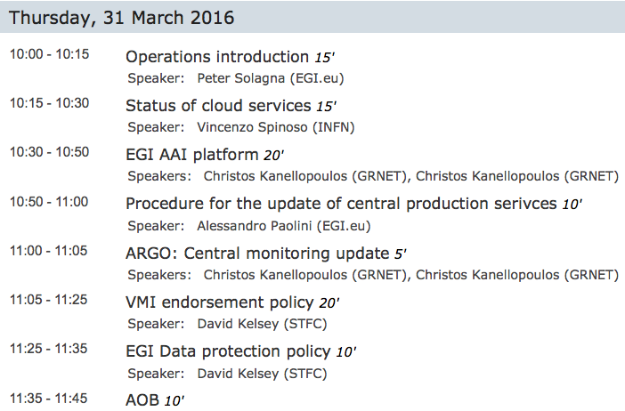

Slide 3
OMB TOR
https://documents.egi.eu/document/117
Few changes to update the text (that was still referring to the EGI-InSPIRE project)
Document with track changes available in the docDB link above

Slide 4
Policies to be approved or recently approved
LTOS AUP:
https://documents.egi.eu/document/2635
Applicable only to the users accessing EGI through the LTOS platform
Main points: the activities of the user must be related to the description of the research provided during registration. User must acknowledge EGI/NGIs. User agrees with the limitations of the LTOS services.
LTOS Security policy
https://documents.egi.eu/document/2769
Applicable only to the sites supporting LTOS VO
Main points: Support for PUSP, commitment to support security requests related to the LTOS platform

Slide 5
Security incident handling procedure
https://wiki.egi.eu/wiki/SEC01
Presented in the Feb OMB
No negative feedback provided
Highlights:
Added cloud-specific requirements and other guidelines, e.g:
Take a snapshot of affected VMs.
Isolate at the network level if possible.
Do NOT destroy VMs.
Physically disconnect systems from the network ONLY where other options are not available.

Slide 6
Changes in the Security Certification Process
https://wiki.egi.eu/wiki/EGI_CSIRT:Security_Resource_Centre_Certification_Procedure
The security survey is filled at the beginning of the certification procedure and the communications are handled by the NGI who is supporting the site in the certification
The changes are still to be validated by EGI CSIRT

Slide 7
EGI Trust Anchor release 1.73-1
https://wiki.egi.eu/wiki/EGI_IGTF_Release
Released on March 29th

Slide 8
EGI Conference 6-8 April 2016
Timetable on indico:
https://indico.egi.eu/indico/event/2875/timetable/#20160406
Agenda highlights:
Wed April 6th:
Fedcloud roadmap
EGI Marketplace
Thu April 7th:
Security training, user oriented
Open Science Cloud
EGI AAI
Fri April 8th:
Services for the LTOS
Interoperating e-infrastructures
Operational tools
GPGPUs

