Slide 1
OMB April 2016
Peter Solagna
Senior Operations manager, EGI.eu

Slide 2
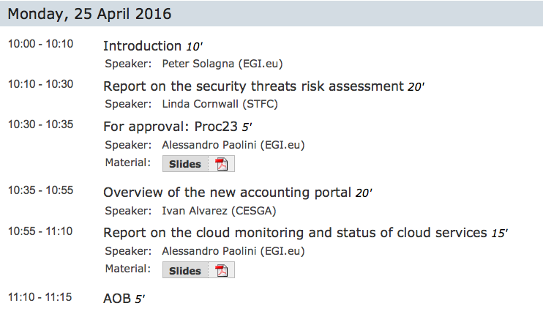
Agenda

Slide 3
Centralized monitoring
2 monitoring engines are up and running
To test high availability this month
In the next 2 months there will be an increase of monitoring activities in the services
1 NGI Nagios + 2 central nagioses submitting ops jobs
Currently ARGO team is validating the A/R results.
Plan to switch off NGI Nagioses is confirmed for June 1st

Slide 4
Storage accounting
dCache accounting data issue has been fixed
Fixed in the central repositories
DPM probes issue is being fixed by APEL, in collaboration with the DPM developers
Testing with early adopters to start in the next weeks for DPM

