Slide 1
OMB June 2016
Peter Solagna – EGI.eu

Slide 2
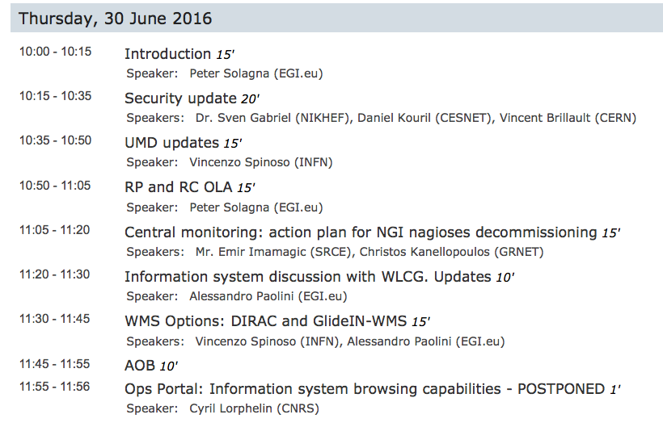

Slide 3
Cloud probes
As agreed in previous OMB the following cloud probes will be used for the A/R tables from July:
eu.egi.cloud.vm-management.occi –eu.egi.cloud.OCCI-Context –eu.egi.cloud.OCCI-VM –org.nagios.OCCI-TCP –eu.egi.OCCI-IGTF
org.openstack.nova –eu.egi.Keystone-IGTF –eu.egi.cloud.OpenStack-VM –org.nagios.Keystone-TCP
See Emir’s presentation for more info about the timeline
Federated cloud has use cases that are using directly Swift services for object storage
There is a Swift probe available that has been pre-tested
Plans to continue the tests and integrate the probe in ARGO if acceptable

Slide 4
August and September OMB
Currently scheduled on August 28th and September 29th
August 28th, Peter will not be available
September 29th, DI4R Krakow
Proposal:
Cancel August OMB meeting and anticipate September OMB, on September 15th
If agreed Next OMBs will be:
July 28th
September 15th (if there are no clashes with other relevant meetings)

Slide 5
Plan for OTAG focused meetings
During 2016 some ops tools have been heavily re-engineered:
Accounting portal, complete re-design
Accounting-next.egi.eu
ARGO: central monitoring deployment
Other ops tools have been updated with new features
We should provide the requirements now in order to have tools that fulfill the NGIs use cases as much as possible
NGI teams should test these tools and record their feedback and requirements
Developments are supported by Engage until August 2017
OTAG meetings to discuss and prioritize the requirements in September/October
Possibly focused on one/two tools, depending on the amount of requirements
Please, begin providing requirements:
In RT.egi.eu (it will be upgrade soon to a newer version wit revised categories)
Writing to the product teams of the tools
Writing to operations@egi.eu

