Slide 1
WMS Options: DIRAC and GlideIN-WMS
V. Spinoso – A. Paolini
OMB June 30, 2016

Slide 2
glideinWMS and DIRAC
Only alternatives
Both pilot oriented

Slide 3
Functionalities needed
discovery of resources through the information system and matching with the user requirements
authentication and authorization: only with VOMS proxy
proxy delegation and renewal: before the user proxy expires, a MyProxy server can be contacted to renew the credentials
Job types: normal, MPI, parametric, collections, DAG.
Multi-VOs support
submission to CREAM and ARC-CE
PUSP support: purpose of a per-user sub-proxy (PUSP) is to allow identification of the individual users that operate using a common robot certificate
Options explored: glideinWMS and DIRAC

Slide 4
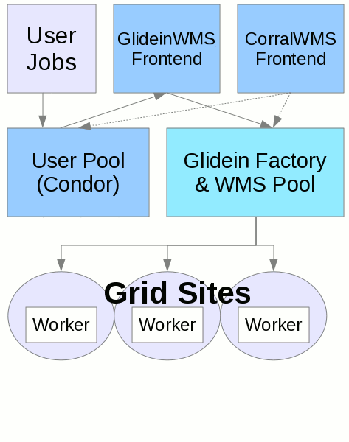
glideinWMS
Workload is managed by
GlideinWMS VO Frontend (Glidein Frontend, VO Frontend)
a service that looks at the queued jobs, resources available to run them and applies VO defined policies to request glideins at desired sites (resources)
Must be one per VO!
GlideinWMS Factory (Glidein Factory)
a service submitting glidein to the available resources
Must be one per VO!
Not integrated with BDII
Can submit to CREAM and ARC (and condor)
It is not possible to easily identify the user that submitted the job under the same robot certificate
PUSP not supported
Some work was done in the past to support this, that can be reused but it is not supported and not used at the moment
Several job types supported by condor, verification is needed if those jobs are supported by the glideinWMS as well
Pilot job submission workflow very well tested and in production since years
Supported by FNAL, used by CMS
Runs on top of condor (well supported and stable as well)
http://glideinwms.fnal.gov/doc.prd/index.html

Slide 5
DIRAC
Devoted initially to LHCb, it offers multi-VO support (i.e. wENMR is using it)
Supports browsing information on BDII
Robot certificates support available
PUSP not yet fully implemented
Authorization using robot certs is working, but
But submission through a PUSP is still not working
Can submit to CREAM and ARC

Slide 6
Summary
 | glideinWMS | DIRAC
BDII support | No | Yes
VOMS proxy auth | Yes | Yes
Identification of individual users (PUSP) | No | Not yet, investigate more
Multi VO support | Yes (but multiple factories needed) | Yes
Submit to CREAM/ARC | Yes | Yes
normal, MPI, parametric, collections, DAG jobs | Yes (parametric, MPI) | Yes (parametric, MPI)

