Slide 1
OMB September 2016 Introduction
Peter Solagna
EGI Foundation Operations Manager

Slide 2
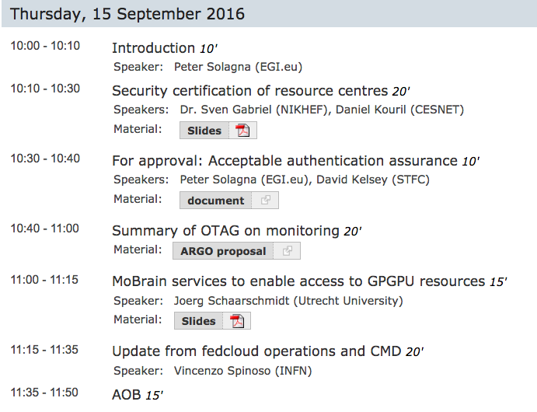

Slide 3
INDIGO first release
INDIGO first release has been released on August 8th
https://www.indigo-datacloud.eu/news/first-indigo-datacloud-software-release-out
Main highlight for the Fedcloud IaaS
Cloud compute
OpenStack OCCI Interface (OOI)
OpenStack Preemptible Instance Extension (OPIE)
OpenStack clients
IM/Tosca-in-heat to orchestrate deployments (TOSCA)
Cloud Container
ONEDock
Nova-docker
Reposync to sync docker containers from docker hub to CMF
Udocker to use docker in useland
Storage
CDMI Server
OneData

Slide 4
INDIGO Staged Rollout
INDIGO is performing a staged rollout testing of the first release
The results will be used for CMD as well
Staged rollout has already started
Two components have already been validated
Some Fedcloud sites are already EA
Plan is to complete the majority of the SR tests by the end of September
If interested in be early adopter for one or more products, please contact Baptiste:
Baptiste.grenier@egi.eu

Slide 5
GOCDB pre-release
https://wiki.egi.eu/wiki/GOCDB/notifications#v5.7
GOCDB is introducing cursor-based paging to the APIs
For the moment available only in the development instance, not released in production
Without paging some queries with large results hit a timeout or memory limits and fail
Paging is disabled by default and it is optional
To allow the tool to use it for queries that would otherwise fail
If your NGI or sites are using GOCDB API, please read the wiki and provide feedback to GOCDB developers

Slide 6
OTAG: ARGO
On Monday there was the OTAG meeting for monitoring
https://indico.egi.eu/indico/event/3092/
Main topics
Status and roadmap of ARGO
Requirements from NGIs/sites
ARGO proposal to extend the use of GOCDB as topology information source for monitoring
See Christos’ presentation later in the agenda

Slide 7
DI4R
Registration closed yesterday
Programme: http://www.digitalinfrastructures.eu/programme
Highlights from an Ops point of view:
Wednesday: AAI sessions, Federated operations, federated cloud
Thursday: Security training, EGI OpenData platform/datahub, WISE security session, INDIGO Portfolio
Friday: Lightning talks

Slide 8
Future of WMS
Selected VOs are being contacted by EGI Operations (Alessandro) for pilot testing DIRAC as replacement of WMS
Answers from compchem
If you would like to suggest a VO, please contact Alessandro Paolini @ egi.eu
DIRAC4EGI instance to support the tests
Thanks to the DIRAC team to help during this pilot

