Slide 1
Introduction OMB October 2016
Peter Solagna – EGI Foundation

Slide 2
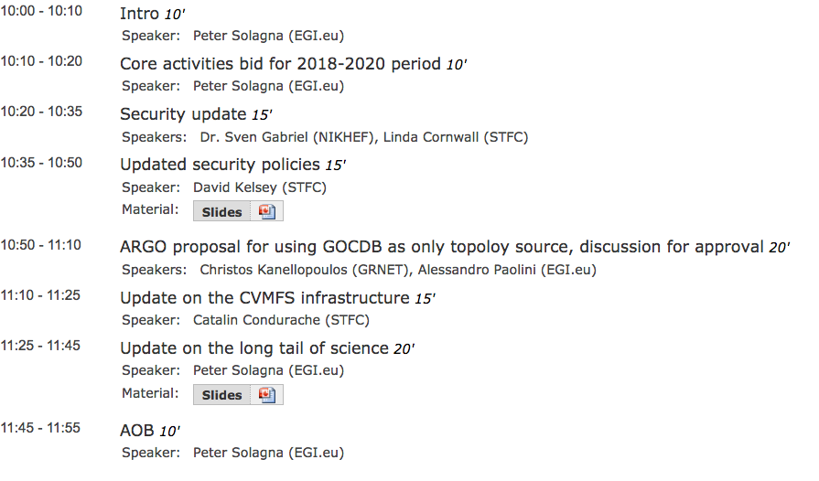

Slide 3
Operations Portal OTAG
Friday, November 4th at 15:00 CET
https://indico.egi.eu/indico/event/3132/
OTAG meeting to discuss requirements for the future development of the Operations portal
NGI representatives participation is very important
Please, take a look at the portal, and in particular at the new features such as the GLUE2 browser
http://operations-portal.egi.eu/vapor/resources/GL2ResSummary

Slide 4
Open Stack swift probe
A probe for the Openstack object storage solution is ready for deployment
In the next weeks will be deployed in the central monitoring
Initially only to validate the probe
No effect on dashboard/statistics

Slide 5
Storage accounting: testing DPM
APEL team is currently testing storage accounting with some DPM sites
If there are more sites interested in deploying the storage accounting (deploying DPM), please contact alessandro.paolini@egi.eu

Slide 6
UMD-3 issue
Signature problem with the UMD-3 configuration package:GGUS #122424
It cannot be installed without disabling the gpg check
Fix will be released by the end of the day

Slide 8
Core activities bid 2018-2020
Peter Solagna – EGI Foundation

Slide 9
Bid phase III: fact sheet
Phase II: current core activities will continue until end of 2017
Phase III: new bid for the period January 2018 – Dec 2020 (tentative)
The output of the PhaseIII bid will be used for the EINFRA-12 project proposal
Including most of the core activities in the bid, if not all
Call circulated to the council yesterday, closing on November 20th

Slide 10
Activities in the bid
Message brokers
Accounting repositories and portal
Monitoring
Service registry (GOCDB)
Services for AAI (CheckIn)
Online CA
Marketplace and resource allocation
Helpdesk (GGUS)
Helpdesk human support
Collaboration tools
Application DB (virtual appliances and applications library)
Operations Portal
Security coordination and security tools
UMD and CMD quality assurance
UMD and CMD software provisioning infrastructure
DIRAC4EGI

