Slide 1

Plans to support IPv6-only CPU on WLCG
David Kelsey (STFC-RAL)
Chair of HEPiX IPv6 working group
EGI OMB meeting
15 Dec 2016

Slide 2
Members of the HEPiX IPv6 group 2016
M. Babik (CERN), J. Chudoba (FZU), A. Dewhurst (RAL), S. Fayer (Imperial), T. Finnern (DESY), T. Froy (QMUL), C. Grigoras (CERN), K. Hafeez (RAL), B. Hoeft (KIT), T. Idiculla (RAL), D. Kelsey (RAL, Chair), F. Lopez Munoz (PIC), E. Martelli (CERN), R. Nandakumar (RAL), K. Ohrenberg (DESY), F. Prelz (INFN), D. Rand (Imperial), A. Sciaba (CERN), U. Tigerstedt (CSC), D. Traynor (QMUL)
And recently joined: H. Ito (BNL), A. Zaytsev (BNL), X. Espinal (CERN), J. Belleman (CERN), A. Falabella (CNAF), M. Bly (RAL), C. Condurache (RAL)
Plus many others in earlier times
Many thanks to them all!

Slide 3
Overview
Working Group timeline
IPv6 global status
Dual-stack storage and IPv6 data transfers
Support for IPv6-only CPU

Slide 4
HEPiX IPv6 Working Group
Timeline
2011: Started work
CHEP2012: “From IPv4 to eternity” – a talk presented the working group plans
2012-2014: Testbed activities and working with Storage developers
CHEP2013: Paper “WLCG and IPv6 - the HEPiX IPv6 working group” (testbed)
2015: Requested LHCOPN/ONE IPv6 peering & dual-stack perfSONAR
CHEP2015: Paper “The production deployment of IPv6 on WLCG” (dual-stack)
2016: Now encouraging more dual-stack storage
CHEP2016: Plans for IPv6-only CPU
2017: First support for IPv6-only CPU

Slide 5
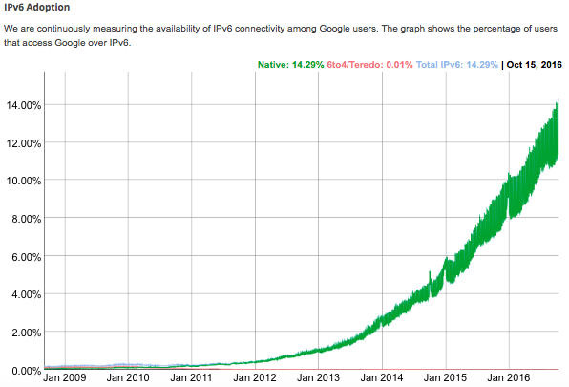
Global IPv6 status
Based on slide from Alastair Dewhurst
Over 14% of access to Google services now via IPv6
  https://www.google.com/intl/en/ipv6/statistics.html
Some commercial hosting companies offer cheaper IPv6 only services
June 2016, Apple now mandates all Apps submitted to the App Store must support IPv6-only networking
September 2016, Microsoft Azure VMs now available as IPv6
For HEP:
  11 sites currently provide dual stack storage.
  2 sites running IPv6 WN (With NAT64/DNS64).

Slide 6
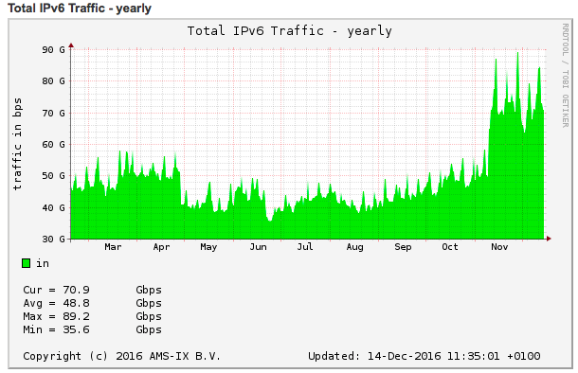
IPv6 traffic at AMS-IX 2016
https://ams-ix.net/technical/statistics/sflow-stats/ipv6-traffic

Slide 7
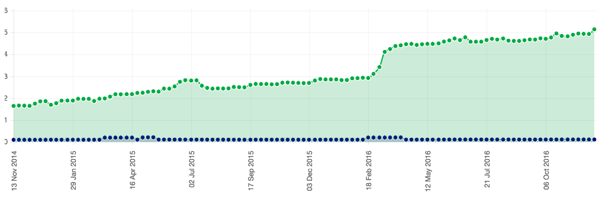
WLCG Dual-Stack services
Services in BDII
Fraction of IPv6 reached ~5%

Slide 8
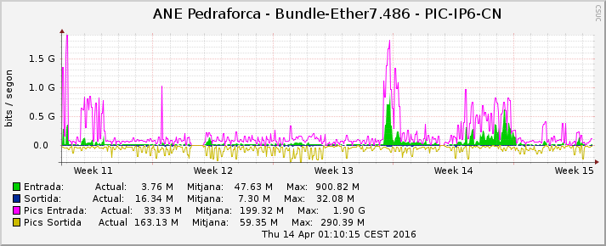
PIC IPv6 traffic 2016
dCache IPv6 traffic from PIC to Tier 2 over general internet

Slide 9
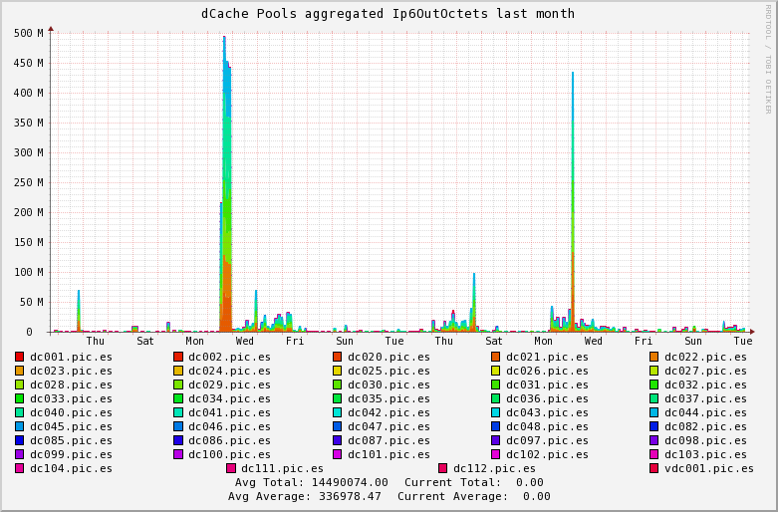
PIC dCache IPv6 traffic (2)
dCache IPv6 traffic from PIC to other sites in Aug 2016 (MBps)
Peaks of ~500 MBytes/s
(4 Gbps average)
- to Imperial, London
Tuesday 30th August with a duration of about 12 hours

Slide 10
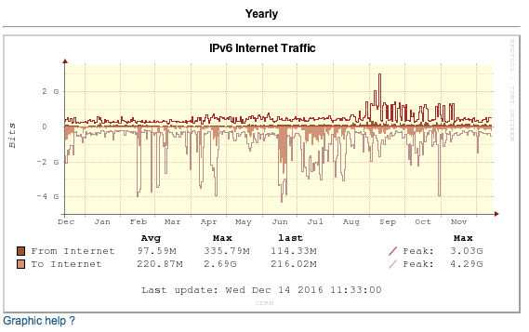
IPv6 internet traffic CERN

Slide 11
Dual-stack Storage & IPv6 data transfers
Most storage solutions and protocols now work in dual-stack mode
  dCache, DPM, StoRM, FTS
  XrootD 4, GridFTP, http
Several sites have been running dual-stack for some time
Production data transfers over IPv6 are happening!
We are working on per experiment monitoring over time
  What fraction of data transfers are IPv6?
It works!

Slide 12
Support for IPv6-only worker nodes/VMs

Slide 15
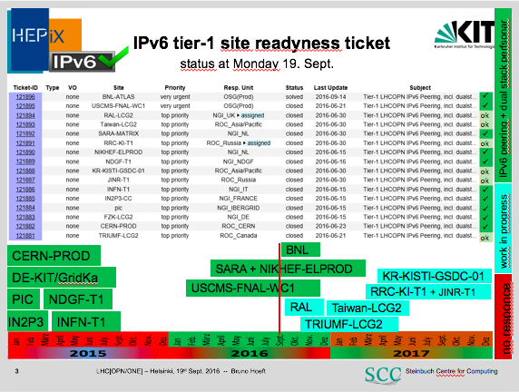

Slide 16
LHCOPN/IPv6 updates
TRIUMF now peering over IPv6
ASGC/Taiwan peering over IPv6 for perfSONAR and testing
Dual-stack perfSONAR
  new sites: BNL, RAL, TRIUMF, ASGC
LHCOPN peering still to come
  RAL
  KISTI
  Russia

Slide 17
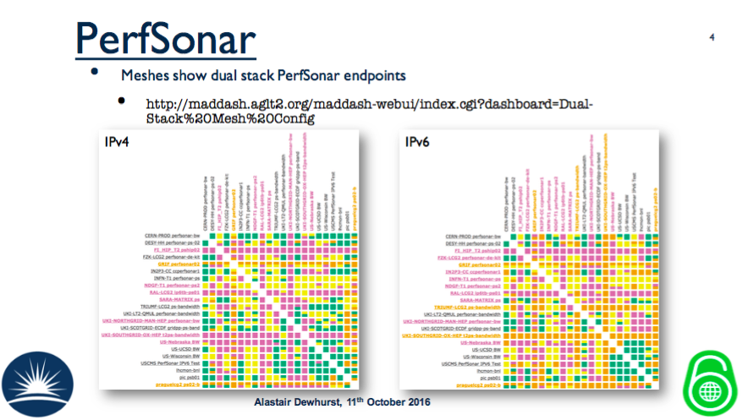

Slide 18
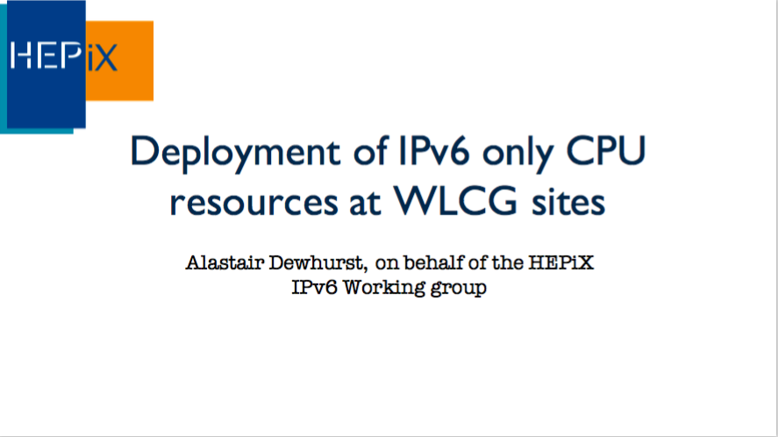
Slides shown at CHEP2016, San Francisco, Oct 2016

Slide 19
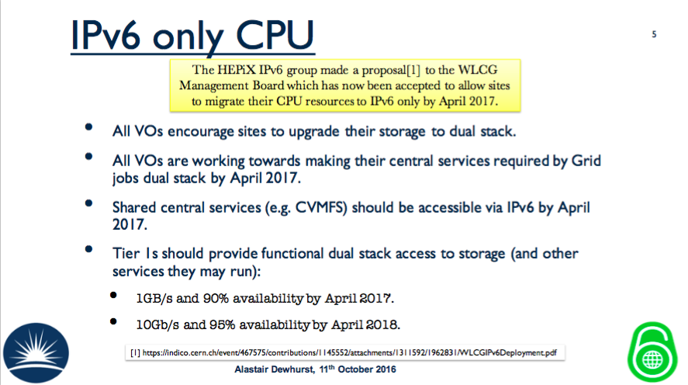

Slide 20
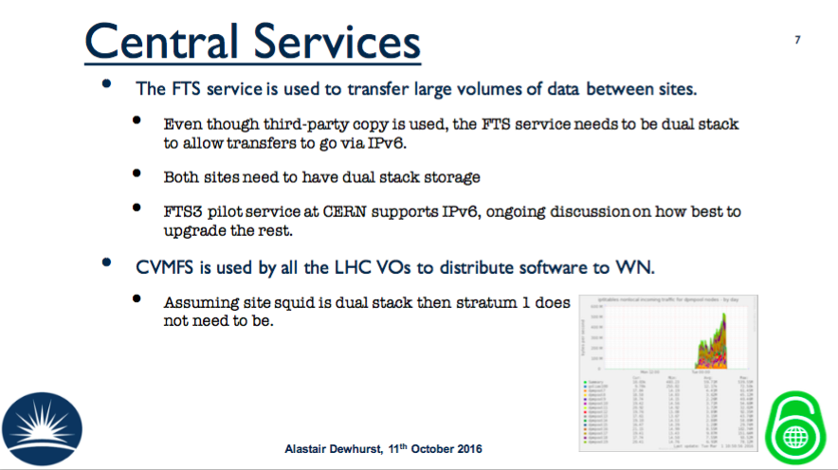

Slide 21
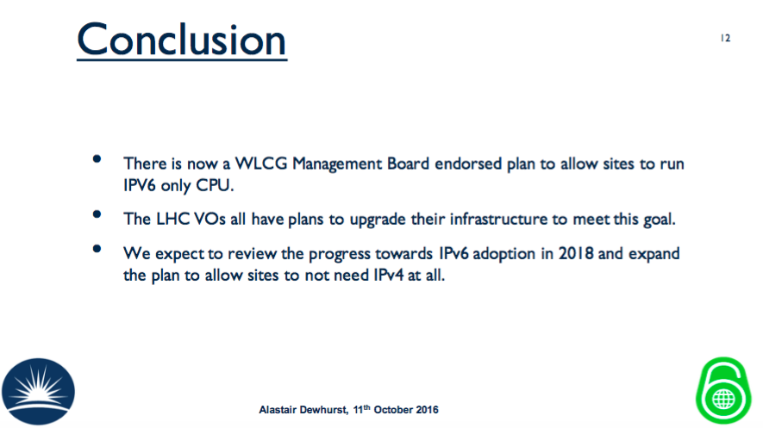

Slide 22
Some final words
Any site wishing to deploy IPv6-only CPU (WN/VM)
  Must discuss with the working group
  Must discuss with the Expts/VOs they support
If you notice IPv6 problems
  Please investigate (often down to config. errors)
  Ask ipv6@hepix.org for help/advice
  Don’t just turn off IPv6 (or make IPv4 default)
WLCG Tier 2s need to plan NOW for IPv6 deployment
  Work together with your site network team
  Dual-stack perfSONAR
  Then dual-stack storage
Request to EGI for all central services and webs/wikis to be dual-stack

Slide 23
Links
HEPiX IPv6 web
http://hepix-ipv6.web.cern.ch
Working group meetings
http://indico.cern.ch/categoryDisplay.py?categId=3538
WLCG Operations IPv6 Task Force
http://hepix-ipv6.web.cern.ch/content/wlcg-ipv6-task-force-0
Papers published in proceedings of CHEP2013 and CHEP20015 (and CHEP2016 to come)

Slide 24
Questions?

Slide 25
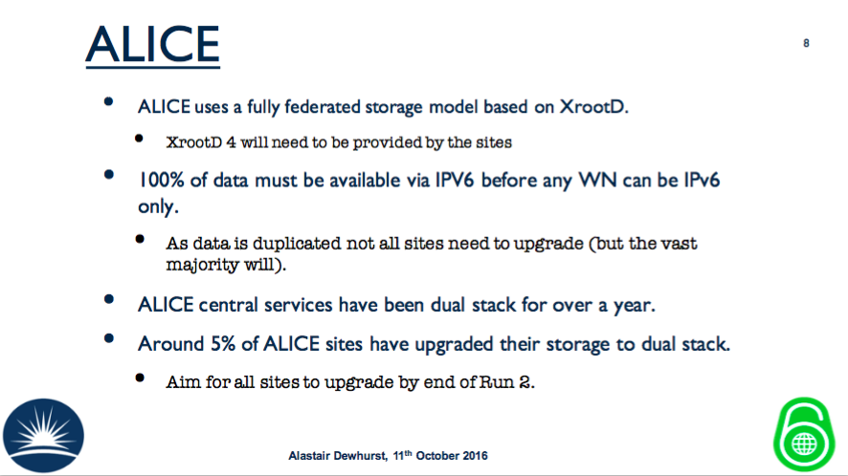

Slide 26
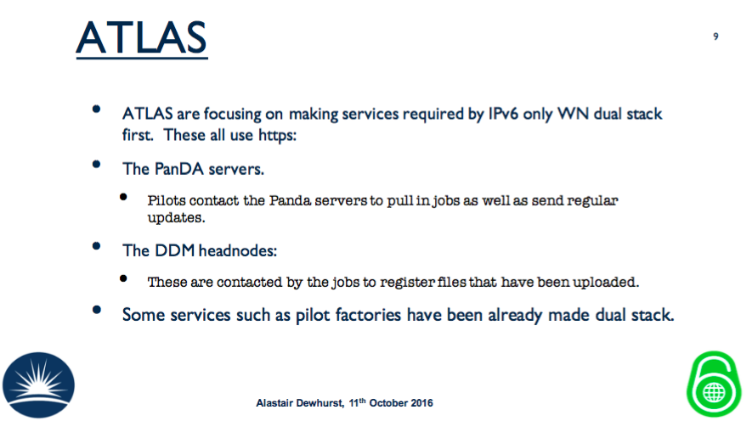

Slide 27
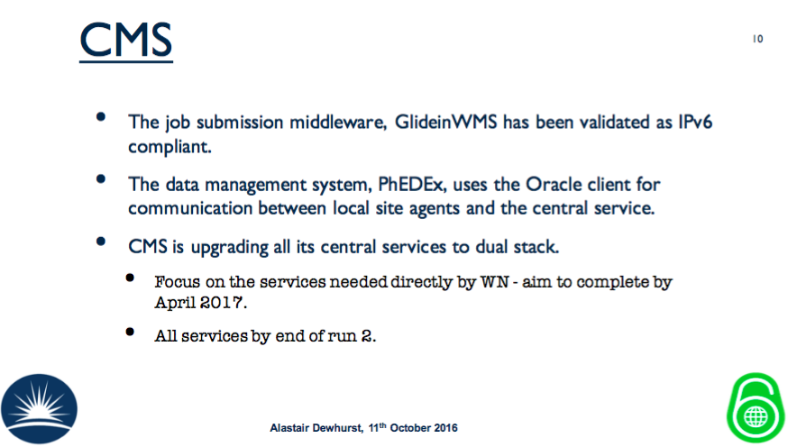

Slide 28
