Slide 1

EDISON Professional Training and Certification Scheme
WP4
26 January 2016
EDISON – Education for Data Intensive Science to Open New science frontiers
Grant 675419 (INFRASUPP-4-2015: CSA)

Slide 2
Summary
WP4 compared ITIL-FitSM and PMI schemes
PMI concept has been chosen but simplified taking to account project constraints
Idea: Find the Certification that Fits You Best
  Pick a certification best meets your experience and needs
  No certification is a pre-requisite for another, however some pre-requisites on individual courses

Slide 3
Summary
Types of certifications:
  General
    Data Scientist Associate – for students or professionals who want to become Data Scientists
      (Foundation) understanding of the fundamental knowledge, terminology and technics of effective data science.
      Based on CF-DS and DS-BoK
    Data scientist Specialist/Professional – for experienced Data Scientists who would like to prove/improve their proficiency
      (Professional/Expert) competence to perform in the role of a Data Scientist and lead data research projects
      Compliant with on CF-DS and DS-BoK, but can go beyond
      Should be independent from scientific field DS is applied
  Specialised
    For experts to demonstrate knowledge and expertise in the specialised area
    Types depending on market need
      How people specialise
      What kind of specialisations are needed on the market
    Can be science area specific and DS profession skill specific
      e.g. DAE (analysis and engineering)

Slide 4
EDISON Certification Overview:
General
Specialisation
Data Scientist Associate
Description
Price
Data scientist Specialist/Professional
Description
Perquisites
Perquisites
Exam
Exam
Practitioner in ??
Description
Price
Perquisites
Exam
Practitioner in ??
…
…
…
Price
…
Notes:
Practitioner, Professional, Associate, Specialist

Slide 5
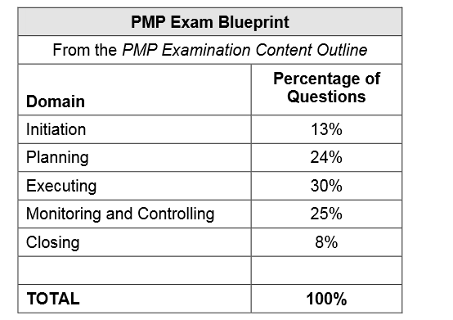
EDISON Certification Overview
The proportion of questions from each domain that will appear on the examination
Proposed domains:
Data Analytics
Data Management and Curation
Data Science Engineering
Research Infrastructure Management and Operation
Scientific and Research methods
Domain related expertise
Communication and interdisciplinary expertise
TODO:
Agree on domains – input from WP2?
Decide proportions of the questions for each examination type - decide which skills are more esential/take more time

Slide 6
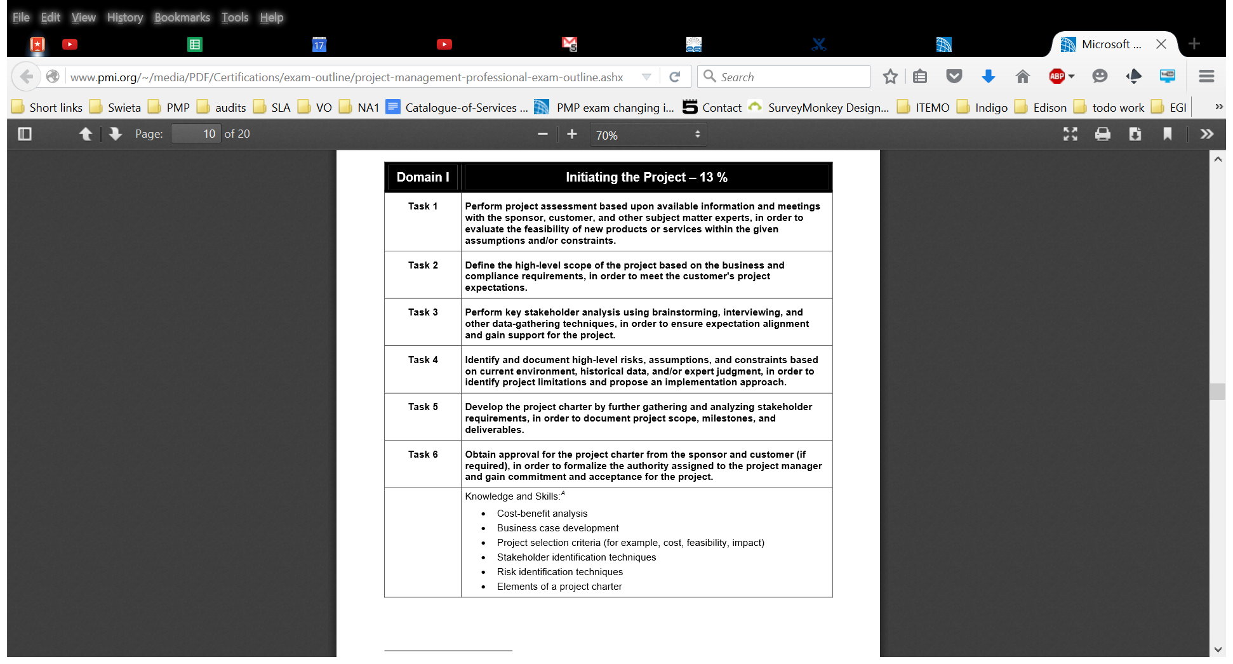
EDISON Certification Overview
Outline - for each Domain define:
Tasks
Knowledge and skills
cross-cutting knowledge and skills, which are used in multiple domains and tasks
*Needed to clearly define what will be checked during the certification.

Slide 7
Exam outline example:
No. | Topic Level 1 Requirements: | No. | Topic Level 2 Requirements: | No. | Topic Level 3 - The candidate can: | Weight
1 | Service and service management basics | 1.1 | Understanding service | 1.1.1 | explain what an (IT) service is | 30%
 |  |  |  | 1.1.2 | describe the components of an (IT) service
 |  | 1.2 | Understanding (IT) service management | 1.2.1 | explain the concept of (IT) service management
 |  |  |  | 1.2.2 | explain the benefits and risks of (IT) service management
 |  |  |  | 1.2.3 | describe the role of tools used within (IT) service management
 |  | 1.3 | Understanding processes | 1.3.1 | describe the benefits and characteristics of a process-based approach
 |  |  |  | 1.3.2 | describe how to measure and control a process
 |  |  |  | 1.3.3 | explain why and which roles are needed
 |  | 1.4 | Understanding continual improvement | 1.4.1 | identify the principles of the plan-do-check-act cycle
 |  |  |  | 1.4.2 | describe what maturity is and how maturity models work
 |  |  |  | 1.4.3 | explain the nature of assessments, reviews and corrective and preventive actions
 |  | 1.5 | Understanding the landscape of standards and frameworks | 1.5.1 | identify the purpose and stakeholder of CMMI, COBIT, ISO 9000, ISO/IEC 20000, ISO/IEC 27000, ITIL
 |  | 1.6 | Understanding the specific challenges of Service Management in federated IT infrastrutures | 1.6.1 | describe the differences between linear chains of responsibility and collaborative approaches to service provisioning.
 |  |  |  | 1.6.2 | describe different kinds of federation and which approaches to service management are suitable in different cases.
2 | Service management processes: Objectives, concepts and requirements | 2.1 | Understanding the processes for Service planning and delivery | 2.1.1 | describe the objective, key concepts and requirements of the Service Portfolio Management process; | 70%
 |  |  |  | 2.1.2 | describe the objective, key concepts and requirements of the Service Level Management process;
 |  |  |  | 2.1.3 | describe the objective, key concepts and requirements of the Service Reporting Management process;
 |  |  |  | 2.1.4 | describe the objective, key concepts and requirements of the Service Continuity & Availability Management process;
 |  |  |  | 2.1.5 | describe the objective, key concepts and requirements of the Capacity Management process;
 |  |  |  | 2.1.6 | describe the objective, key concepts and requirements of the Information Security Management process;
 |  |  |  | 2.1.7 | describe the objective, key concepts and requirements of the Customer Relationship Management process;
 |  |  |  | 2.1.8 | describe the objective, key concepts and requirements of the Supplier Relationship Management process;
 |  | 2.2 | Understanding the processes for Service operation and support | 2.2.1 | describe the objective, key concepts and requirements of the Incident & Service Request Management process;
 |  |  |  | 2.2.2 | describe the objective, key concepts and requirements of the Problem Management process;
 |  |  |  | 2.2.3 | describe the objective, key concepts and requirements of the Configuration Management process;
 |  |  |  | 2.2.4 | describe the objective, key concepts and requirements of the Change Management process;
 |  |  |  | 2.2.5 | describe the objective, key concepts and requirements of the Release & Deployment Management process;
 |  |  |  | 2.2.6 | describe the objective, key concepts and requirements of the Continual Service Improvement process;

Slide 8
Outline proposal (draft)
Data Analytics
  Use appropriate statistics to provide insight on data
  Use appropriate techniques for analysing data (A/B Testing, Association rule Learning, Crowdsourcing, Data fusion and integration, Data Mining, Ensemble learning, Machine learning)
  Use Predictive analytics to analyse big data and discover new relation
  Research and analyse complex data sets, combine different sources of data to improve analysis
  Develop specialised analytics to enable agile decision making
Data Management and Curation
  Develop and implement data strategy
  Develop data models including metadata
  Collect, Integrate, and manage different data source
  Develop and maintain a historical data repository of analysis
  Visualize complex and variable data
  Manipulate and analyse complex, high-volume, high-dimensionality, (non)relational and (un)-structured
  data from varying sources

Slide 9
Outline proposal (draft)
Data Science Engineering
  Use engineering principles to research, design, or develop, instruments, experiments, processes, systems, or technologies
  Develops specialized data analysis tools to support executive decision making
  Design efficient algorithms for accessing and analysing large for multiple data source
  Ability to use Big Data frameworks/solutions
  Develop software solution that exploit Multi-core/processor and distributed systems (Cloud, super-computers) for both Linux and Microsoft Operating systems.
  Design, build, operate relational (SQL) non-relational databases (NoSQL)
  Develop software solutions for secure and reliable data access
  Programming skills: Statistical analysis languages and tooling
Research Infrastructure Management and Operation
  General knowledge about existing European and National (types, how to in get involved, …)
  Use existing RIs European and National to perform large scale experimentations
  Understand the technical Operation and Exploitation of existing Ris
  Understand the Policy-making of RIs in Europe and the world

Slide 10
Outline proposal (draft)
Scientific and Research methods
  Create new understandings by using scientific and research methods (hypothesis, experimentation, and evaluation techniques)
  Initiate systematic studies to enable deeper knowledge or understanding of the fundamental aspects of observable facts, and phenomena
  Apply the eScience approach and tools to data processing (eScience lifecycle, data lifecycle, …)
Domain related expertise
  Translate Data domain specific technical challenges into data science engineering requirements
  Understand Data domain specific business requirements and translate them into technical requirement
  Use existing domain specific tools and services to better manipulate, process the data
Communication and interdisciplinary expertise
  Understand and deal with the communication Barriers in interdisciplinary collaboration
  Know techniques for team building (leadership and management attributes; communication strategies;, personal rewards, training and development)
  Understand Business process management (improve business using Big data and a data Analytics, IS and Business strategy alignments, Service Level Management, Business plan development)
  Ability to use tools to facilitate and enhance the processes and outcomes of collaborative, team-based work
  Data scientist should have Inter-professional education, combining at least two different fields.

Slide 11
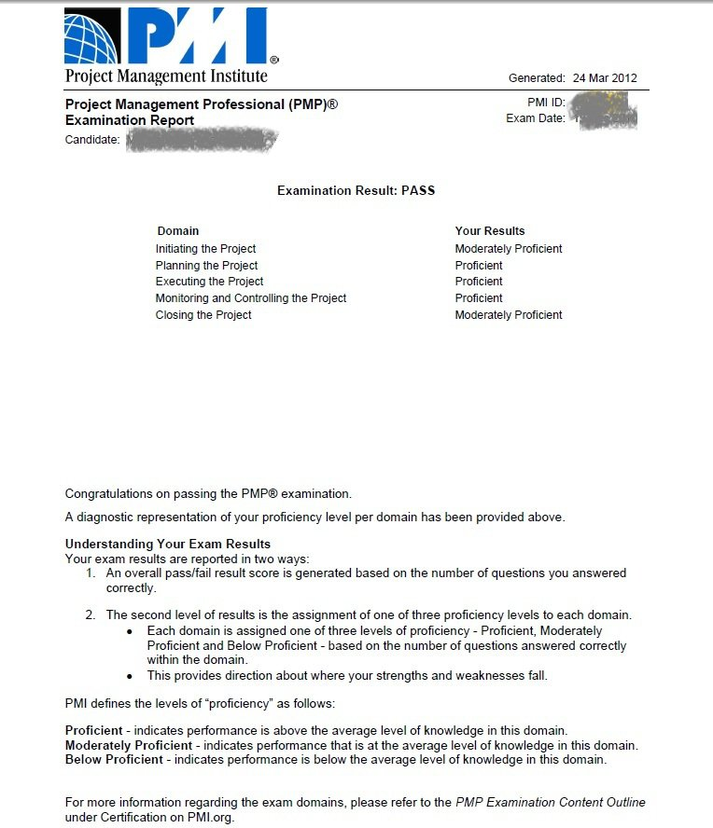
EDISON Certification Overview
Result:
Provide your proficiency result per domain
You can get result below proficiency score for a domain and still pass
TODO:
Define rules for passing

Slide 12
EDISON DS Associate exam
Topics which may be covered:
What is Data Science; Background
EDISON Data Science Competence Framework
Intro into Data Science
  Competencies and Skills
  Scientific Methods
  Business Process Operations
  Roles and Profiles
Career paths and job market
Related standards, frameworks and initiatives
Understanding concept, terminology, tools
Etc
TODO:
Define level of difficulty

Slide 13
EDISON DS Associate format
General:
  The exam is closed book, i.e. no aids are allowed.
  The exam consists of XX multiple-choice questions.
  Each question comes with four possible answers (A, B, C and D).
  One of these answers is correct.
Instructions:
  Please mark the correct answer for every question.
The time allowed for completing this exam is XX minutes.
Evaluation:
  For each correct mark, you receive 1 point.
  Example: The maximum number of total points that can be achieved for this exam is 20. If you obtain 13 points (65 per cent of the maximum score) or more, the exam is passed.
TODO:
Define number of questions and passing rate
Notes:
I would add more questions

Slide 14
EDISON DS Associate exam format: Example
Sample Question
Correct answer | Which of these cities is located in Europe?
 | Tokyo
X | b) Paris
 | c) New York
 | d) Rio de Janeiro
Correct answer (B) marked
Resulting score for this question: 1 point
0 points in any other case (incorrect answer marked or more than one answer marked)

Slide 15
EDISON DS Professional/Expert exam
Topics which may be covered:
  Data Mining
  Machine Learning
  Data Analytics applications development
  Scientific programmer
  Data Science/Big Data Infrastructure engineer/developer/operator
  Digital Librarian, Data Archivist, Data Curator
  Data Science creative
  Data Science consultant/Analyst
  Domain specifics
  Organisational workflow/processes model definition/formalisation
  Data models and data structures
  Apply data analytics methods (to organizational processes/data)
  Data analytics application development
  Data management applications and tools
  Data Science infrastructure deployment
  User/Usage data/statistics analysis
  Service delivery/quality data monitoring
  Information and Knowledge Management (powered by DS) – refactored
  Data presentation/visualisation, actionable data extraction
  Support business processes/roles with data and insight
  Data management/preservation/curation with data and insight
  Business Process Management
  Business Analyst
  Big Data Platforms and Tools
  e-Infrastructures
  Relations between Data Scientist and Subject Domain specialist
  Employing new skills into job market
TODO:
Define level of dificulty

Slide 16
EDISON DS Professional/Expert format 1
General:
  The exam is closed book, i.e. no aids are allowed.
  The exam consists of XX multiple-choice questions.
  Each question comes with six possible answers.
  Each of these answers may either be true or false.
Instructions:
  Please mark every correct answer with a cross in the column labelled "True" and each incorrect answer with a cross in the column labelled "False".
  You may decide not to mark any of the two options for a given question.
The time allowed for completing this exam is XX minutes.
TODO:
Chose format, define number of questions and passing rate

Slide 17
EDISON DS Professional/Expert format 1
Evaluation:
  For each correct mark, you receive 1 point which is added to the total score for the respective question.
  For each incorrect mark, 1 point is deducted from the question's total score.
  For each answer which is left unmarked, 0 points are added or deducted.
  The maximum score per question is 6 points.
  The minimum score per question is 0 points, even if the number of incorrect marks is higher than the number of correct marks for this question (no negative question total scores).
  The maximum number of total points that can be achieved for this exam is 180. If you obtain 135 points (75 per cent of the maximum score) or more, the exam is passed.

Slide 18
EDISON DS Professional/Expert format 1
Sample Question
True | False | Which of these cities are located in Europe?
X |  | Paris
X |  | Barcelona
 | X | New York
 | X | Rio de Janeiro
X |  | Munich
X |  | Helsinki
All marks correct
→ Resulting total score for this question: 6 points

Slide 19
EDISON DS Professional/Expert format 2
Exam tests knowledge, application and analysis
The multiple-choice format examination.
Usually based on use cases, story
Some questions are formula-related calculations
Types of questions:
  Situational questions – require to integrate real-world experience and knowledge. Example: What is the best to do?
  Question with two or more right answers – What is the first thing to do?
  Questions with extraneous information – check understanding of the situation - Not all information is relevant
  Questions using made-up terms as answers – check knowledge about terminology

Slide 20
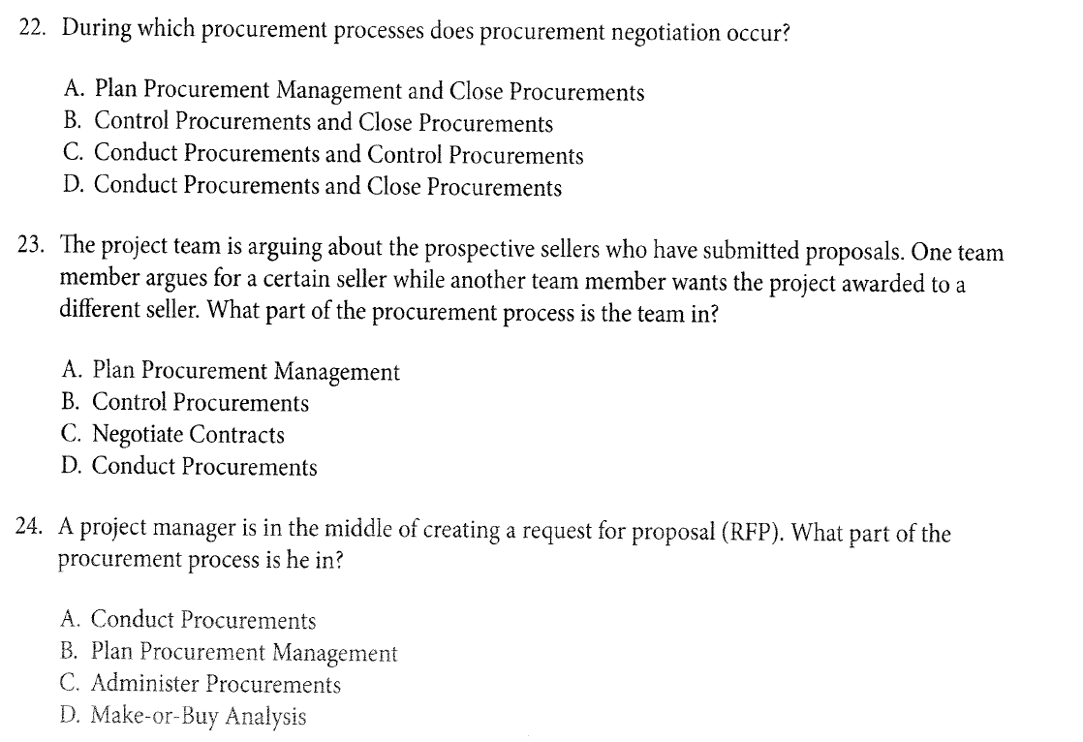
EDISON DS Professional/Expert format 2
Sample Question

Slide 21
Registration as a EDISON training organisation
When should you register your organisation as an EDISON training organisation?
  If you are going to organise internal EDISON trainings and exams for the members / employees of your organisation, which will be given by one or more trainers associated with your organisation
  If you are going to offer public EDISON trainings and exams or internal EDISON trainings and exams for other organisations, which will be given by one or more trainers associated with your organisation
How to register:
  Select an EDISON certification body / examination institute
  Fulfil the registration according to the procedures of the certification body.
  (This usually includes the provision of some information on the organisation and the foreseen trainers as well as an image file of the organisation’s logo for inclusion in the public website of the certification body, if desired)
Notes:
Additional information:
Registration as an EDISON training organisation is a prerequisite for registering individual EDISON trainers and ordering EDISON exams from the certification body.
Registration as an EDISON training organisation would free of any charges with any certification body contracted under ITEMO e.V.

Slide 22
EDISON trainer policy
To give any training from the EDISON qualification scheme, the trainer must comply with the following:
  Need deep discussion applicable for Universities
  If the trainer offers EDISON training(s) individually, the trainer must, prior to ordering the exam from an EDISON certification body [e.g. TUV SUD], register with the certification body him-/herself which will require the trainer to provide at least the following information:
    Personal and contact data
    Record or evidence of relevant training, education and experience
The certification body and the ITEMO e.V. EDISON qualification working group may monitor exam results and training / exam feedback, supervise trainings and exams and reserve the right to revoke trainer privileges. Trainings and exams may be subject to quality control mechanisms, and every trainer must commit to support and contribute to this process.
Notes:
Additional information:
Trainer registration according to the above policy is a prerequisite for ordering a EDISON exam from the certification body.
Trainer registration would be free of any charges with any certification body contracted under ITEMO e.V.

Slide 23



Example Sustainability Model
ITEMO e.V. (non-profit)
Maintenance of the EDISON certification scheme
[TBD] Maintenance and continual improvement of the training material
Certification body / examination institute
Processing and invigilation of EDISON exams
Issuing of certificates for persons after they passed the exams
Trainers and training organisations
Provision of EDISON trainings
Continual development and improvement of the pools of exam questions
Registration of trainers and training organisations
Overall quality control, training and exam feedback evaluation, …
[TBD] Optional: Contribution to the development of EDISON trainings (e.g. material)
….

Slide 24
Questions
Types of exams do we want to provide
  Base (DSA, DSS) minimum
  Future maybe specialised – TBD by wp2?
  Do we want to go beyond CF-DS and DS-BoK? Especially for DSS
  Examination Content Outline for both exams
    Decide proportions of the questions for each examination type - decide which skills are more esential/take more time
    Agree on domains
Prerequisites for each exam
  DSA – nothing/anyone ?
  DSS – University degree or XX working experience in DS ?
Exam questions
  Much less questions than PMI! (200)
  Define rules for passing
  Define level of difficulty
  Type of questions – especially for DSS

Slide 25
Questions
Training materials
  Ideally we want to provide materials, but maybe not within the project, only outline for examinations and CF-DS and DS-BoK
Certify organisations
  Not certification, but registration with certification authority?
Certify trainers
  Need deep discussion applicable for Universities

