Slide 1
Security Monitoring
Daniel Kouril
EGI CSIRT Meeting, 28. Jan 2016, Prague

Slide 2
Status update
Pakiti
Minor changes to Pakiti
Development of Pakiti v3 continues
Site certification
Security dashboard
New functions released in Dec 2015
Notes:
Minor but visible, pakiti dev - users

Slide 3
Security Dashboard
Notifications about security issues
https://operations-portal.egi.eu/csiDashboard/notificationsIssues
Capture WN instead of host : the Worker node is displayed (when available) instead of the host name into the list of issues
Metrics : we have put in place reports for the Nagios issues
https://operations-portal.egi.eu/csiDashboard/report
Sites under certification process : we have extended the list of sites to display potential issues on candidate sites

Slide 4
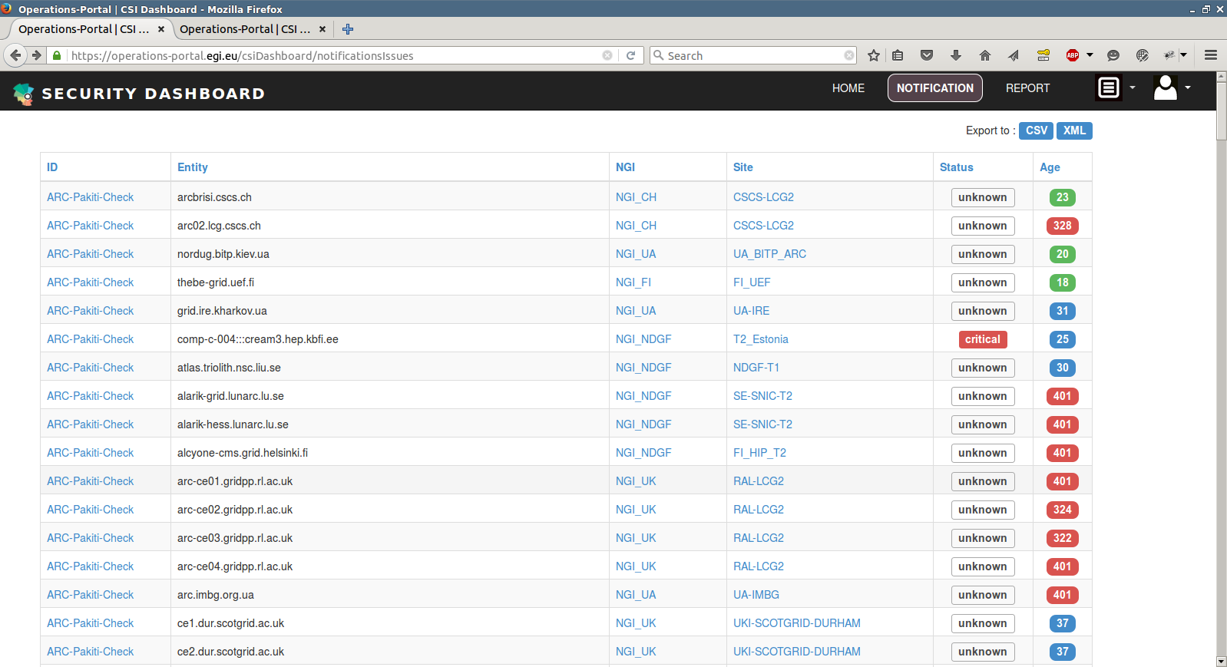

Slide 5
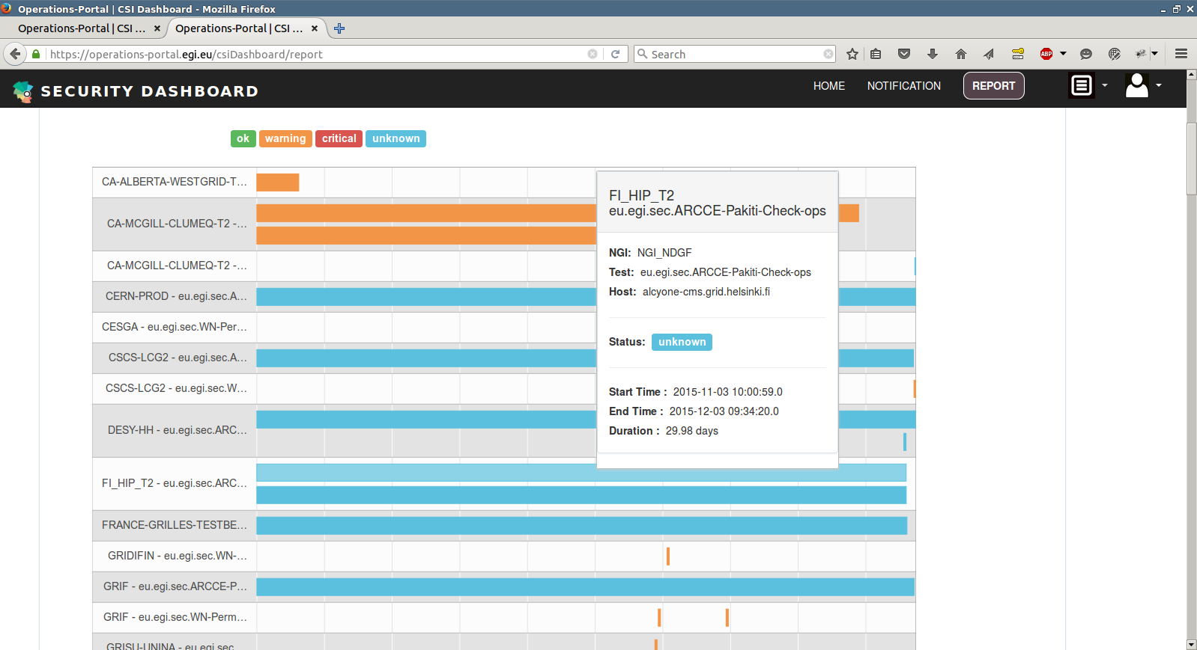

Slide 6
VA Assessment
Motivation
Common security flaws should be detected soon
Part of endorsement
Automated mechanism necessary
Notes:
Summary of talks in Bari, …

Slide 7
Secant
Automated framework to detect common flows in VM images
Instantiates a VM in a contained environment and runs a series of probes
External – nmap, “nessus”, weak passwords, …
Internal – Pakiti, configuration flaws - Lynis
Provides input for endorsement
Eventually should be integrated with AppDB
Code available
https://github.com/CESNET/secant
Waiting for ON update to provide a pilot at CESNET
Notes:
Engage

Slide 8
Short-term plans
Getting rid of Unknown status in Nagios
Secant pilot
Enable dashboard functionalities
Exception handling in Pakiti (?)

Slide 9
Longer-term ideas
Tools for cloud monitoring aimed at sites
Network-level monitoring
Collecting information about situation in EGI Fedcloud (honeypots, ..)

