Slide 1
EGI, EGI-ENGAGE and the Open Data Platform - Introduction

Slide 2
24 countries
CERN, EMBL-EBI
1 coordinating organization – EGI.eu

Slide 3
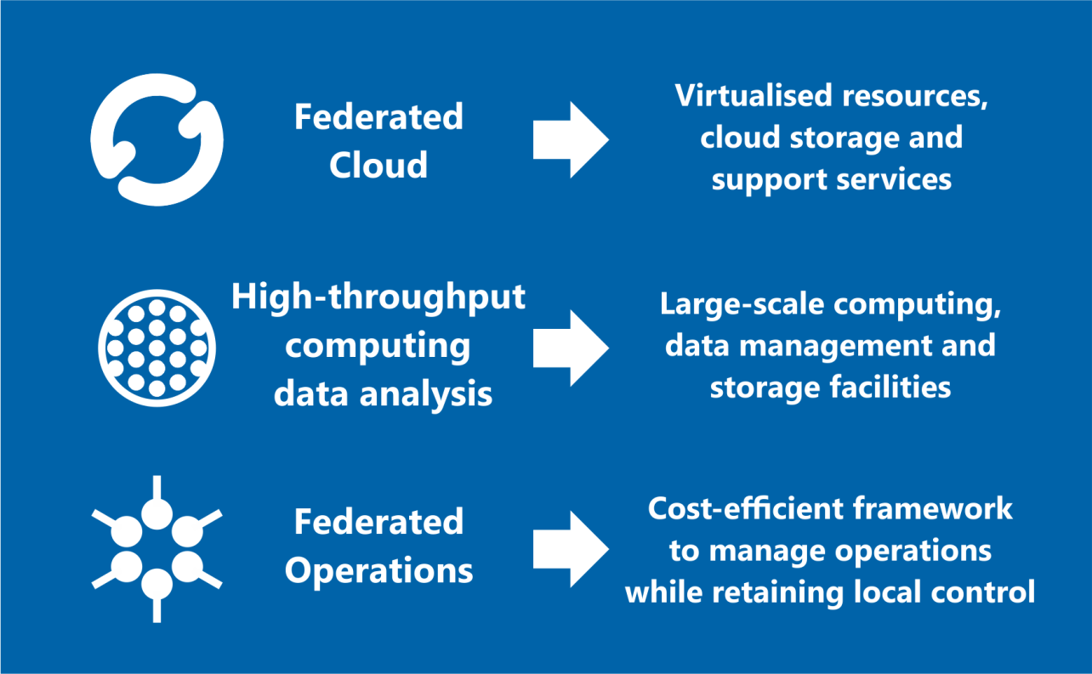
Open Solutions

Slide 4
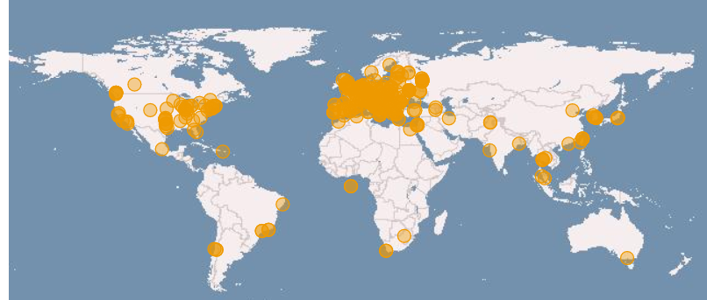
Global collaborations
Russia
Ukraine
Canada
USA
Asia
Pacific
Latin America
Africa
Arabia
www.egi.eu

Slide 5
EGI-ENGAGE
The flagship project of EGI
30 Months from Mar ‘15
€8M
1169 PMs
42 Beneficiaries

Slide 6
EGI-ENGAGE - User Engagement
User-centric approach, 39% of project effort for user-driven developments and integration, community engagement
User-driven co-development of federated HTC and cloud infrastructure with the support of 7 RIs on the ESFRI roadmap
Multiple user groups
long tail ad hoc services and policies
Research Infrastructures
Industry/SMEs
Data as a service
On-demand VREs (data products for information as a service)
Scientific software as a service

Slide 7
EGI-ENGAGE - Services
Evolution of the AAI infrastructure and security operations infrastructure
Technical evolution of the tools for federation including accounting, monitoring, resource allocation, operations tools)
Integration with infrastructure for PID registration and resolution
Development of the cloud solution
From IaaS to community-managed and/or EGI-managed PaaS
Federated secure cloud storage
Data as a service
Scalable access to “active” archives, no more separation between data and computing

Slide 8
EGI-ENGAGE - From IaaS to PaaS and DaaS
Development of new cloud solutions
From IaaS to community-managed and/or EGI-managed PaaS
Federated secure cloud storage
DaaS - Data as a service
Scalable access to “active” archives, no more separation between data and computing

Slide 9
EGI-ENGAGE - New Platforms
Federated services for education (supported by the federated cloud)
Infrastructure for citizen science
Federated GPGPU infrastructure
Virtual appliance library
On-demand VREs

Slide 10
EGI-ENGAGE - Business Models
From federation of community services to
Pay for use
Free at point of use
SLAs in a federated environment
Cross-border procurement of public services
Big data exploitation across domains

Slide 11
EGI-ENGAGE - Open Data Platform
Development of a prototype of a solution providing:
open data publishingu/use/reuse of
integrated data/computing services
integration of existing cloud infrastructures
integration of accelerated computing facilities (GPGPUs)
implementing AAI design from AARC
distributed AuthN, AuthZ
technology interoperation
Notes:
inc. scientific data released into the public domain
e.g. canadian CAMFAR
AuthN – IdP federations integration
AuthZ – att. authorities integration
technology interoperation via token translation

Slide 12
Supplementary slides

Slide 13
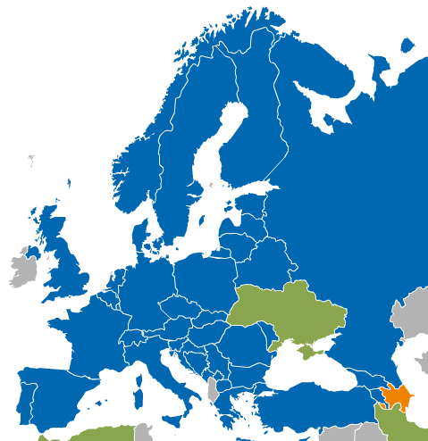
What is the EGI Federated Cloud?
The EGI Federated Cloud is federation of institutional private Clouds, offering Cloud Infrastructure as a Service to scientists in Europe and worldwide.
EGI Federated Cloud is based on:
Standards and validation: federation is based on common Open-Standards – OCCI, CDMI, OVF, GLUE, etc...
Heterogeneous implementation: no mandate on the cloud technology, the only condition is to expose the chosen interfaces and services.

Slide 14
AppDB - Appliances Marketplace
Web-based VM image catalogue with automatic deployment on the EGI Federated Cloud sites
Cloud VM image repository
Publish your image
Manage your VM images
Sharing
Automatic deployment on the cloud sites
Images automatically deployed on the cloud sites
Re-use images certified by EGI
Manage versions
Create private images
Automatic update
AppDB
Cloud Marketplace
Publish
image
Image deployed in cloud sites
Site 1
Site 2

Slide 15
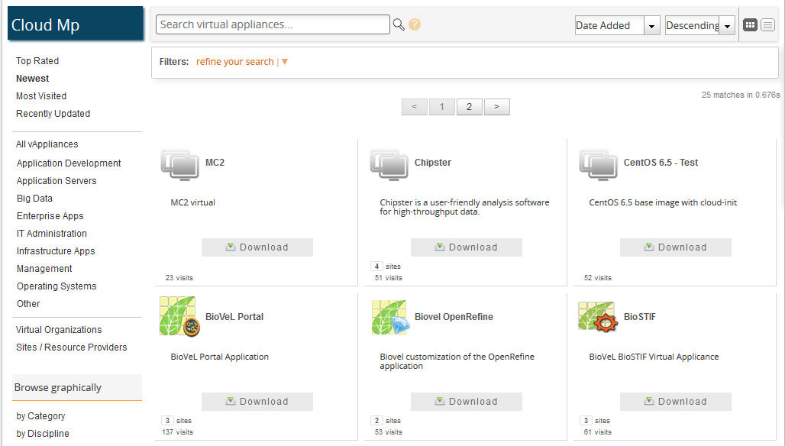
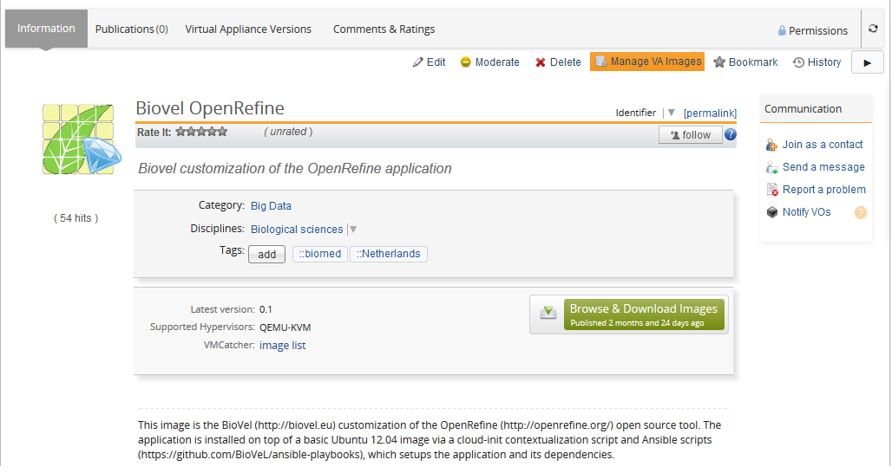
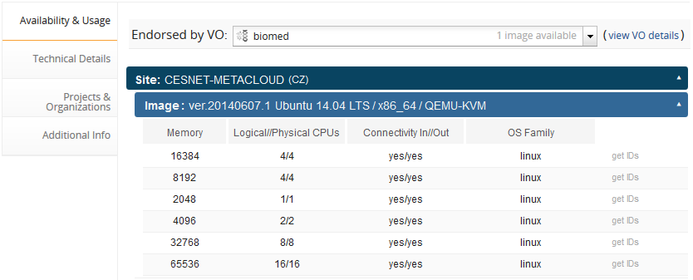
AppDB - Appliances Marketplace

Slide 16
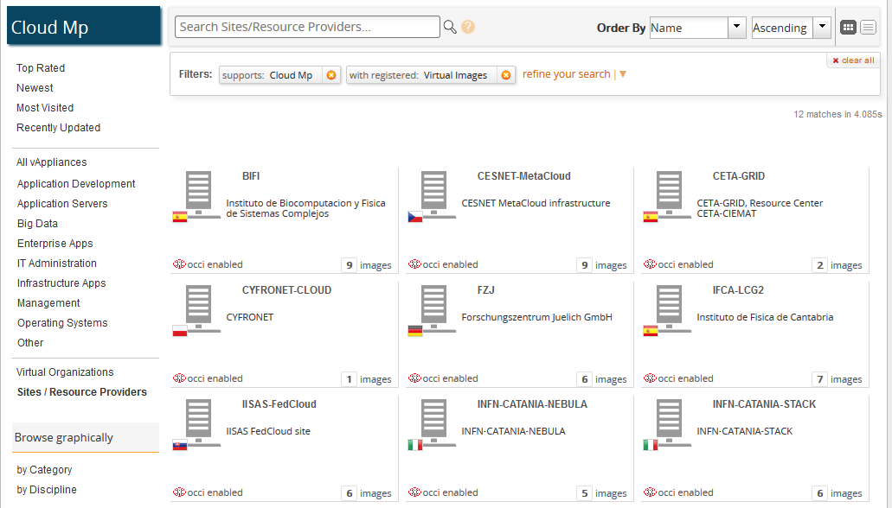
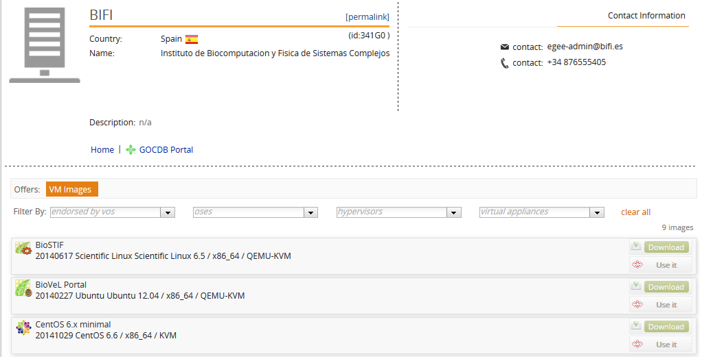
AppDB - Appliances Marketplace

