Slide 1
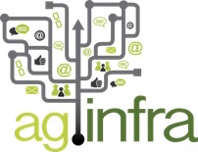
from to
strategy for evolution 2016-2020
Open Science Retreat, 23 Feb 2016, Amsterdam
Nikos Manouselis, Agroknow, Greece
Rob Lokers, Alterra, Wageningen UR, the Netherlands
05/02/16

Slide 2
World Food Summit
declaration, 2009
“...we will promote research for food and agriculture, including research to adapt to, and mitigate climate change, and access to research results and technologies at national, regional and international levels...
...we will reinvigorate national research systems and will share information and best practices...
...we will improve access to knowledge...”
Heads of State and Government, World Summit on Food Security, Rome, November 2009

Slide 3
welcome aginfra.org
data management & sharing infrastructure for agriculture & food
a global atlas of agricultural research & extension (including institutions, people, publications, data sets, projects, courses, OERs)
a semantic layer for processing, enriching & interlinking research information from distributed, heterogeneous sources & formats
a catalogue of software components (open source software stack & APIs) that anyone may use to process research information
a help desk service to support institutions & projects that wish to publish their research information openly
a set of data-rich service and application demonstrators for specific case studies (food safety, viti, crop composition, …)

Slide 4
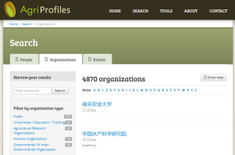
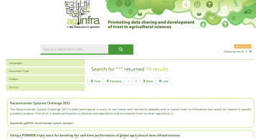
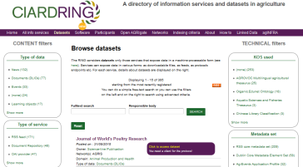
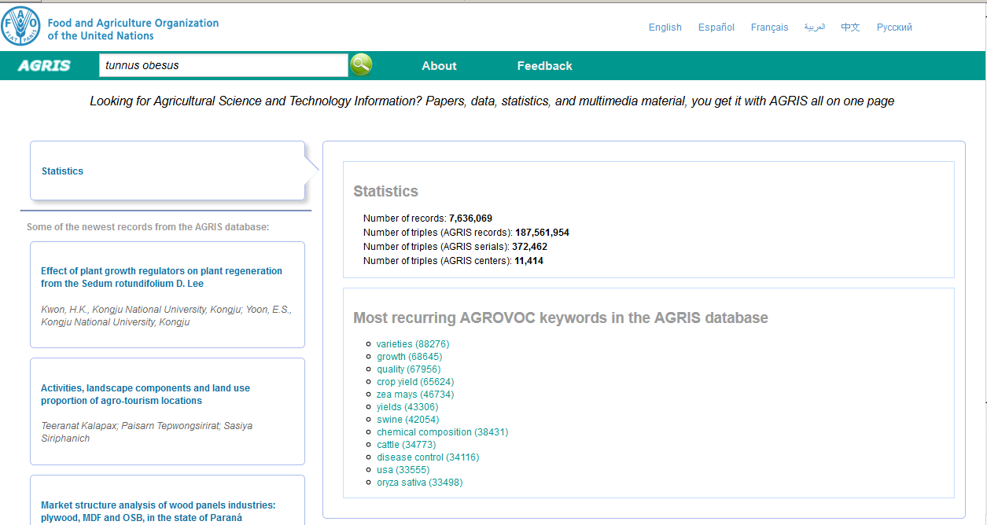
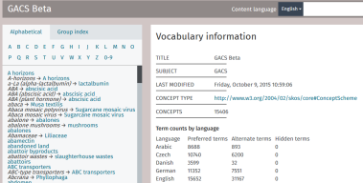
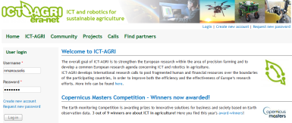
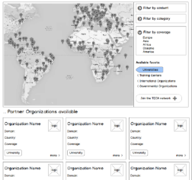
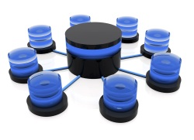
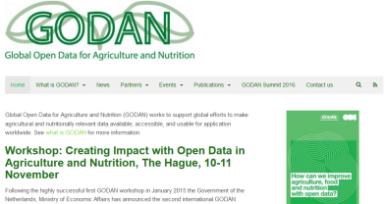
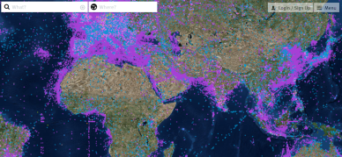
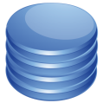
AGINFRA as a global agri-food research & extension atlas
AgriProfiles
E-infrastructure micro-sites
CIARD RING site
FAO’s AGRIS search
AgriSemantics/ GACS/ AGROVOC
ICT-AGRI ERANET OA search
GODAN data registry
Agri-food relevant IoT data points map
AgriProfiles providers (agri-food people, organisations)
AGRIS providers (agri-food publications)
CIARD RING providers (agri-food data, OERs & software)
VEST registry (schemas, ontologies)

Slide 5
AGINFRA as an enabler of communities
actively supporting global “data-providing & consuming” communities of practice
advocacy & decision making stakeholders (CIARD, GODAN)
agricultural data/knowledge managers, data scientists (e.g. FAO’s AIMS, RDA IGAD, ODI)
agri-tech software developers & companies (OADA, FIWARE)

Slide 6
AGINFRA as a resource for open research data
cataloguing public and private research outcomes published as open data
joining forces with global stakeholders advocating & supporting the publication of agri-food research data by the public & private sector

Slide 7
AGINFRA as a resource for open educational resources (OERs)
cataloguing public and private training & capacity building offerings
joining forces with global stakeholders advocating & supporting the publication of agri-food education as OERs

Slide 8
AGINFRA as a registry of IoT data points
federating existing catalogues of Internet of Things (IoT) data measurement & broadcasting stations
Such as Weather Underground, Smart Citizen, the UK Met Office Weather Observations Website, Netatmo, Thingspeak, Air Quality Egg, The International Soil Moisture Network , The Sea Turtle Conservancy
supporting search & visualisation of various data end points from IoT sources
similar to the way that the generic IoT search engine Thingful.net does

Slide 9
AGINFRA as an Open Access Help Desk
a domain-specific Open Access Desk for research & academic institutions carrying out work with funding from various donors with an open policy (e.g. H2020, CGIAR OA/OD, USDA/USAID, Gates…)
domain-specific & cross-donor support on Open Access requirements, Data Management Plans, etc.
help publishing & linking research outcomes from projects (esp. publications, research data sets) using domain ontologies & authority services
single point of service to disseminate through multiple channels (i.e. OpenAIRE, FAO’s AGRIS, USDA’s AGRICOLA)

Slide 10
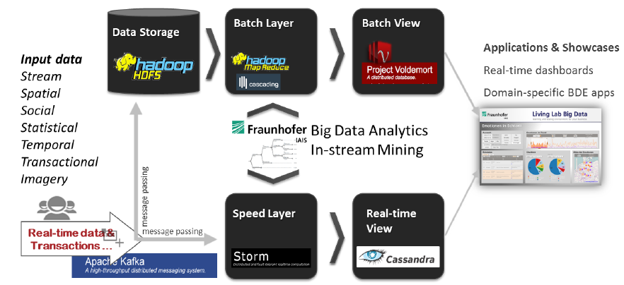
AGINFRA as an open stack of software for big data analytics & text/data mining

Slide 11
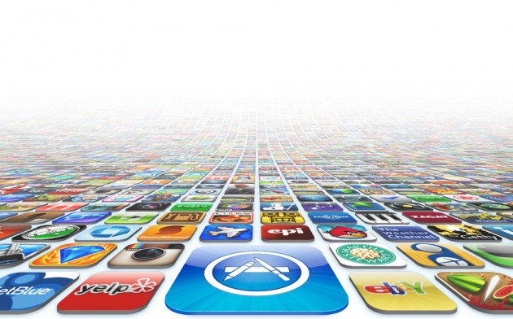
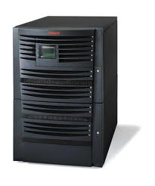
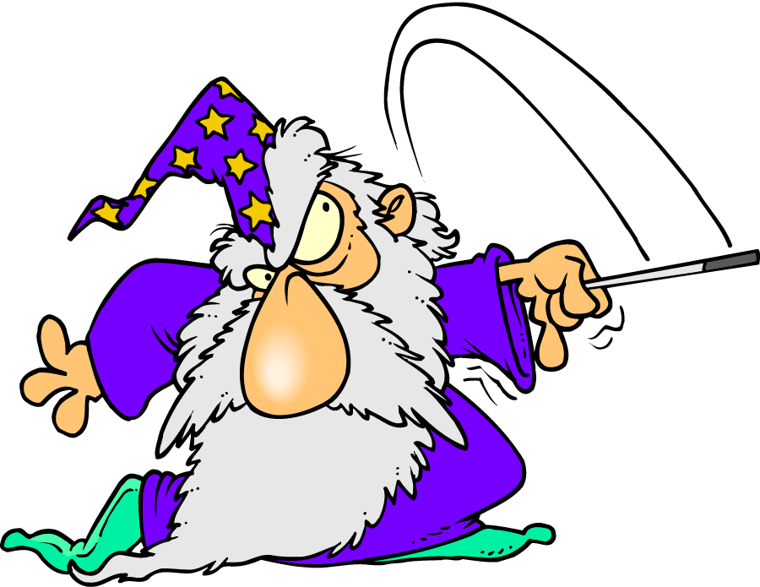
AGINFRA as the EOSC community node
Software apps/tools/services for research
(which may be powered by cloud & grid hosting and computing services & resources)
European Open Science Cloud
Domain specific data management & sharing infrastructure
All the researchers of Europe waiting eagerly to use research-oriented software apps/tools/services

