Slide 1
EGI vision for the EOSC
Tiziana Ferrari/EGI.eu
EGI Conference 2015
19 May 2015, Lisbon

Slide 2
Outline
Open Science and Open Science Commons
Open Science Cloud principles
EOSC Vision

Slide 3
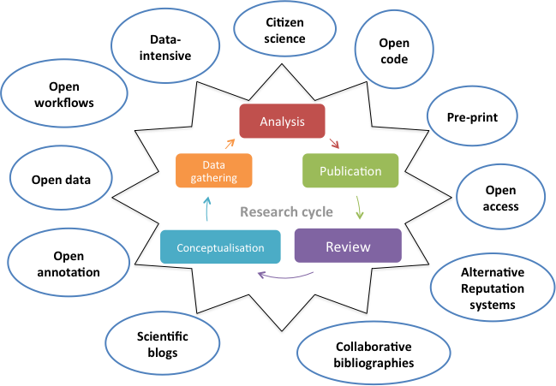
Open Science
Opening of the creation and dissemination of scholarly knowledge towards a multitude of stakeholders, from professional researchers to citizens
Openness
Participation
Collaboration
Sharing
Re-use
Greater social value
Source: http://goo.gl/uO9MK5

Slide 4
Open Science: a Complex Resource System
Shared resources
Integrated, easy and fair access
Engaged communities
Participating in the process
Culture of sharing
Collaborating in the management and stewardship
Governance
Rules to access
Rules to resolve conflicts
Rules to balance quality vs. openness
Financial support
For long-term availability
Digital services and applications
Knowledge & Expertise
Research Data
Instruments

Slide 5
A multi-stakeholder endeavor (EU perspective)
Digital services and applications
Knowledge & Expertise
Research data
Instruments
Research Infrastructures
Virt. Research Env. providers
Innovation Centres
Centres of Excellence

Slide 6
Commons
Institutionalised community governance of the production and/or sharing of a particular type of resource (from natural to intellectual)
GÉANT: European Communications Commons
Constructing Genome Commons
Wikipedia
…
e-Infrastructure Commons
Linux
Internet

Slide 7
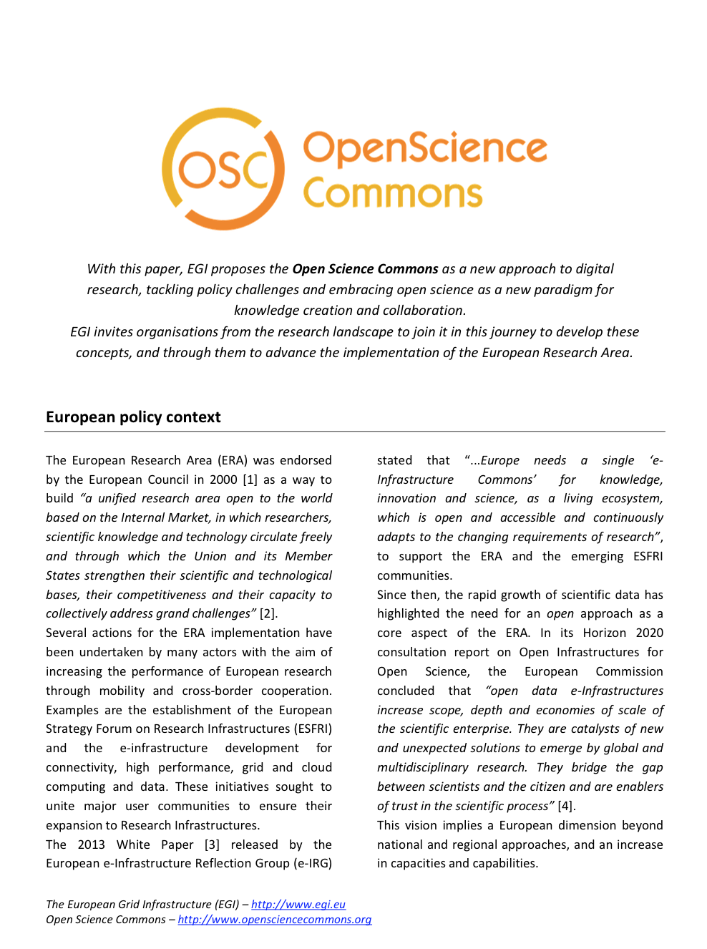
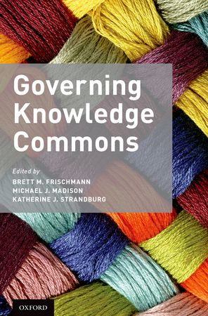
Nov 2014. Open Science Commons
A set of interrelated resource systems governed as commons that support the open creation and dissemination of scholarly knowledge
Digital services and applications
Knowledge & Expertise
Research Data
Instruments
website: www.opensciencecommons.org - paper: http://go.egi.eu/osc

Slide 8
Open Science Commons: When implemented…
Researchers from all disciplines
have easy, integrated and open access
to the advanced digital services, scientific instruments, data, knowledge and expertise
they need to collaborate and achieve
excellence in science, research and innovation.
They feel engaged in governing, managing and preserving these resources for everyone’s benefit, with the support of all stakeholders.

Slide 9
Key aspects in Open Science
Principles of the Commons | What it means to the Open Science Commons
Shared community resources | Research data, scientific instruments, digital services, software, scientific publications, educational and training, expertise (aka Research Objects)
Community-based rules and procedures with incentives for sharing and responsible use | Access modes are well defined and non-discriminatory (e.g. see charter for open access to RIs)
Governance: the community is part | Governance model with multiple stakeholders, it should include the users of the resources
Long-term, persistent care of resources | Long-term support of funding agencies for stability and sustainability Community committed to manage, preserve

Slide 10
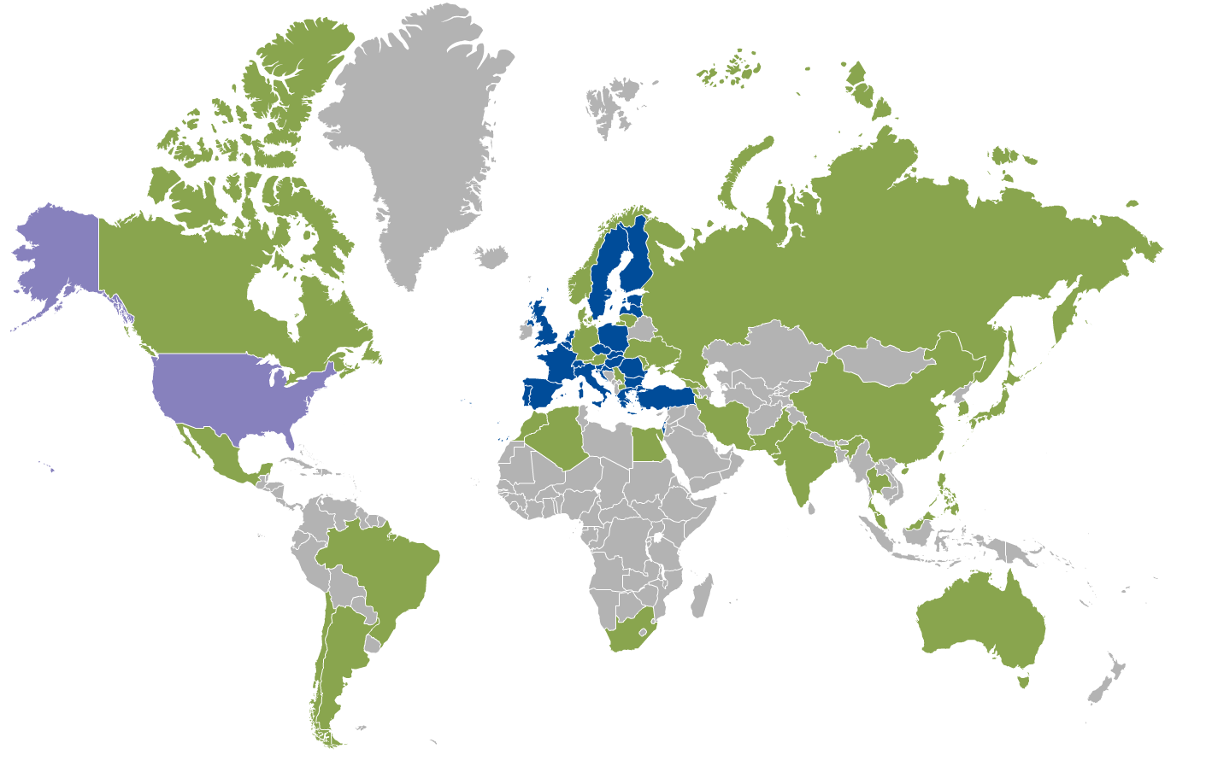
Best practices: Commoning in EGI
Types of shared resources
Large-scale computing/storage/cloud IaaS-PaaS-SaaS/data services
Applications, tools, science gateways
Knowledge, expertise, training
Rules
Various types of access modes
e.g., policy-based, excellence-driven, membership-based
Not yet fully harmonized across Member States
Governance
Mainly service providers at the moment
Evolving to include research infrastructures
Advisory board for user communities
Funding
National funding agencies, EC, service providers, user communities

Slide 11
Developing an OSC (1): Governance structure and funding models
Analyse governance structure of existing infrastructure/knowledge resource systems in open science
Identify best practices and patterns for commoning
Develop guidelines
Define a multi-stakeholders governance – European and national – bringing together the different stakeholders including communities
Identify funding models for sustainability and capacity building

Slide 12
Form open science commons to EOSC

Slide 13
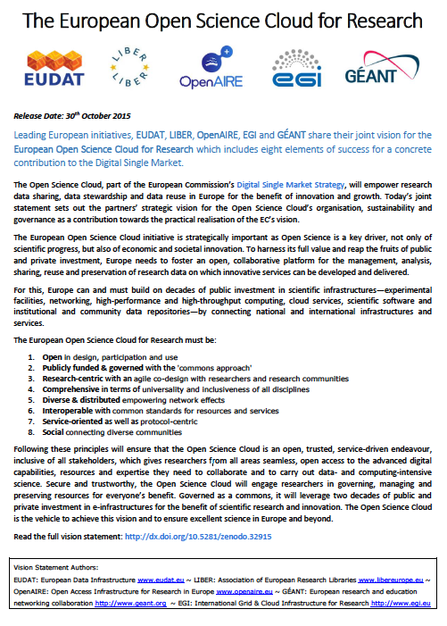
EOSC principles?

Slide 14
Developing an OSC (1): Open Science network of Research Objects
The set of generic ICT capabilities (research objects) across countries and communities offering
Compute/Data intensive capabilities
Easy discovery, access, use and reuse
Shared capacity
The set of specialized ICT capabilities provided by research communities, platform providers, Ris
Required open standards and policies
The federated service management processes and services to orchestrate different service “domains”
The business processes for service delivery and consumption

Slide 15
Developing an OSC (2): Research data
Bridge preservation and data use/reuse infrastructures
stimulate the creation of networked repositories of open research data coupled with diverse computing capabilities, software, applications, workflows, publications for Data as a Service
Scalable reuse of big open data repositories
Develop a culture of sharing and the right incentives to contribute and maintain data
Address data legal and policy issues
Prefer minimal IPR or non-exclusive licensing
Many initiatives exist (e.g. RDA, CODATA)

Slide 16
Developing an OSC (3): European open knowledge hubs
A coordinated network of competence centers
Distributed Competence Centres
Training and education from ESFRI RIs and VRE projects
e-Infrastructure support and training
Open Knowledge Hub
Offering knowledge and expertise for scientific software, applications, tools
Knowledge and expertise from a network of European training and education centres
Scientific software is open, documented, discoverable, supported
Support to access different capabilities (HTC, HPC, cloud, open research data, tools, applications, software…)

Slide 17
EOSC Research Objects Hub
Thematic services (data products, pipelines, software, virtual appliances..)
Research outputs
Hub-specific service management processes, business processes, policies
Cloud compute
Cloud container compute
HTC and HPC
Storage/data management
EOSC Research Objects Hub

Slide 18
Federation services and processes
Core EOSC services and activities
(examples)
Federation services/processes
(accounting, monitoring,..
Business processes and channels
Research objects libraries
OSC Core Hub
Federated IdP, Auth, Authz
Markeplaces
Standards and policies
Research Object Indexing
and discovery services
Knowledge an d training

Slide 19
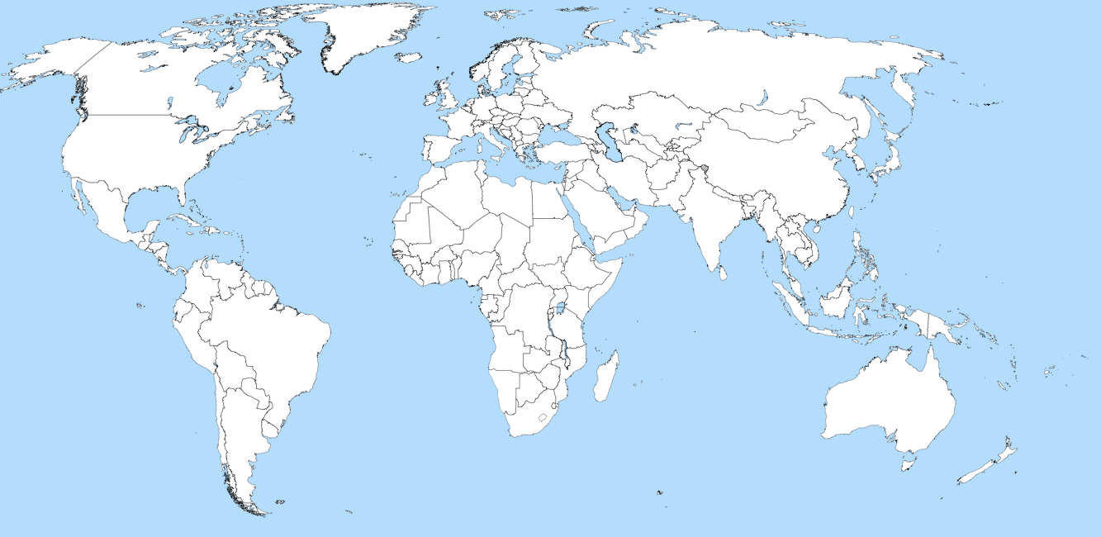
A worldwide OSC
EOSC core Hub
EOSC Hub
EOSC Hub
OSC Core Hub
EOSC Hub
OSC Hub
OSC Hub
OSC Hub
OSC Hub
OSC Hub
OSC Hub
OSC Hub
OSC Hub
OSC Hub
Private cloud

Slide 20
Open Science Commons and service providers/consumers business relationships
B2C Relationships
Public&
private research/
Educators/
Citizen science/
E-gov/
Innovators
EOSC
Reserch
Community services
Composite service providers
E-Infras
Data providers
RIs
…
…
B2B Relationships
B2B Relationships
Service providers (publicly funded/commercial)

