Slide 1
iMarine Case
Managing data as a service
challenges and approaches
Pasquale Pagano
CNR – ISTI (Pisa, Italy)

Slide 2
Outline
Managing Data
Virtual Research Environments
Context
Dealing with Licence complexity
Requirements
Terms of Use to manage federation

Slide 3
Context
Data Curation
Data Sharing
VRE Builder
Data Preparation
Data Publication
Security
Data Analysis
Data Provenance
Monitoring
Mediator
Connector
Mediator
Connector
Data Infrastructures
Computing Infrastructures

Slide 4
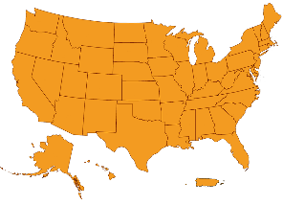
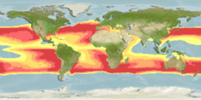
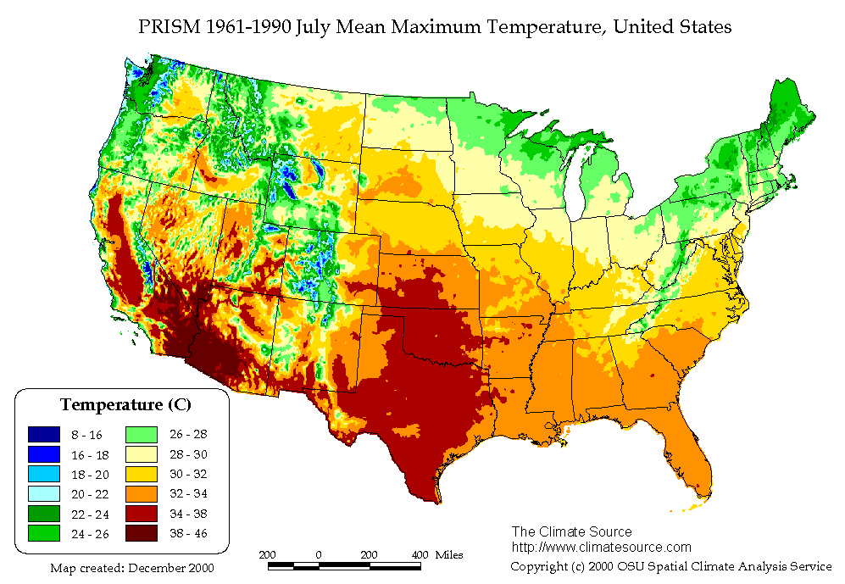
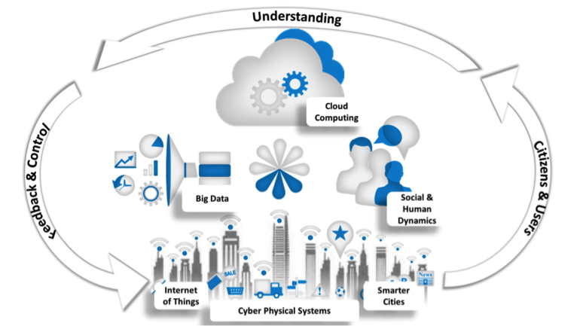
Requirements
Support collaborative research
Reusability, Reproducibility, Repeatability
Sharing data and findings
Grant access to scientific discoveries
Sustainability (low-cost maintenance)
Manage policies heterogeneity

Slide 5
Managing Data: what this means?
Managing Data does not ONLY mean
Support discover
Provide access
Enable share and analyse
It must include support for
legal interoperability
copyright management
licensing of single and derivative products
terms of use
fine-grained policies
attribution
citation policy
provenance management

Slide 6
Managing data: disambiguating terms
Copyright
License
Terms of Use
Copyright is a legal right that grants the creator of an original work exclusive rights for its use and distribution for a limited amount of time. Copyright can exist on individual data as well as over a dataset or database as a whole. The application of copyright to factual data and metadata have no eligibility for copyright protection.
A license is a unilateral permission by the right holder from the licensor to the licensee to use certain rights. Licenses distinguish themselves from contracts since the implementation of a license does not require mutual agreement.
The terms of use are rules that one must obey in order to use the service. The terms of use agreement is mainly used for legal purposes by data providers and databases that store data. A legitimate terms of use agreement is legally binding and may be subject to change.

Slide 7
Managing data: type of data and their licenses
three broad types of data
Metadata
Primary/raw data
Derivative data
reference data describing either the primary/raw data or derivative data
data processed from primary/raw data
data coming directly from the source
Primary/raw data and derivative data may be licensed under different conditions and by different stakeholders

Slide 8
Managing data: dealing with complexity
Three types of licenses are involved
the one agreed between D4Science and the primary data owner
the one selected for derivative product that may differ from the one associated with primary data
the one agreed between the D4Science and the data consumer
All these licences have to be captured by the “terms of use” of the D4Science infrastructure, i.e., they are part of the rules a consumer must agree to accept when using the services

Slide 9
Managing data: D4Science ToU
D4Science ToU has to include a re-use license that concerns at least attribution, copyleft requirement, and control on commercial exploitation of the dataset.
D4Science promotes Creative Commons adoption by offering the right holders a menu of elements from which they can pick their favourite combination:
Licence | Rights
CC-BY | Attribution
CC-BY-ND | Attribution No Derivatives
CC-BY-NC | Attribution Non-Commercial
CC-BY-NC-ND | Attribution Non-Commercial No Derivatives
CC- BY-NC-SA | Attribution Non-Commercial Share Alike
CC-BY-SA | Attribution Share Alike
CC0 | waiving all its rights
Attribution (BY)
Non-Commercial (NC)
No Derivative Works (ND, only verbatim copies)
Share Alike (SA, require derivative works to adopt identical license)

Slide 10
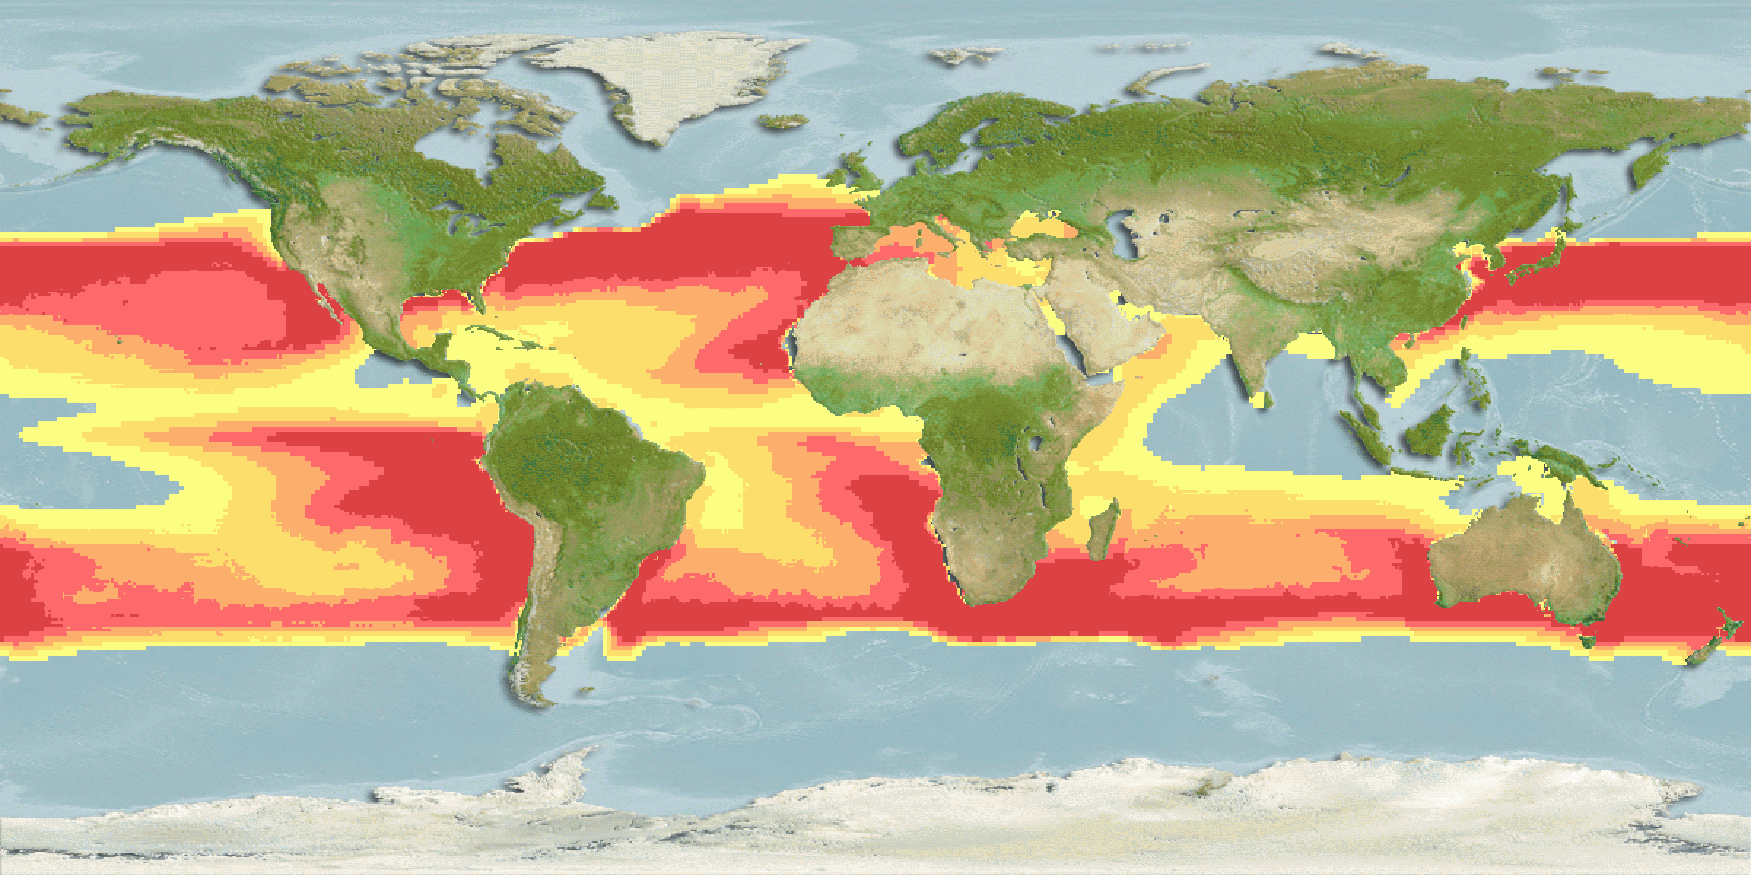
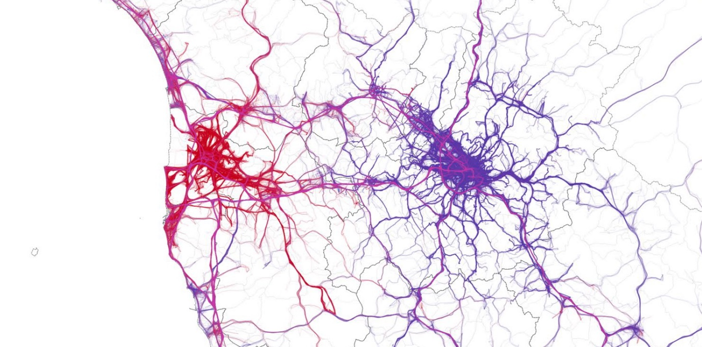
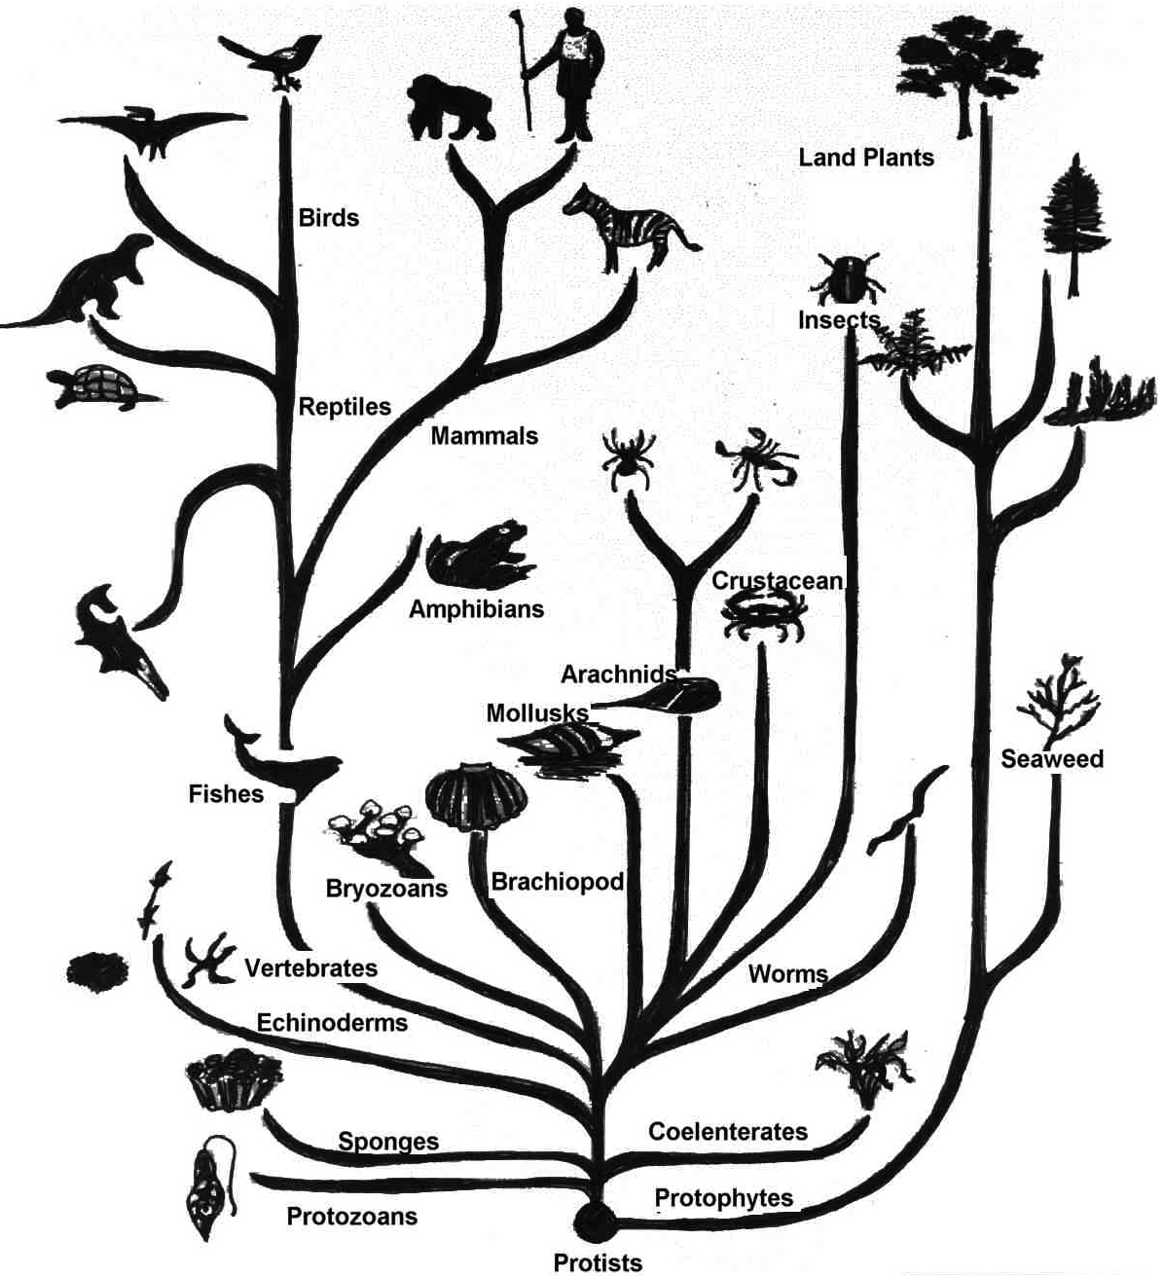
Virtual Research Environments
Define sub-communities
Allow temporary dedicated assignment of computational, storage, and data resources
Simplify the management of license and policies
Promote data and information sharing
VRE
VRE
VRE
Unified Resource Space
Enables
Powered by gCube
D4Science.org Infrastructure
Integrates

Slide 11
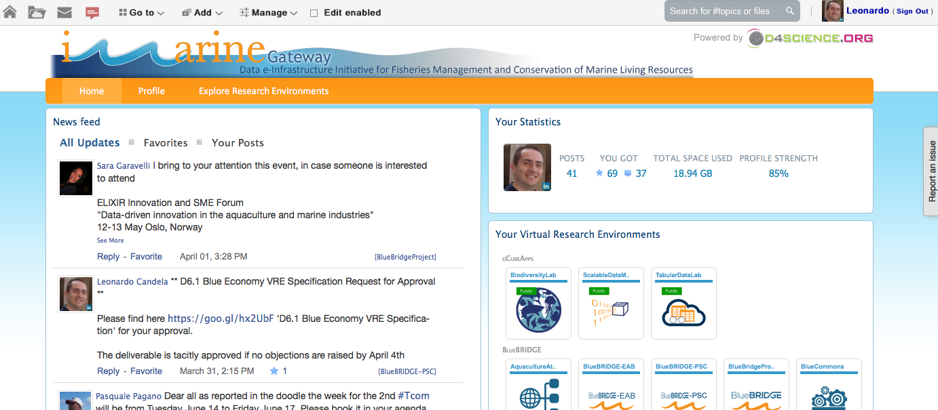
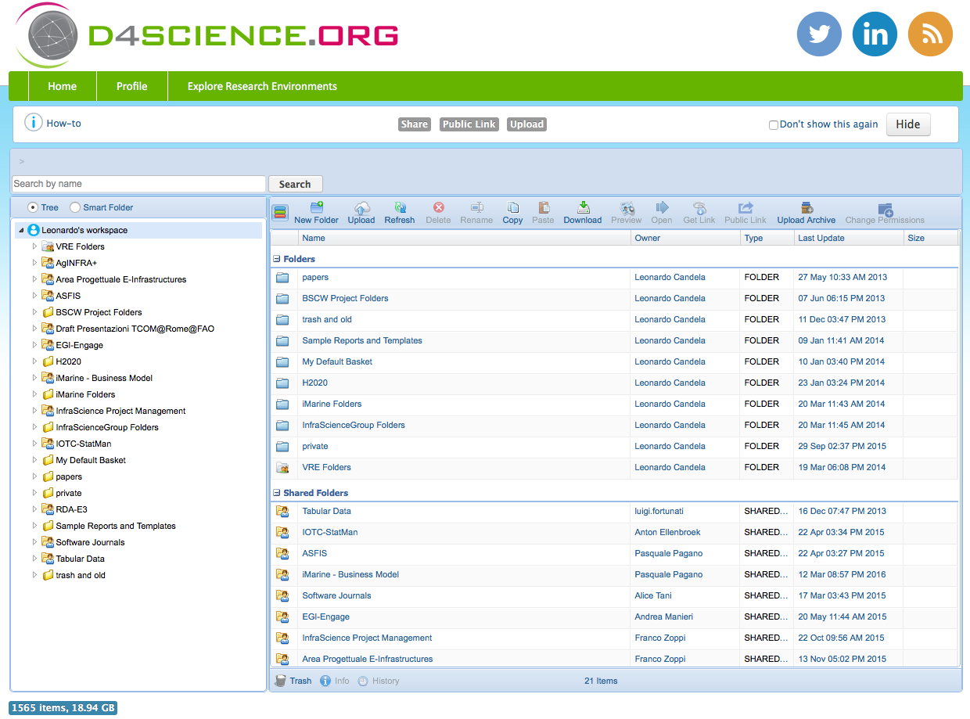
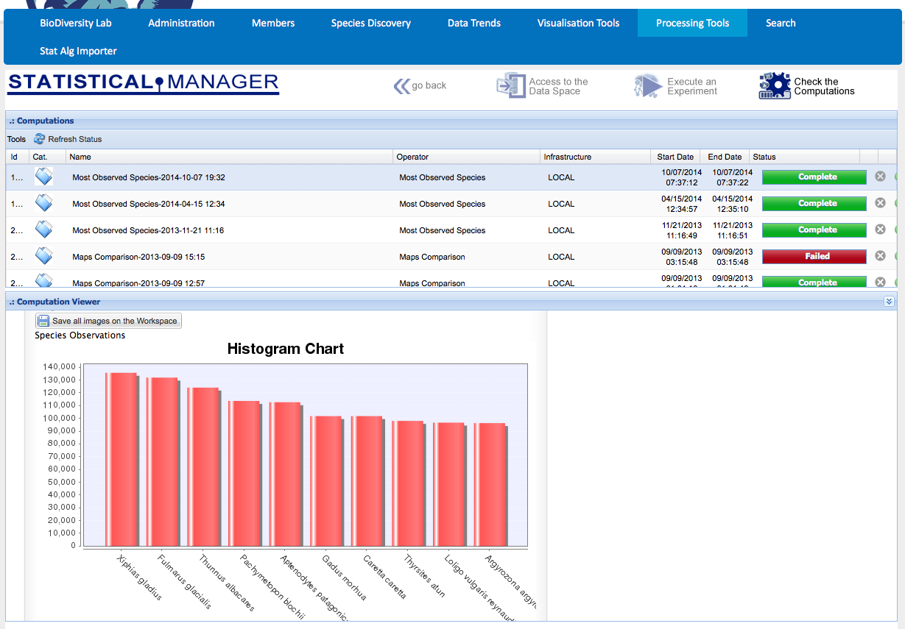
Virtual Research Environments
Innovative, web-based, community-oriented, comprehensive, flexible, and secure working environments
Communities are provided with applications to interact with the VRE services
Client services are provided both with APIs (Java, R) and simple HTTP-REST interfaces

Slide 12
Managing data: VRE as an instrument to manage the complexity
Virtual Research Environments (VREs) terms of use are automatically composed according to the combined data and services selected at the time of VRE definition
Raw data
Derivative data
licensed according to the license expressed by the data owner/custodian and expressed at time of registration of the data content to the e-infrastructure
licensed with a license compatible and legally interoperable with the one associated with the primary data
Automatically enriched with provenance and attribution policies
Enriched with citation policies
It remains under the responsibility of a single user, as expressed in the VRE terms of use, to confirm the license to associate with any produced derivative data

Slide 13
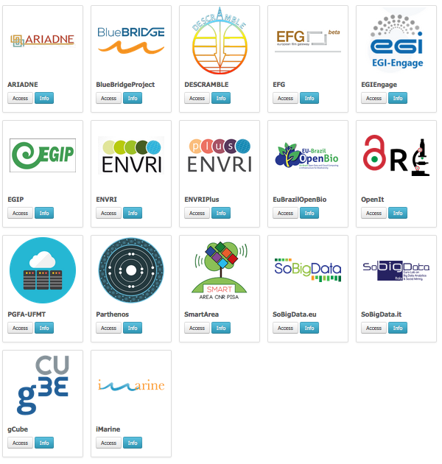
Numbers
+50 VREs hosted
+2500 scientists in 44 countries
+50 data providers
+25,000 derivative data/month
over a billion quality records
+20,000 temporal datasets
+50,000 spatial datasets

Slide 14
Conclusion
Use, Re-use and publish either data or derivative data require
Management of licences
Enforcement of policies
Clear and detailed terms of use

Slide 15
Thank you
Read More
D2.6 – Report data sharing policies and legal framework in fishery and marine sciences
https://documents.egi.eu/public/ShowDocument?docid=2699
Contact Points
pasquale.pagano@isti.cnr.it
www.d4science.org
info@d4science.org
www.i-marine.eu

