Slide 1
Developing synergies between EGI and user communities using ESIF: the case of France V. Breton France Grilles director
Crédit: JP Chanet, S. Gervois, V. Legoll, G. Mathieu, J. Pansanel, G. Romier, L. Royer

Slide 2
France Grilles is about
federating a distributed infrastructure for high throughput computing
12 production grid (95% of CPU resources) and 8 academic cloud (5%) sites across France
Integrated into EGI (670 million CPU hours in 2015)
And making it available to user communities
France-Grilles VO was EGI largest multidisciplinary VO in 2015 (Top 10)
But, only 1500 + users compared to > 1 million researchers, engineers and technicians in french universities and research laboratories
Notes:
Experience shows that it takes distribution to reach the long tail of sciences

Slide 3
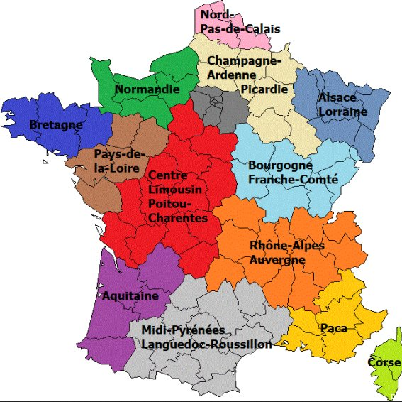
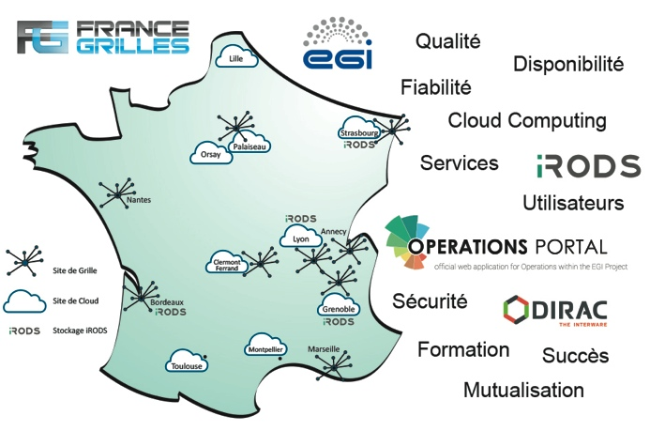
Can ESIF funds help building France Grilles/EGI?
Yes. European Structural and Investment Funds can help
Adding/developing regional infrastructures integrated into EGI
Connecting user communities to the national/international context
Notes:
ESIF allow bringing innovation and technology closer to the users

Slide 4
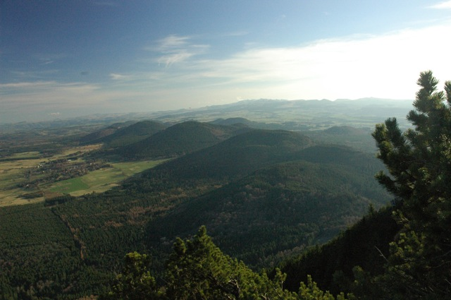
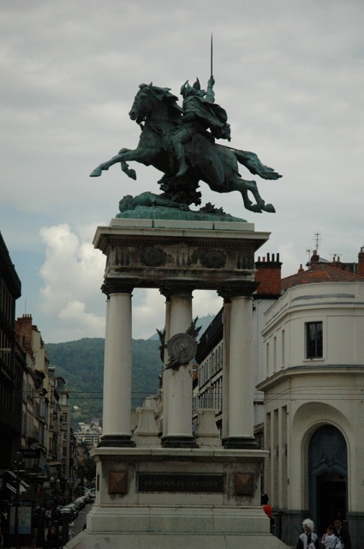
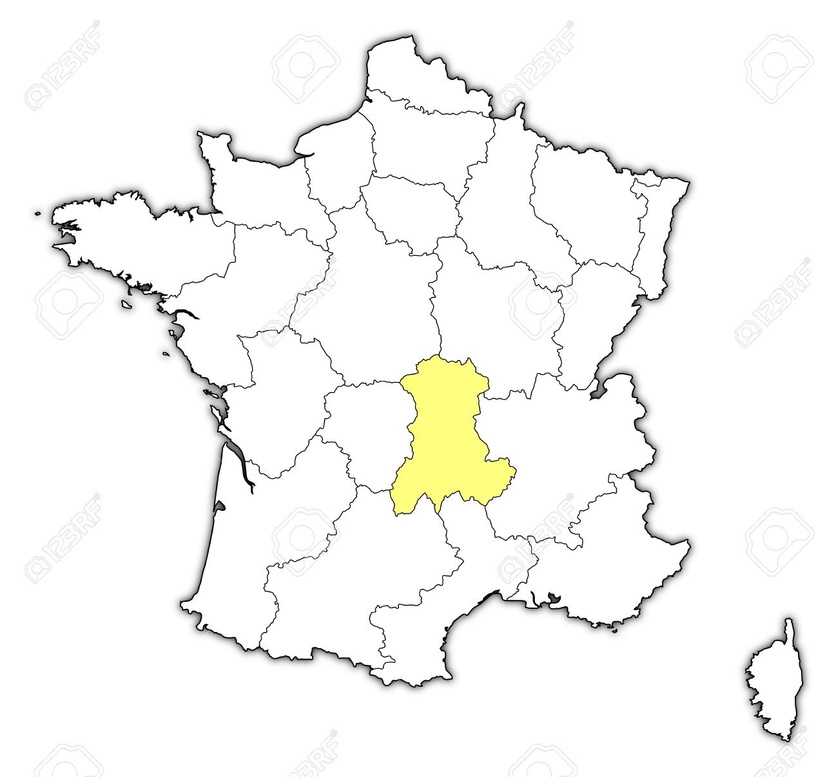
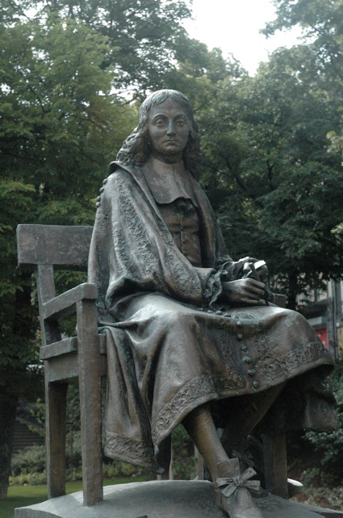
Welcome to Auvergne, at the heart of France
1,35 Million inhabitants
26013 km²

Slide 5
The vision
Develop a regional computing/data center
Integrated at national/international levels (EGI)
Initiate Long Term Ecological Research around region specific landscapes and ecosystems
Integrated at national/international levels (LTER Europe, LifeWatch)
New: LTER on former uranium mines
Understand how radioelements impact ecosystems
ESIF instrumental to implement the vision
Notes:
Symmetric multiprocessing (SMP)

Slide 6
The computing center (1st phase - 2016)
HTC: a computing and storage cloud
Budget: 600 KEuros
OpenStack based cloud infrastructure
Targetted communities: astronomy, cellular imaging, life sciences
HPC: an SMP architecture
Budget: 500 KEuros
Targetted communities : life sciences, chemistry, atmosphere physics (TBC)
Funding scheme: state (20%), region (20%), ESIF (60%)
3 M€ over 6-year contract (2015-2020)
To be integrated into France Grilles and EGI cloud federations

Slide 7
Long Terme Ecological Research
Regional data/computing center
Modelling
Wireless communication platform
Data
Modelling
Sensor data
(Geolocalisation, pluviometry, physico-chimique, meteorological…)
Sites | Localisation | Pluviometry | Meteorology | Tree growth | Water properties | Groundwater | Communication network
Aydat |  | X | X | - | X | X | X
Montoldre |  | X | X | X | X | X | X
Allier | X | X | X | X | X | X | X
ZATU |  | X | x | X | X | X | X
Aydat
Montoldre
Auzon
Roffin
Modelling

Slide 8
The ESIF tools used in Auvergne
European Regional Development Funds
Goal: strengthen economic and social cohesion in the
European Union by correcting imbalances between its regions
European Territorial Cooperation (INTERREG)
Goal: support to regional development through transnational projects funded by European Regional Development Funds

Slide 9
ESIF funding
Water quality
modelling
Regional data/computing center
INTERREG SUDOE: PENVIMA, “France-Portugal-Spain Virtual Research Environments Platform to support Environmental Research initiatives”
Computing and
Storage
Modelling
Missing geospatial data
Wireless communication platform
Robustness
Wireless sensor network
Protocol
Modelling
Sensor data
(Geolocalisation, pluviometry, physico-chimique, meteorological…)
Sensors
PhD grants
Aydat
Montoldre
Auzon
Roffin
Ecosystem modelling
Equipment

Slide 10
Conclusion
ESIF instrumental to trigger the emergence of regional research infrastructures integrated at national/International levels
What is done in Auvergne is not possible everywhere
Beware of S3 priorities in your region
S3 (Strategy for Smart Specialization): domains eligible for Regional Development Funds
Available at: http://s3platform.jrc.ec.europa.eu/s3-platform-registered-regions

Slide 11
Thank you !

