Slide 1
EOSC market demand for art, humanties and cultural heritage
Amsterdam– EGI Conference– 7/4/2016
Franco Niccolucci Scientific Coordinator, PARTHENOS

Slide 2
PROJECT DESCRIPTION
PARTHENOS is a cluster project developing joint data strategies and policies in the broad domain of language studies, humanities, cultural heritage, history and archaeology. It addresses similar issues with common solutions and tools.
The domains addressed by PARTHENOS have similarities as well as distinctive features. They avail of the historical method, typical of the humanities, and of the scientific method, typical of sciences. Research may use a synchrotron or semantics, computer visualization or philology. Or the four together

Slide 3
Communities and their needs
PARTHENOS represents different communities
CLARIN ERIC (Language studies)
DARIAH ERIC (Digital humanities)
ARIADNE (Digital archaeology)
IPERION CH (Conservation science)
EHRI (Holocaust studies)
but also E-RIHS (New ESFRI project on heritage science), possible new starting communities, and more …

Slide 4
Requirements of the different communities
PARTHENOS report on user requirements
Extensive (320 pages) report on the requirements of the different user communities in terms of data management:
Data policies (data lifecycle, quality)
Standardization
Interoperability
Tools
Training and Education
It includes use-cases for all the communities represented in the project

Slide 5
Considering a (broad) use case as a summary example
In what follows I will consider one use case – data management in Archaeology – because:
It is exemplary of the diverse issues that may present within PARTHENOS and its communities
It is relatively well-advanced to offer concrete samples of issues
This example is being developed within ARIADNE (www.ariadne-infrastructure.eu), a project on the integration of archaeological datasets in Europe. ARIADNE also produced a survey of users’ needs, which has been now distilled into the PARTHENOS report.

Slide 6
USERS’ NEEDS
Data transparency: inconsistent interfaces, insufficient provenance information and scattered and heterogeneous resources.
Data accessibility: data appeared as difficult to find, because not online, and when online, difficult to access. Lack of downloadable "raw data” for re-use, such as the database used for the creation of a scholarly edition.
Metadata quality: due to the lack of awareness about the importance of metadata for data sharing, most researchers often do not produce metadata for various data(sets) they generate in projects.
Data quality: users often complain lack of usefulness because data are structured in different way, are incomplete or lack important details, and are not up to date.
International dimension: researches between different institutes and access to a wider geographical dataset will help facilitate cross-collaboration and enhance funding opportunities.

Slide 7
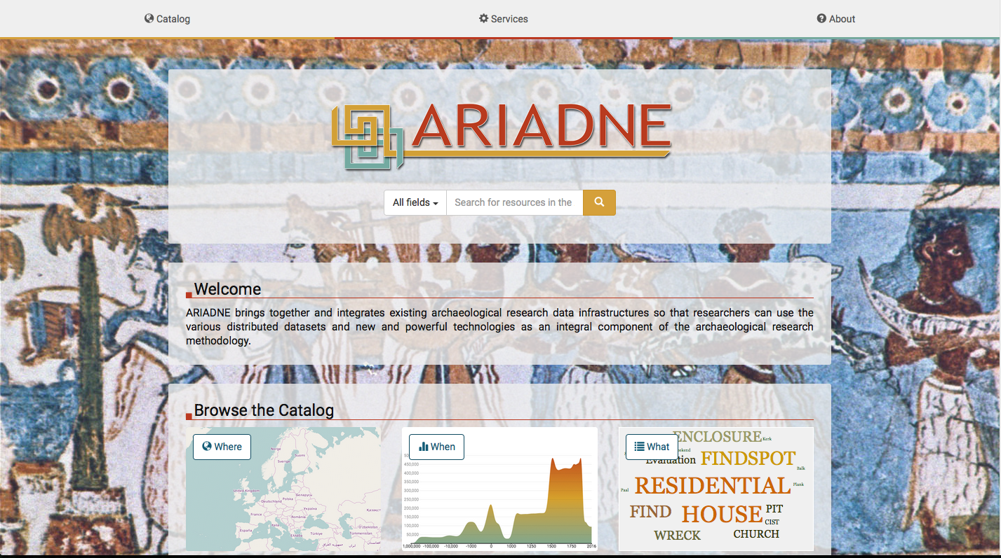
The ARIADNE solution
The ARIADNE Registry and Portal
A searchable catalogue of archaeological datasets in Europe, enabling resource discovery. They include reports (texts), databases, GIS, images, 3D, videos and more.
At present it covers about 1,630,000 datasets, providing links to the original location where they are stored.
It also provide tools for data manipulation

Slide 8
Still remaining issues
Access: sometimes data are irrationally “protected”, especially (but not only) images.
Language: data are potentially in 26 languages (currently in 10). Work needs to be done on multilingual thesauri, NLP, etc.
Coverage: the portal is based on institutional repositories; not all research data are covered. Many researchers do not deposit their data because they are not interested/they don’t know how to/they have no place where to.
Standardization: in a few subdomains, there are no standards for data collection/storage
Virtualization: to enable the use of virtual replicas of archaeological finds, they must incorporate different features of the original. Models need to go beyond the shape of objects

Slide 9
What an EOSC platform could do for us
DISCOVER
SELECT
GET
ANALYZE & PROCESS
USE IN OWN RESEARCH
TOOLS, VRE, …

Slide 10
THANK YOU!
PARTHENOS is a project funded by the European Commission under Horizon2020
Franco Niccolucci PARTHENOS
franco.niccolucci@gmail.com
www.parthenos-project.eu

