Slide 1
EUDAT Collaborative Data Infrastructure
EUDAT-EGI Interoperability Session
Giuseppe Fiameni
CINECA

Slide 2
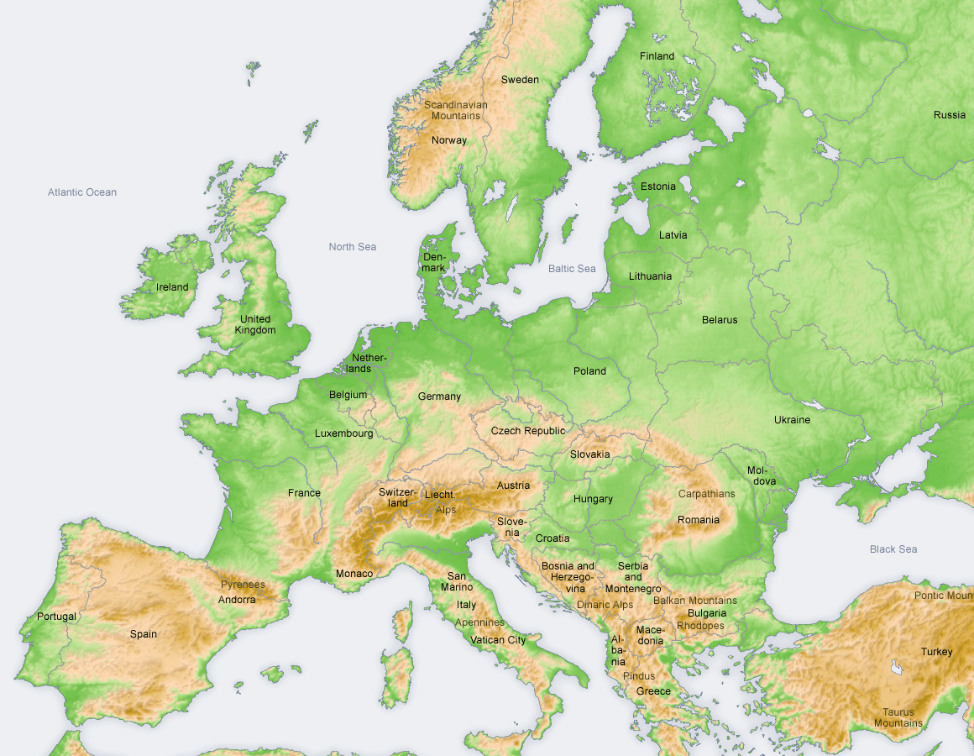
EUDAT is ...
a pan-European initiative building a sustainable cross-disciplinary and cross-national data infrastructure providing a set of shared services for accessing and preserving research data
supporting multiple research communities by working closely with them to deliver technical services as part of the EUDAT Collaborative Data Infrastructure (CDI)
consortium of high performance computing (HPC) / data centres, libraries, scientific communities, data scientists

Slide 3
EUDAT – European Data Infrastructure

Slide 4
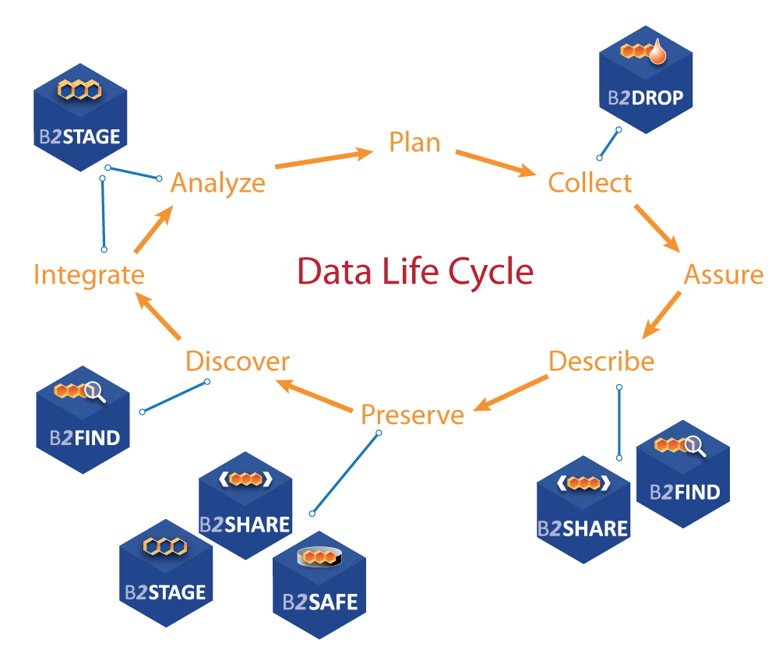
Data Life Cycle
Delivering an integrated suite of common data services covering the full research data lifecycle & addressing both long tail and big data

Slide 5
History of the EUDAT CDI
Common Services for heterogeneous communities
Science data rates are exploding and will likely continue to do so
Building bespoke services for new communities is not cost effective
Initial Set of Services developed as result of community needs
Beyond the original ‘core’ communities
New services and specific community issues highlighted
Notes:
Not just ‘big’ experiments such as LHC and SKA, but the number of communities

Slide 6
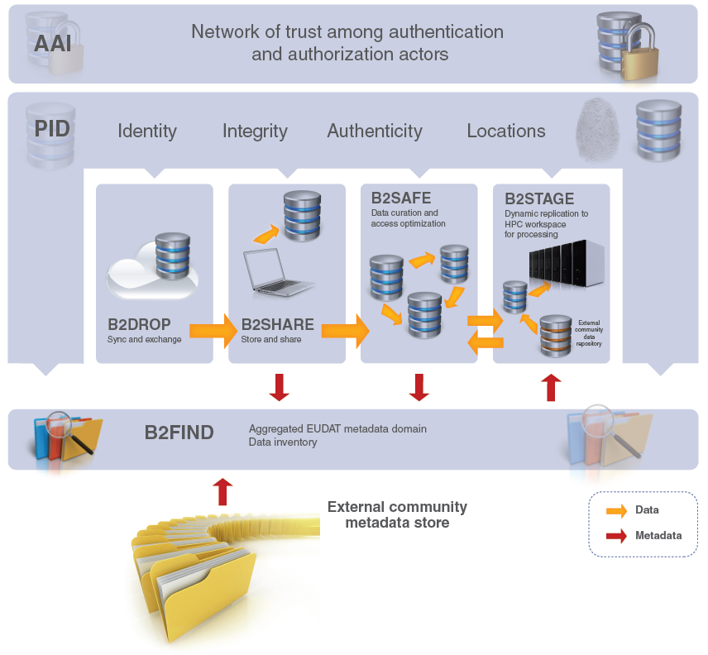
B2 Service Suite
B2ACCESS
B2Handle

Slide 7
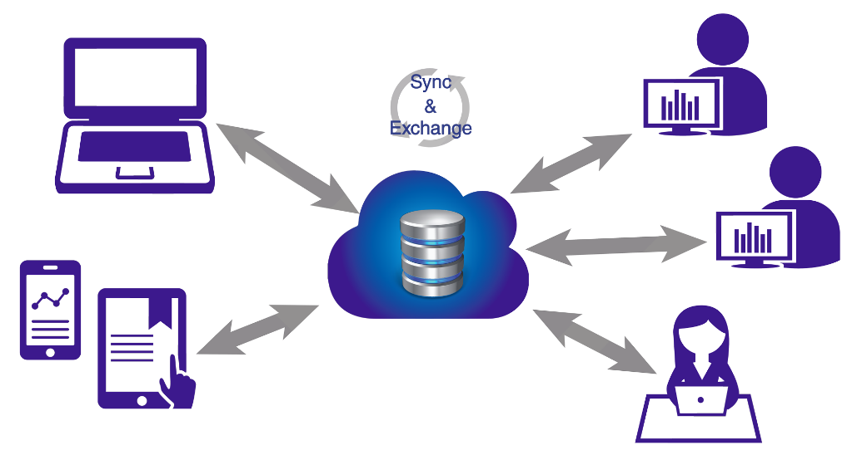
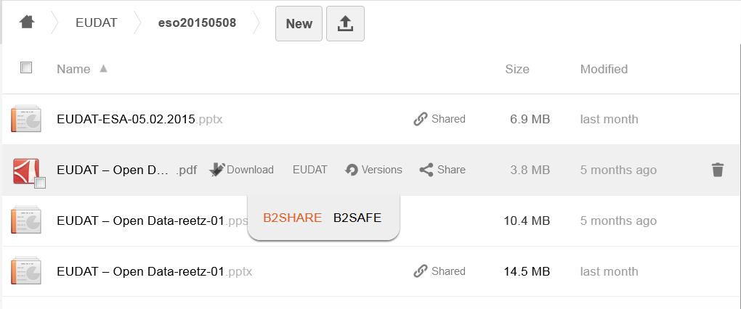
Who
Citizens Scientists and small teams
What
Store and exchange data
Synchronize multiple versions
Ensure automatic desktop synchronization
Why
Ease of Use
Trusted European Service
EUDAT2020
Further integration with EUDAT CDI (e.g. B2SHARE)
Integration with B2ACCESS to enable access by many different Identity Providers
Cloud Storage Federation, collaboration with GEANT in OpenCloudMesh
Assess B2DROP as workspace area to computing facilities
Notes:
Based on ownCloud, open source (GNU AGPLv3)
access and manage permissions to files from any device and any location, via browser, desktop, mobile apps and WebDAV
up to 20GB of storage space for research data
simple to use and open to all researchers, scientists (e.g. self-registration)
synchronize and exchange data with one or multiple users
users decide with whom to exchange data, for how long and how

Slide 8
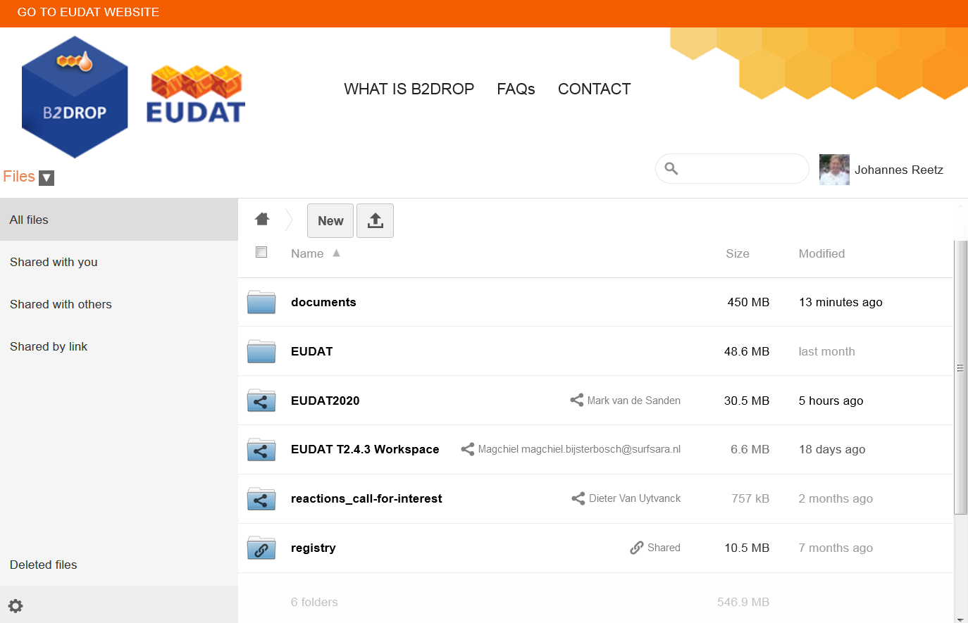

Slide 9
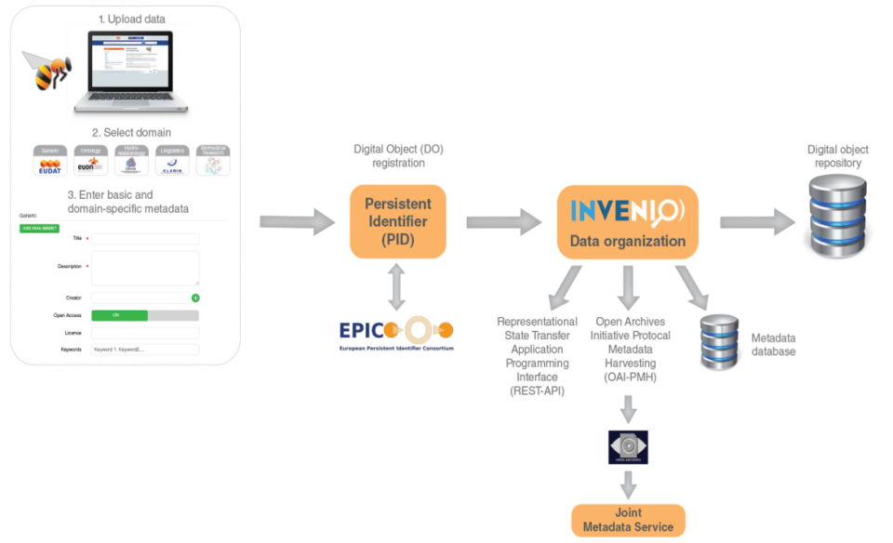
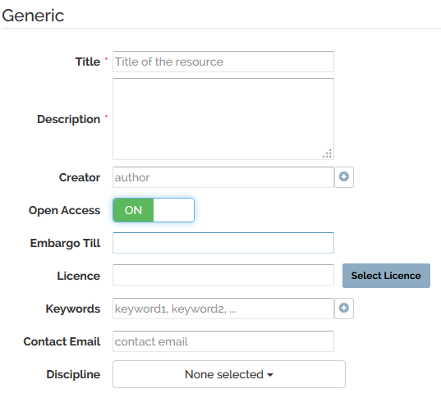
Who
Small to Medium Teams
What
Store data (incl. software) and add domain meta data
Share registered research data worldwide
Preserve (small-scale) research data for long-term
Why
Register Data for Publications
Make known to wider community
EUDAT2020
Further integration with EUDAT CDI (e.g. B2DROP, B2SAFE)
Integration with B2ACCESS (incl eduGAIN), focus on authorization
Embargo period
Editing of metadata
Data versioning and annotation
Extended HTTP Restful API interface
Easy installable software package
Notes:
Based on Invenio, open source (GPL v3)
Supports 8 community-metadata templates
Data assigned a persistent identifier and a checksum
Access via a HTTP Rest API
Open accessible, user self-registration
Data owner defines access policy
Open access license choose feature
Discipline choose feature
Open harvestable metadata, harvested by B2FIND

Slide 10
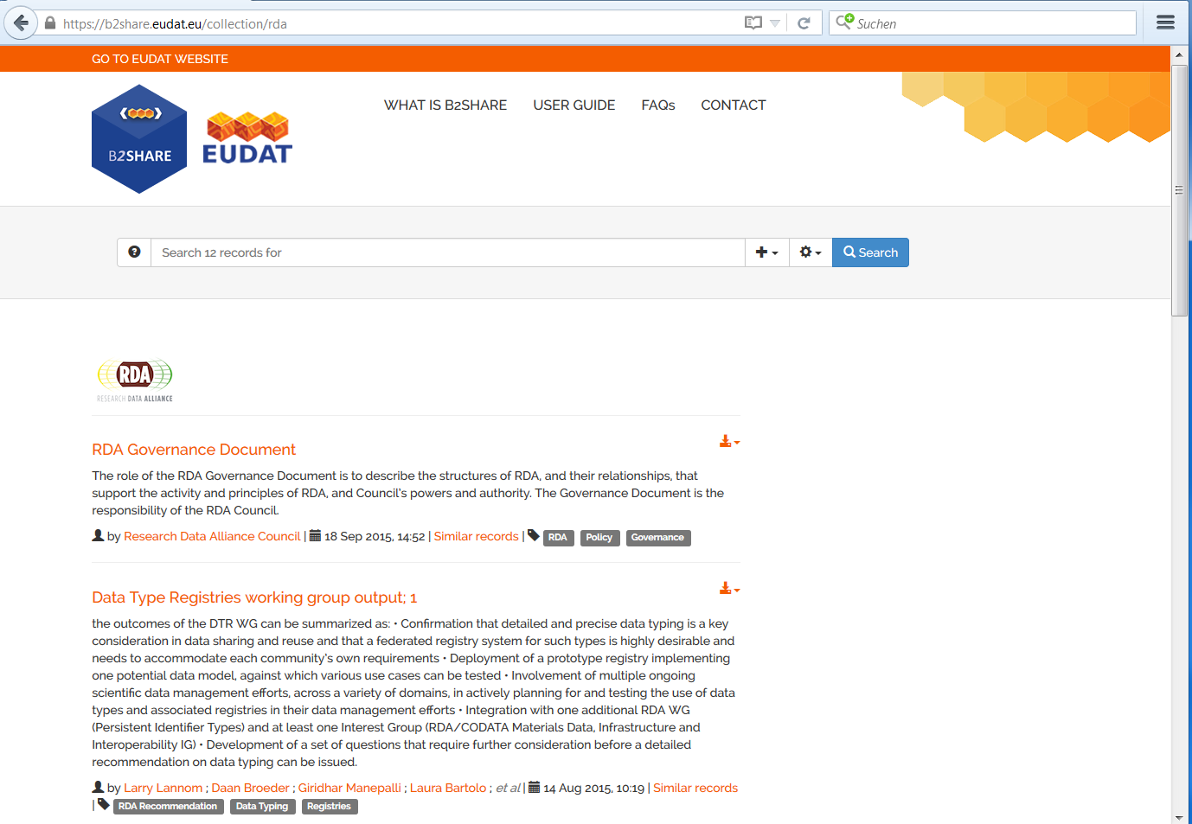
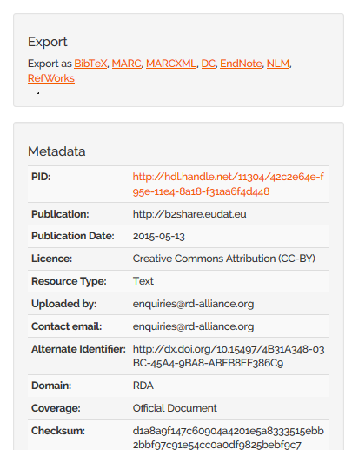
Collection of official RDA documents

Slide 11
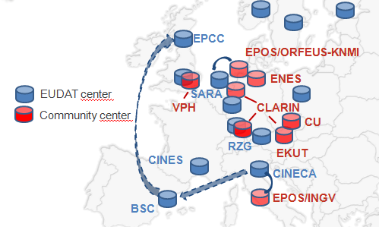
Who
Community Data Managers
‘Sophisticated’ Organisations
What
Provide an abstraction layer which virtualizes large-scale data resources
Guard against data loss in long-term archiving and preservation
Optimize access for users from different regions
Bring data closer to powerful computers
Why
Performance
Replication between trusted sites
Data Preservation
EUDAT2020
Support iRODS v4
Support metadata
Optimize and extend policies to support data curation and provenance
Further integration with B2ACCESS
Support authorization on basis of community access rules
Assess B2SAFE as workspace area to computing facilities

Slide 12
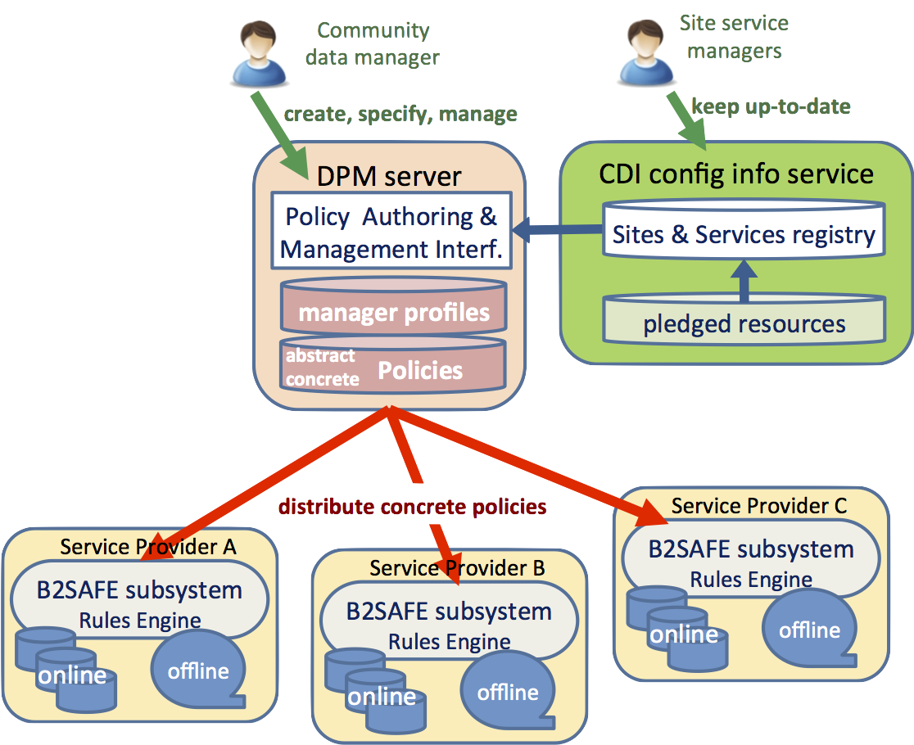
Data Policy Manager
Data policies are centrally managed
Policy rules are implemented and enforced by site-local rule engines
Policies describe in an abstract language
Community data managers must authenticate to provide trust
Support policies for data replication and integrity checking
Central logging for auditable data policies to monitor execution
Active collaboration with the RDA Practical Policy WG
EUDAT2020
Handover to operations
Extend number of policies supported
Focus on data curation and provenance policies
Integrate with B2ACCESS

Slide 13
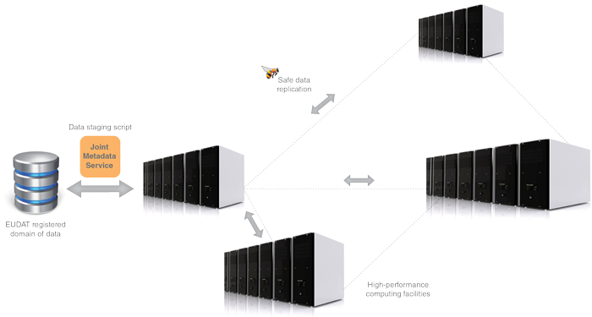
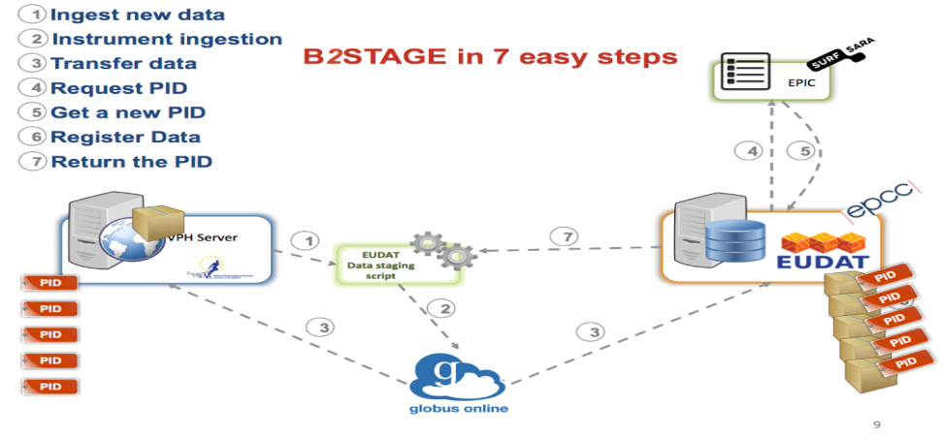
Who
Users and Communities with Significant Computational Needs
What
Transfer large data collections from EUDAT storages to external HPC facilities for processing
Copy large data sets, ingesting them onto EUDAT storage resources
Why
Integration/Collaboration with PRACE
Simplify Data Transfer
EUDAT2020
Further develop HTTP to a mature interface and extend functionality to metadata
Native support PIDs within GridFTP transfers
Extend EUDAT client API library to other B2 services (e.g. B2SHARE, B2FIND, PID)
Further integration with B2ACCESS
Notes:
Extension of the B2SAFE and B2FIND services, which allow users to store, preserve and find data
Providing access via GridFTP and basic HTTP
data-staging script facilitates staging, ingestion and retrieval of persistent identifier (PID) information of transferred data
Start development of EUDAT client API library and command line tools
Integrated with EUDAT Federated AAI on basis of X.509 certificates

Slide 14
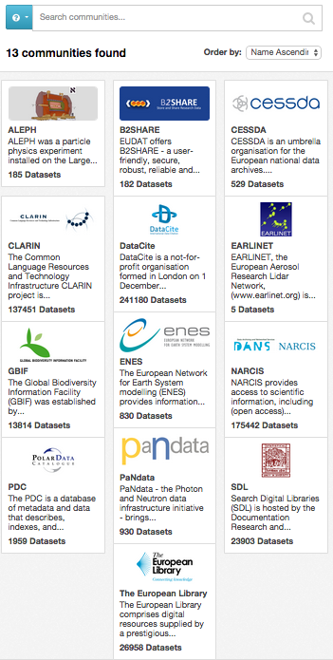
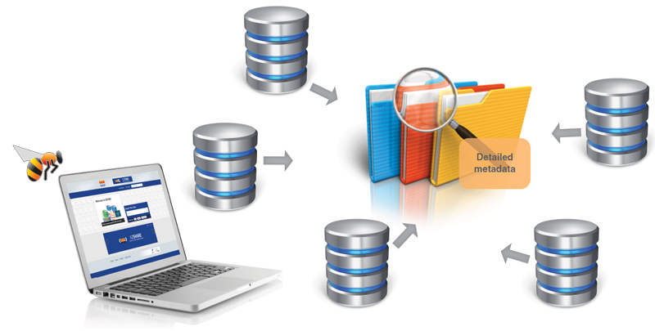
Who
Anyone
What
Find collections of scientific data quickly and easily, irrespective of their origin, discipline or community
Get quick overviews of available data
Browse through collections using standardized facets
Why
Unique collection
Ease of Searching
EUDAT2020
Harvesting of metadata stored in B2SAFE
Community customizations
Annotation of datasets
Further assess RDF and Linked Data
Further assess scalability and performance
Notes:
On the EUDAT1, MDTF/B2FIND community wiki page, 15 additional community repository services are planned or in enabling phase.
At the developers workshop Heinrich and Yann Le Franc talked about the the integration of the B2NOTE service with B2FIND.
Based on CKAN, open source (GNU AGPL v3)
Facetted search (e.g. 10 facets) and full text search, recently added timeline search
Focus on community recommended metadata
13 community repositories harvested, more lined up
Open accessible, no registration needed
Open harvestable metadata
Searchable via Web-based GUI and HTTP RESTful API

Slide 15
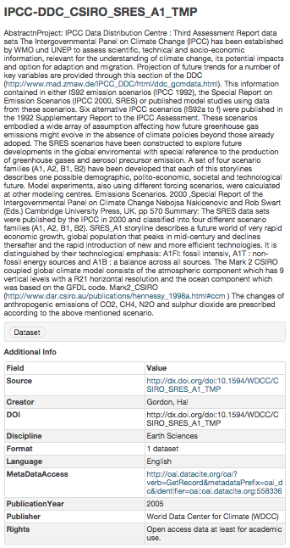

Slide 16
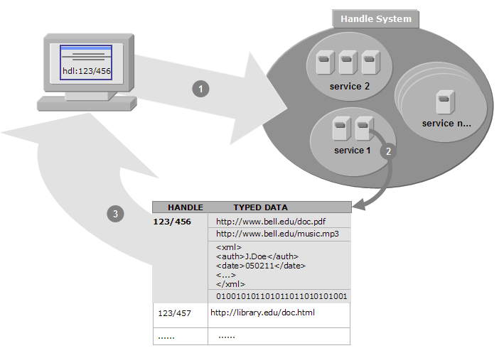
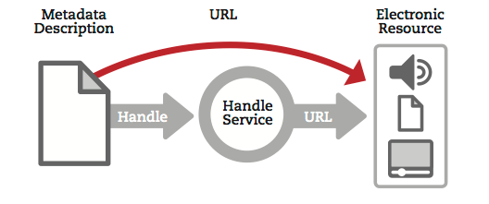
Who
Groups or Communities who want to make their data citable
What
Follows policies to register data and make it long term refer- and citable
Reliability through mutual PID mirroring
Provides abstraction layer between a globally unique persistent identifier and physical location of data objects
Machine readable via HTTP RESTful API
Why
Simple integration
Technology Agnostic
Development plan
Develop the policies for the B2HANDLE service (e.g. PID namespace mngmt)
Migrate service from Handle v7 to v8
Define PID Information Types for data, metadata, collection records
Integrate with Data Type Registry service
Consolidate B2HANDLE API library with EUDAT API library
EUDAT 6M EC Review, 28th October 2015, Brussels

Slide 17
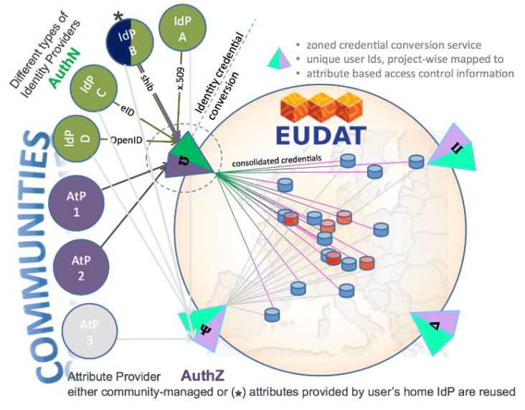
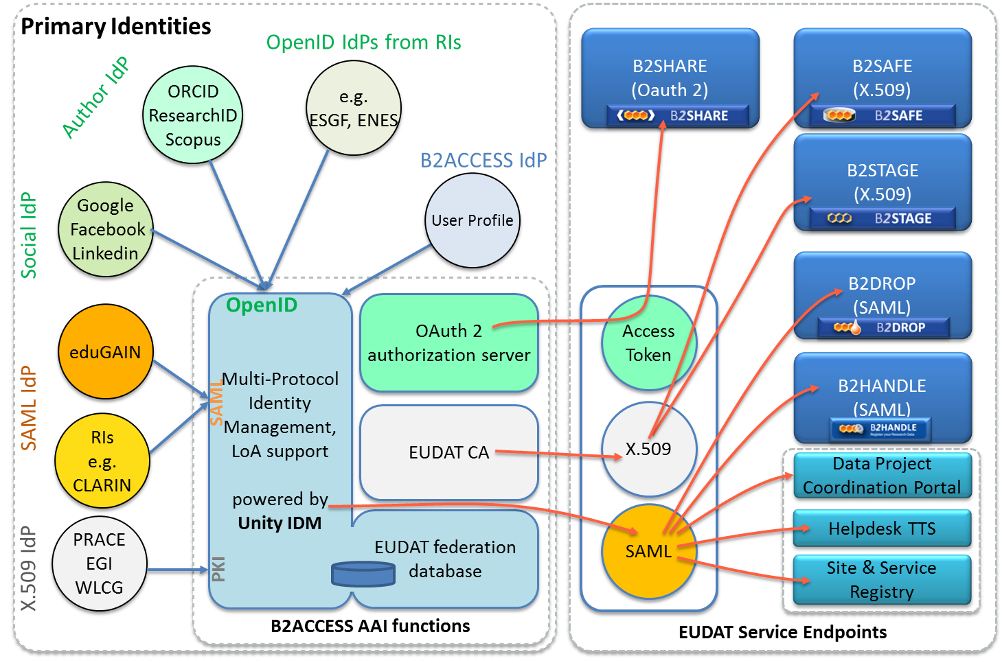
Who
Anyone wanting to use the B2 Services
What
Complies with community ownerships and access rights, basis of trust
Credential conversion approach (e.g. SAML, OpenID, X.509, Username/password)
Identity provider for citizen scientists
Why
Use your own ID in federated environment
EUDAT2020
Integration with operational and all B2 services
B2SHARE B2DROP B2STAGE
B2SAFE B2HANDLE, DPM, CREG , TTS,
Integration with community IdP domains and portal environments
Enabling access via eduGAIN social IDs
enabling access via ORCID CLARIN IdPs
Focus on authorization
Collaborate on cross e-infrastructure access (e.g. PRACE, EGI)
Extend European collaboration via AARC (e.g. Geant, Terena)

Slide 18
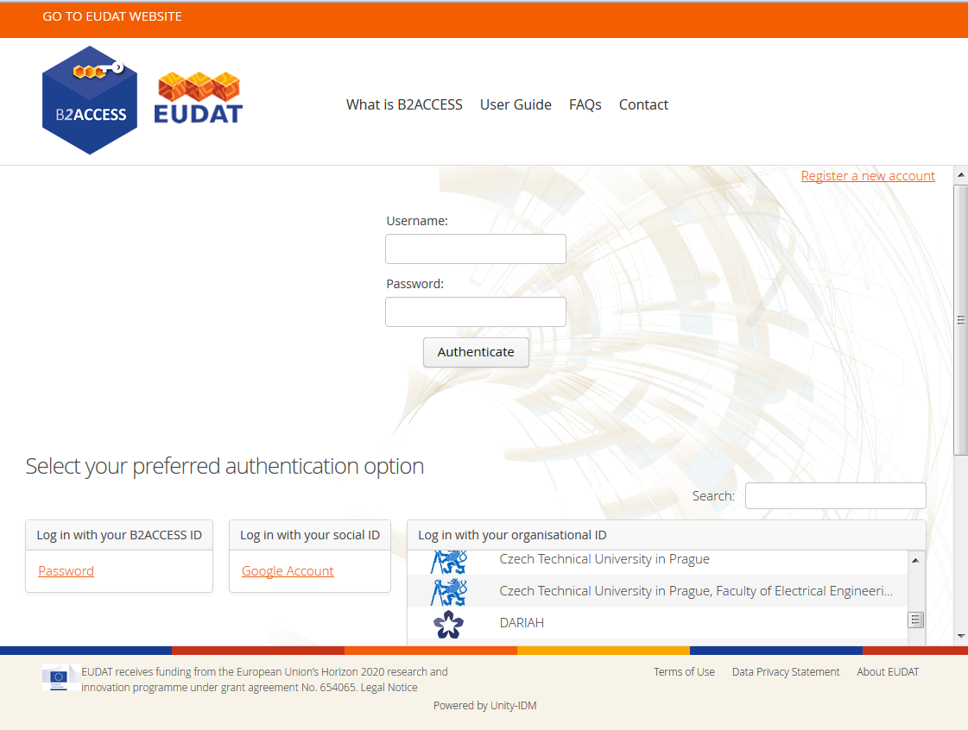
Notes:
B2ACCESS

Slide 19
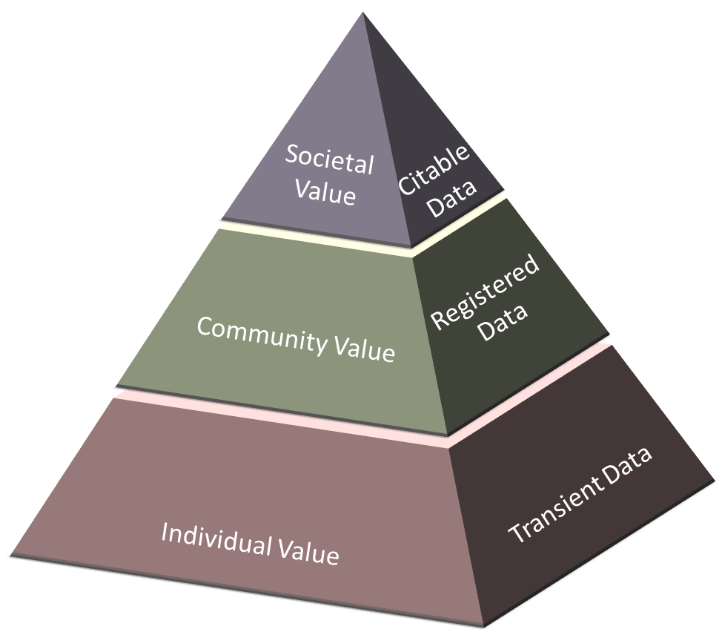
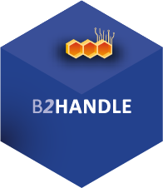
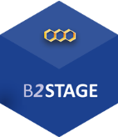
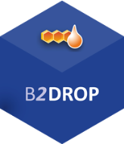
B2Services and the Research Data Pyramid

Slide 20
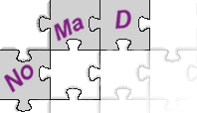
Community-Driven
ENVIRONMENTAL SCIENCES
BIOMEDICAL & MEDICAL SCIENCES
MATERIALS & ANALYTICAL FACILITIES
MAPPER
SOCIAL SCIENCES & HUMANITIES
PHYSICAL SCIENCES
& ENGINEERING

Slide 21
How does EUDAT support Open Science?
EUDAT offers a complete set of research data services, expertise and technology solutions to all European scientists and researchers.
These shared services and storage resources are distributed across 15 European countries.
Data is safely stored alongside some of Europe’s most powerful supercomputers.

Slide 22
E-Infrastructure Collaboration
DFT, data fabric, PID, metadata, practical policy
RDA
Four interoperability pilots fostering the coupling of data and cloud resources. Large communities involved, BBMRI, ICOS, EISCAT-3D, ELIXIR.
Policy & networking
Output adoption
Test beds
Contribution to regular PRACE calls by providing medium/long-term storage capacity and services. 5 pilots granted by DECI Call (13th)
Policy & guidelines
Data management plans
Service integration
Cloud Catalogue
Open AIRE
GEANT
DMP
LERU
LIBER
EGI
Cross-infra services & ops
Common protocols, APIs
HPC/HTC/Clouds
PRACE
Helix Nebula
Data Cloud
DECI calls
Notes:
PRACE (DECI call), GEANT (cloud catalogue), RDA (DFT, PID, metadata, practical policy) and OpenAIRE/LIBER (ongoing)

Slide 23
Collaboration
Goal
Enable researchers seamlessly access e-Infrastructures services pairing data and high-throughput computing resources together
Communities
ELIXIR, EISCAT-3D, BBMRI, ICOS
EPOS, ENVRI+
Open Call?
Timeframe
March 2014 – February 2016

Slide 24
Use Case “alpha”
Definition:
Permit a user of both e-infrastructures to instantiate a VM on the EGI Cloud Federation for the execution of a computational job consuming data stored onto EUDAT resources
Assumptions:
the user holds a valid and trusted security token (X.509 certificate)
he/she has been granted to access EGI resources
he/she has already deposited data within the EUDAT infrastructure

Slide 25
More detailed flow
The user authenticates to the EGI infrastructure
The EGI infra instantiates the environment and performs preliminary configuration (account, network, firewall, tools, libraries, compilers, applications, ...) → contextualization
The virtual environment (VE) is started up → user’s credentials are copied into the VM
The VE stages data from EUDAT to a local storage area for performance and locality reasons, using authentication obtained in step 1
data staging via GridFTP or HTTP (CDMI)
data discoverability via B2FIND

Slide 26
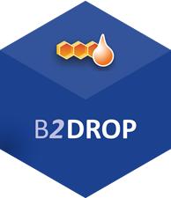
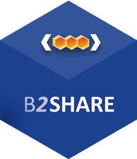
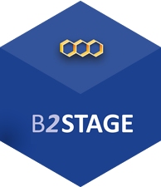
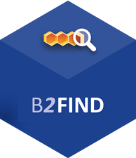
For more info:
https://b2drop.eudat.eu
https://eudat.eu/services/userdoc/b2drop
https://b2share.eudat.eu
https://eudat.eu/services/userdoc/b2share
https://eudat.eu/services/userdoc/b2safe
https://eudat.eu/services/userdoc/b2stage
http://b2find.eudat.eu
https://eudat.eu/services/userdoc/b2find

Slide 27
Thanks for your attention

