Slide 1
Establishing the infrastructure layer of the European Open Science Cloud
A GÉANT viewpoint
Afrodite Sevasti, Activity Leader for Integration with other eInfrastructures in GÉANT (GRNET)
Michael Enrico, CTO (GÉANT Ltd.)
EGI Conference 2016 (EOSC workshop)
7th April 2016

Slide 2
European Cloud Initiative
“How to better connect the new and existing infrastructures across Europe?”
European Data Infrastructure
Super-computing capacity
Fast connectivity
High-capacity cloud solutions
Data storage
Challenges
Fragmentation (domains and countries)
Governance
Disconnection
Silos
Notes:
ECI to better connect and enable federation of infrastructures across Europe (from intro section of draft ECI communication)
There is an infrastructure layer and it is fragmented
This needs to be fixed
Data centric infras not mentioned here as the focus is on the EDI infrastructure layer
The presentation will focus on three out of the four challenges (technical rather than governance aspects)
Domains means subject domains
Governance – challenge is that gov models differ for net, storage and compute
Disconnection – refers to the digital infrastructures
Silos – refers to the separation of operation of the digital infras

Slide 3
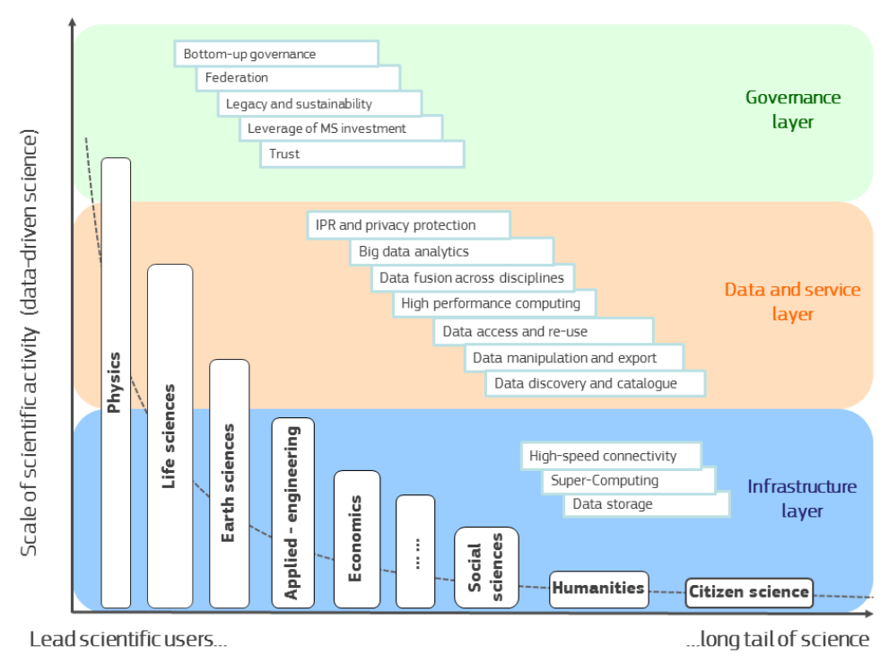
The Infrastructure Layer
No governance or data aspects in this talk!
Source: Wainer Lusoli, European Commission DG Research & Innovation, Open day event: towards the European Open Science CloudEMBL, Heidelberg, 20 January 2016

Slide 4
Forecasts and expectations
eInfrastructure user base
1,000s of campuses and institutions
1,000,000s of potential users
Multiple levels of user relations
Evolving user community requests
On-demand delivery
Minimum lead times
One-stop-shop
Service bundling/composite services
A European scale environment
Notes:
The infrastructure layer of the ECI should be ready to handle the increasing demand in volumes and capabilities
And the volumes shown here are just considering the current R&E centric user base, let alone the aim to extend to gov and industry

Slide 5
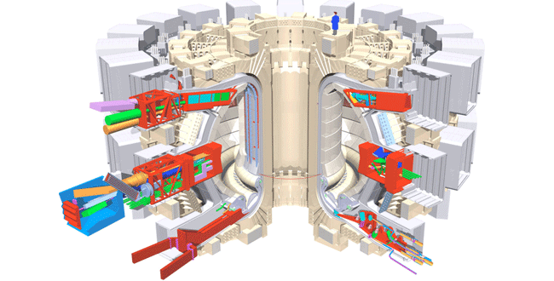
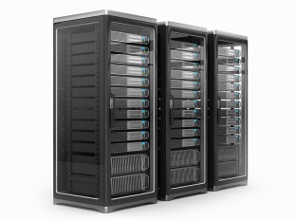
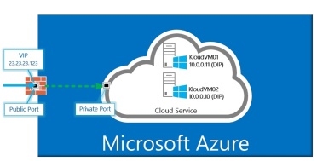
GÉANT new service era (indicative illustration)
“I would like to access computing/data center/HPC site A via a virtual private network in my lab”
Site A
NREN
NREN
NREN
NREN
NREN
NREN
NREN
Notes:
Envisaged future GEANT service era:
Getting very complex for GEANT/NRENs
Requests from individuals, labs, VROs, campuses (each different in nature)
Different kinds of SPs connected
Demos have been done on things like OCX (including CSPs)
This is indicative, not happening today, but we need to be prepared
Getting more complex to coordinate and orchestrate
Users getting more demanding in terms of capabilities and lead times

Slide 6
A multi-Service Provider environment Orchestrated business and operations
Service catalogue management
SPs should maintain and dynamically expose their up-to-date portfolio in an open market place
Composable services
Users should be able to browse multiple SP catalogs and cherry pick services to compose their working environment
SPs could provide bundled service offerings to users (e.g. cloud machines accessible via L2 private lines and/or VPN instances)
Order management
The order should be seamlessly handled by underlying providers.
The user should be presented with live status updates on the status of his order from a one-stop-shop.
Service assurance
Event and incident management
SLA management
Orchestration for:
Provisioning
Troubleshooting
Decommissioning
Accounting usage levels (later billing)
User analysis and retention
A campus user submits a service order to obtain L2 access to a remote data center/CSP facility.
Operational level – transparent to user
Notes:
Often GEANT sits in the middle of the multi-service environment
Interconnects others
Magnitude of handling the volume and complexity of service instance requests expected to increase
In order to be prepared for this…
A priority should be to expose catalogues in a dynamic way
A common catalogue framework is important (INFRASUPP-03…?), however, automation in publishing offerings is also very important, as is the ability of users to browse and order through the catalogues
Need to enable the orchestration of dynamic handling of
Composable services: important points: to be able to browse, pick and compose
This is a heads-up; we can have workshops to examine
What happens after they compose?
Important thing here is that user can see progress of order through order management
Infrastructure layer of EOSC should provide a homogeneous experience to user
After service is provided
Need E2E service assurance – need to orchestrate monitoring (e.g. of net stats), availability monitoring
Events and incidents: expected and unexpected ones, need to be handled in a homogeneous fashion
SLA mgmt: need to agree on common parameters: (1) on service itself (uptime, etc) and (2) user experience (response times to queries, etc)
SPs need to orchestrate operations under the service layer in a way transparent to the users
Now need to orch operational aspects: prov, troubleshooting, decommissioning
Accounting of resource usage levels important as preparation for billing capabilities (inc pay-per-use)
Finally…
User analysis and retention
Operate in silos; user (satisfaction, stats, etc) has to be done E2E, allows a more complete approach to service improvement thereby bettering the chance of retention

Slide 7
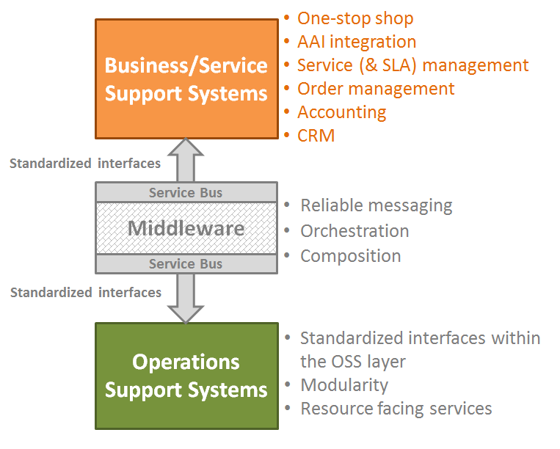
Systems’ architecture
Service Provider
Service Provider
Service Provider
The ‘brains’
Notes:
Service providers (eInfrastructures, CSPs, … ) should be able to expose both business and operations layer capabilities across the federated SP environment.
Service management aspects should be tackled at the business layer and build upon already established frameworks, however again here automation and systems interoperation is key, to be able to handle large volumes of service instances.
Information models and process coherency across the layers (business <-> service) is key.
In order to enable a loosely coupled environment, each SP should employ a middleware element to undertake the north-south and east-west integration.
WRT the latter, processes across the borders of SPs should exercise the minimum requirements from participating SPs: messages, orders and requests as well as random events (e.g. system failures) should be handled reliably but according to the operational principles of each SP (e.g. asynchronous processing or requests).
User experience should be the ultimate goal: any request, at any point in time should be in a definite state of processing by one or more of the participating SPs

Slide 8
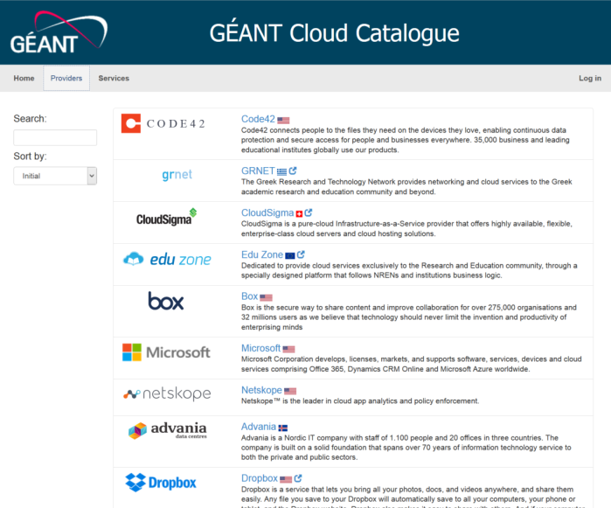
Integration with CSPs
“ … a lightweight framework to allow end-to-end orchestration with underpinning GÉANT/NREN services …”
“ … one-stop-shop interfaces to allow end users provision combined services from multiple providers (local campus connectivity, NREN and GÉANT connectivity, CSP activities – connectivity, host provisioning) through a single interface and a single order …”
“… commonly agreed, standards-based simplified APIs …”
“… certain elements of each provider’s systems should be made available by some means (REST API for example) and should address both operational and business processes …”
Indicative processes supported:
Service Portfolio
Order Management
Provisioning (across campus, GEANT/NREN, CSP infrastructures)
Service Assurance – incident alerting and management
Service Availability & SLA metrics
Accounting Information – for potential billing purposes
Notes:
GEANT is establishing very attractive cloud service offerings for its community
Mention cloud catalogue
This is a mini scale precursor of what might happen in terms of the ECI
Establishing simplified APIs to receive requests from and pass requests to CSPs for delivering cloud services to campus users via the NRENs and GEANT.

Slide 9
sevasti@grnet.gr
michael.enrico@geant.org

