Slide 1
The EGI Accounting Repository in the Big Data Era
Adrian Coveney
EGI Conference 2016
Notes:
The EGI Accounting Repository collects accounting data from sites participating in the EGI and WLCG infrastructures as well as from sites belonging to other Grid organisations that are collaborating with EGI. It generates statistical summaries that are available through the Accounting Portal to Users, VO Managers and Site Administrators.
This session will cover current and upcoming developments of the Accounting Repository under EGI-Engage.

Slide 2
Outline
Accounting System Overview
Recent Updates
Data Set Usage Accounting
Cloud Accounting
Big Data Tools
Storage and Accelerator Accounting

Slide 3
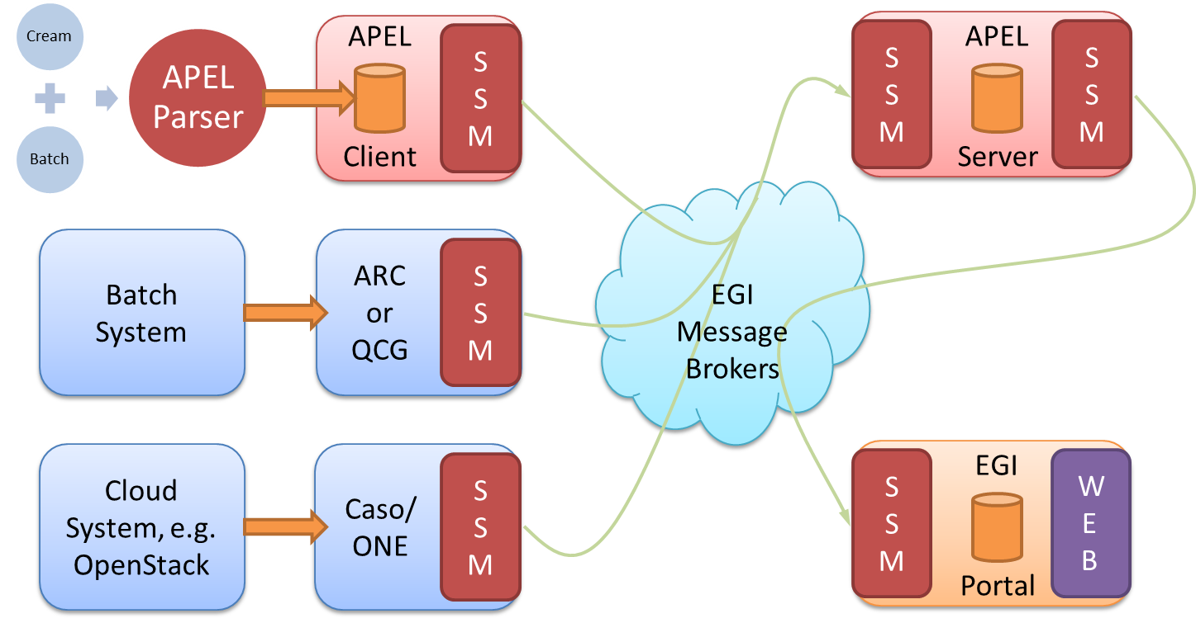
Accounting System Overview
Notes:
APEL clients can run an APEL parser to extract data from a batch system and place it in their client database, or they can use third-party tools to extract batch or cloud data. This data is then unloaded into a message format suitable for transmission.
APEL clients run a sending Secure Stomp Messenger (SSM) to send these messages containing records via the EGI Message Brokers the central APEL server. The messages can contain either Job Records or Summary records. This is configurable in the APEL client.
The central APEL server runs an instance of the SSM, which receives these messages and a “loader” processes the records in the messages and loads them into a MySQL database.
A “summariser” process runs to create summaries of any Job Records received and load them in a “SuperSummaries” table along with any Summary records. This summariser runs as a cron job approximately once a day.
A database “unloader” process unloads the summary records into the message format to be sent on by the sending SSM via the EGI Message Brokers to the EGI Accounting Portal.
https://github.com/apel/ssm

Slide 4
Recent Updates
Software Releases:
APEL version 1.5.1 released as part of D3.3 (https://documents.egi.eu/document/2659)
Bug fixes and support for new version of Torque
SSM version 2.1.7 released simultaneously
Bug fixes
Team changes
Contact: apel-admins@stfc.ac.uk

Slide 5
Data Set Usage Accounting
Questionnaire and interviews conducted with results incorporated into report for M3.2
Clear interest in data set accounting from the surveyed communities
Main requirements for data set accounting include user-access, data set PID logging, and recording transfer operations
Challenge: Wide range of data set storage systems in use with no consistent approach to recording data set usage
APEL Team will investigate some of the projects that are developing data set accounting

Slide 6
Cloud Accounting
Cloud usage record version 0.4
Will be moved to production along with changes to display CPU counts
Display of CPU counts in the Portal
Data is in the cloud records, but not in the summaries sent to the Portal
Some development needed to change this
Long-running VMs
Working on initial version to be released in April for testing and feedback

Slide 7
Big Data Tools
Report completed for D3.5: Analysis on Techniques to Manage Big Data on the EGI Accounting System (https://documents.egi.eu/document/2667)
3 Broad categories:
Optimised use of the MySQL database
Replacement with Apache Hadoop and the Hadoop Distributed File System
Replacement with a time series databases
Testing of technologies to start following this conference
Notes:
The central processing stage for the CPU accounting data takes many hours to complete and operates in a single processor thread. Although the data is backed up regularly, the data is not distributed across multiple hosts to provide greater resilience and processing power. Recent advances in Big Data tools provide an opportunity to address these limitations: improving the performance and resilience of the central repository.

Slide 8
Storage and Accelerator Accounting
Storage accounting (https://wiki.egi.eu/wiki/APEL/Storage)
Have identified the issues that need resolving with DPM and dCache to get correct storage accounting
Once resolved, we will aim to get more sites publishing
Accelerated Computing
[See also later talk]

