Slide 1
AARC Architecture Blueprint
Christos Kanellopoulos
Architecture (JRA1) WP Leader, GRNET
EGI Conference
April 7th 2016

Slide 2
The starting point
The scenario:
  There is a technical architect of a research community
  Her community is distributed internationally
  Increasing number of services need authentication
  and authorization
  Her job is to find a solution
  She wants to focus on research and not reinvent the wheel
  She starts googling
So, there are some solutions available, but…

Slide 3

It would be nicer if there was also compatibility & interoperability

Slide 4

The AARC Project
Authentication and Authorisation
for Research and Collaboration
Two-year EC-funded project
20 partners
  NRENs, e-Infrastructure providers and Libraries as equal partners
About 3M euro budget
Starting date 1st May, 2015
https://aarc-project.eu/

Slide 5
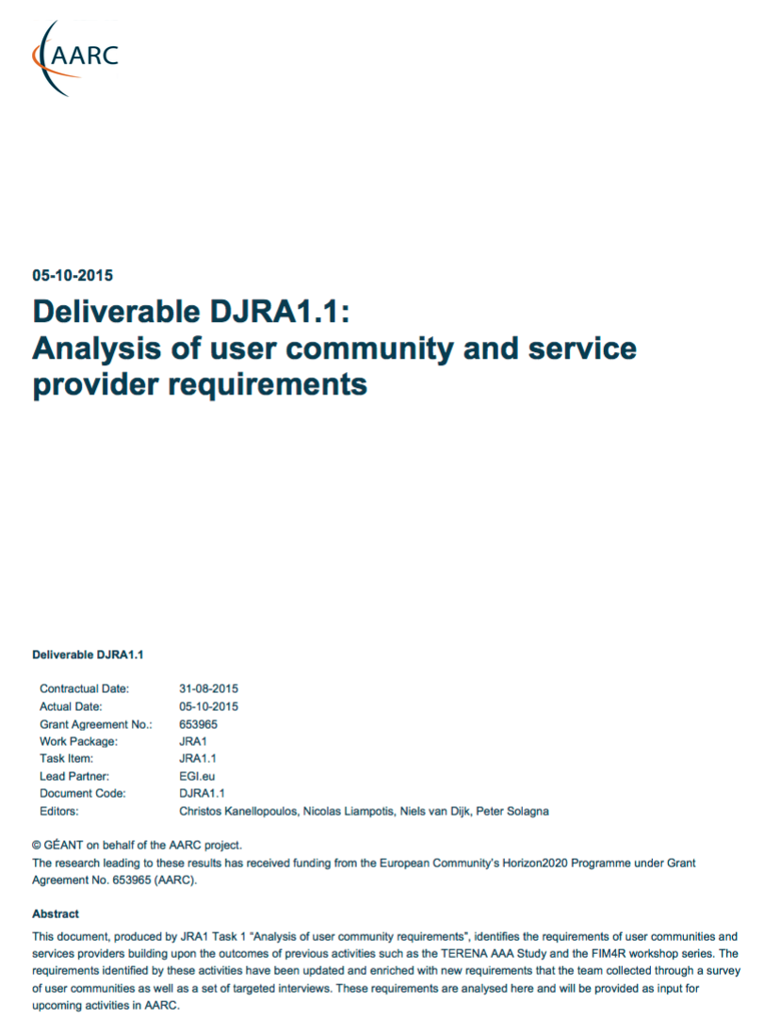
Requirements
Attribute Release .
Attribute Aggregation
User
friendliness
SP
friendliness
Analysis of
User Communities
Credential translation
Persistent Unique Identifiers
User Managed Information
Credential Delegation
Levels of Assurance
Homeless
users
Step up Authentication
Best Practices and Policies
Community based AuthZ
Non-web-browser
Social & e-Gov IDs
Incident Response
And Infrastructure Providers
aarc-project.eu

Slide 6
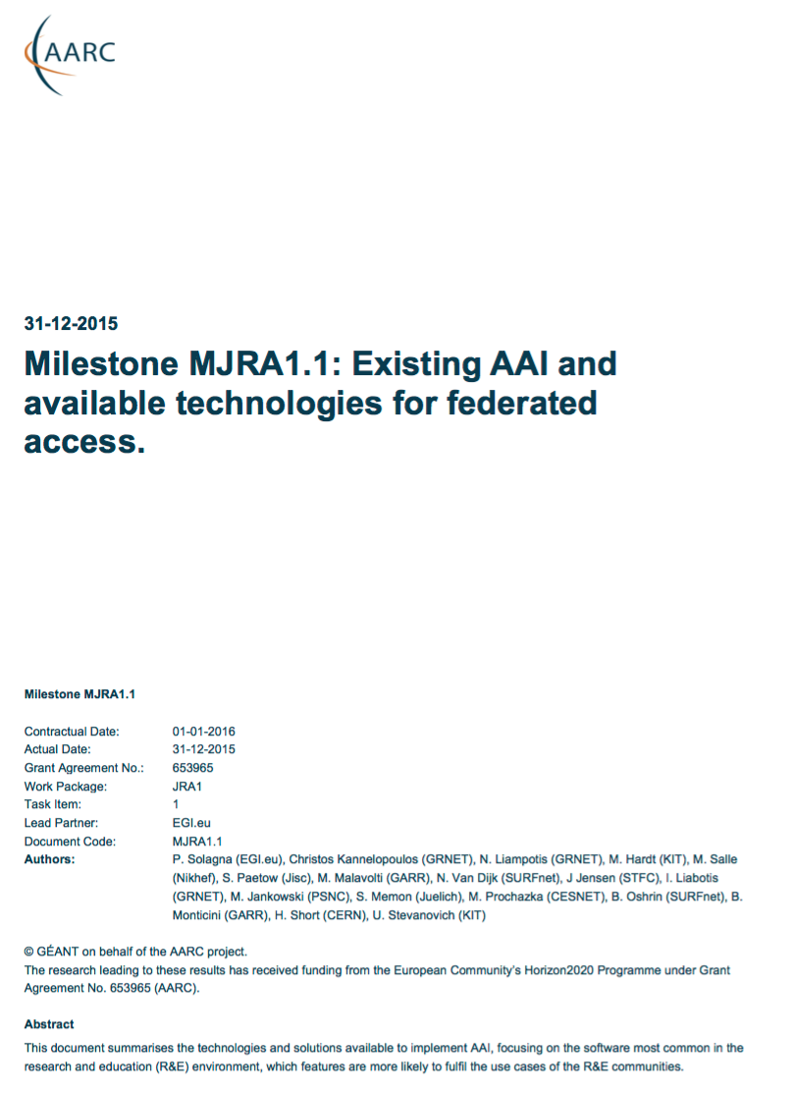
The Functional Components and available AAI tools
Analysis of
User Communities
IdPs
Available
AAI Components
Attribute Authorities
Proxies
Token Translation
And Infrastructure Providers
Service Provider
aarc-project.eu

Slide 7
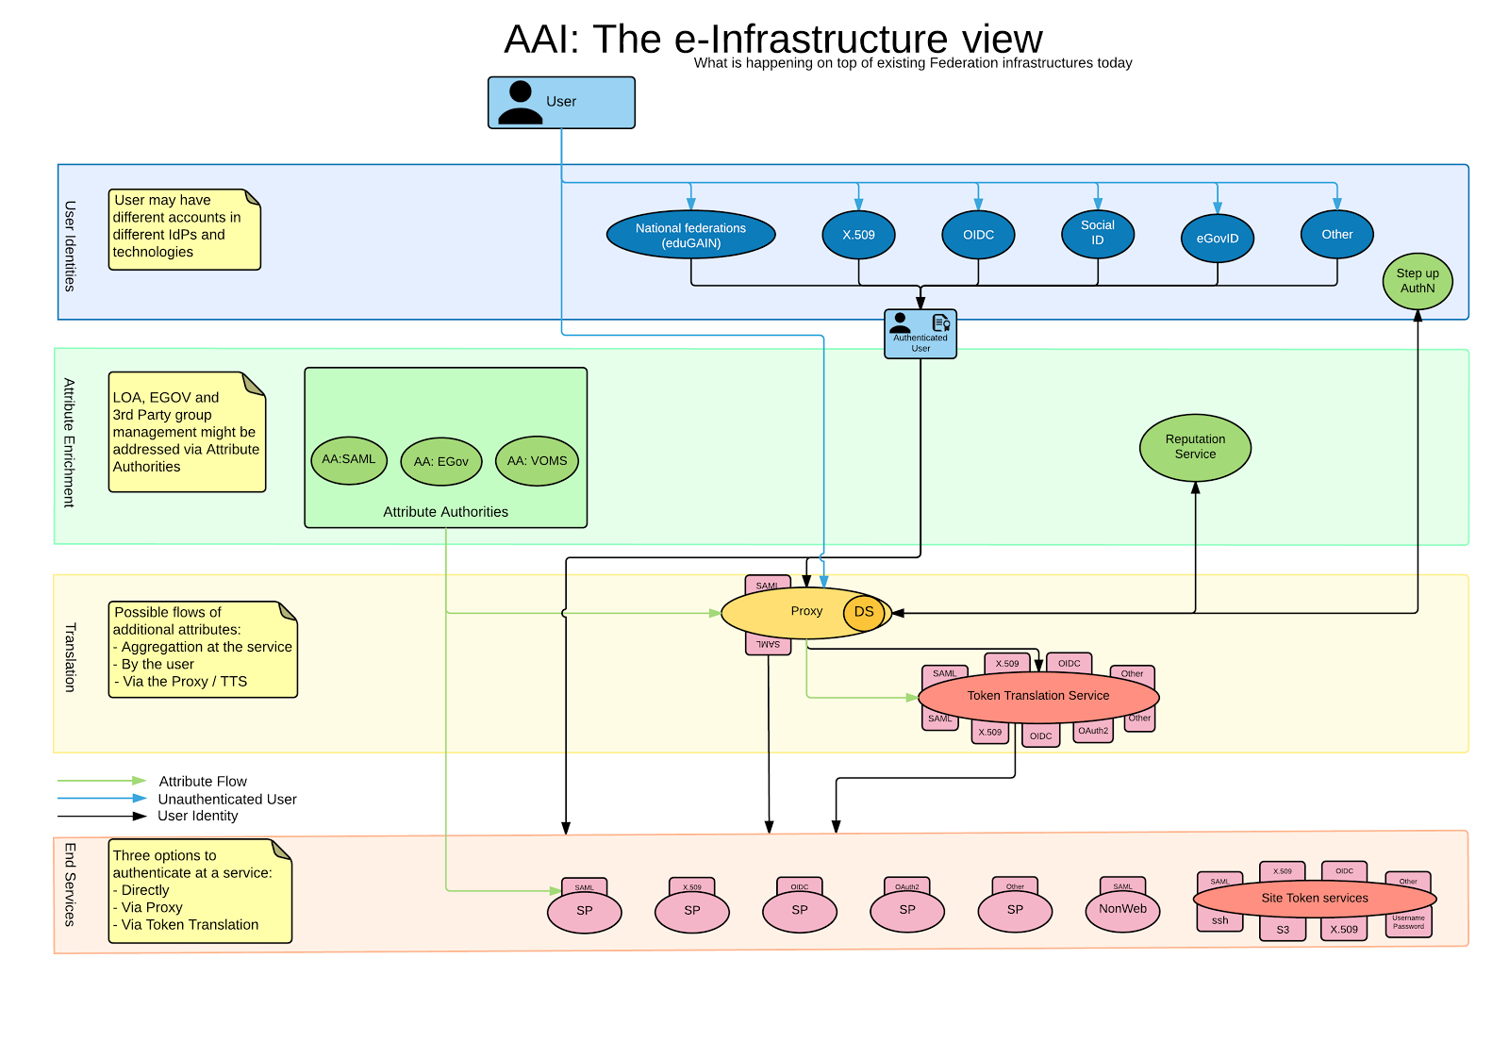
The Functional Components and available AAI tools

Slide 8
The functional Components
Requirements
User Community
Available
AAI Components
aarc-project.eu
Notes:
High level Goals and Approach:
Demonstrate that the solutions identified and proposed by “Architectures for an integrated and interoperable AAI” and ”Policy and Best Practices Harmonisation” are effective in addressing the requirements of the communities
Proof of concepts will involve services from the main e-infrastructures in Europe
Show to what extent different technologies used by the e-infrastructures and service providers are compatible and interchangeable
(Re-)using not building
Started pilots guided by several AARC deliverables
Available @ aarc-project.eu

Slide 9
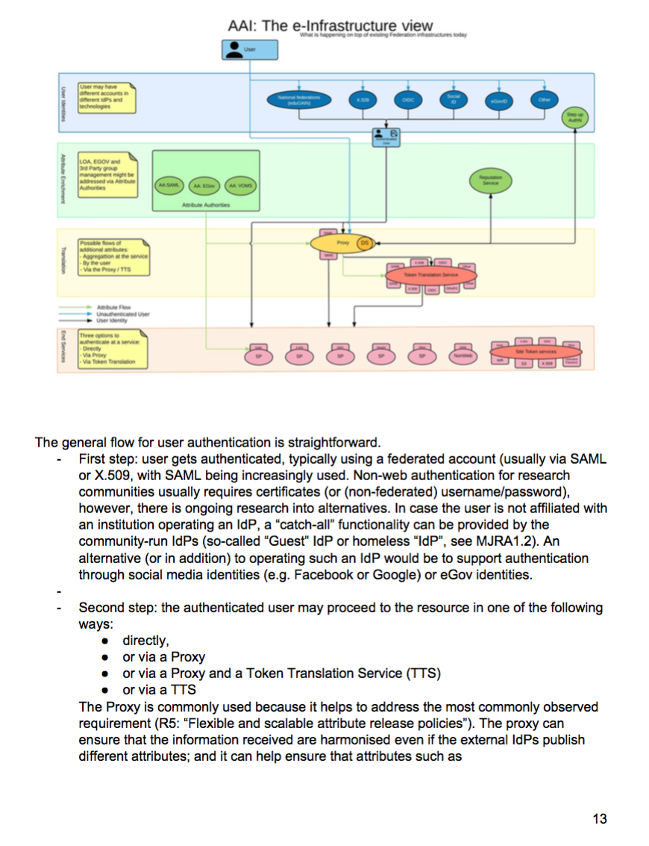
Pilots
Requirements
User Community
Overview Available
AAI Components
Draft Blue-Print
Architecture
Running Pilots
With Communities
aarc-project.eu
Notes:
High level Goals and Approach:
Demonstrate that the solutions identified and proposed by “Architectures for an integrated and interoperable AAI” and ”Policy and Best Practices Harmonisation” are effective in addressing the requirements of the communities
Proof of concepts will involve services from the main e-infrastructures in Europe
Show to what extent different technologies used by the e-infrastructures and service providers are compatible and interchangeable
(Re-)using not building
Started pilots guided by several AARC deliverables
Available @ aarc-project.eu

Slide 11

eduGAIN & AARC
eduGAIN and the Identity Federations
A solid foundation for federated access in R&E
Authentication and Authorization Architecture
for Research Collaboration
A set of building blocks on top of eduGAIN
for International Research Collaboration

Slide 12
Glimpse in the future: AARC 2
“Development of a pan-European identity federation services for researchers, educators and students…Stimulate AAI services supporting communities involved in the emerging data-rich science era to manage and share their resources”
(Some) AAI innovation with user communities will happen in AARC2 (TRL6 as a starting point)
More user-communities in AARC2
Specific pilots to support user-community use-cases and/or to integrate AARC results into existing e-Infrastructures

Slide 13
Christos Kanellopoulos
skanct@admin.grnet.gr

