Slide 1
Business and service management processes for the EOSC Commons
III European Open Science Cloud workshop
Tiziana Ferrari
Technical Director/EGI.eu

Slide 2
Outline
Best practices in federations today
Federation in the EOSC of the future

Slide 3
Setting the scene

Slide 4
Definition and challenge
“A globally interoperable and accessible infrastructure. It includes the required, human expertise, resources, standards, best practices and underpinning infrastructures.”
Challenge: The fragmentation between domains causes repetitive and isolated solutions”

Slide 5
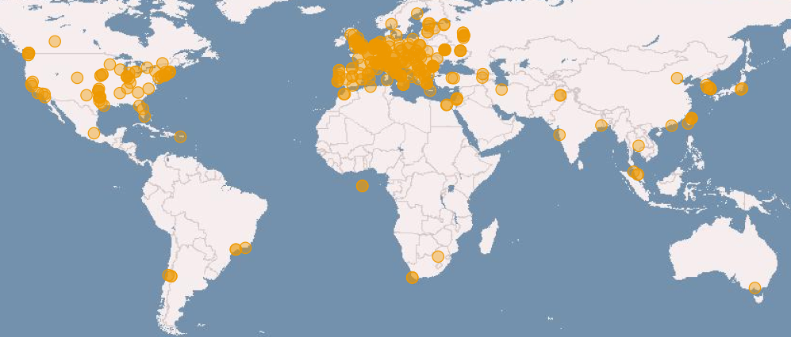
Experience in federating digital infrastructures
Russia
Ukraine
Canada
USA
Asia
Pacific
Latin America
Africa
Arabia

Slide 6
Experience in federating digital e-Infrastructures
Various levels of integration in a federation are possible from loose to tight
The level of integration critically affects the user experience and determines how easily services in a federated environment can be accessed

Slide 7
Loose federation
Achieved today
Single Sign On
Research object identification (PID)
Harmonized security and access policies
Community platform ensuring interoperation between different technologies to handle the complexity of different interfaces
Risk of community-specific ad hoc solutions
Some agreement achieved on data management protocols/interfaces for access and transport
plethora of standards of de facto standards for distributed access to compute
Usage accounting
One support channel

Slide 8
Tight federation (Europe)
Definition of minimum set of security policies
(security for collaborating e-Infrastructures initiative)
Harmonization of access policies
(e.g. policy-based, excellence-driven, membership-based)
Federated
service management
Regional/National infrastructures
Nat. Access policies
Revenue streams
Customer segments
Service Portfolio
Service management processes
European infrastructures

Slide 9
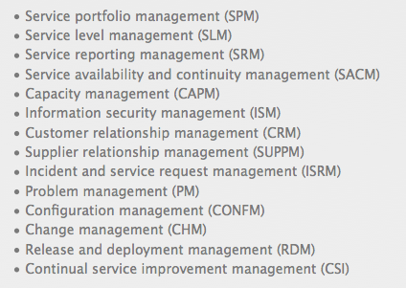
Why federated service management
FitSM standard to simplify service management implementation in a federated environement
http://fitsm.itemo.org/

Slide 10
Example of European federation: EGI Cloud Federation
Collaboration Platform
VM image catalogue, Helpdesk
EGI endorsed images
Community Platform
Community Platform
Cloud Realm
Cloud Realm
Cloud Realm
Cloud Realm
EGI Core Infrastructure Platform
AAI, Service Registry, Accounting, Monitoring, Federated Service Management
Cloud Realm
subset of cloud providers exposing homogeneous cloud management interfaces and capabilities which use the the services of the EGI Core Infrastructure Platform for creating a federation
Community Platforms
provide community-specific data, tools and applications and can be supported by one or more realms.
Notes:
Community Platform: Brokering, community-specific data, tools and applications

Slide 11
Cloud Realms: hybrid infrastructures with custom federation level
Open Standards Realm
OpenStack Realm
Both integrated with all EGI core services
Different IaaS interfaces: OCCI/CDMI for Open Standards Realm, OpenStack for OpenStack Realm
Open Standards Realm supported by OpenNebula, OpenStack and Synnefo

Slide 12
EOSC Research Objects “Hub”
Thematic services (data products, pipelines, software, virtual appliances..)
Research outputs
EOSC Hub
defined by service management processes, business processes, policies
Cloud compute
Cloud container compute
HTC and HPC
Storage/data management
EOSC Research Objects Hub

Slide 13
Federation services and processes
EOSC federation services and activities
(examples)
Federation services/processes
(accounting, monitoring,..
Business processes and channels
Research objects libraries
Federated IdP, Auth, Authz
Markeplaces
Standards and policies
Research Object Indexing
and discovery services
Knowledge an d training

Slide 14
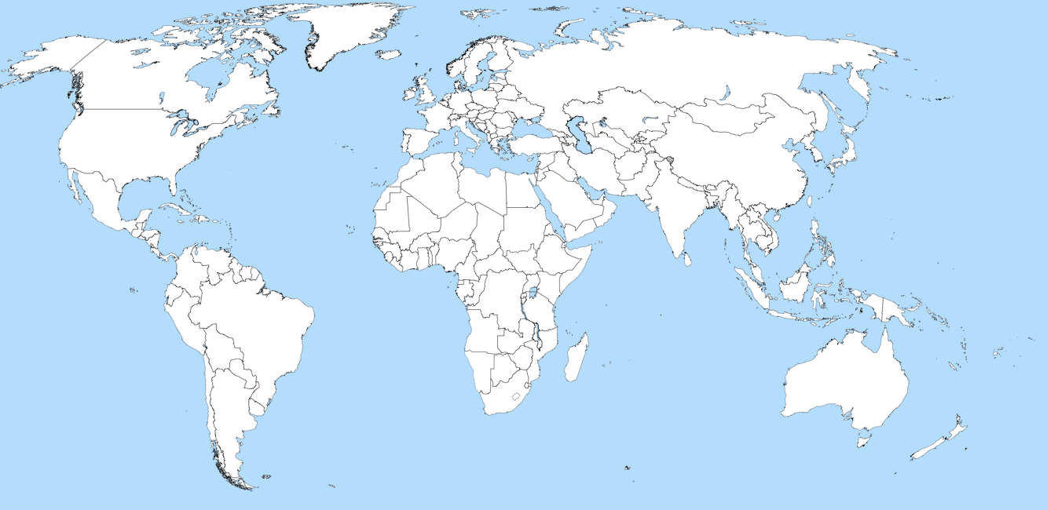
A worldwide Open Science Cloud
EOSC Hub
EOSC Hub
EOSC Hub
OSC Hub
EOSC Hub
OSC Hub
OSC Hub
OSC Hub
OSC Hub
OSC Hub
OSC Hub
OSC Hub
OSC Hub
OSC Hub
Private cloud

Slide 15
Towards the EOSC of the future
B2C Relationships
Public&
private research/
Educators/
Citizen science/
E-gov/
Innovators
EOSC
Reserch
Community services
Composite service providers
E-Infras
Data providers
RIs
…
…
B2B Relationships
B2B Relationships
Service providers (publicly funded/commercial)

Slide 16
Summary
Different federation models possible
Simple and lightweight BUT the choice of the right level will affect the usability of the data and services system
Federated service management to coordinate individual providers and provide horizontal and vertical solutions

