Slide 1
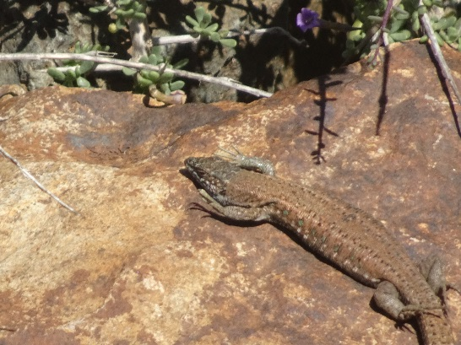

R tools for Ecological Observatories
Experiences from the
EGI-LifeWatch Competence Center
Competence centres, user communities
EGI Conference 2016 in Amsterdam
Presented by
Jesús Marco de Lucas
IFCA-CSIC, Spain
for EGI LW CC team

Slide 2
Outlook
The context of the EGI LifeWatch Competence Center
  ESFRI LifeWatch in 2016
  The project within EGI-Engage WP6
  Exploiting FedCloud
  Success Stories
Experience with R tools for Ecological Observatories
Are we addressing OUR REAL CHALLENGES?

Slide 3
What is LifeWatch?
LifeWatch is an e-science and technology infrastructure for biodiversity and ecosystem research to support the scientific community and other users.
It is putting in place the infrastructure and information systems necessary to provide an analytical platform for the modeling and simulation of both existing and new data on biodiversity to enhance the knowledge of biodiversity functioning and management
Example of case studies:
  Invasive species
  Evolution of wetlands
  Evaluating the ecological quality of habitats

Slide 4
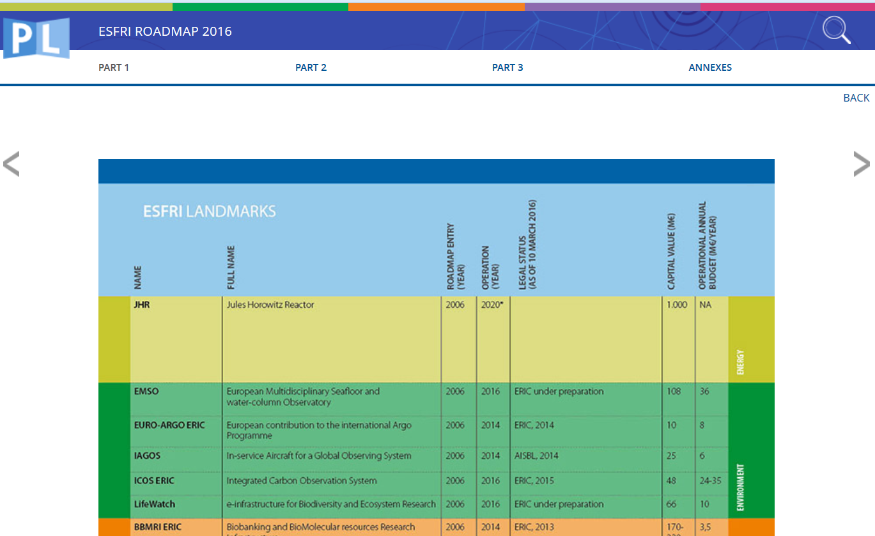
LifeWatch in the 2016 ESFRI Roadmap
http://www.esfri.eu/esfri_roadmap2016/roadmap-2016.php

Slide 5
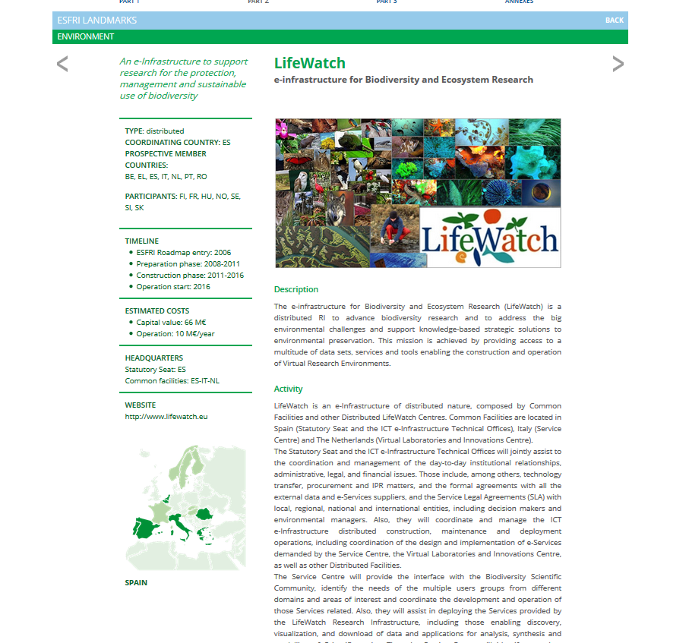

Slide 6
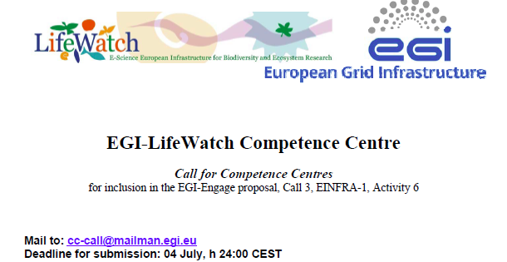
EGI- LW Competence Center
Proposal presented by
I.Blanquer & J.Marco

Slide 7
Objectives
Objective 1- Adoption and exploitation of the EGI infrastructure by the LifeWatch user community, reach users through dissemination of LifeWatch in EGI and assist them along the path of enrolment, learning and exploitation.
Objective 2- Deploy the tools required to support data management, data processing and modeling for Ecological Observatories in the framework provided by EGI.eu.
Objective 3- Integrate, and as necessary develop, on the EGI FedCloud framework, the services required to support workflows oriented to the deployment of Virtual Labs for LifeWatch.
Objective 4- Support to the direct participation of citizens in LifeWatch contributing observation records, in particular those including sounds or images uploading and processing.

Slide 8
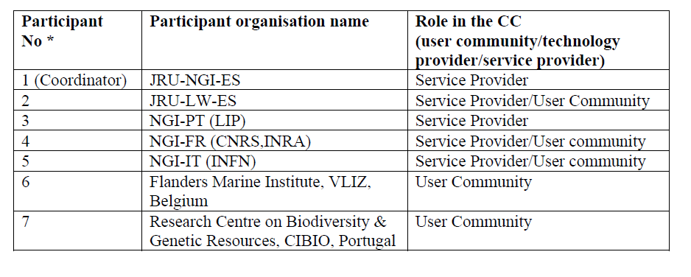
Participants
LW EGI CC acting as a key technical collaboration forum!
Participation of more LifeWatch partners (not formal partners in EGI-Engage): LifeWatch Spain JRU, LifeWatch Greece team at HCMR, LifeWatch Italy team at UniSalento, LifeWatch Belgium at U.Lovaine, LifeWatch NL at UvA…

Slide 9
Task 1: Support to LifeWatch Community and Exploitation
LifeWatch is implementing a comprehensive process to support its developers, operation and end-users
The LifeWatch support to end-users is handled through a Service Center being established in Lecce
The Lifewatch CC in EGI will connect a support team in EGI, operated by IBERGRID (NGI-ES and NGI-PT) and the core-ICT team in LifeWatch, with the communities of developers and end-users, in particular for the integration, operation and monitoring of new applications and services.
This connection will be established at different levels:
  Full lifecycle support for application projects, including: a register of projects, documentation, incidents and evolution management.
  General forum for discussion of evolution, new ideas, and to gather feedback, implemented using communication tools and complemented with workshops.
  Training platform, including hands-on exercises, user guides, webinars and on-line specific courses

Slide 10
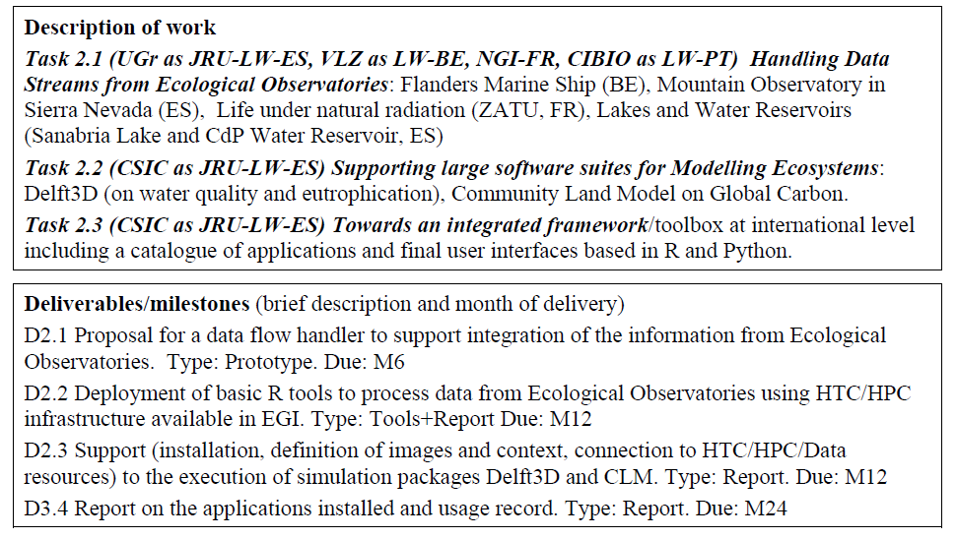
Task 2: Big Data and Ecological Observatories

Slide 11
Task 3:Supporting Workflows & Virtual Labs in FedCloud for LifeWatch
Task 3.1 Integration of Bioinformatic interfaces and frameworks (Galaxy) on EGI FedCloud
Adaptation of a Galaxy portal to run jobs on EGI FEdCloud
Link the public part of INRA’s numerical taxonomy database (R-Syst)
Create a repository of configurations for addressing different Biocomputing problems
Task 3.2 An extensible framework for biodiversity pipelines on EGI Federated Cloud.
Prototype available through the OpenModeller HTC service developed in EUBrazil OpenBio
Niche Modelling Service is implemented through the COMPSs programming framework and available in the EGI AppDB.
COMPSs will be adopted to develop the applications and to optimize their execution, through automatic parallelization techniques, on the EGI Federated Cloud.
Task 3 .3 Implementation of the Network of Life.
After an analysis of the framework of different standards, protocols and tools available within GBIF, the needs of adaptation/expansion to support species relationship data will be defined.
Storage and organization needs of geo-referenced information on species interactions, extracted from the primary literature, will be considered.
The system implemented will be able to build networks of potential interactions, based on the species that have been reported in a given area. Social network algorithms will be used.

Slide 12
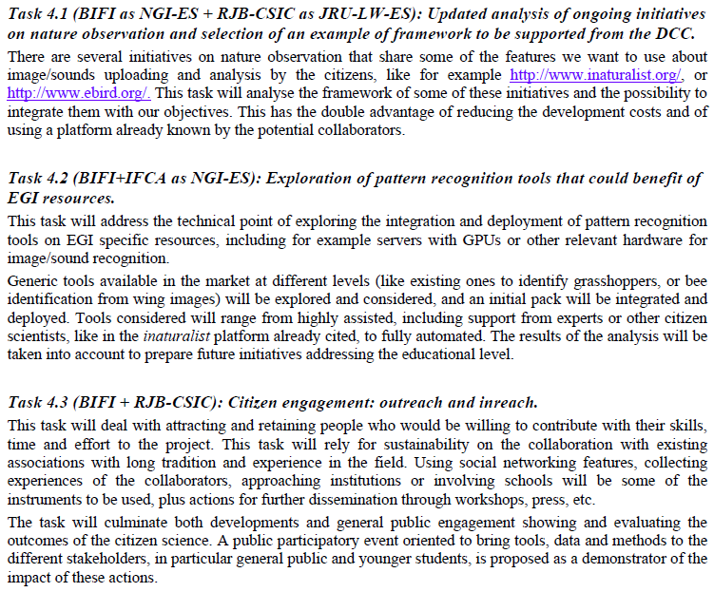
Task 4: Advanced Support to Citizen Science in Biodiversity

Slide 13
LifeWatch Competence Center
TASK SA2.7 LifeWatch (Lead partner: IFCA, M1 – M30)
The goal of the LifeWatch EGI CC is to capture and address the requirements of Biodiversity and Ecosystems research communities.
To achieve this the CC will
  deploy cloud and GPGPU based e-Infrastructure services required to support data management, data processing and modelling for Ecological Observatories,
  explore possibilities to increase the participation of citizens in data-intensive biodiversity research,
  facilitate the adoption and exploitation of the EGI infrastructure by the LifeWatch user community.

Slide 14
LW-CC Deliverables & Milestones
Assigned to SA2.7
D6.1:Assisted pattern recognition tools integrated with EGI for citizen science (OTHER, M09)
D6.6 Data flow handler and basic R tools to integrate and process data from Ecological Observatories on EGI (DEM, M12)
D6.18 Report on the installed LifeWatch applications and their usage record (R, M24)
Related to SA2.1 Training
M6.1 Joint training program for the first period is agreed M03
M6.5 Joint training program for the sec. period is agreed M15

Slide 15

LW-CC Scope
The proposal prepared in July included:
A support task from NGIs (ES,PT,IT)
Two lighthouse projects (24M):
  Big Data and Ecological Observatories
  Supporting Workflows & Virtual Labs in FedCloud for LifeWatch
A path finding project (12M):
  Advanced Support to Citizen Science in Biodiversity
90 PM requested, EGI-Engage will fund 59 PM
LIFE-WATCH related initiatives will complement in what possible
# | Participant | Role in the CC
1 | JRU-NGI-ES | Service Provider
2 | JRU-LW-ES | Service Provider/User Community
3 | NGI-PT (LIP) | Service Provider
4 | NGI-FR (CNRS, INRA) | Service Provider/User community
5 | NGI-IT (INFN) | Service Provider/User community
6 | VLIZ, Belgium | User Community
7 | CIBIO, Portugal | User Community
Spain 32 PM
Portugal 9 PM
Italy 3 PM,
CIBIO 3 PM
VLIZ 6 PM
INRA 6 PM

Slide 16

Exploiting FedCloud
FedCloud adopted in LW CC as the basis (IaaS) for supporting the different services and applications
Have we made the RIGHT SELECTION?
We aim to integrate under an Open Science Cloud
LifeWatch VO supported on FedCloud resources
but… the cloud world is not “easy”
  PILOT PROJECT IN SEVILLE HAS SHOWN MANY OF THE POSSIBILITIES, BUT ALSO THE CHALLENGES!
  We are collaborating directly with FedCloud team, and with Data Commons team within EGI-ENGAGE
  We profit of the collaboration with INDIGO-DATACLOUD
    With participation of several LW CC partners

Slide 17
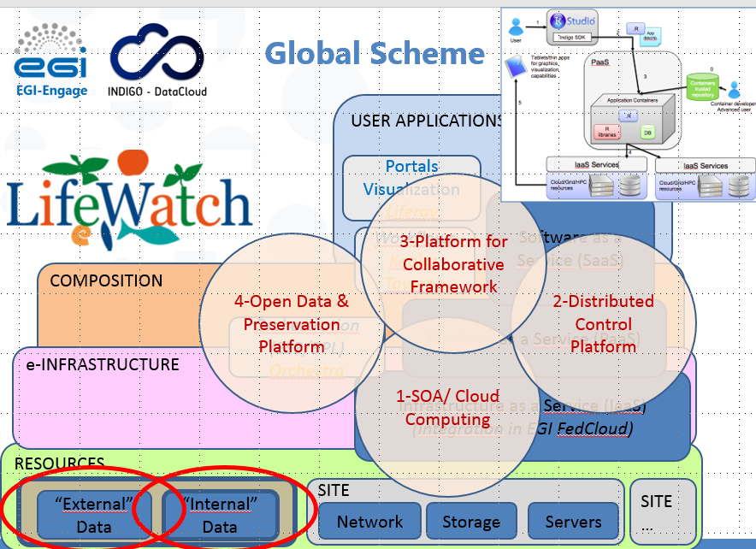
Exploiting FedCloud
Architecture followed in the pilot project

Slide 18
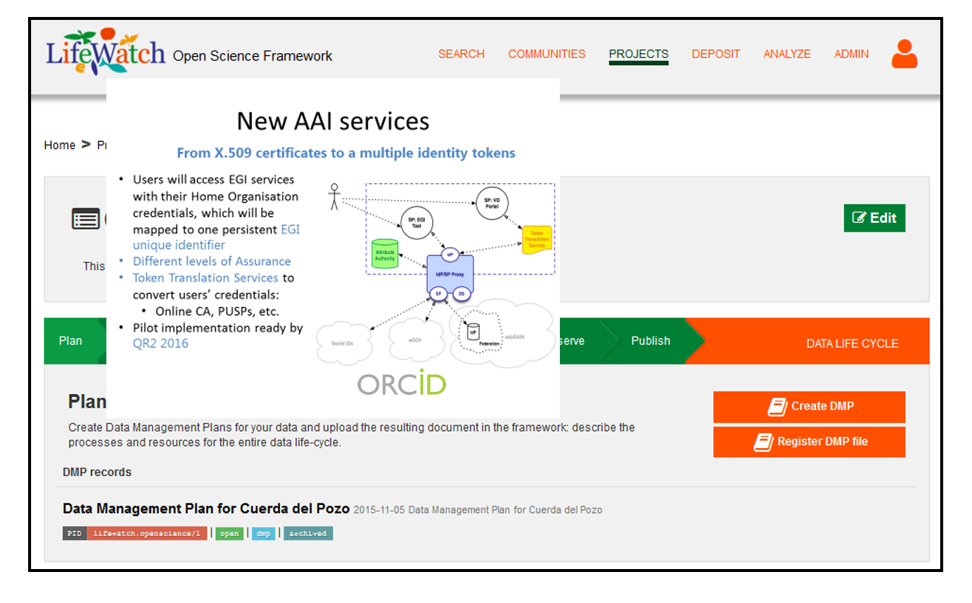
Exploiting FedCloud
Open Science Framework in the pilot project

Slide 19
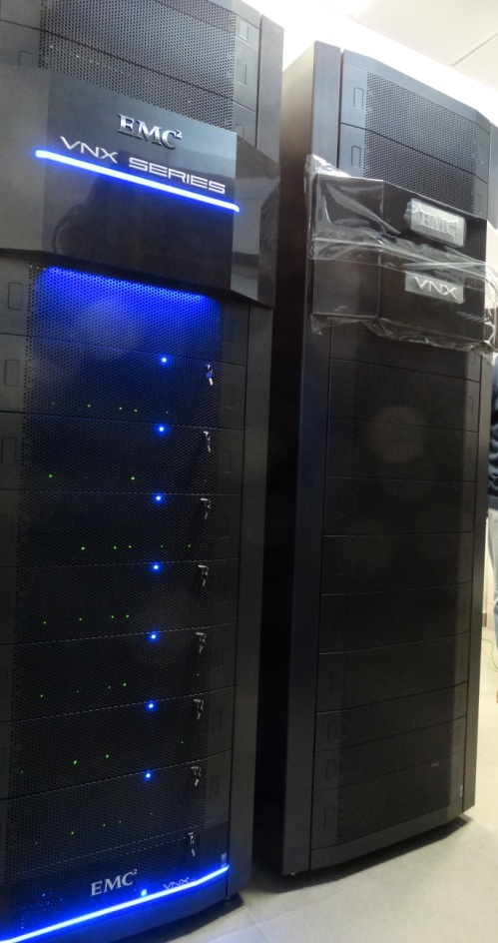
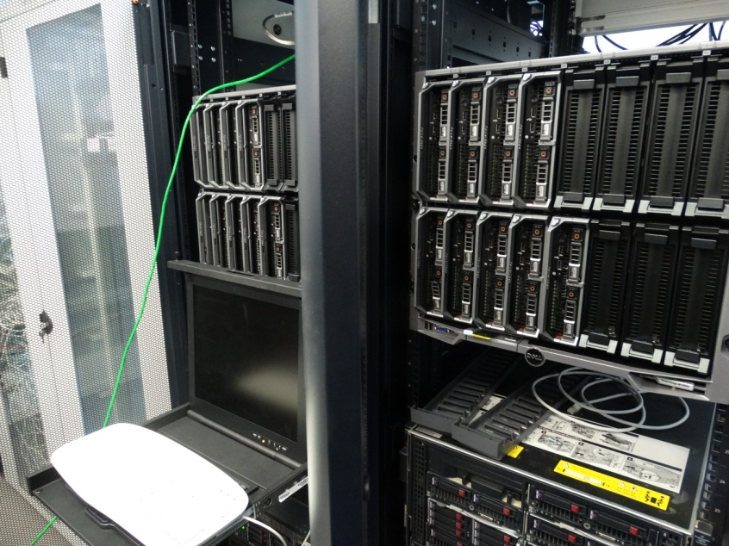
Exploiting FedCloud
Integrating resources in the dedicated pilot project
  New servers (around 1000 cores,
  including large RAM, GPU, etc.)
  New storage (1 + 1 PB)
  Dark fiber network connection
Need to define “service levels”
  FitSM?
  SLA?

Slide 20
Success Stories
Data flow from observatories
  Marine Observatories
  Water Reservoir (contribution to LIFE+ project ROEM+)
Data processing and workflows:
  R and python
  Galaxy (elastic clusters) and TRUFA (genomic) in the FedCloud
  Python based workflows
Support to Citizen Science:
  Support to Natusfera
  Deep NN using GPUs and assisted image recognition (Bari’ demo)
  Outreach events!
Integration of Preservation framework under Data Commons
Lessons learnt on Requirements, OpenProject, and Working Groups

Slide 21
Ecological Observatories and R tools
Two Ecological Observatories provide data into FedCloud via LW‐EGI‐CC:
  Flanders Marine Institute (VLIZ) has installed a number of biosensors on board of the Research Vessel Simon Stevin, as part of the Flanders Marine LifeWatch Observatory, providing a data flow that will reach about 50Tb of data per year, mainly video and images, collected by the vessel in quasi real time and requiring a substantial computational power, to incorporate a framework based in R for the final researcher.
  IFCA and a Spanish SME (Ecohydros SL) have been operating for the last five years an advanced monitoring platform in a water reservoir to detect cyano‐algae blooms, that is providing acontinuous data flow and requires also the integration of external data into EGI FedCloud, used by the SME researchers to contrast the modelling tools. R is used systematically to provide to the online monitoring with the computation of relevant quantities like the vertical temperature profile parameters evolution (epilimnion /hypoliminion parameters among many others)

Slide 22
Ecological Observatories and R tools
Marine Data Stream
Data Flow in the Case Study of the marine observatory managed by VLIZ center

Slide 23
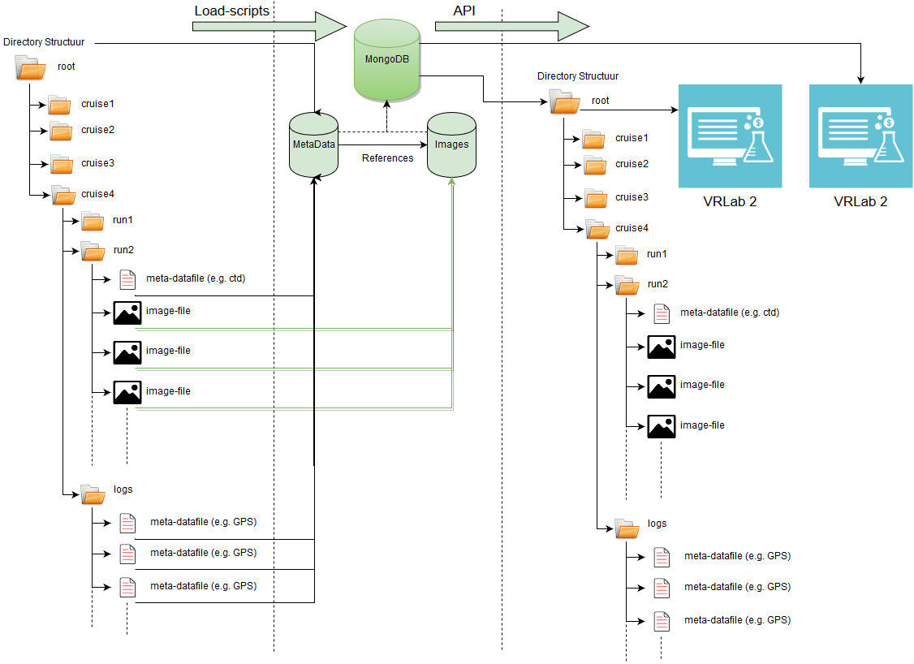
Ecological Observatories and R tools
Data synchronization + Data accessibility
The MongoDB databases in VLIZ and IFCA are accessible from the Rshiny/ Rstudio based virtual lab running at VLIZ: the LifeWatch data explorer.
Demonstration website accessing server at VLIZ: http://rshiny.lifewatch.be/ZooScan%20data/
Access to files through MongoDB
The virtual labs should also have access to the individual files generated by the different biosensor instruments:
Access to data in SQL databases: http://rshiny.lifewatch.be/
Access to data through Geoserver webservices
Using Geoserver clusters could boost the speed of accessing data.
This is ongoing work within the Geoserver working group in LW-EGI CC.

Slide 24
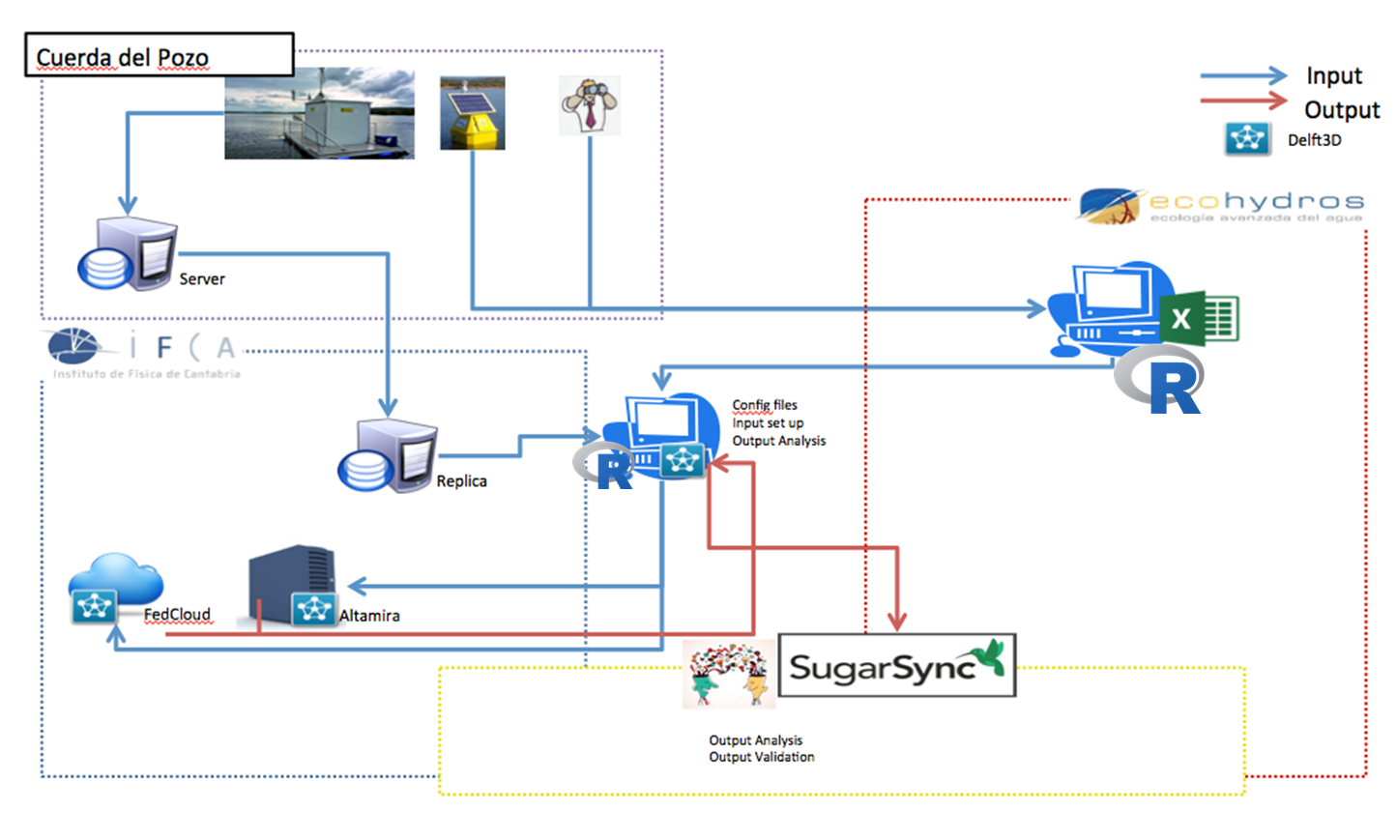
Ecological Observatories and R tools
CdP Water Reservoir Data Flow Schema

Slide 25
Ecological Observatories and R tools
A detailed analysis of the possibilities to implement and deploy services oriented to support the use of R is presented in EGI-Engage D6.6
  starting from the previous experience in the Grid framework (processing data from the LTER Observatory of Sierra Nevada in Spain)
  describing the implementation in HPC systems, in clusters in other LifeWatch centers (HCMR, VLIZ, IFCA)
  also starting the discussion on how to compare the performance in order to improve it combining the experience and different approaches of the different teams in the LW‐EGI‐CC.

Slide 26
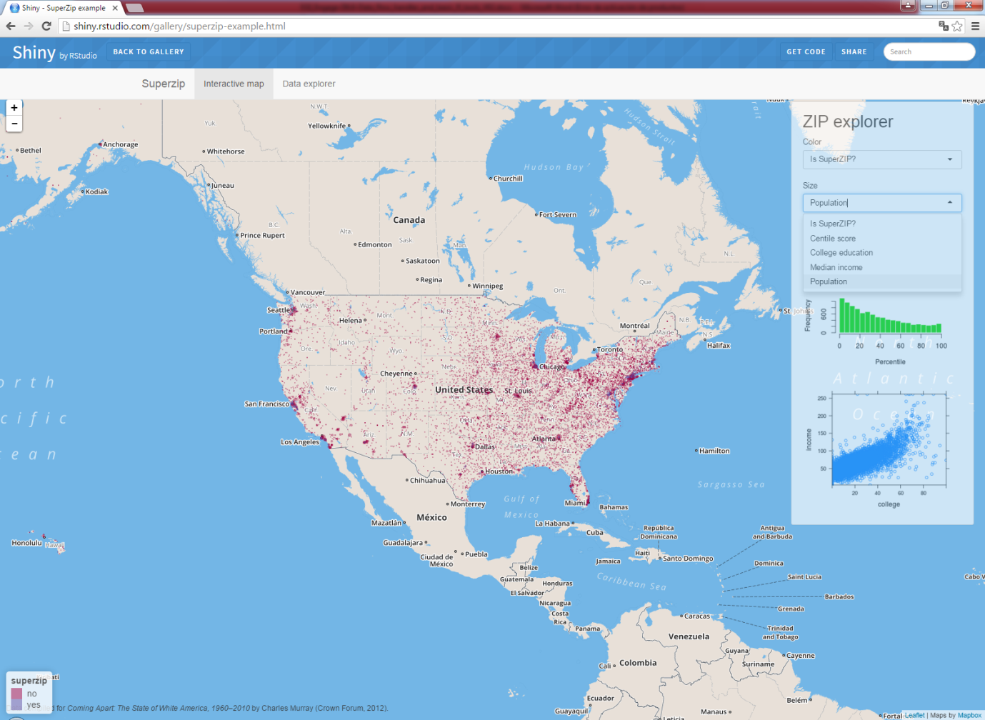
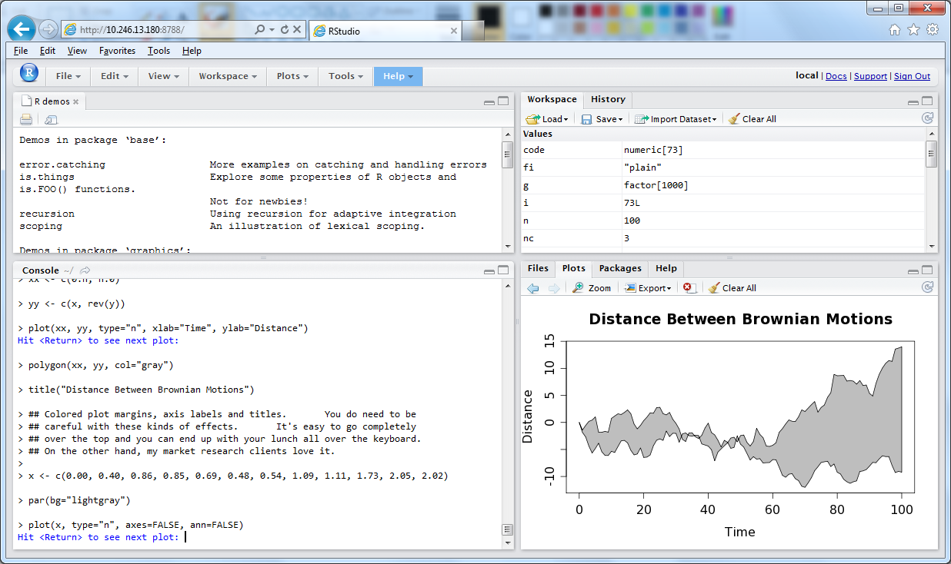
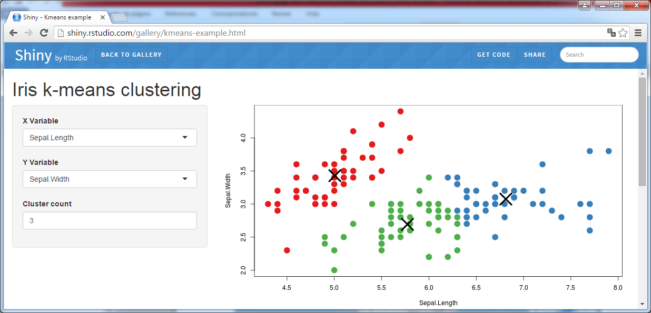
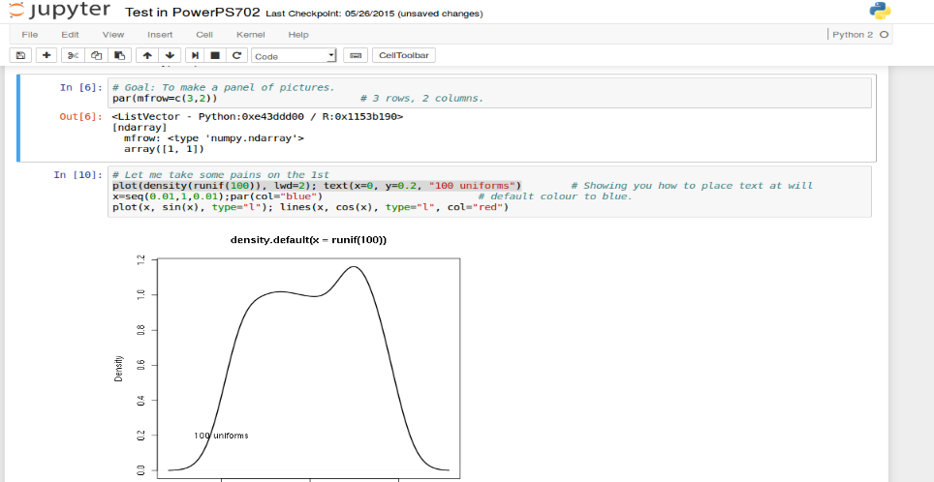

R tools / frameworks
R Studio
R Shiny
Jupyter

Slide 27
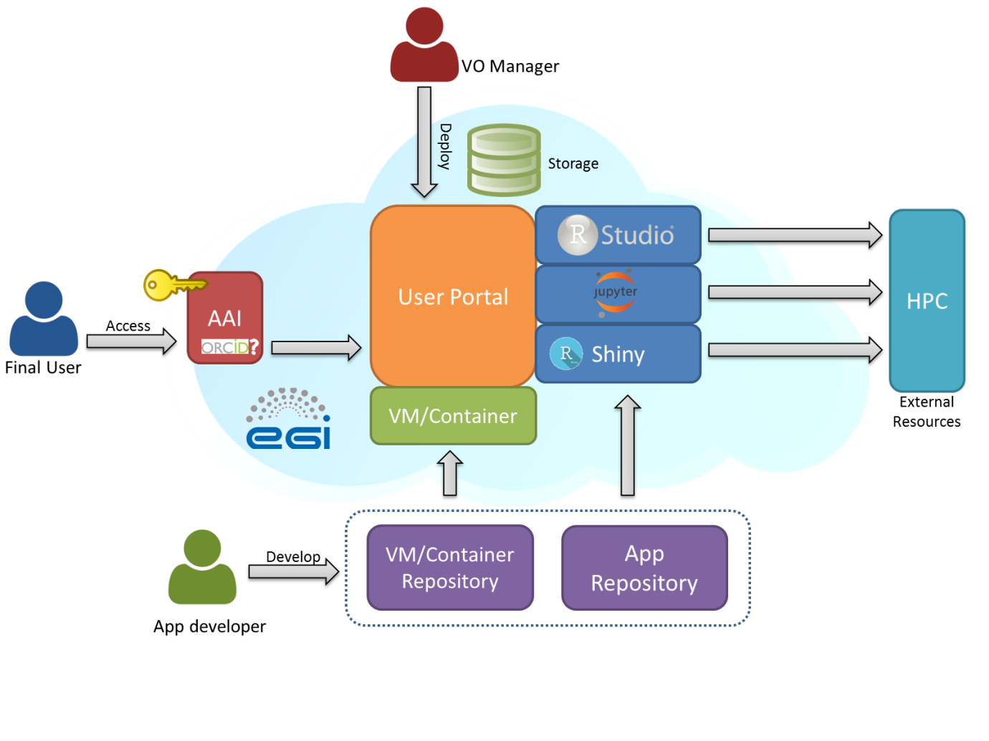
Implementations within LifeWatch
LW-Be
http://rshiny.lifewatch.be/ and http://rstudio.lifewatch.be/
LW-Gr (@HCMR)
https://rvlab.portal.lifewatchgreece.eu/
Draft proposal for
implementation as service:

Slide 28
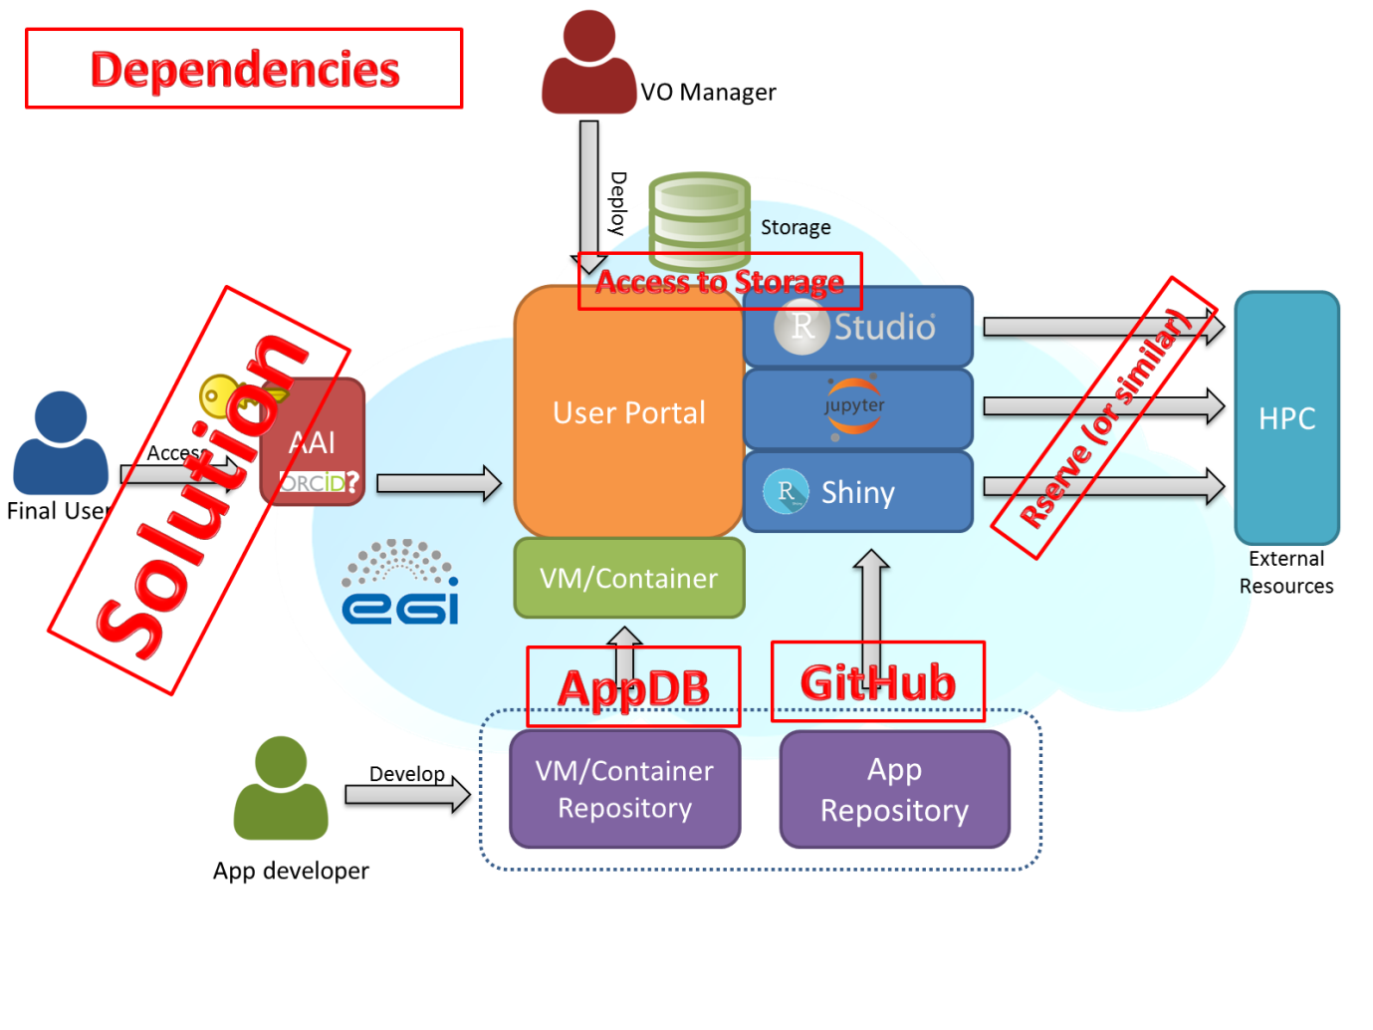
Implementations within LifeWatch
LW-Be
http://rshiny.lifewatch.be/ and http://rstudio.lifewatch.be/
LW-Gr (@HCMR)
https://rvlab.portal.lifewatchgreece.eu/
Draft proposal for
implementation as service:

Slide 29
CHALLENGE 1: A REALISTIC FRAMEWORK
From EGI CONF 2015 !!!
We need Real Requirements from Real Applications
  Covering both basic research and management
  Different scope (Marine, Fluvial, Terrestrial…)
  Cross-disciplinary, cross-scales
  Need a catalog of Open Source solutions
  Benefiting from LW e-Infrastructure
Human in the middle?
  Sustainable?
User friendly
  Starting from Authentication… to Visualization
Workflows?
  easy or sophisticated?
In collaboration with other H2020 initiatives

Slide 30
CHALLENGE 2: DEFINITION AND SETUP OF THE e-INFRASTRUCTURE
From EGI CONF 2015 !!!
FedCloud framework, what do we need?
  LW will go in production mode in 2016
  Who will support LW VO?
  Is FitSM a good idea? we need SLA and CRM
  Additional components (Control Platform)
Access to external data: GBIF, LTER, ESA, etc.
Support to Open Data
  The Complete Data Life Cycle
  Preservation issues

Slide 31
CHALLENGE 3: ENGAGE THE COMMUNITY
From EGI CONF 2015 !!!
LW regional and national initiatives
VRE `platforms: VRE marine LW,…
Fragmentation of Biodiversity initiatives
  Biodiversa, Natural Parks, LIFE…
  Ecological Quality and “Management” projects
Citizen Science

Slide 32
Concluding remarks
EGI LW Competence Center has been instrumental for us to progress !
We have adopted the FedCloud basis, and are exploring the components (PaaS, SaaS levels), in collaboration with other projects (like INDIGO)
A lot of effort put!
  -Many thanks to all people and teams!!!
We start to have an idea of how this framework can be sustained, what tools do we need and what do we miss (in particular more resources)
Because the challenge in front of us is very large
A final reflection towards our integration into Open Science (Cloud) , motivated by “Creating a Learning Society: A new approach to Growth” (Stiglitz&Greenwald): WE CAN HAVE A LARGE (SOCIETAL) IMPACT IF
  We are able to reach an adequate scale
  We realize that our experience should be exploited to provide learning support!

Slide 33
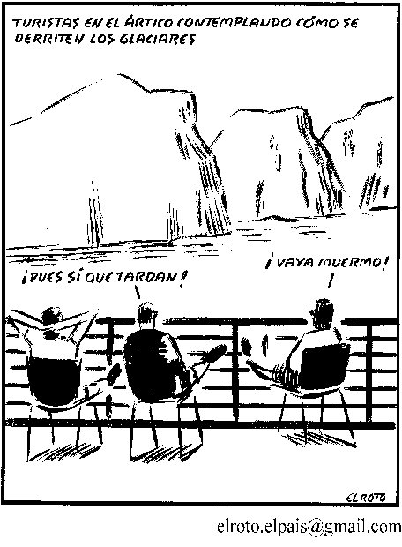
You are cordially invited to the LW CC meeting at 15h today!

