Slide 1
EPOS CC - empowering use cases from the Solid Earth Science domain
Daniele Bailo, Mariusz Sterzel, Alessandro Spinuso
EGI CONFERENCE 2016 6-8 April 2016 Science Park

Slide 2
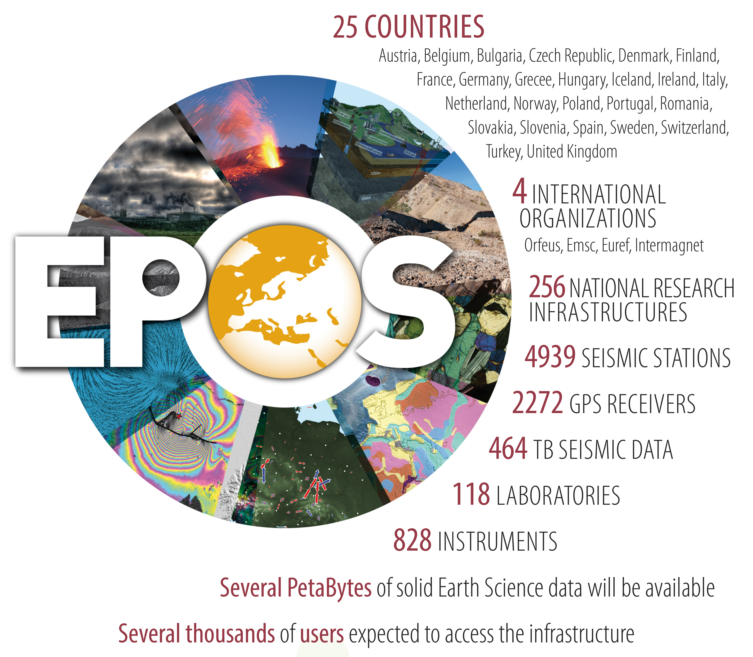
What is EPOS?
EPOS is a long-term plan for the integration
of research infrastructures for solid Earth Science in Europe
EPOS integrates the
existing (and future) advanced European facilities into
a single, distributed,
sustainable infrastructure
taking full advantage of new e-science opportunities
Notes:
Existing = abbiao I dati
E-science opportunity

Slide 3
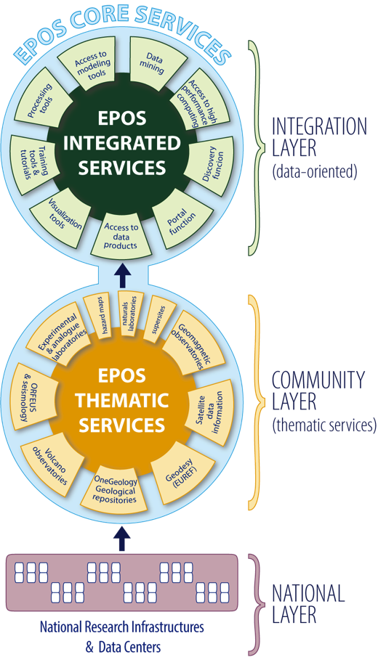
EPOS services
EPOS Integrated Core Services.
Provide access to:
multidisciplinary data, data products, synthetic data from simulations,
processing and visualization tools
Thematic Core Services are infrastructures to provide data services to specific communities (they can be international organizations, such as ORFEUS for seismology)
National Research Infrastructures and facilities provide services at national level and send data to the European thematic data infrastructures.
Notes:
FROM THE BOTTOM:
3. National RI, alrady operational, provide services at national level. Some of them send already data to european organization
2. We want to promote a community buliding action to move from this scattered set of Ris to THEMATIC CORE SERVICES, i.e. RI to provide data to specific communities (geodesy, seismology) . They’ll EUROPEAN disciplinary integrated nodes
1. Integration layer, the EPOS infrastructure which will be able to integrate all the data from different THEMATIC. Access … (leggi slide)

Slide 4
Compatibility layer
ICS/TCS comunication
Metadata catalogue+APIs
Web Services
AAI mechanisms (deleg.)
COMPATIBILITY LAYER
Notes:
FROM THE BOTTOM:
3. National RI, alrady operational, provide services at national level. Some of them send already data to european organization
2. We want to promote a community buliding action to move from this scattered set of Ris to THEMATIC CORE SERVICES, i.e. RI to provide data to specific communities (geodesy, seismology) . They’ll EUROPEAN disciplinary integrated nodes
1. Integration layer, the EPOS infrastructure which will be able to integrate all the data from different THEMATIC. Access … (leggi slide)

Slide 5
COMPETENCE CENTER USE CASES
A basic AAI use case, discovery of data from the ICS-C portal by accessing to system with heterogeneous credentials.
Single discipline computational oriented use case, usage, from user’s side, of a computational seismology tool which orchestrates the access to data and to computational resources on behalf of the user.
Use case involving satellite data: processing of sattelite images with EGIFedCloud

Slide 6
AAI use case

Slide 7
Definition: AAAI
Authentication → “who are you?”
Authorization → “what are you allowed to do?”
Accounting → log actions -> provenance
Infrastructure → …Infrastructure...

Slide 8
What problem are we facing?
EPOS IdP
User wants:
1 single authentication
to access all resources
System must:
be delegated
to act on user behalf
TCS must know
Who’s querying it
EPOS ICS-C
External IdP
OTHER HTC
SERVICES
SEISMOLOGICAL SERVICES
ANTHROPOGENIC HAZARD SERVICES

Slide 9
AAAI in EPOS
Several TCSs, RIs, etc., have already developed DIVERSE AAAI solutions
Hub technologies passing logins, passwords, etc. have to be abandoned by principle. Instead modern, attribute based, solution is advised.
Once user is authenticated within the infrastructure all the authorisation should be done by attributes only
Curent external IdPs we are aware of include: EduGAIN, LDAP, OpenID, x509 certificates, …

Slide 10
Issues/challanges
Users want to access ICS with their credentials
TCS have heterogeneous AAAI
ICS will retrieve TCS resources on behalf of the user

Slide 11
Architecture
1
2
3

Slide 12
Cloud approach: Identity Management As a Service
with attributes management and authentication included.
Multiple authentication protocols supported
easy integration with various consumers/clients.
Ability to outsource credentials (and attributes) management to a 3rd party service.
Again multiple upstream protocols supported.
UNITY becomes a bridge (protocol translation)...
... and a hub (single service aggregating various IdM systems).
http://www.unity-idm.eu/

Slide 13
Instead of using local authentication UNITY can delegate the authentication to external service.
LDAP/ActiveDirectory
SAML IdP
OpenID Connect provider
OAuth
X.509 Certificates
others...

Slide 14
EPOS AAI Prototype 1
ICS AAI service (based on UNITY)
https://epos-aai.cyfronet.pl/
… enables accesss to „dummy ICS services”
Plain application: https://epos-aai.cyfronet.pl/home/home
…with option to authenticate throught a TCS login
TCS-AH: https://unity.epos.cyfronet.pl

Slide 15
More infos
UNITY website http://www.unity-idm.eu/

Slide 16
Computational use case

Slide 17
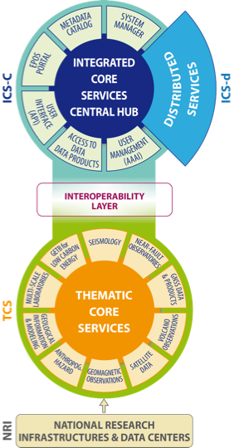
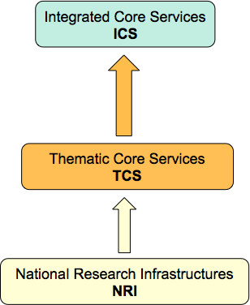
EPOS
Computational Earth Science (CE)
CES
Computational Seismology
Satellite Data
processing
Computational
Seismology
Anthropogenic
Hazard

Slide 18
Virtual Earthquake and Seismology Research Community in Europe
http
portal.verce.eu

Slide 19
The Forward Modelling Use Case
Earthquake Simulation: Synthetic Seismograms for various Earth models and Earthquakes via the execution of HPC simulation codes called solvers
Raw data acquisition & Misfit: The synthetic data may be compared with real observations adopting Data Intensive methods
Inversion: Model updates and improvement

Slide 20
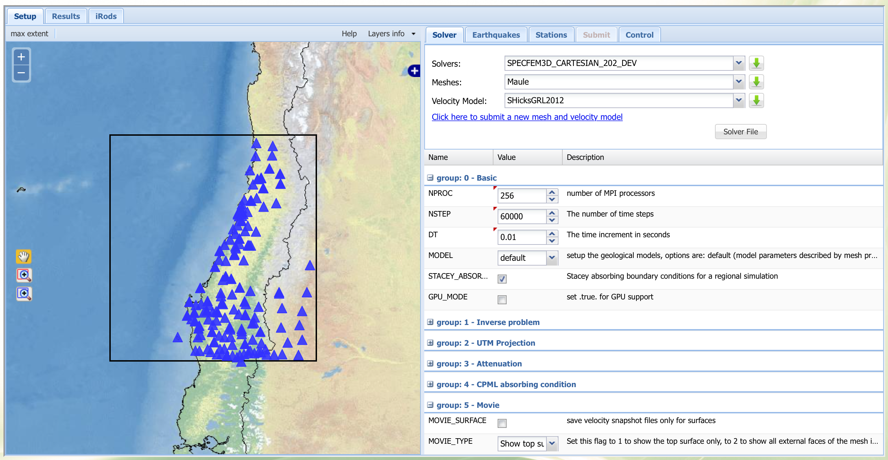
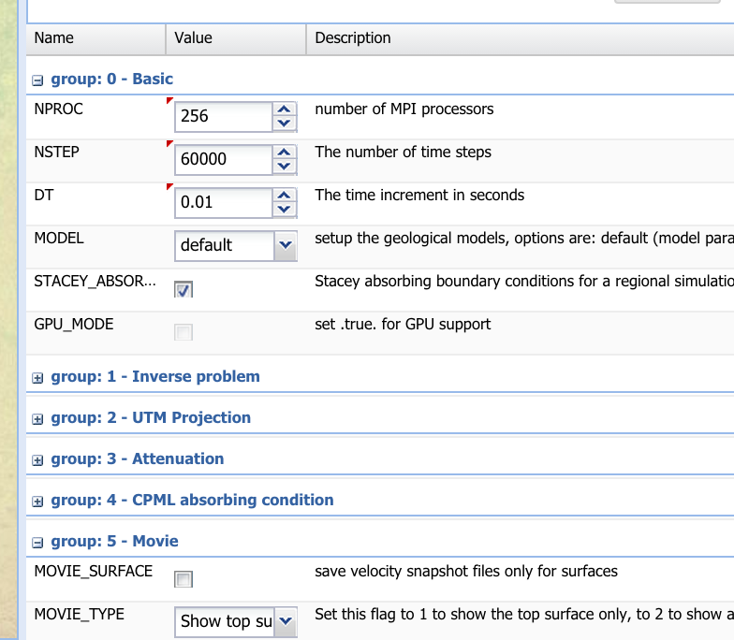
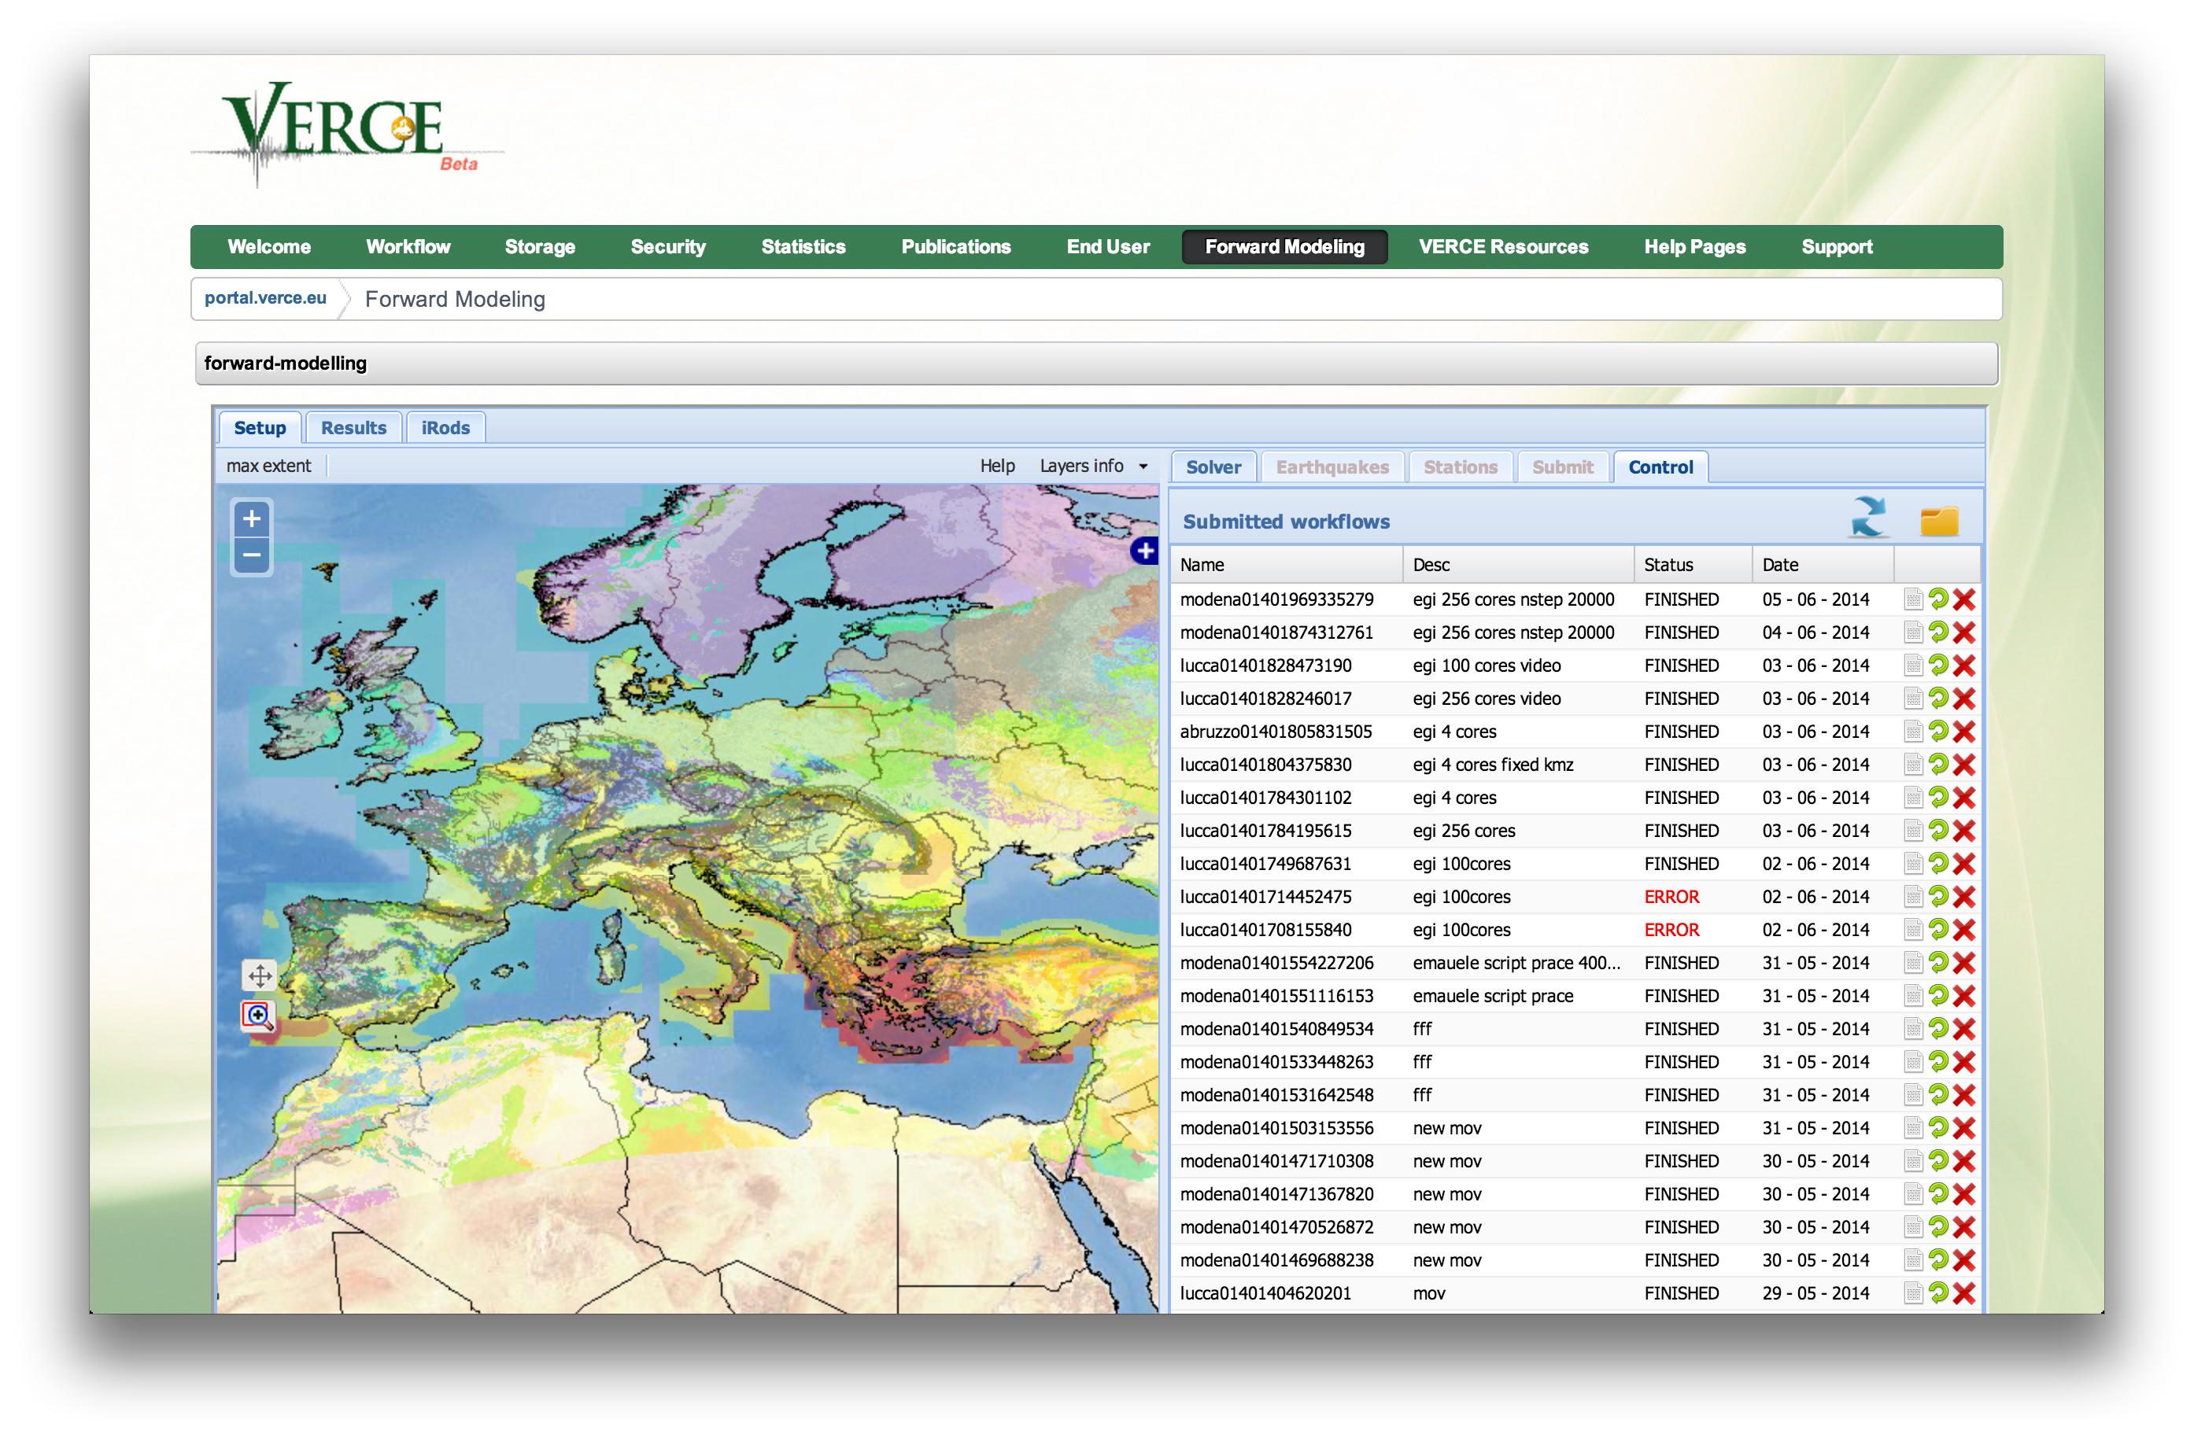
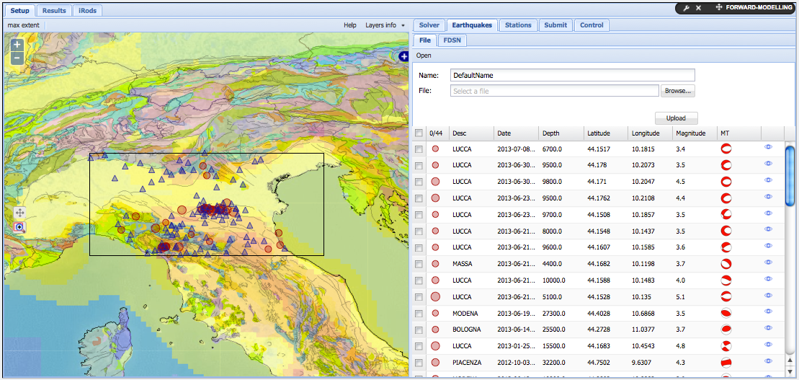
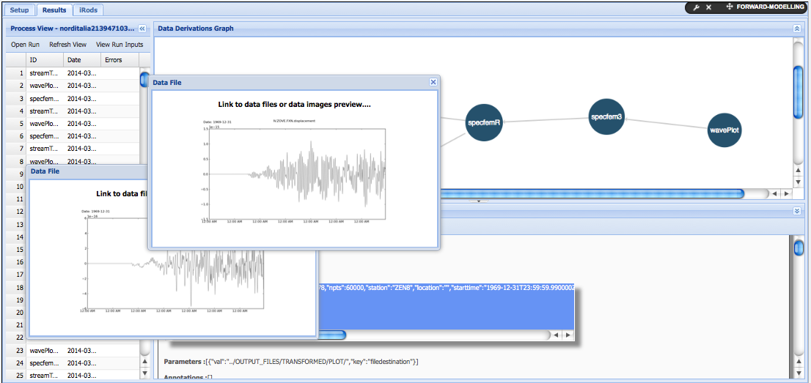
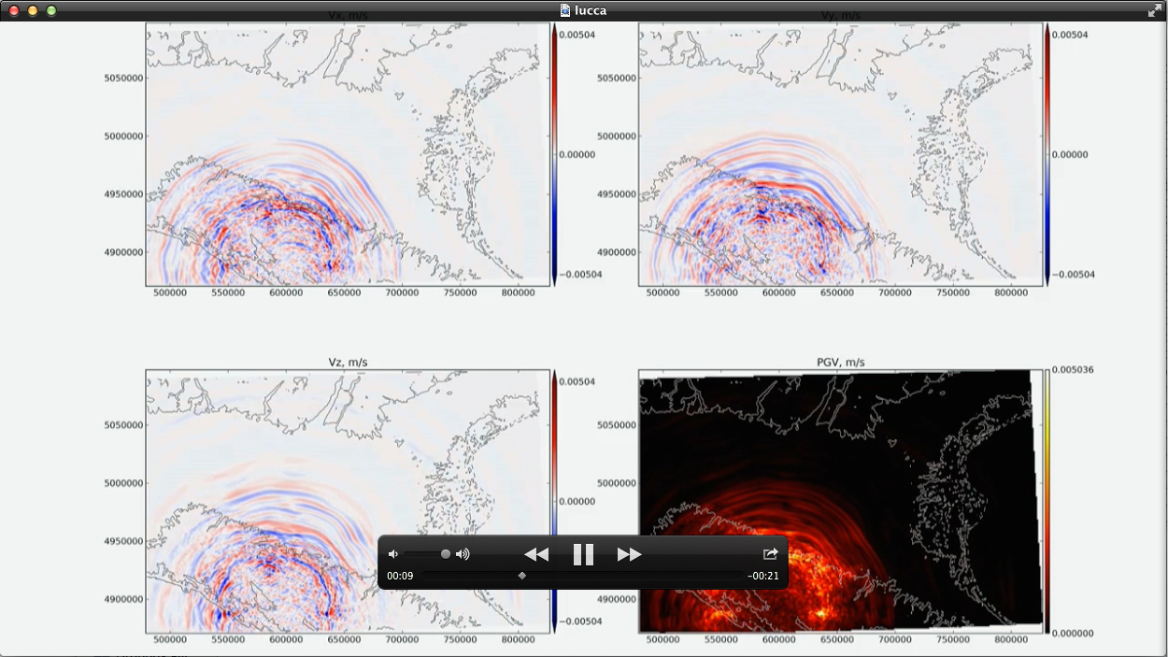
Earthquake Simulation
Simulation setup and control

Slide 21
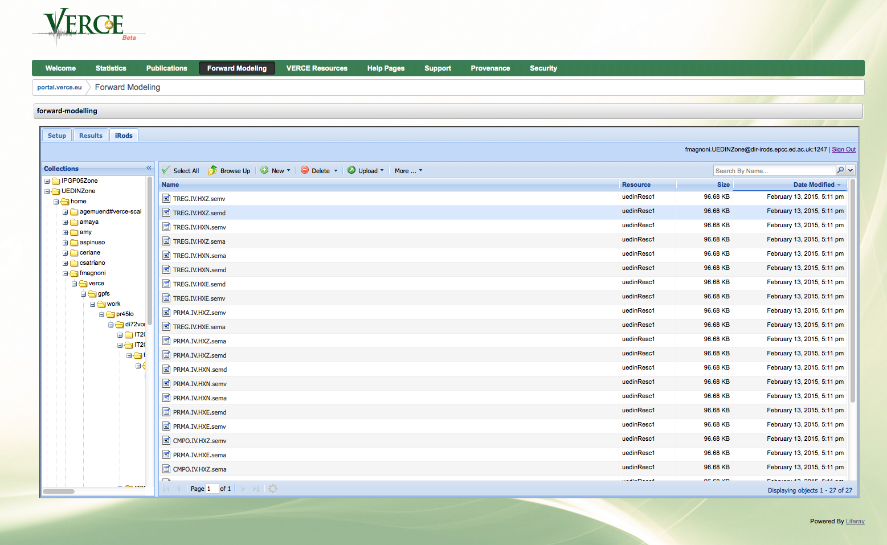
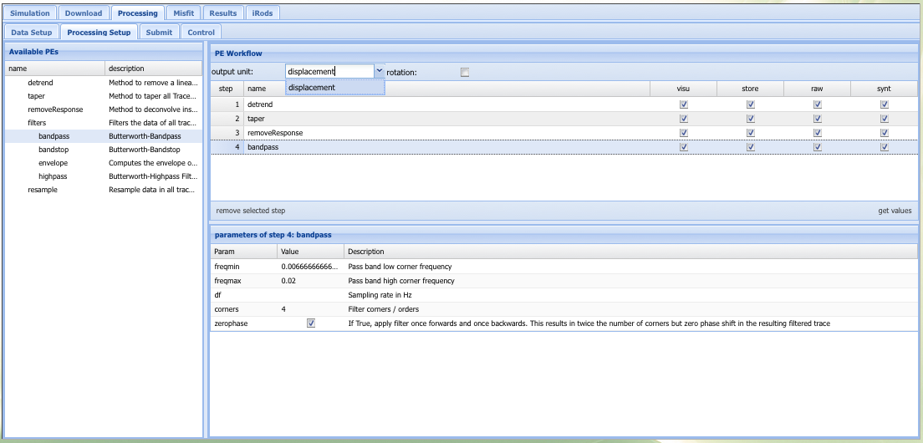
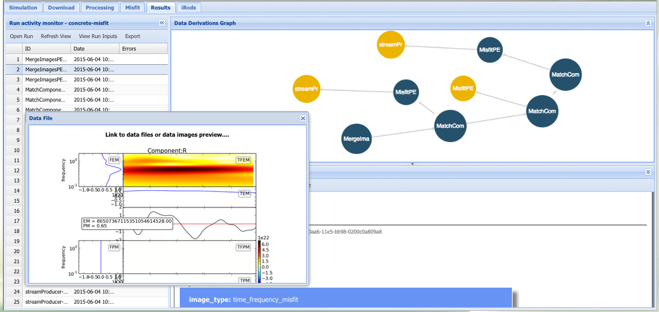
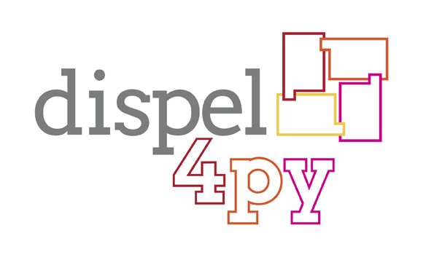
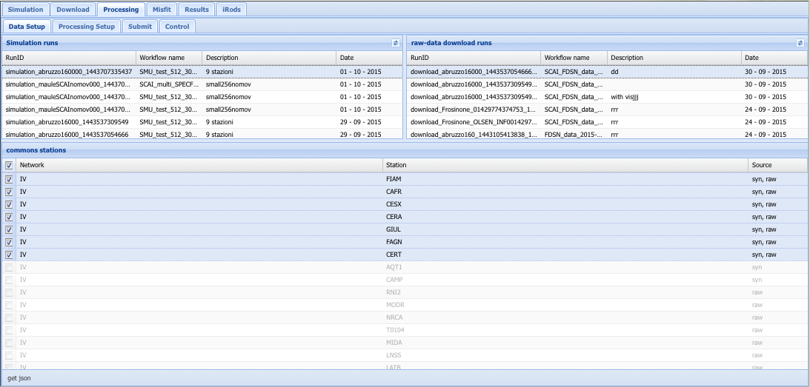
Misfit Calculation
Misfit between SYNTHETICS and DATA
Simulated Synthetics
Data/Synt Processing
Misfit Analysis
Data Download (EIDA)

Slide 22
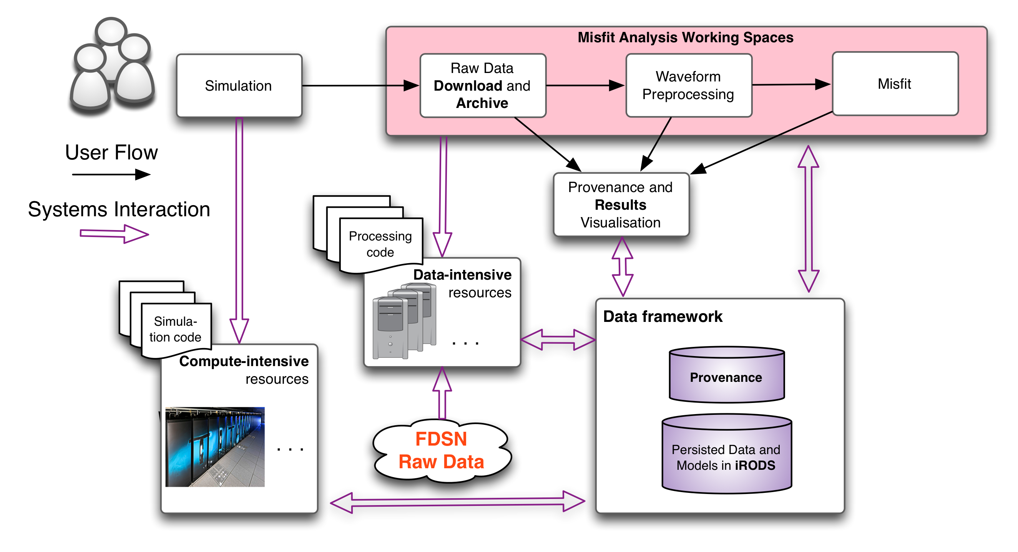
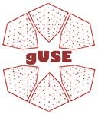
Gateway Services Overview

Slide 23
Task Force Goals
STAGE ONE
1.1 - Best strategy for WS-PGRADE to access Fed Cloud partners (CNRS - GRNET)
1.2 - Secure and Efficient Data Transfer protocols towards the Current iRODS VERCE - DMS (GridFTP X.509)
1.3 - Impact evaluation on the current VERCE Science Gateway
STAGE TWO
2.1 - Integration of third party Data Storage Services (EUDAT/EGI) and Unity based AAI (EPOS-CC 2nd Task Force and Long Tail of Science)
2.2 - Porting the Misfit computational service according to results.

Slide 24
Satellite Data use case

Slide 25
Satellite Data use case
Satellite data TCS
deal with the processing of the EO datasets
including the Sentinels of the Copernicus programme
Address societal challenges: climate, natural hazards and risk assessment and, efficient usage of resources.
Satellite data TCS services deployed on top of ESA Geohazard TEP (GEP)
Pilot services will be deployed on top of the GEP interconnected to the EGI FedCloud
Integration of the GEP with the EGI FedCloud is running under the EGI-Engage task SA1.3

Slide 26
Conclusions
Steps forward with the AAI use case
Unity demonstrated to be an appropriate solution
Computational use case:
Use case designed
Ongoing work
Integration with VERCE platform and more (see tomorrow’s talk)
Satellite use case: first steps and use case design
The competence center had a relevant impact on EPOS developments

