Slide 1
Towards the EISCAT_3D Portal - Experiences with DIRAC
Víctor Méndez Muñoz

Slide 2
Agenda
Introduction
EISCAT-3D computing model overview
dirac.egi.eu service suite
EISCAT-3D Proof of concept with dirac.egi.eu
EISCAT-3D portal system: adapted frontend + dirac.egi.eu backend
Conclusions

Slide 3
Introduction

Slide 4
Introduction
EISCAT project
EISCAT_3D is a project that aims at constructing a new generation of ionospheric and atmospheric radar in the auroral zone in the Fenno-Scandinavian Arctic.
The first stage will consist of three radar sites: transmitter and receiver at Skibotn (NO), and receivers in Karesuvanto (FI) and Bergfors (SE).
EISCAT_3D will also have an operations centre, and two or more data centres located in the Nordic area.

Slide 5
Introduction
EGI Competence Centre for EISCAT-3D
Users will interact with EISCAT_3D data and related applications through a user portal
At the beginning of 2016, the EGI Competence Centre for EISCAT-3D decided to adopt DIRAC to ease distributed computing
At the present a proof of concept has been implemented
There is a work in progress to implement a prototype for the coming EISCAT-3D data.

Slide 6
EISCAT-3D computing model overview

Slide 7
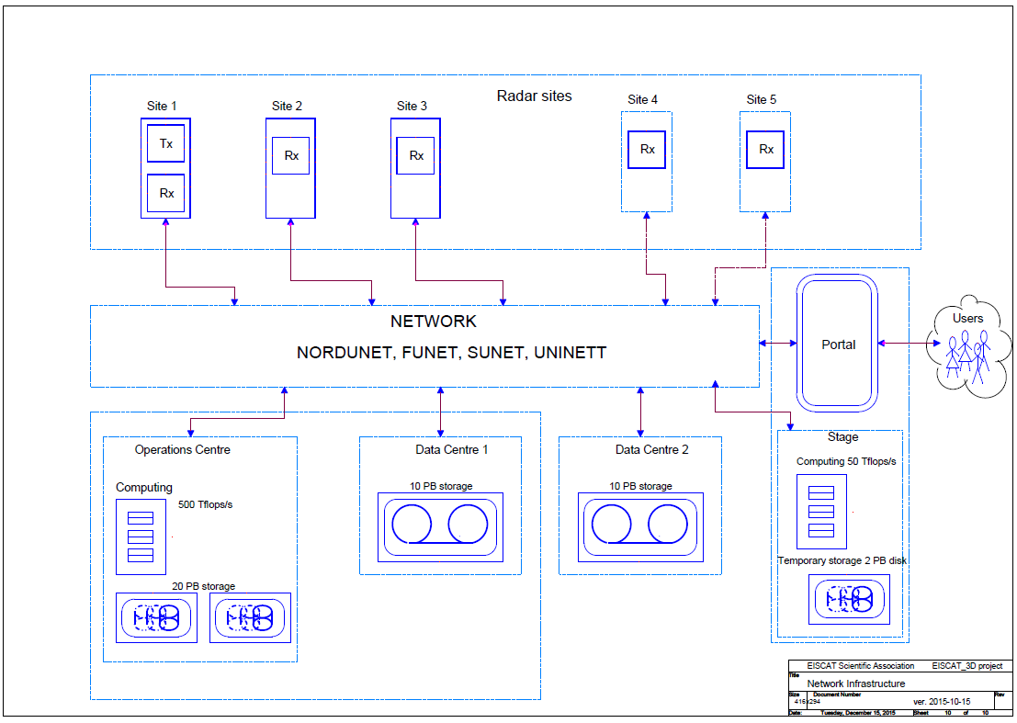
EISCAT-3D computing model overview
Computing Infrastructure https://wiki.neic.no/wiki/EISCAT_3D_Support#Documents

Slide 8
EISCAT-3D computing model overview
Online
Offline
Computing Infrastructure https://wiki.neic.no/wiki/EISCAT_3D_Support#Documents

Slide 9
EISCAT-3D computing model overview
Data Taking
Computing Infrastructure https://wiki.neic.no/wiki/EISCAT_3D_Support#Documents

Slide 10
EISCAT-3D computing model overview
Portal enabling computing and storage
Computing Infrastructure https://wiki.neic.no/wiki/EISCAT_3D_Support#Documents

Slide 11
EISCAT-3D computing model overview
Operations: 500 Tflops + 20 PB of temporal disk
Computing Infrastructure https://wiki.neic.no/wiki/EISCAT_3D_Support#Documents

Slide 12
EISCAT-3D computing model overview
Archival initial size by data centre
10 PB tape
Computing Infrastructure https://wiki.neic.no/wiki/EISCAT_3D_Support#Documents

Slide 13
EISCAT-3D computing model overview
End-user stage:
50 Tflops + 2 PB disk
Computing Infrastructure https://wiki.neic.no/wiki/EISCAT_3D_Support#Documents

Slide 14
dirac.egi.eu service suite

Slide 15
dirac.egi.eu service suite
dirac.egi.eu service suite
Backend for distributed computing
Web portal for general scientific computing needs
A set of software tools
User community support
User and technical support of dirac.egi.eu platform
SLA / OLA
Advisory in extreme scale computing (Exascale), HPC and HTC
Resource provider integration
Ad-hoc infrastructures for user communities
Advisory in enabling Cloud, Grid and Storage services to communities needs

Slide 16
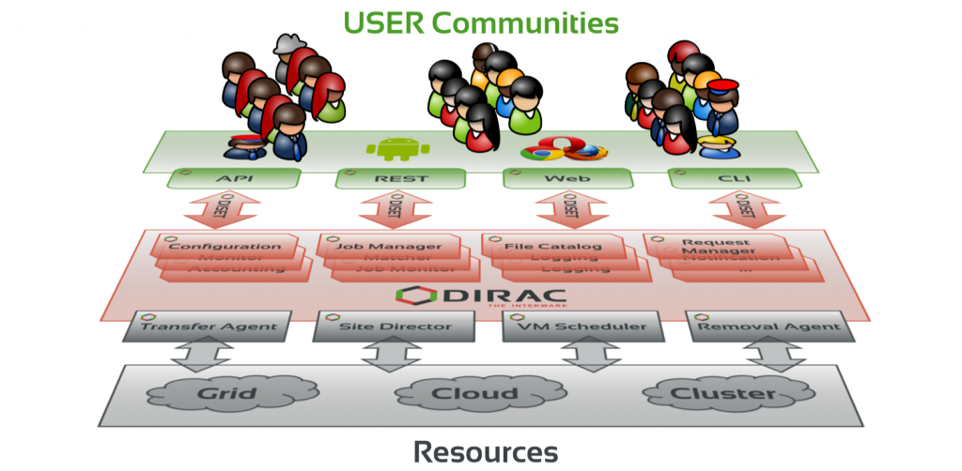
dirac.egi.eu service suite
dirac.egi.eu platform
Hosted at CYFRONET
User and technical support by UAB
DIRAC project is in consultancy and projects alignment

Slide 17
dirac.egi.eu service suite
dirac.egi.eu platform
Scientific communities high level services for processing and data management

Slide 18
dirac.egi.eu service suite
dirac.egi.eu platform
Transparent use of the infrastructure resources

Slide 19
dirac.egi.eu service suite
dirac.egi.eu platform
End user can access by …
DIRAC Portal
CLI
DIRAC client

Slide 20
dirac.egi.eu service suite
dirac.egi.eu platform
VRE / Scientific Gateways may build in the top of DIRAC …
PaaS
REST

Slide 21
dirac.egi.eu service suite
dirac.egi.eu platform
Main Services
WebAppDIRAC
developing framework
Data sets management
And so on …
Job processing
File catalogue

Slide 22
EISCAT-3D Proof of concept with dirac.egi.eu

Slide 23
EISCAT-3D Proof of concept with dirac.egi.eu
Proof of concept aims:
Discover data through metadata (instead of file location or physical file name).
Download batches of EISCAT files through the DIRAC server.
Test cloud data processing

Slide 24
EISCAT-3D Proof of concept with dirac.egi.eu
Proof of concept build
File Server
EISCAT files
Previous EISCAT data
Configuration System (EISCAT setup)
File Catalog (EISCAT metadata)
Workload Management System

Slide 25
EISCAT-3D Proof of concept with dirac.egi.eu
Proof of concept build
File Server
DIRAC Storage Element
EISCAT files
Configuration System (EISCAT setup)
File Catalog (EISCAT metadata)
Workload Management System

Slide 26
EISCAT-3D Proof of concept with dirac.egi.eu
Proof of concept build
File Server
DIRAC Storage Element
EISCAT files
Configuration System (EISCAT setup)
Metadata migration of 2007 data set
File Catalog (EISCAT metadata)
Workload Management System

Slide 27
EISCAT-3D Proof of concept with dirac.egi.eu
Proof of concept build
Enablling eiscat.se VO
File Server
DIRAC Storage Element
EISCAT files
Configuration System (EISCAT setup)
File Catalog (EISCAT metadata)
Workload Management System

Slide 28
EISCAT-3D Proof of concept with dirac.egi.eu
Proof of concept build
User access system by …
CLI
b) Dirac.egi.eu web portal
File Server
DIRAC Storage Element
EISCAT files
Configuration System (EISCAT setup)
File Catalog (EISCAT metadata)
Workload Management System

Slide 29
EISCAT-3D Proof of concept with dirac.egi.eu
Proof of concept build
User access system by …
CLI
b) Dirac.egi.eu web portal
File Server
DIRAC Storage Element
EISCAT files
Configuration System (EISCAT setup)
File Catalog (EISCAT metadata)
Workload Management System
cloud resources
of the eiscat.se VO

Slide 30
EISCAT-3D Proof of concept with dirac.egi.eu
Proof of concept build
User access system by …
CLI
b) Dirac.egi.eu web portal
File Server
DIRAC Storage Element
EISCAT files
Configuration System (EISCAT setup)
Integration of eiscat.se cloud infrastructure in EGI Fedcloud
File Catalog (EISCAT metadata)
Workload Management System
cloud resources
of the eiscat.se VO

Slide 31
EISCAT-3D Proof of concept with dirac.egi.eu
Proof of concept build
User access system by …
CLI
b) Dirac.egi.eu web portal
File Server
DIRAC Storage Element
EISCAT files
Configuration System (EISCAT setup)
DIRAC PaaS for data management
File Catalog (EISCAT metadata)
A VM in a IaaS
Pre-allocation & pull job
A VM in a IaaS
Workload Management System
cloud resources
of the eiscat.se VO

Slide 32
EISCAT-3D portal system: adapted frontend + dirac.egi.eu backend
EISCAT-3D prototype aims (work in progress):
Assess the suitability of using DIRAC for the EISCAT portal.
Establish a baseline file structure to access the EISCAT files through the portal.
access control, PIDs, frequent queries, …
Establish a baseline metadata schema to discover EISCAT data through metadata via the portal.
The schema will be improved in the future to optimise access management
Collect feedback about data organisation for the EISCAT_3D data model for the coming EISCAT_3D activity.

Slide 33
EISCAT-3D portal system: adapted frontend + dirac.egi.eu backend
EISCAT-3D prototype build
User may access by a web portal adapted for eiscat.se
File Server
DIRAC Storage Element
EISCAT files
Configuration System (EISCAT setup)
File Catalog (EISCAT metadata)
A VM in a IaaS
A VM in a IaaS
Workload Management System
cloud resources
of the eiscat.se VO

Slide 34
EISCAT-3D portal system: adapted frontend + dirac.egi.eu backend
EISCAT-3D prototype build
Final user access system by …
eiscat.se portal
Operators/admins access by ..
CLI
b) Dirac.egi.eu web portal
File Server
DIRAC Storage Element
WebAppDIRAC adapted for eiscat.se
EISCAT files
Configuration System (EISCAT setup)
File Catalog (EISCAT metadata)
A VM in a IaaS
A VM in a IaaS
Workload Management System
cloud resources
of the eiscat.se VO

Slide 35
EISCAT-3D portal system: adapted frontend + dirac.egi.eu backend
EISCAT-3D portal system
WebAppDIRAC adapted for eiscat.se
Computing Infrastructure https://wiki.neic.no/wiki/EISCAT_3D_Support#Documents

Slide 36
EISCAT-3D portal system: adapted frontend + dirac.egi.eu backend
EISCAT-3D portal system
File Server
DIRAC Storage Element
WebAppDIRAC adapted for eiscat.se
EISCAT-3D files
Configuration System (EISCAT setup)
Other computing resources
HTC challenge
File Catalog (EISCAT metadata)
A VM in a IaaS
Workload Management System
HPC challenge
A VM in a IaaS

Slide 37
EISCAT-3D portal system: adapted frontend + dirac.egi.eu backend
EISCAT-3D portal system implementation
dirac.egi.eu backend will be extended to provide additional features for the EISCAT_3D requirements, briefly:
User access rights and permissions at all levels
Integration with third party authorization and storage systems.
Computing resource integration for analysis jobs and pre-processing.
A customize portal based in WebAppDIRAC will support two user profiles:
EISCAT admins: high level management of the operations and data centres
EISCAT end-user: access to the stage resources
HPC
out of the box (DIRAC adaption to eiscat.se workloads and infrastructures)
within the box (eiscat programs adaption to the HPC infrastructures)
HTC in computing resources using DIRAC PaaS data management

Slide 38
Conclusions

Slide 39
Conclusions
A promising proof of concept of the EISCAT-3D portal has been implemented
Data and storage integration
Metadata advanced features
Web environment
Cloud resources integration
A prototype portal is been building to prepare the coming EISCAT-3D extreme scale computing and data management
Web developing framework (WebAppDIRAC) to fast implementation based in existing web applications and gadgets
Developing and integration of overlying systems: AAI, HPC, HTC…
To prepare operations for EISCAT-3D production

