Slide 1
EGI Applications Database
VM operations through AppDB
Marios Chatziangelou, et al. <mhaggel@iasa.gr>
Institute of Accelerating Systems and Applications (IASA)

Slide 2
Capabilities
A community driven, central service that stores and provides:
software solutions (in the form of native software and/or virtual appliances), originated from almost every scientific area/discipline
reference of scientific datasets (pilot - under development)
the programmers and scientists responsible for them
the publications derived from the registered items (SW, VA & datasets)
Insert footer here

Slide 3
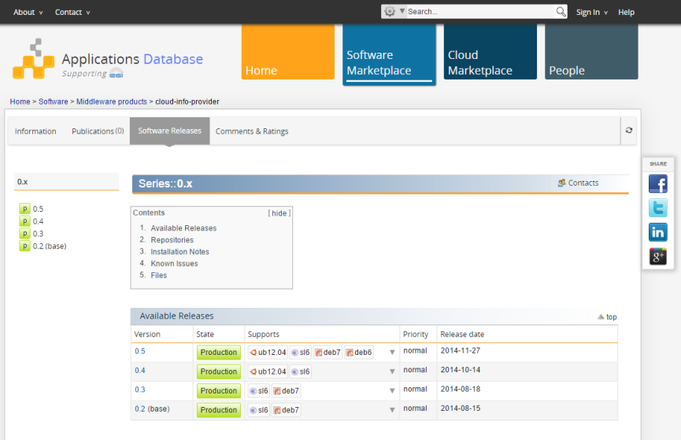
Software Marketplace
Registry for Software items:
Applications, tools, Workflow frameworks and instances, Science Gateways, Middleware products, …)
Offers release management capabilities
- unlimited series of releases
- light-weight & collaborative, release
management process
Acts as a repository for binary artifacts
generic tarballs, RPM & DEB (32bit/64bit) binaries
multiple flavor / operating system combinations
simplified, web-based, process for uploading the binary artifacts
YUM & APT repositories for automatic distribution
artifacts populated through the UMD Community Repository

Slide 4
Cloud Marketplace (1/2)
Virtual Appliance
Virtual Appliance is a logical container of Virtual Appliance versions
Virtual Appliance version maps to one Virtual Machine (VM) Image ready to be used either on a cloud infrastructure (i.e. EGI FedCloud) or even to be downloaded for personal use
Users::visitors
Search, download, get technical information, details on about how it can be accessed, where (site) is available, how it can be used,….
Users::submitters
Register Virtual Appliance
Create/Update Virtual Appliance versions and link a VM image to them
Provide a contextualization script for each VM image
Project & VO Managers
Select which of the registered Virtual Appliances, should be pushed to the cloud infrastructure (sites).
The AppDB system takes the responsibility for distributing the “chosen” ones to the respective Resource providers/sites.
AppDB gets feedback from the sites that the Virtual Appliances are indeed available ready to be used by the users

Slide 5
Cloud Marketplace (2/2)
Remote Sites
Search for vAppliances
Information System
(Top-BDII for
FedCloud sites)
Get availability & usage details
cloud m/w
Start/Stop/…. an image
local info system
push info
about the VA
availability
and usage
perform VM operations
using rocci command line tool
Next logical step:
perform VM operations through
the AppDB
vmcatcher
user::visitor
subscribe and/or get any update
AppDB Image List Store
AppDB
Cloud Marketplace
AppDB portal
generate
image_list
(Re)publish VO or Project’s accepted list of Virtual Appliances
Publish new vAppliance version
Select/update/exclude vAppliances
Insert/update/remove image(s)
Create a new vAppliance version
Register a vAppliance
VO or Project Manager
AppDB portal
AppDB portal
user::submitter
Notes:
Make notes for interaction
Submitter
- Through the AppDB portal (=graphical interface) is able to register a vApp
The vApp is versioned. Each vApp version contains VM images, The submitter can create a vApp version either using the AppDB portal (graphically) or even through a command line tool (mainly for automation i.e. upload updates of images without human intervention)
Can create vApp version and at the end publish it and therefore meke it publicly available
VO or Project Manager
Selects the vApps (or their updates) that considere as suitable to be offered by his/her sites of responsibility
And publishes the chosen ones in to the AppDB Image List Store
Sites / Resource prividers
Subscribe and download the vApps or their respective updates
And inform back the AppDB that indeed the sites are downloaded and are accepted by the sites (EGI is using the TopBDII for this but this part of the chain can be replaced by other information systems or technilogies)
The site does not only inform AppDB about the vApp availability but also gives back usage ditails (= all details the user needs in order to make use of the vApp in question. In EGI. usage details = occi_id, template_id site occi endpoint)
The end user
Through the AppDB portal can search for a vApp and perhaps download it for use it into his own PC (i.e. VirtualBox)
Gets the info about which vApp is available in wich site and how he//she can use it (again, In EGI that means => occi_id, template_id site occi endpoint).
Having the usage details he/she can perform brokering actions (start/stop/…) to the remote site by using the OCCI command line tool
Next in the raw: to give the ability to the end user to perform brokering action through the AppDB portal in a graphicall way. Hiding all the technicalities (occi_id, template_id site occi endpoint) .from his eyes

Slide 6
VM Operations through the AppDB
The objective: “The EGI Applications Database (AppDB) will evolve from its current role as catalogue of applications and virtual machines (VM) to include a graphical user interface allowing authorized users to perform basic VM management operations”
Context diagram
AppDB
Portal
Dashboard
(including VM operations frontend)
VM operations backend

Slide 7
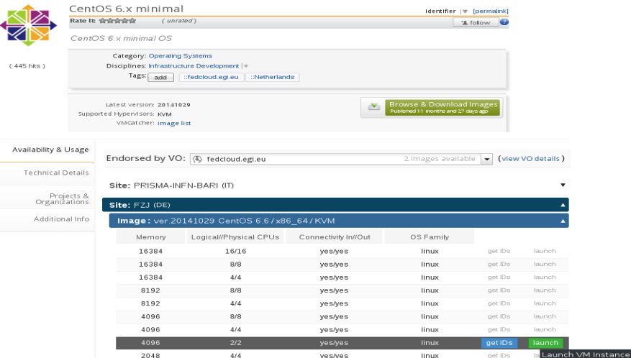
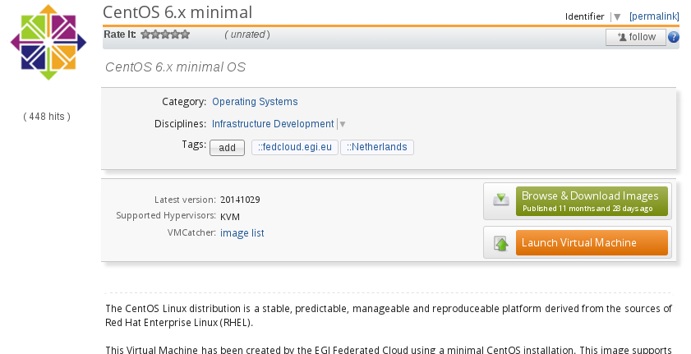
Main entities: AppDB Portal
Portal
Select VMI (=VA version )
or, select VMI (VA version), & VO & site/endpoint & template
…. and be redirected to the Dashboard for further adjustments and execution

Slide 8
Main entities: AppDB Dashboard
Dashboard (GUI)
Select VMI (VA version), VO, site/endpoint, template,
Describe topology:
One or more VM images to be used
How many instances of each type
Describe interconnection (under investigation)
Configure VM (depending on the available templates):
network, CPU(s), Memory, disk(s)
Issue VM ops commands:
Start/Stop (all in ‘topology’ or just one of the ‘topology’)
Status
Deploy/Un-deploy
Runtime (under investigation)
Attach storage
Add network

Slide 9
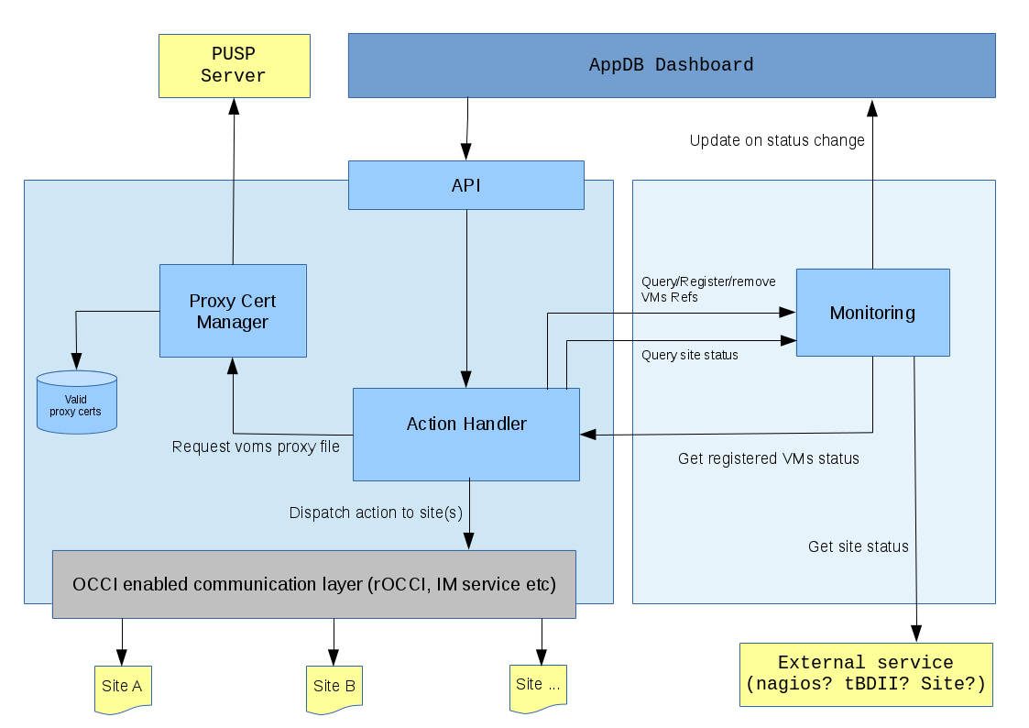
Main entities: AppDB VM ops backend (1)
Dedicated for AppDB use only
Consists of:
API (TOSCA oriented)
Proxy certificate manager
Action handler
OCCI-enabled comm layer
Monitoring

Slide 10
Main entities: AppDB VM ops backend (2)
API
exposes VM management related actions to the VM Ops frontend (Dashboard).
performs checks upon the validity of the requests and forwards them to the action handler
provides functions for acquiring the status of VM instances initiated through AppDB
TOSCA oriented

Slide 11
Main entities: AppDB VM ops backend (3)
Action handler
consists of atomic request and response actions, which each implement a specific workflow, according to the action type.
performs checks, prepare, and then forward the action itself to the OCCI-enabled communication layer.
Requesting a proxy certificate from the proxy certificate manager is part of that preparation.
deals with the request action results, makes the necessary data transformations and communicates the results back to the frontend.
able to handle bundles of actions in the form of a single request, allowing a user to describe the desired solution from the frontend and then submit it once instead of waiting for individual steps to complete.

Slide 12
Main entities: AppDB VM ops backend (4)
Proxy certificate manager
manages the proxy certificates issued by the AppDB on behalf of the users.
acquires and refreshes (periodically) the proxy certificates by interfacing with
the PUSP server
is meant to be used solely by the action handler component
OCCI-enabled communication layer
a wrapper for the Infrastructure Manager backend service, which will perform the actual communication with the OCCI-enabled site endpoints
Infrastructure Manager Backend
A tool that eases the access and the usability of IaaS clouds by automating VMI deployment, instantiation, configuration and monitoring
Supports many kinds of infrastructures out of the box (not only OCCI-enabled).
Already used by production grade infrastructures.
Development effort is shared by more than one teams

Slide 13
Main entities: AppDB VM ops backend (4)
Monitoring
targeted at improving the overall performance and user experience of the service, by maintaining a local, cached status of running VMs and of the OCCI interfaces of the sites (updated periodically)

Slide 14
Status
Developments are on-going
First release of the VM operations dashboard, is expected in mid to end of Summer
VM ops backend: May 2016
VM ops dashboard (frontend): July 2016
Integration with the AppDB & testing: July 2016

