Slide 1
EGI Service Portfolio
Roberta Piscitelli
EGI.eu Strategy and Policy Officer

Slide 2
EGI Service Portfolio
With EGI services you can build, test and deploy compute- and data-intensive experiments on EGI reliable infrastructure

Slide 3
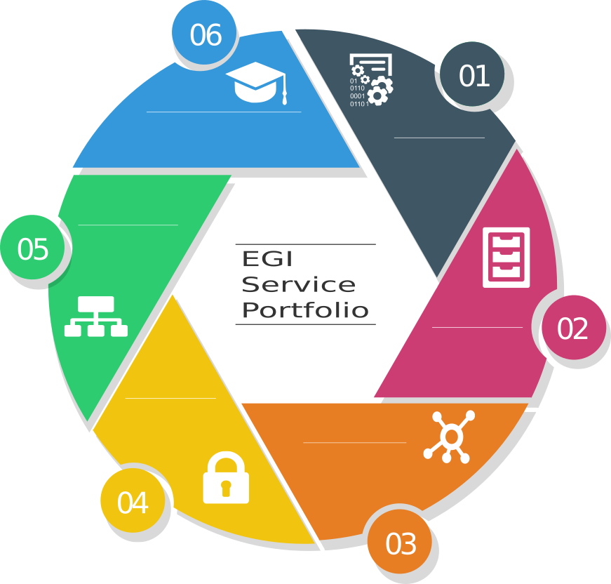
TRAINING
LEARN WITH EGI INFRASTRUCTURE
COMPUTE
RUN, EXECUTE, ANALYZE
OPERATIONS
CONFIGURATION, MONITORING AND TOOLS FOR YOUR INFRASTRUCTURE
STORAGE
EASY AND SECURE ACCESS TO YOUR FILES
SECURITY
MANAGE COMMUNITY, EXPOSE TRUSTED INFORMATION
DATA
MANAGE, ACCESS, TRANSFER AND DELIVER DATA

Slide 4
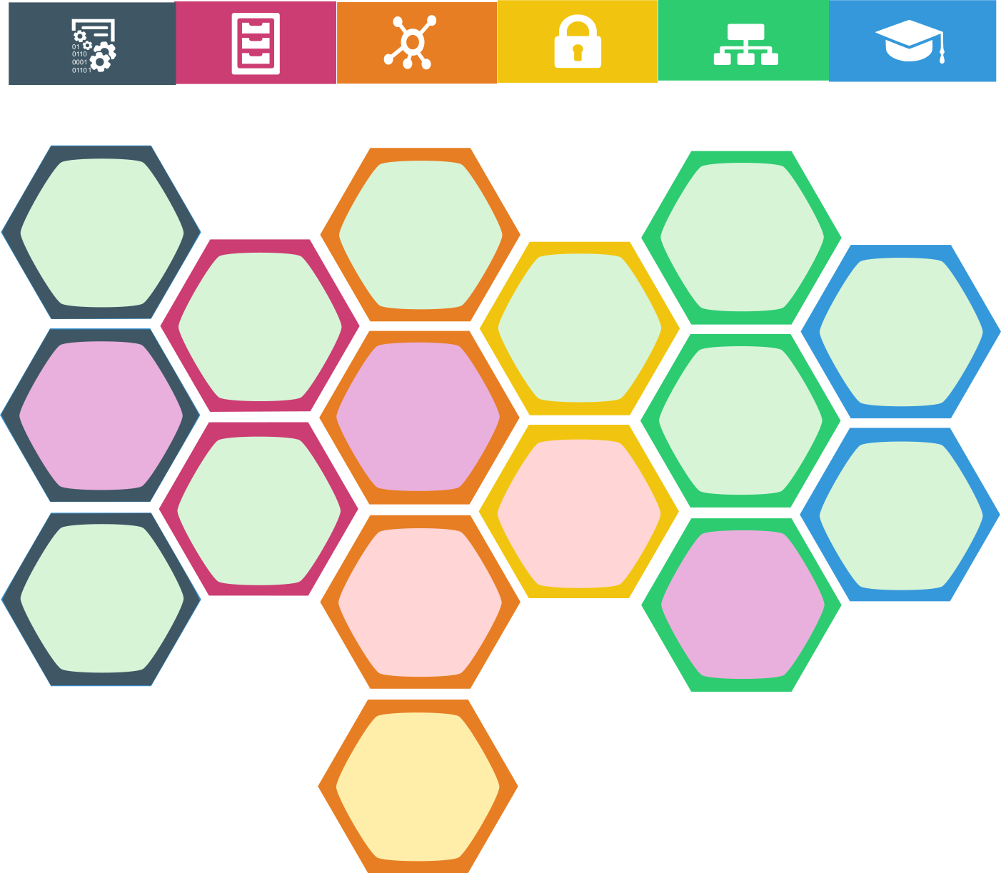
Compute
Storage
Data
Security
Operations
Training
Design Phases
Cloud Compute
Data Transfer
Configuration Database
Discovery
Online Storage
Attribute Management
FitSM
Alpha
Cloud
ContainerCompute
Content Distribution
Service Monitoring
Beta
Archive Storage
Training Infrastructure
IdP Proxy
High Throughput
Compute
Federated Data Manager
Production
Helpdesk
Retired
Data Hub
Notes:
Each service can be in a different design phase defines as follows:
discovery: researching users needs, exploring technological or policy constraints;
alpha: prototype available for closed set of users;
beta: service being developed while available for testing publicly;
production: service available in the live environment meeting security/performance requirements;
retired: the service is not anymore offered

Slide 5
Cloud Compute
Run virtual machines on-demand with complete control over the computing resources
Run any kind of scientific application on virtual machines
Benefits
Full control over computing resources
Standard interface to deploy on multiple service providers
On-demand provisioning
Complete control over the resources you choose
Notes:
Cloud Compute provides on-demand computing resources to run any kind of workload on virtual machines. You will have complete control over the resources you choose to run a scientific application.

Slide 6
Cloud Container Compute
Run Docker containers within isolated user-spaces with no overhead
A container is a lightweight virtual machine
Benefits
Accessible through different interfaces
Interoperable and transparent
Built more "directly" on top of the operating system
[Beta]
Notes:
A container is a lightweight virtual machine. While a VM is usually made abstracting the full hardware stack (BIOS, CPU, Disk, Network...), the container is built more "directly" on top of the operating system.

Slide 7
High-Throughput Compute
Analyze large datasets by executing large numbers (thousands) of computational tasks
Analyze large datasets and execute thousands of parallel computing tasks
Benefits
Achieve faster results
Shared resources among users, enabling collaborative research
Access large amounts of processing capacity over long periods of time
Distributed network of computing centers
Access via a standard interface and membership of a VO
Notes:
The High-Throughput Compute (HTC) service gives access to the EGI infrastructure. With HTC you can, for example, analyse large datasets and execute thousands of parallel computing tasks. HTC computing resources are provided by a distributed network of computing centres, accessible via a standard interface and membership of a virtual organisation.

Slide 8
Online storage
Store and retrieve files, their metadata and assign global identifiers on a large scale
Store data in a reliable and high-quality environment
Benefits
Highly scalable storage system accessible from anywhere
Easily share data
Access through different interfaces
flexible hierarchical structure to store your files
Notes:
File Storage allows you to store data in a reliable and high-quality environment supported by the EGI resource providers. You can save your data using files and folders in a flexible hierarchical structure.

Slide 9
Archive storage
Archive your data and preserve it for future use in a secure environment
Store large amounts of research data
Stores large amounts of data
Long-term retention
Reliable and interoperable
Benefits
Easily locate files and retrieve them from different platforms
Notes:
Archive Storage allows you to store large amounts of research data in a secure environment, freeing up your usual file storage resources. All the files in Archive Storage are easily located and retrieved to and from different types of platforms.

Slide 10
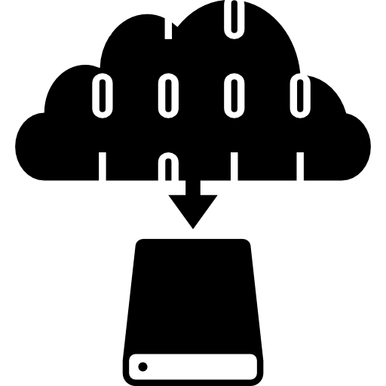
Data Transfer
Transfer asynchronously large sets of files from one storage facility to another
Benefits
Ideal for very large files
Able to handle large amounts of files
Transfer process with automatic retrying
Move research data quickly
Specialized analytics of on-going transfers
User interface to manage transfer and network resources
Notes:
File Transfer allows you to move research data from one site to another with dedicated interfaces to display statistics of on-going transfers and manage network resources. File Transfer is ideal to move large amounts of files or files too large to be efficiently handled by common transfer systems.

Slide 11
Content Distribution
Deliver data in the most efficient way
Scalable, reliable and low maintenance software
Benefits
Manage centrally the software to distribute across federated environments
Make content available as a read-only file system that efficiently downloads and caches files on demand
Data delivery system available as user-space read-only file system
[Beta]
Notes:
Deliver content with scalable, reliable and low maintenance software and data delivery system available as user-space read-only file system

Slide 12
Federated Data Manager
Share, discover, and process data federated from different sources
A single virtual storage that maps virtual paths to physical file paths
Benefits
Single virtual storage that maps virtual paths to physical file paths
Files can be distributed across different types of storage and across multiple storage providers
Users can store their data across multiple sites, and can run their applications directly as if the files are local
[Alpha]
Notes:
Share, discover, and process data federated from different sources
The service provides a single virtual storage that maps virtual paths to physical file paths. Files can be distributed across different types of storage and across multiple storage providers, but users can store their data across multiple sites, and can run their applications directly on their personal computers or workstations, as if the files are local.

Slide 13
Data Hub
Access key scientific datasets scalably
Selected public datasets
Benefits
Easy access to selected large-scale datasets
Easy and efficient access
Consume them from EGI compute services
[Discovery]
Notes:
Access selected public datasets and efficiently consume them from EGI compute services

Slide 14
Attribute Management
Manage community membership and expose trusted information
Manage user membership
Benefits
Easy and trusted way to manage Virtual Organization membership
Users can register and ask to be part of a community
The community supervisor can approve or remove users
Notes:
Attribute Management helps you to manage user membership, where users can register and ask to be part of a community, and where the community supervisor can approve or remove users from the group.

Slide 15
Identity Provider Proxy
Handle transparent Single Sign-On from multiple heterogeneous identity providers
Benefits
Only one account needed to sign in for multiple heterogeneous service providers
Authenticates the users and issues signed and encrypted access to the Service Provider
IdP is the only component users give their credentials to
Notes:
Federated access involves two entities: a Service Provider (SP) that ensures that the user is authenticated and protects the content against unauthorized access and an Identity Provider (IdP) installed centrally at an organisation.
The Identity Provider Proxy (IdP) authenticates the users and issues signed and encrypted access to the Service Provider. Thus, user authentication is not done at the content provider, but at the IdP which is the only component users give their credentials to.

Slide 16
Configuration Database
Manage the configuration information of a federated e-infrastructure including the provided service instances and staff contacts
Benefits
Ready-to-use solution
Implement a complex distributed hierarchy of services.
Improves the operation of a distributed infrastructure
Hierarchical management with roles and capabilities
Handle a hierarchical distribution of roles of a distributed infrastructure
Notes:
GOCDB is a configuration database with advanced features to implement a complex distributed hierarchy of services. The business logic of the tool is already implementing the access controls to handle a hierarchical distribution of the roles of a distributed infrastructure

Slide 17
Service Monitoring
Monitor a wide range of platforms and provide operational and business insight for a wide range of built-in and user defined key performance indicators
Benefits
Repository of information and solutions
Monitoring of federated environments services
Progress tracking
Data collection and statistic tools
User-friendly interface
Notes:
Service Monitoring provides complete monitoring of federated environments services, including data collection and statistic tools, with a user-friendly interface

Slide 18
Helpdesk
Handle service requests and incidents for distributed support teams
Benefits
Reduced cost for setting up the monitoring services, minimal development effort
Technical support ticketing system
Ready-to-use user interfaces and flexible availability calculating flexible tools
Automated reporting tools
[Beta]
Notes:
Helpdesk services offers professional, reliable and efficient technical support ticketing system to guarantee a well-run infrastructure with improved productivity and usability. Setting up helpdesk facilities for federated infrastructures is expensive and is a real cost that lowers your bottom line on a daily basis; while, outsourcing is viewed as a deductible business expense

Slide 19
FitSM
Learn how to manage IT services with a pragmatic, lightweight and achievable standard
Increase your expertise in managing IT services
Lightweight standards family
Increase professional profile with a recognized certification
Service management in IT service provision, including federated scenarios
Benefits
Upcoming training events
9-12 May
30 May- 2 June
http://go.egi.eu/fitsm-training-calendar
Notes:
. FitSM is a lightweight standards family aimed at facilitating service management in IT service provision, including federated scenarios. FitSM training aims at providing those involved in operating federated infrastructures with the professional skills they need in order to effectively manage their services.
FitSM professional training is certified by TÜV SÜD, a global leader in standardisation and certification. The qualification programme offers three training levels: Foundation, Advanced and Expert.

Slide 20
Training Infrastructure
Handle online training courses and learning activities in a dedicated resource pool
Benefits
Allows easy deployment, predictability and repeatability of courses
Cloud infrastructure for training courses
Customizable Virtual Machine images on the training infrastructure can be deployed before the course
Deploy custom VM images on the infrastructure before the training
Those VMs offer the training environment for the students
Notes:
Training Infrastructure offers a baseline cloud infrastructure for training courses about scientific software and services. Trainers can deploy custom Virtual Machine images on the training infrastructure before the training, and these images offer the training environment for the students.
Students can have dedicated training environments, and the community can benefit from the easy deployment, predictability and repeatability of courses, thanks to the cloud-based operational model.

Slide 21
Thank you for your attention!
Questions?
@EGI_eu
#EGIConf16
roberta.piscitelli@egi.eu
Acknowledgements:
This presentation used icons made by Freepik from www.flaticon.com
EGI Service Portfolio – Marketplace Session – EGI Conf’16
6 Apr 2016 - Amsterdam

