Slide 1
EGI and EUDAT Interoperability – Introduction and Why interoperate?
Matthew Viljoen, EGI.eu
Giuseppe Fiameni, EUDAT

Slide 2
Content
EGI introduction
EUDAT introduction
Benefits of Interoperation
Work done so far
Next steps

Slide 3
24 countries
CERN, EMBL-EBI
1 coordinating organization – EGI.eu

Slide 4
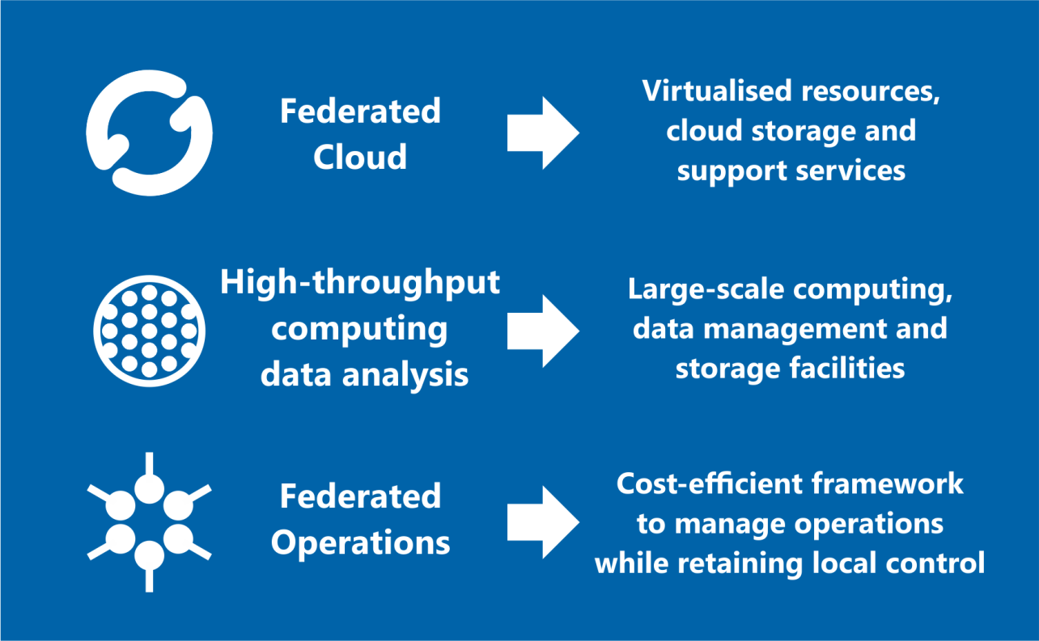
Open Solutions

Slide 5
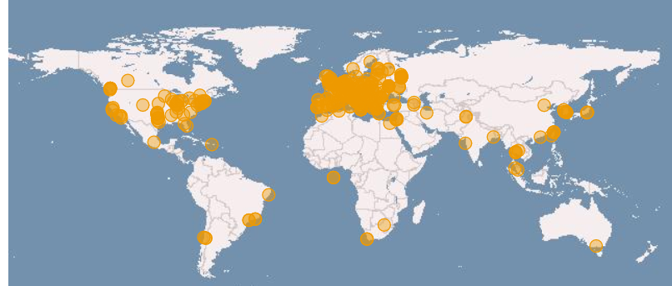
Global collaborations
Russia
Ukraine
Canada
USA
Asia
Pacific
Latin America
Africa
Arabia
www.egi.eu

Slide 6
EUDAT
EUDAT – offers a complete set of research data services, expertise and technology solutions to all European scientists and researchers. These shared services and storage resources are distributed across 15 European nations and data is stored alongside some of Europe’s most powerful supercomputers.

Slide 7
EUDAT

Slide 8
Benefits of interoperation
Federated services on EGI + common data services of EUDAT brings together:
Computation on EGI Federated Cloud + HTC
Existing EUDAT services for:
transfer, synching, sharing, preservation of data
Augmentation of services from existing communities using EGI/EUDAT

Slide 9
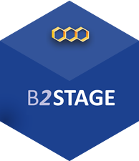
Work done so far
Pilot – the Universal Usecase (demo in Bari by Diego Scardaci)
Access to EGI and EUDAT services with a single user identity
Data Staging between EGI Federated Cloud and EUDAT services
Run analysis
1. Run analysys
Retrieve Data
2. Stage output data in B2STAGE
VM
Data stored in B2SAFE for Long Term preservation

Slide 10
Next steps
Communities identified for the next steps:
ICOS
EPOS
Now implementing prototypes of their usecases
Challenges
Scaling up from PoC to multiple users (AAI interoperation)
Managing co-existing support systems
Lever future Fedcloud usability improvements

