Slide 1
Accelerated Computing activity progress report
Marco Verlato (INFN)
Viet Tran (IISAS)
EGI Conference 2016
6-8 April, Amsterdam

Slide 2
Introduction/1
Task part of EGI-Engage JRA2: Platforms for the Data Commons
To provide a new accelerated computing platform by:
implementing the support in the information system (based on OGF GLUE standard)
extending the HTC and cloud middleware support for co-processors
Duration: 1st March 2015 – 31st May 2016 (15 Months)
Partners:
INFN: CREAM-CE developers at Padua and Milan divisions
IISAS: Institute of Informatics, Slovak Academy of Sciences
CIRMMP: Scientific partner of MoBrain CC (and WeNMR/West-Life, INDIGO-DataCloud H2020 projects)

Slide 3
Introduction/2
Key performance indicators:
Ideally divided in two subtasks:
Accelerated computing in Grid (=HTC platform)
Accelerated computing in Cloud
Previous sessions:
http://bit.ly/Lisbon-GPU-Session
http://bit.ly/Bari-GPU-Session
metric | Description | Target 1st Y | Target 2nd Y
MJRA2.AC.1 | Number of batch systems for which GPGPU integration is supported through CREAM | 1 (Torque/Maui) | 3 (Torque/Maui, Slurm, HTCondor)
MJRA2.AC.2 | Number of CMF for which GPGPU integration is supported | 1 (OpenStack) | 2 (OpenStack, OpenNebula)
MJRA2.AC.3 | Number of disciplines with user applications supported | 2 (structural biology, molecular dynamics) | 3 (structural biology, molecular dynamics, biodiversity)

Slide 4
Accelerated Computing in Grid

Slide 5
Accelerated computing in Grid
The problem:
CREAM-CE is the most popular grid interface (Computing Element) to a number of LRMSes (Torque, LSF, Slurm, SGE, HTCondor) since many years in EGI
Most recent versions of these LRMSes do support natively GPGPUs (or MIC cards), i.e. servers hosting these cards can be selected by specifying LRMS directives
CREAM must be enabled to publish this information and support these directives
Work plan
Indentifying the relevant GPGPU-related parameters supported by the different LRMS, and abstract them to significant JDL attributes
Implementing the needed changes in CREAM-core and BLAH components
Writing the info-providers according to GLUE 2.1
Testing and certification of the prototype
Releasing a CREAM update with full GPGPU support
Progresses recorded in https://wiki.egi.eu/wiki/GPGPU-CREAM

Slide 6
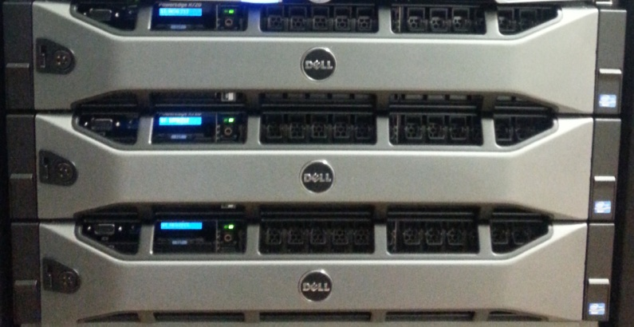
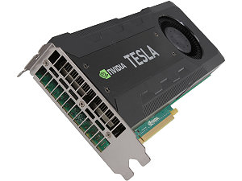
News after Bari/1
CIRMMP testbed used for MoBrain applications
AMBER, Powerfit and DisVis applications with CUDA 5.5
3 nodes (2x Intel Xeon E5-2620v2) with 2 NVIDIA
Tesla K20m GPUs per node
Torque 4.2.10 (source compiled with NVML libs) + Maui 3.3.1
EMI3 GPU-enabled CREAM-CE prototype
Example of JDL for DisVis (see https://wiki.egi.eu/wiki/CC-MoBrain):
$ glite-ce-job-submit -o jobid.txt -d -a –r cegpu.cerm.unifi.it:8443/cream-pbs-batch disvis.jdl
$ cat disvis.jdl
[
executable = "disvis.sh";
inputSandbox = { "disvis.sh" ,"O14250.pdb" , "Q9UT97.pdb" , "restraints.dat" };
stdoutput = "out.out";
outputsandboxbasedesturi = "gsiftp://localhost";
stderror = "err.err";
outputsandbox = { "out.out" , "err.err" , "res-gpu.tgz"};
GPUNumber=2;
]
Deliverable
D6.7 to be published soon

Slide 7
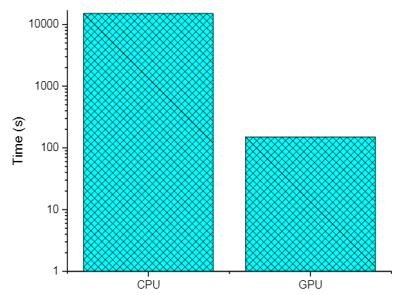
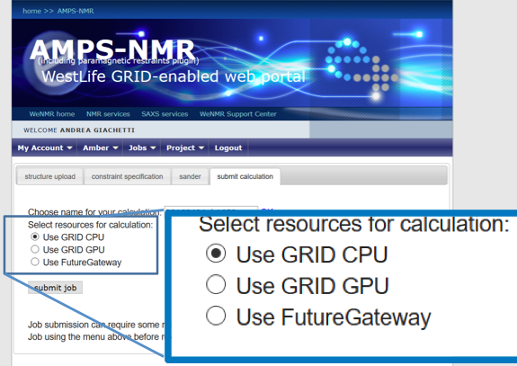
AMBER on GPU-enabled grid testbed
MD simulations with AMBER:
Restrained Energy Minimization on NMR Structures
Free MD simulations of ferritin
a)
~100x gain
b)
WeNMR/AMBER grid portal can now exploit GPU resources

Slide 8
News after Bari/2
Static info-provider based on GLUE2.1 ExecutionEnvironment class deployed at CIRMMP testbed:
$ ldapsearch -LLL -x -h cegpu.cerm.unifi.it -p 2170 -b o=glue | grep GPU
GLUE2ExecutionEnvironmentGPUClockSpeed: 706
GLUE2ExecutionEnvironmentGPUModel: Tesla K20m
GLUE2ExecutionEnvironmentGPUVendor: NVIDIA
GLUE2ExecutionEnvironmentPhysicalGPUs: 6
GLUE2ExecutionEnvironmentLogicalGPUs: 14976
Dynamic info-providers need new attributes in GLUE2.1 draft:
ComputingManager class (the LRMS)
TotalPhysicalGPUs, TotalGPUSlots, UsedGPUSlots
ComputingShare class (the batch queue)
FreeGPUSlots, UsedGPUSlots

Slide 9
News after Bari/3
CIRMMP testbed was also used to test new JDL attributes propagation from CREAM-core to different batch systems
A new testbed with GPU and MIC cards managed by HTCondor was made available at GRIF/LLR in March 2016
A CREAM/HTCondor prototype supporting both GPU and MIC cards was successfully implemented and tested (thanks to A. Sartirana)
Two additional JDL attributes were defined, other than GPUNumber
GPUModel: for selecting the servers with a given model of GPU card
e.g. GPUModel=“Tesla K20m”
Info published in GLUE2ExecutionEnvironmentGPUModel of GLUE2.1 ExecutionEnvironment class
MICNumber: for selecting the servers with the given number of MIC cards

Slide 10
News after Bari/4
The new attributes are supported also by LSF and Slurm batch systems
CREAM/Slurm prototype supporting GPUs was successfully implemented and tested at ARNES data centre (thanks to B. Krasovec)
3 GPU nodes with 2 Tesla GPUs each (K40c, K20c and K10 models)
Support to GPUModel selection not available yet (needs upgrade to Slurm version 15)
This site is in production, CREAM is maintained for supporting Belle VO, other EGI VOs could be enabled with lower priority
Basic tests successfully carried out at Queen Mary data centre, a SGE based cluster with OpenCL compatible AMD GPU (thanks to D. Traynor)

Slide 11
Summary
CREAM GPU-enabled prototype available and tested at:
CIRMMP (local Torque based GPU cluster)
GRIF/LLR (Production HTCondor based GPU & MIC cluster)
ARNES (Production Slurm based GPU cluster)
Queen Mary (local SGE based cluster with AMD GPUs)
Plans to test the prototype at INFN-CNAF (LSF9 based GPU cluster)
The goal is to have a major release of CREAM-CE on CentOS7, in order to be included in UMD4, with GPU/MIC support for Torque, HTCondor, Slurm, SGE, LSF
Still missing:
GLUE2.1 draft approval
Writing GLUE2.1 compliant dynamic info-providers
GPU accounting?

Slide 12
Accelerated Computing in Cloud

Slide 13
Accelerated computing in Clouds
Supporting GPGPU in clouds
Virtualization technologies
KVM with passthrough is rather mature
Virtualized GPU is in early stage
Cloud framework support
Openstack support for PCI passthrough
Fedcloud services support
Accounting, information index
Current status
Working sites with GPGPU in EGI FedCloud
Instructions for site admins, developers and users
Details at https://wiki.egi.eu/wiki/GPGPU-FedCloud

Slide 14
News after Bari
IISAS-GPUCloud is in production
Images of supported VOs installed
Ceilometer added for better monitoring
Various test with GPU VMs: VM migration (only for stopped Vms), OpenCL
New site has been installed at INCD/LIP
2 compute nodes have NVIDIA GPUs - Tesla K40
Openstack Kilo, PCI passthrough
Being integrated to EGI FedCloud: OCCI installed, waiting for keystone-voms for keystone v3
Support for docker images

Slide 15
Ongoing works
Publishing of GPU information in the Cloud BDII
GLUE2.1 is welcomed
Adding GPU information to ExecutionEnvironment as EntityOtherInfo in current scheme if GLUE2.1 will not available
Accounting VMs with GPGPU
New items added to accounting records
Coordinated with APEL team
GPU pass-through support in OpenNebula
Capability introduced in OpenNebula 4.14
CESNET-Metacloud will upgrade their endpoint in April
They’ll provide GPU-enabled templates, images and guides
The long-term goal is to provide OCCI extensions to select these "additional" capabilities for virtual machines on a case-by-case basis (not just by using a pre-defined template)

Slide 17
GPU Accounting report
Adrian Coveney (STFC, APEL team)

Slide 18
GPU Accounting Issues
GPUs are usable by multiple users/jobs so batch systems do not attribute usage to a job/user.
On the other hand, GPUs are attached to cloud VMs in the hypervisor and so are only attached to one VM at a time. This removes the multiple user issue.
Cloud systems currently return wallclock time only. (We hope that this can be improved.) If the wallclock for how long a GPU was attached to a VM is available then the GPU reporting would be in line with cloud CPU time, i.e. wallclock only.
This might make it more meaningful to attempt cloud GPU accounting first.

Slide 19
What’s needed for accounting
Batch systems should report GPU usage attributable to the job in the batch logs. APEL would then parse the logs files to retrieve the data.
Any GPU monitoring which can record usage in a database, with attributes which allow it to be identified as belonging to a batch job or VM, will enable the APEL client to join it with existing data into an extended Usage Record.
The existing cloud extraction tools oneacct and cASO can be extended to include cloud GPU usage if a GPU expert can identify the relevant fields.
The accounting portal would define new views to display GPU usage in a similar way to existing CPU views.

Slide 20
What APEL can do
Define an extended Usage Record.
Extend the database to include additional fields.
Update the database loader.
Produce new summaries which include GPU usage.
However, if we cannot join GPU records with Job records then we cannot do job based accounting. Anything else, like GPU summaries per user per time period, is a significant change to how we do things now.

